Slide 1
Chicago food inspection project
Yuncheng Liang

Slide 2
Agenda
Aim and method of approach
Feature engineering
Exploratory data analysis
Modeling and evaluation
Key findings and considerations
Recommendations of operation
Appendix – reference datasets and project artifacts

Slide 3
Aim and method of Approach
The aim is to identify establishments at a higher risk of violations.
In “Result” column, the only categories that connect to risk of violations of different degrees are “Fail”(must have violations, potentially critical ones), “Pass w/ Conditions” (have violations but mostly non-critical), “Pass”(likely have no violations).
The aim could then be transformed into predicting correct categories of each inspection result.
This could be achieved by multiclass classification or regression.
Regression was chosen, reasons see next page

Slide 4
Aim and method of Approach – why regression
Since hierarchical relationship exists between above three types (Fail< Pass w/ Conditions < Pass), multiclass classification is not ideal.
For more detailed illustration, think about scenario that the model falsely predict "Fail" cases as "Pass w/ Conditions", it should be more tolerable than the model mistakenly predict "Fail" cases as "Pass“. This will be taken care of by regression.
However, if multiclass classification is chosen, it will treat the false predictions of "Fail" cases equally. It can not differentiate between "Pass w/ Conditions" and "Pass", it only sees "Fail" and "Not Fail".
That's how SoftMax works, it will not punish false prediction of "Fail" as "Pass" harder than false prediction of "Fail" as "Pass w/ Conditions".
Thus, regression is being adopted by converting ‘Fail’ to 0 , ‘Pass w/ Conditions’ to 1 , and ‘Pass’ to 2.

Slide 5
Agenda
Aim and method of approach
Feature engineering
Exploratory data analysis
Modeling and evaluation
Key findings and considerations
Recommendations of operation
Appendix – reference datasets and project artifacts

Slide 6
Feature engineering – food inspection dataset
Categorical features:
Facility type – contain 7 major categories and an “Other” category (any small categories that are less than 1% of total number of observations are bundled into category called “Other”), use one hot encoding
Inspection type – contain 7 major categories and an “Other” category, use one hot encoding
Risk – only preserve three major categories, use label encoding to reflect hierarchical relationship, with “Risk 1 (High)” as 1, “Risk 2 (Medium)” as 2, “Risk 3 (Low)” as 3.

Slide 7
Feature engineering – food inspection dataset
Numerical features construction steps:
Extract list of violation codes from “Violation” column for each inspection using regular expression.
Frequency and percentage of occurrence for each violation code is first evaluated and only the most common 30 codes are being preserved.(0.97)
Fail rates are being calculated for each of the 30 codes to determine the seriousness level of each code violation. Then the 30 codes are bundled into three tiers to reflect seriousness level.
tier_0 = [18, 29, 8, 24, 19, 3, 26, 12] - most critical, fail rates 39%-42%
tier_1 = [21, 2, 11, 16, 9, 14, 37, 30] – crtical, fail rates 30%-35%
tier_2 = [41, 36, 40, 38, 35, 32, 43, 45, 34, 31, 33, 42] – normal, fail rates under 27%

Slide 8
Feature engineering – food inspection dataset
Then the violation code list for an inspection is then group into three boxes (violations_tier_0, violations_tier_1, violations_tier_2) and counted.
One ground consensus for feature selection is that features chosen should not lead to data leakage.
In other words, when we are trying to predict the result of an inspection, any information that is derived after this inspection should not be used as features.
Thus, if we want to use information from “Violation” column(notes of current violations), in order to prevent data leakage, we should only use historical records of violations for a given establishment.

Slide 9
Feature engineering – food inspection dataset
Historical records of violations for a given establishment and a given date are aggregated in both a past 10 years window and a past 1 year window.
"violations_tier_0_sum_10years", "violations_tier_1_sum_10years",
"violations_tier_2_sum_10years", "violations_tier_0_sum_1year",
"violations_tier_1_sum_1year", "violations_tier_2_sum_1year“ are the numerical features constructed in the end.
same method is used to create numerical feature " Fail_count_10years".
'time_since_last_inspection’ is a numerical feature as the name suggests, record the number in days since last previous inspection.

Slide 10
Feature engineering – external dataset
Other three datasets are being used to create additional three numerical features for the model.
ncei_noaa_govaccesspast_weatherchicago.csv is used to create numerical feature "Rolling_3_tmax" which is the average highest temperature of past 2 days including today for each inspection
311_Service_Requests_Sanitation_Code_Complaints_No_Duplicates.csv is used to create numerical feature "Service Request Number" which counts how many recent(past 2 months) Sanitation Code Violations in surrounding area(same zip code) of the establishments for each inspection
311_Service_Requests_Rodent_Baiting_No_Duplicates.csv is used to create numerical feature "Rodent complaints number" which counts how many recent(past 2 months) Rodent Complaints in surrounding area(same zip code) of the establishments for each inspection

Slide 11
Agenda
Aim and method of approach
Feature engineering
Exploratory data analysis
Modeling and evaluation
Key findings and considerations
Recommendations of operation
Appendix – reference datasets and project artifacts

Slide 12
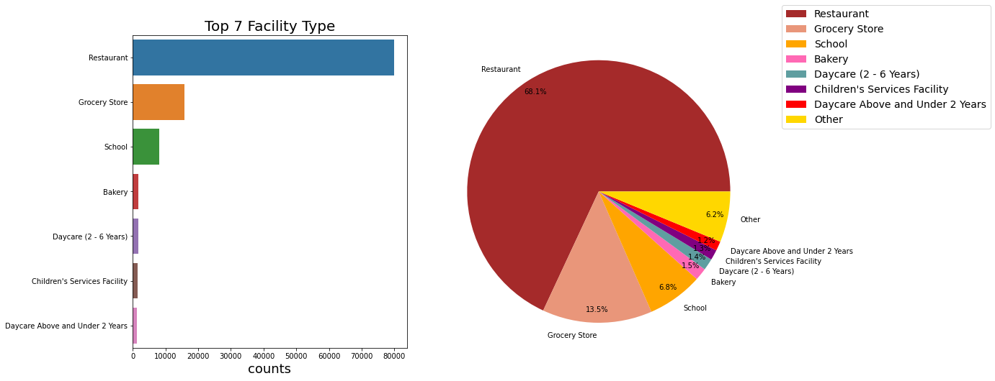
Exploratory data analysis – facility type

Slide 13
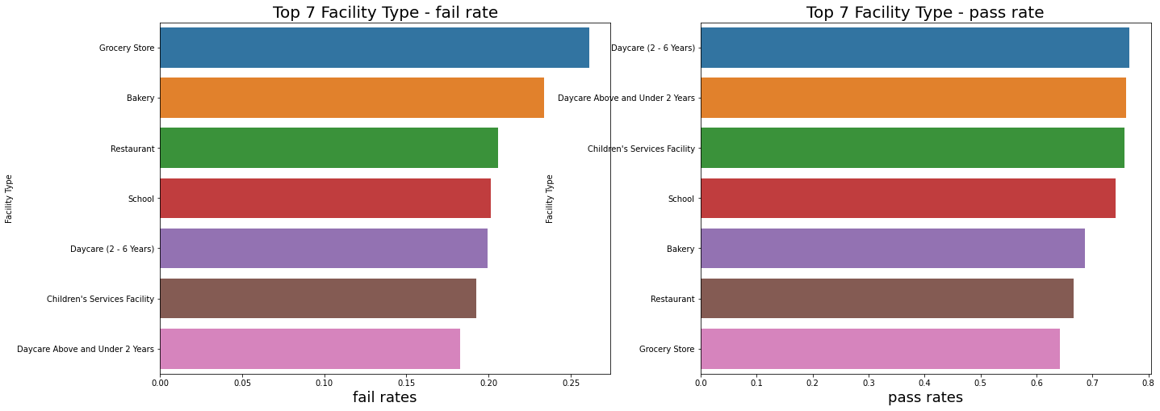
Exploratory data analysis – facility type
As can be observed in the above graph, facilities related to children and kids has less fail rates, might be due to reason that they have more sense of responsibility and potentially under supervision of parents

Slide 14
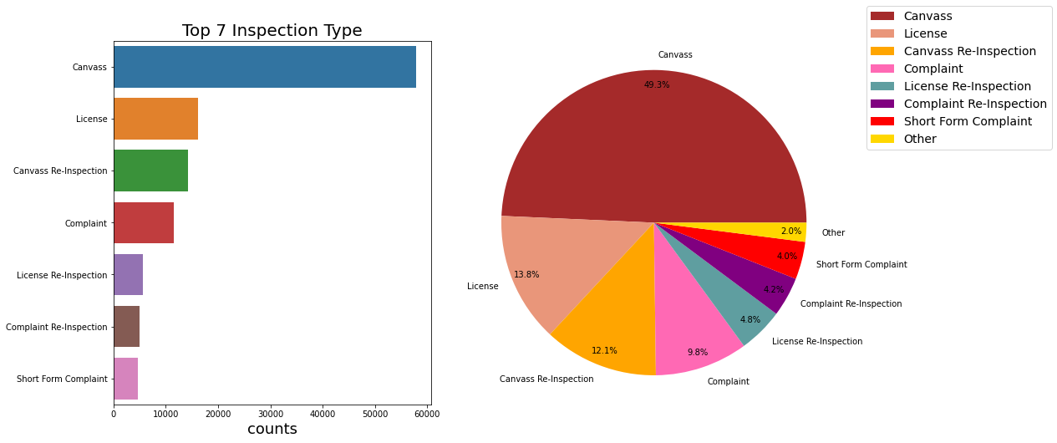
Exploratory data analysis – inspection type

Slide 15
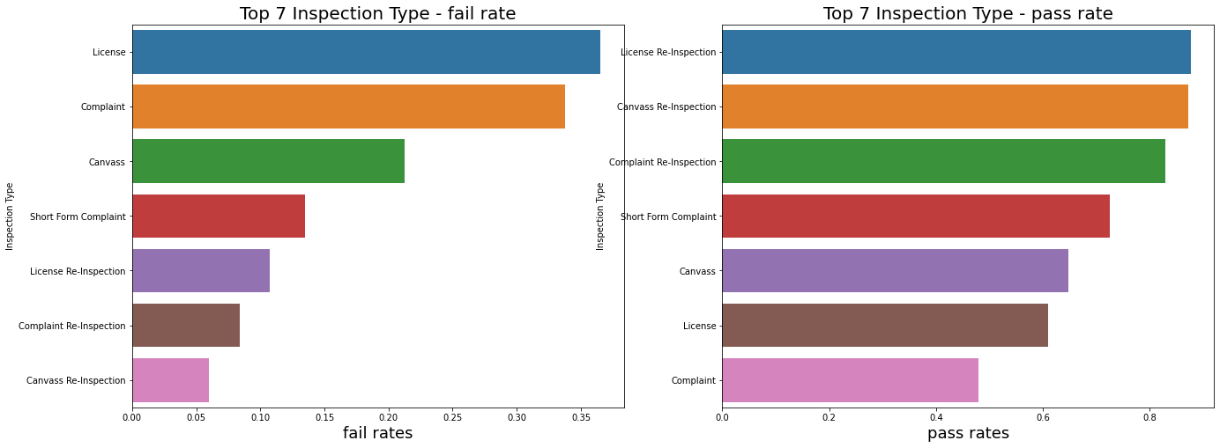
Exploratory data analysis – inspection type
Re-inspections has significantly less fail rates, that is intuitive since people tend to value their "second chance" and correct past mistakes for the incoming re-inspection

Slide 16
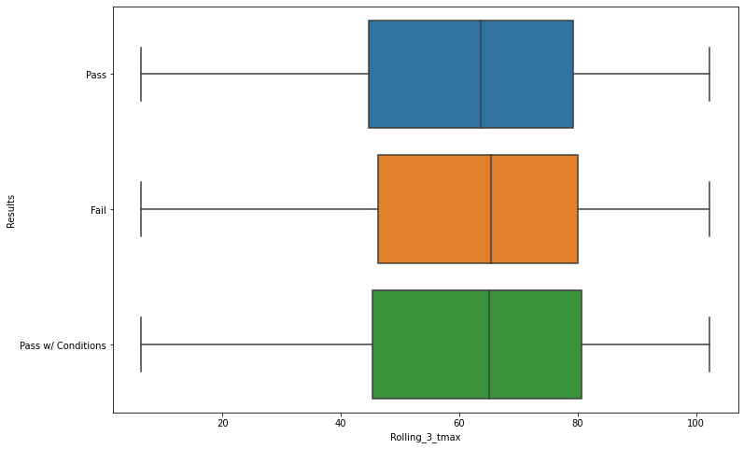
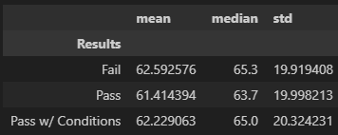
Exploratory data analysis – 3 days’ average highest temperature
Though it is not obvious, from the stats we could see as 3 days average highest temperature goes up, the inspection fail chance tend to increases.

Slide 17
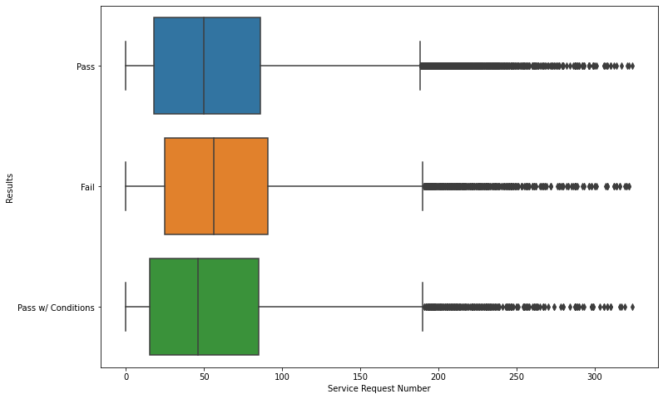
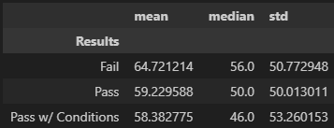
Exploratory data analysis – past 2 months’ sanitation compliant request number
From the stats we could see as past 2 months’ sanitation compliant request number within the same area code as the establishments goes up, the inspection fail chance tend to increases. However, expected “Pass w/ Conditions” stats to fall between the stats of “Fail” and “Pass” was not observed here, with “Pass w/ Conditions” having even a little smaller number of average sanitation complaints than “Pass”.

Slide 18
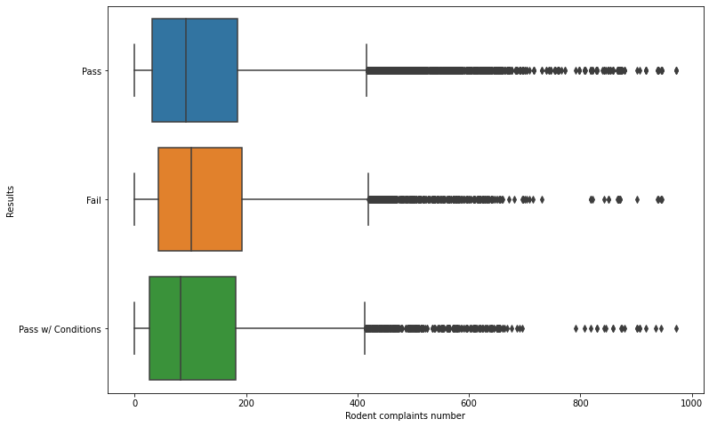
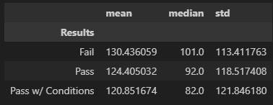
Exploratory data analysis – past 2 months’ rodent compliant request number
From the stats we could see as past 2 months’ rodent compliant request number within the same area code as the establishments goes up, the inspection fail chance tend to increases. However, same pattern with sanitation complaints number was overserved here, with “Pass w/ Conditions” having even a little smaller number of average sanitation complaints than “Pass”.

Slide 19
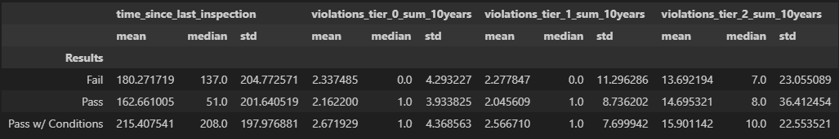
Exploratory data analysis – some other features
From the stats we could see as time since last inspection, past tier0 violations’ sum, past tier1 violations’ sum go up, the inspection fail chance tend to increases. However, stats of “Pass w/ Conditions” do not seem to fall within the stats range of “Pass” and “Fail”, with significant higher stats than “Fail” in terms of time since last inspection, past tier0 violations’ sum, past tier1 violations’ sum.

Slide 20
Agenda
Aim and method of approach
Feature engineering
Exploratory data analysis
Modeling and evaluation
Key findings and considerations
Recommendations of operation
Appendix – reference datasets and project artifacts

Slide 21
Modeling and evaluation – train test set preparation
Data was sort by datetime index ascendingly, with first 80% data used as training set and the rest 20% used as test set.
Above operation and Time series split was used since features like “past fail counts” contain past information. This is necessary since if training on a recent inspection of an establishment which have features contains info regarding past inspection results and then inference on this establishments’ past inspection would potentially lead to data leakage.
Name | Date | Past fail counts | … | Result(target)
Mc Donald | 2023-01-01 | 1 | … | 1
Mc Donald | 2022-01-01 | 0 | … | 1
If train on the one above, model would know in the past it fails, then if test on the one below the model is likely to output 1 as Result.

Slide 22
Modeling and evaluation – models and metrics
Three models are being tested; MAE are used as evaluation metric:
Xgboost: Overall_MAE: 0.657 Fail_MAE: 1.282
Pass_w_condition_MAE: 0.416 Pass_MAE: 0.491
Randomforest: Overall_MAE: 0.663 Fail_MAE: 1.252
Pass_w_condition_MAE: 0.383 Pass_MAE: 0.517
Elasticnet: Overall_MAE: 0.686 Fail_MAE: 1.353
Pass_w_condition_MAE: 0.420 Pass_MAE: 0.511

Slide 23
Modeling and evaluation – conclusion
1. After above modeling experimentation, we could see all models have similar performances with Xgboost performs a little better overall than the rest, thus stacking or voting may not increase the model performance for a significant range even if conducted.
2. Overall by observing MAE for each subset, models tend to perform better on "Pass" and "Pass w/ Conditions" subsets than “Fail” subset
3. 1.5 is the mid segregation point between "Pass" and "Pass w/ Conditions", and 0.5 is the mid segregation point between "Pass w/ Conditions" and "Fail"
We labeled "Pass" as 2 and it is MAE is 0.491, 2>2-0.491>1.5>1>>0,
it means on average the model tend not to make mistakes of treating "Pass" as "Pass w/ Conditions", and almost makes no mistakes of treating "Pass" as "Fail"
We labeled "Pass w/ Conditions" as 1 and it is MAE is 0.416, 2>1.5>1+0.416>1>1-0.416>0.5>0,
it means on average the model tend not to make mistakes of treating "Pass w/ Conditions" as "Pass” or "Fail"
We labeled "Fail" as 0 and it is MAE is 1.28, 2>1.5>0+1.28>1>0,
it means on average the model tend to make mistake of treating “Fail” as “Pass w/ Conditions”, but tend not to make mistakes of treating "Fail" as "Pass”.

Slide 24
Agenda
Aim and method of approach
Feature engineering
Exploratory data analysis
Modeling and evaluation
Key findings and considerations
Recommendations of operation
Appendix – reference datasets and project artifacts

Slide 25
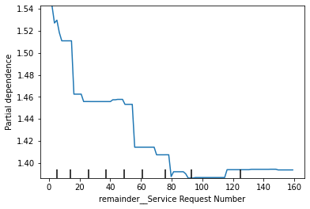
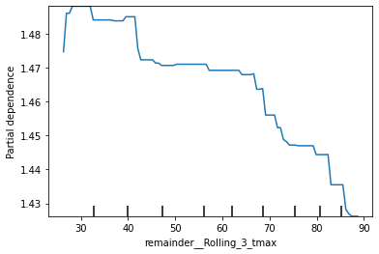
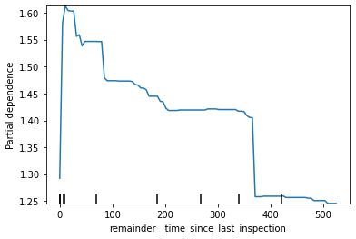
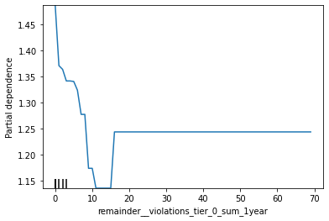
Key findings and considerations – partial dependency plots

Slide 26
Key findings and considerations – partial dependency plots insights and interpretation
1. If "Inspection Type" is related to re-inspection, then the establishments have higher chance to pass, this is intuitive since people tend to value their "second chance" and correct past mistakes for the incoming re-inspection
2. Service facilities involving kids and children like Daycare, children service facility and school tend to have higher change to pass, this might due to reason that these facilities are related to children thus have higher sense of responsibilities and also potentially under supervision of parents.
3. For "time since last inspection", the partial dependency plot shows the tendency to pass first increases as time span increase but really soon the tendency to pass start and continue to decease as time span increases. It is intuitive since when time is too short between two inspections(likely the later one is re-inspection), it is hard for the establishments to correct its mistake on time. But as time span increases, establishments tend to cut slack since lack of supervision and guidance, thus tend to fail with an inspection that hasn't happened for years.
4. The more service request number (sanitation complaints) happened at the same zip code area with the establishments during past 60 days, the more likely the inspection ended up failing. Since bad sanitation condition of the neighborhood may affect the establishments.
5. The higher the average highest temperature of past 2 days including today(3 days in total), more likely the establishments will fail. Since the violation codes listed lot of temperature related problems, most of them are about food quality under improper temperature. The higher the outside temperature is, the harder it is for staff at establishments to prevent food quality decay.
6. Past Tier0 violation counts is important since tier0 code violations are serious code violations and lead to high inspection fail rates. Thus, the more an establishments accumulate this kind of violations during the years, the more likely it will fail an inspection. The inspector may be more cautious due to the establishments past serious violations' history

Slide 27
Agenda
Aim and method of approach
Feature engineering
Exploratory data analysis
Modeling and evaluation
Key findings and considerations
Recommendations of operation
Appendix – reference datasets and project artifacts

Slide 28
Recommendations of operation
Our final aim is to identify establishments at a higher risk of violations.
Based on the finds, I would suggest focusing on the establishments having facility types not involving children and kids, having gone through long time since last inspection, sitting in the zip code areas which have high sanitation complaints number during the past two months, having high number of past accumulated tier0(critical) violations. And, to make sure establishments have proper temperature control, conduct the inspection when the average past 3 days’ highest temperature is high.

Slide 29
Agenda
Aim and method of approach
Feature engineering
Exploratory data analysis
Modeling and evaluation
Key findings and considerations
Recommendations of operation
Appendix – reference datasets and project artifacts

Slide 30
Appendix – reference datasets and project artifacts
Input Datasets:
Food_Inspections_and_Violations.csv
311_Service_Requests_Sanitation_Code_Complaints_No_Duplicates.csv
311_Service_Requests_Rodent_Baiting_No_Duplicates.csv
ncei_noaa_govaccesspast_weatherchicago.csv
Output Datasets:
baseline_train.csv
baseline_test.csv

Slide 31
Appendix – reference datasets and project artifacts
Project artifacts:
workbook.iypnb – all the code
xgboost_model.json – trained xgboost model
randomforest_model.pkl – trained random forest model
elasticnet_model.json – trained elasticnet model
requirements.ext – all libraries and packages

