Slide 1
Introduction to Design Patterns

Slide 2
How Do We Design Software?
Modeling: identify concepts and their relationships
Apply good architecture
Use appropriate data structures
Use design patterns when appropriate
Refactor (change the design) as necessary

Slide 3
How Do We Design Software?
Modeling: identify concepts and their relationships
Apply good architecture
Use appropriate data structures
Use design patterns when appropriate
Refactor (change the design) as necessary

Slide 4





Slide 5
What is a Design Pattern?
A general reusable solution to a commonly occurring problem.
A description or template for how to solve a problem that can be used in many different situations.

Slide 6
Benefits of Design Patterns
Reuse solutions, speed up development process
Improve internal quality of code
Start from a “higher perspective” on the process of design and not worry about details too early
Improve team communication and learning

Slide 7
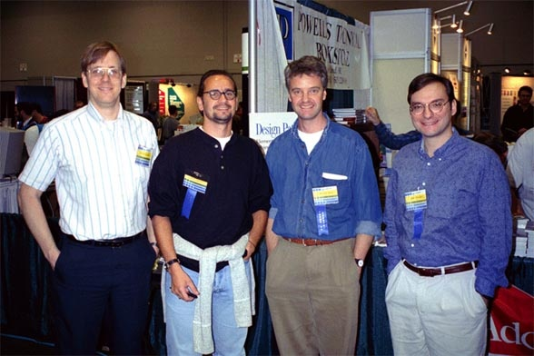
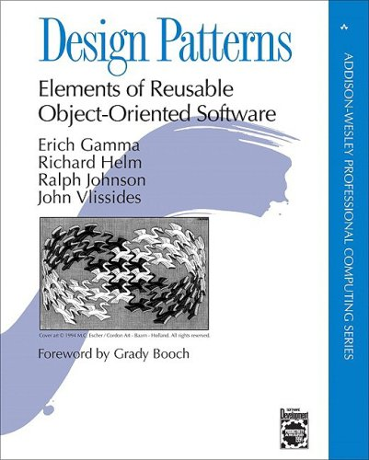
Gang of Four (1994)

Slide 8
GoF Design Patterns
Abstract Factory
Adapter
Bridge
Builder
Chain of Responsibility
Command
Composite
Decorator
Facade
Factory Method
Flyweight
Interpreter
Iterator
Mediator
Memento
Observer
Prototype
Proxy
Singleton
State
Strategy
Template Method
Visitor

Slide 9
GoF Design Patterns
Abstract Factory
Adapter
Bridge
Builder
Chain of Responsibility
Command
Composite
Decorator
Facade
Factory Method
Flyweight
Interpreter
Iterator
Mediator
Memento
Observer
Prototype
Proxy
Singleton
State
Strategy
Template Method
Visitor

Slide 10
Categories of Design Patterns
Creational: how objects are created
Structural: how objects are composed
Behavioral: how objects communicate

