Slide 1
Factory Method Pattern

Slide 2
Categories of Design Patterns
Creational: how objects are created
Structural: how objects are composed
Behavioral: how objects communicate

Slide 3
Creational Design Patterns
“Separate the code that creates an object from the code that uses an object.”
Hide the implementation details of how objects are created.
Benefits: stability, changeability, reusability

Slide 4
Design Problem
Problem:
Class A has a dependency on Class B
We may want to use different variations of B and don’t want to have to change A

Slide 5
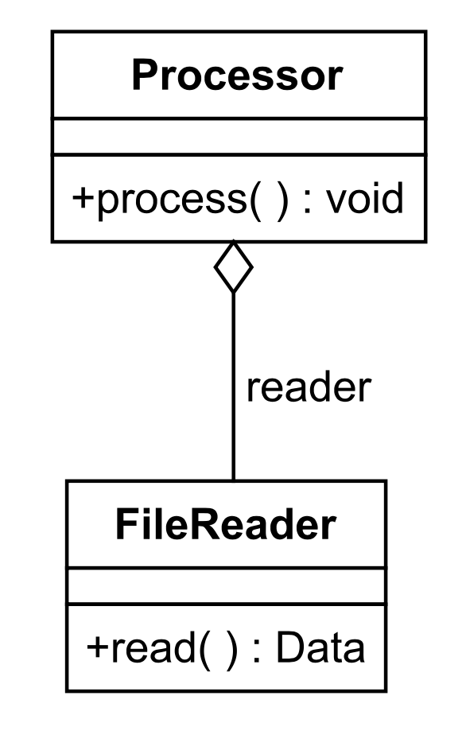
Processor.java
public class Processor {
protected FileReader reader;
public Processor() {
reader = new FileReader(. . .);
}
public void process() {
. . .
Data data = reader.read();
. . .
}

Slide 6
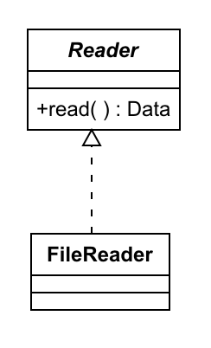
Processor.java
public class Processor {
protected Reader reader;
public Processor(Reader reader) {
this.reader = reader;
}
public void process() {
. . .
Data data = reader.read();
. . .
}

Slide 7
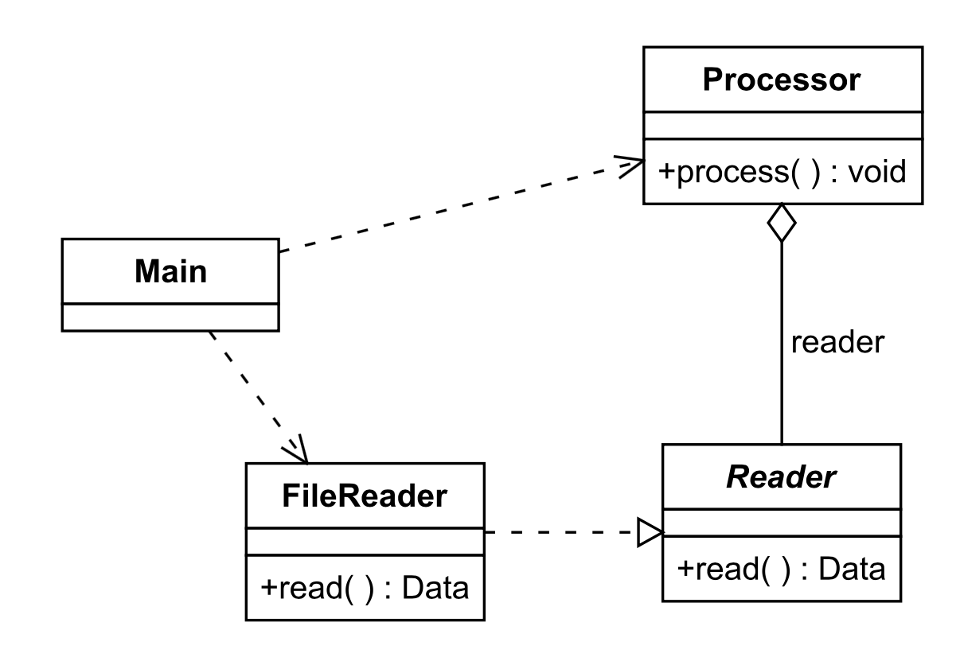

Slide 10
Design Problem
Problem:
Processor has a dependency on Reader
We may want to use different variations of Reader and don’t want to have to change Processor
Solution:
Separate the code in Processor that uses Reader from the code that creates an instance of Reader
Allow subclasses of Processor to create instances of different variations of Reader

Slide 11
Solution: Factory Method
Class A has a dependency on Class B
Class A contains code to use Class B
Subclasses of A override a “factory method” used to create the desired subclass of B
This method is then invoked in Class A to create the instance of B that it will use

Slide 12
Factory Method Pattern (1)
public abstract class Processor {
protected Reader reader;
public Processor() {
reader = createReader();
}
public void process() {
. . .
Data data = reader.read();
. . .
}
protected abstract Reader createReader();
public interface Reader {
public Data read();
}

Slide 13
Factory Method Pattern (2)
public class FileProcessor extends Processor
{
@Override
protected Reader createReader() {
return new FileReader(. . .);
}
}
public class FileReader
implements Reader {
public Data read(){
. . .
}
}
public class DbProcessor extends Processor
{
@Override
protected Reader createReader() {
return new DbReader(. . .);
}
}
public class DbReader
implements Reader {
public Data read(){
. . .
}
}

Slide 14
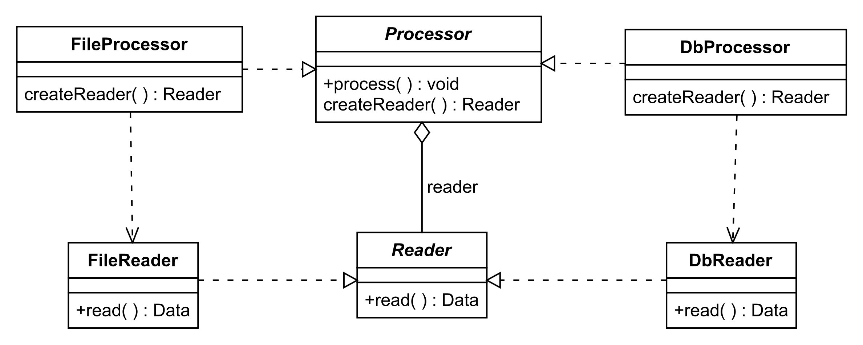

Slide 15
Summary
Factory Method Pattern: Separate the code that uses another class from the code that creates it
Class A has a dependency on Class B
Class A contains code to use Class B
Subclasses of A override a “factory method” used to create an instance of the desired subclass of B
Improves abstraction and stability so that the “client” of Class A doesn’t have to know about its dependencies

