Slide 1
Bridge Pattern

Slide 2
Categories of Design Patterns
Creational: how objects are created
Structural: how objects are composed
Behavioral: how objects communicate

Slide 3
Categories of Design Patterns
Creational: how objects are created
Structural: how objects are composed
Behavioral: how objects communicate

Slide 4
Structural Design Patterns
Address problems such as:
how do we assemble the constituent parts of an object?
how do we define the relationships between classes?
how do we combine objects into larger structures?
Benefits: changeability, stability

Slide 5
Design Problem
Problem: want to allow for combinations of concepts (abstractions) and the things that use them (implementors)
Concern: if we have M abstractions and N implementors, we would have M*N classes to represent the combinations
Solution: decouple abstraction and implementor so that both may vary independently
Maintain separate inheritance hierarchies
“Bridge” them using aggregation
Client only needs to work with abstraction

Slide 6
Example
A graphics package is able to draw different Shapes using different Renderers (e.g. color, grayscale, 3D, etc.).
Each Renderer should be able to draw each Shape, but we want to avoid having separate classes to represent each combination, e.g. ColorCircle, ColorRectangle, GrayscaleRectangle, etc.
We can apply the Bridge Pattern to solve this problem

Slide 7
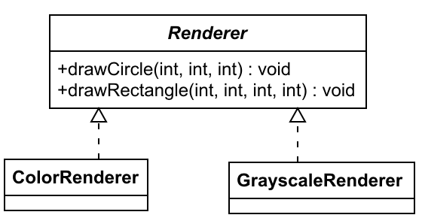
Renderers
public interface Renderer {
void drawCircle(int x, int y,
int radius);
void drawRectangle(int x1,
int x2, int y1, int y2);
}
public class ColorRenderer
implements Renderer { . . . }
public class GreyscaleRenderer
implements Renderer { . . . }

Slide 8
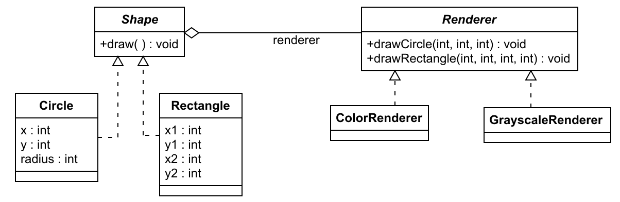
Bridge

Slide 9
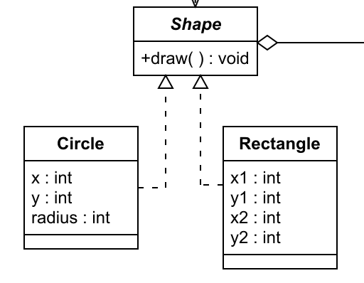
Shape Class
public abstract class Shape {
protected Renderer renderer;
public Shape(Renderer r) {
renderer = r;
}
public abstract void draw( );
}

Slide 10
Circle Class
public class Circle extends Shape {
protected int x, y, radius;
public Circle(int x, int y, int radius,
Renderer renderer) {
super(renderer);
. . .
}
public void draw( ) {
renderer.drawCircle(x, y, radius);
}

Slide 11
Using the Shapes
Shape grayCircle = new Circle(50, 50, 20, new GrayscaleRenderer());
Shape colorRectangle = new Rectangle(80, 80, 120, 120, new ColorRenderer());
. . .
if (condition) {
performAction(grayCircle);
}
else {
performAction(colorRectangle);
}
void performAction(Shape s) {
. . .
s.draw();

Slide 12
Summary
Structural design patterns: Decouple abstraction and implementation so that both may vary independently
Bridge Pattern: Maintain separate inheritance hierarchies and “bridge” them using aggregation so that Client only needs to work with abstraction

