Slide 1
Observer Pattern

Slide 2
Review: Design Patterns
Creational: how objects are created
Examples: Singleton, Factory Method
Structural: how objects are composed
Example: Bridge
Behavioral: how objects communicate
Example: Strategy

Slide 3
Design Problem
Problem: Object needs to notify a varying set of other objects that something has occurred
Concern: We don’t know which other objects to use in advance, and want to dynamically link the object to its dependencies
Solution: Maintain a set of Observers to which the object can send events, and create a method for sending messages to each Observer in the set

Slide 4
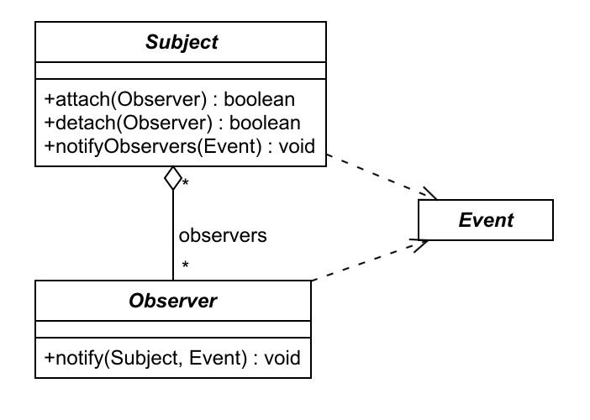

Slide 5
Subject Class
public abstract class Subject {
protected Set<Observer> observers = new HashSet<>();
public boolean attach(Observer o) {
return observers.add(o);
}
public boolean detach(Observer o) {
return observers.remove(o);
}
protected void notifyObservers(Event e) {
for (Observer o : observers) {
o.notify(this, e);
}

Slide 6
Example
A library for developing a graphical user interface has elements that can be rendered in the visual display
When a user clicks on a UI element, the application needs to log the location of the click
In some cases, a click should also lead to updating the graphics, and in other cases, some background activities need to occur

Slide 7
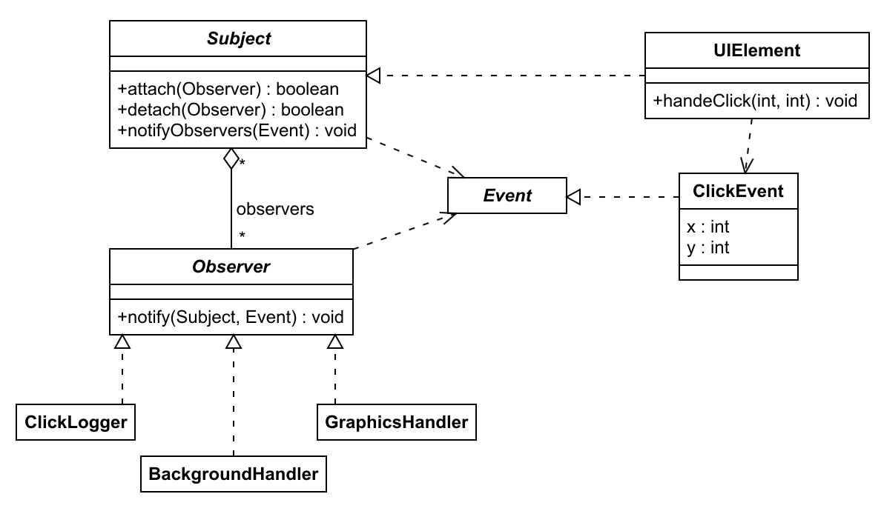

Slide 8
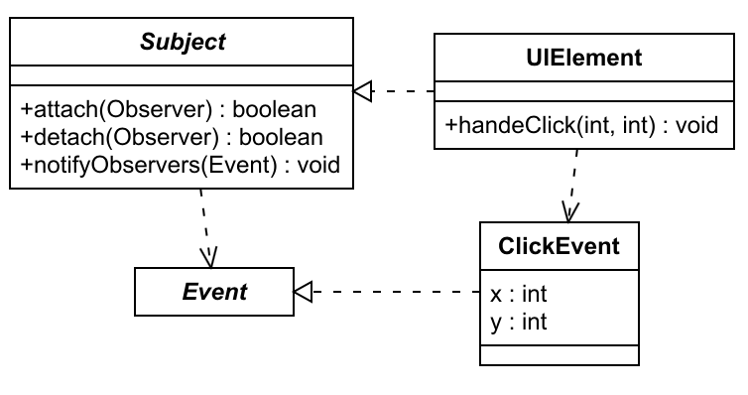
Subject and Event Classes
public class UIElement extends Subject {
public void handleClick(int x, int y) {
ClickEvent event = new ClickEvent(x, y);
notifyObservers(event);
}
public class ClickEvent extends Event {
protected int x, y;
public ClickEvent(int x, int y) {
this.x = x;
this.y = y;
}

Slide 9
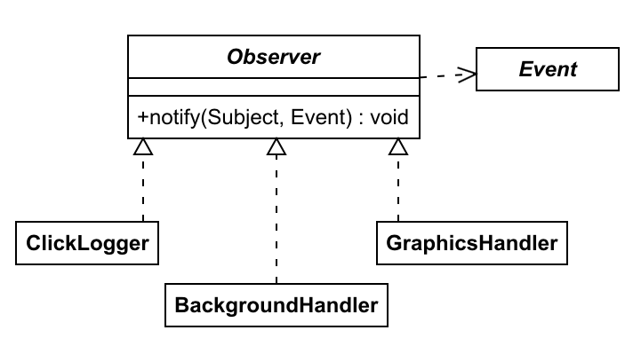
Observers
public class ClickLogger extends Observer {
public void notify(Subject s, Event e) {
// write info to log file
}
public class BackgroundHandler extends Observer {
public void notify(Subject s, Event e) {
// perform some tasks in the background
}
public class GraphicsHandler extends Observer {
public void notify(Subject s, Event e) {
// update the graphical elements
}

Slide 10
Using the Observer Pattern
UIElement element = new UIElement();
element.attach(new ClickLogger());
Observer o1 = new GraphicsHandler();
element.attach(o1);
// ...
element.handleClick(100, 200);
element.detach(o1);
Observer o2 = new BackgroundHandler();
element.attach(o2);
// ...
element.handleClick(50, 180);

Slide 11
Summary
Observer Pattern: a Subject has a set of Observers that can be notified when an event occurs
Observers can be added and removed as the program runs
Typically used in GUI systems, e.g. Android and Java Swing
Sometimes referred to as Publish-Subscribe

Slide 12
Summary: Design Patterns
General reusable solutions to commonly occurring problems
Allow programmers to reuse solutions
Categories
Creational: how objects are created (Singleton, Factory Method)
Structural: how objects are composed (Bridge)
Behavioral: how objects communicate (Strategy, Observer)

