Slide 1

AI-Empowered Research
Part 3 · Live Workflow: An Education-Policy Study
Yung Chun · CERP³ · Hillman Hall 130 · 2026-10-16
All data are synthetic. The results are hypothetical.
Notes:
[Title (0 min)]
Part 3 starts at 10:20, right after the break. Go straight to the next slide. Reminder: the live copy of the project has no answer_key/ or slides/ folder; backups B1–B7 at the end of this deck use the instructor copy. All data are synthetic; the planted effects were revised on 2026-10-15 for teaching.

Slide 2


The starting point
Part 3 · Live workflow
A research question, raw data, and five prompts. Nothing else
part3_live_workflow/
├── CLAUDE.md # question + rules
├── prompts/ # 01 → 05
├── data_raw/ # 7 CSVs + codebook
├── code/ # empty
├── data_clean/ # empty
├── outputs/ # empty
└── writing/ # empty
Research question
Did the Choice Neighborhoods Initiative (CNI), which began in 2019 in ZIP 63106 and five schools, (a) change who lives in the neighborhood and (b) raise test scores for students who entered CNI schools or moved in?
All data are synthetic. The results are hypothetical.
Everything in the empty folders at the end was produced in this room.
Notes:
[The Starting Point (1.5 min)]
The demo mirrors the workflow of a real, funded study of school mobility in St. Louis. The real data can't be shared, so everything here is simulated: about 4,400 students, 2012–2023, plus an ACS-style ZIP panel. CNI is fictional. The ZIP codes are real so that maps work, but every attribute attached to them is fake (data_raw/codebook.md).
Make two points. First, the code/, data_clean/, outputs/, and writing/ folders start empty, so everything in them at the end was produced during this session. Second, CLAUDE.md deliberately leaves the design open ("To be decided … in step 03"), so the agent can't jump ahead to estimation.
The live copy has no answer_key/ folder. CLAUDE.md also forbids reading it, as a second safeguard.

Slide 3
Five steps, five checkpoints
Part 3 · Live workflow
Each prompt ends with: stop and wait for the researcher
01
Data audit
02
Cleaning
03
Strategy
04
Analysis
05
Brief
Claude produces
Claude produces
Claude produces
Claude produces
Claude produces
An import script and a data audit
1000-series scripts, clean .rds files, a cleaning log
An analysis plan (in plan mode)
2000/3000 scripts, figures and tables
A manuscript brief
You decide
You decide
You decide
You decide
You decide
How to fix each issue
Whether the clean data look right
Which design
Whether results are plausible
Framing, interpretation, claims
Standing rules → CLAUDE.md Step instructions → prompts/ Run: Follow @prompts/01_data_audit.md
Notes:
[Five Steps, Five Checkpoints (1.5 min)]
The table comes from prompts/README.md. Point at the right-hand column: that's the researcher's job, and the agent stops at every row. It's the design principle from Part 1, Slide 7 (Brodeur et al.): AI-assisted beats AI-led.
Explain the split. CLAUDE.md holds what's true for the whole project (the question, folder rules, "never print individual records," naming). The prompts hold what to do in each step. That's why the prompts never mention St. Louis and can be reused unchanged on another project.
How each step runs: Follow @prompts/01_data_audit.md. The @ attaches the file to the message.

Slide 4



Data audit
Part 3 · Live workflow · step 01
Read before writing. Report each problem with a count, not a record
01
≈ 6 min
Watch for
Follow @prompts/01_data_audit.md
Issues the codebook doesn't mention: mid-year movers, ZIP+4 and blank ZIPs, out-of-area students, no 2020 tests…
Claude produces
code/0000_import.Rmd (inspection only)
Checkpoint: you decide
writing/data_audit.md: inventory and links
Each issue with evidence (a count) and a fix
Approve, change, or reject each proposed fix.
Open questions for the researcher
Notes:
[Step 01: Data Audit (6 min)]
Live: Follow @prompts/01_data_audit.md. Claude writes and knits code/0000_import.Rmd (inspection only) and writes writing/data_audit.md.
Expected findings (counts from data_raw/, computed 2026-10-12; issues from ground_truth.md). The codebook documents only the first and fifth.
| # | Issue | Expected evidence | Fix to approve |
|---|---|---|---|
| 1 | Mid-year movers have two core records (seq) | 2,592 student-years with a seq = 2 record | Keep highest seq |
| 2 | Years before the study period | 2,970 core rows in 2012–2013 | Drop < 2014 |
| 3 | ZIP formats | 3,468 ZIP+4 and 450 blank (of 23,077 core rows) | Cut to 5 digits; drop blank |
| 4 | Out-of-area students | 400 students in 641xx / 652xx / 658xx | Drop (study area is STL City/County) |
| 5 | MAP +2000 flag | 548 of 13,697 scores ≥ 2000 | Subtract 2000 |
| 6 | No MAP tests in 2020; one subject missing | 0 test rows in 2020; 405 rows with one subject blank | Keep as NA |
| 7 | Discipline is long; lengthremoved missing; one 180-day expulsion | 2,652 incidents; 97 missing lengths | Sum ISS + OSS days; no row = 0 |
| 8 | Enrollment duplicates for movers | 2,592 student-years with two rows | Collapse; weight attendance by days enrolled |
What to point out: it reads the codebook and every file before writing anything, it reports counts and never prints a student row (CLAUDE.md §5), and it lists open questions for the researcher. If it misses an issue, say so. That's part of the lesson: the audit is a draft, and you're the reviewer.
Researcher decision to give: approve all eight fixes as listed. For #7, say "use suspension days (ISS + OSS); don't let the single expulsion drive totals."

Slide 5
Cleaning
Part 3 · Live workflow · step 02
Apply exactly the approved fixes, and nothing else
02
≈ 8 min
Watch for
Follow @prompts/02_data_cleaning.md
data_raw/ is never touched. Only 1000-series scripts write to data_clean/.
Claude produces
One row per student-year, with treatment timing
Checkpoint: you decide
A ZIP-year panel for the neighborhood question
A cleaning log: rows and students after each step
Do the clean data look right? About 4,000 students, minus a few blank ZIPs.
Checks that stop the script if keys aren't unique
Notes:
[Step 02: Cleaning (8 min)]
Live: Follow @prompts/02_data_cleaning.md. Expect code/1000_*.Rmd (student-year panel) and a 1100_*.Rmd (ZIP panel from the ACS file), saved as .rds.
Expected cleaning log (answer key 1000_clean_demo.Rmd; the live run may order steps differently):
| Step | Rows | Students |
|---|---|---|
| Raw core records | 23,077 | 4,400 |
| Drop years before 2014 | 20,107 | 4,400 |
| Keep highest seq per student-year | 17,698 | 4,400 |
| Drop blank ZIPs (ZIP+4 cut to 5 digits) | 17,360 | 4,375 |
| Keep St. Louis City/County ZIPs | 15,737 | 3,975 |
Treatment cohorts (answer key): CNI school 214 / 92 / 91 / 107 / 132 students first exposed in 2019–2023, 3,339 never; ZIP 63106 74 / 35 / 32 / 31 / 54, 3,749 never. Exposure is absorbing (intent-to-treat).
What to point out: the cleaning log is what goes in a Methods section; the stopifnot() checks; .rds outputs; the knitted HTML. Ask the room: "Would you have written the log yourself?" A good sign is that the agent asks before making an unapproved research decision, such as redefining treatment (prompt 02, "Do not").
Researcher decision to give: accept, after checking that the final counts make sense (about 4,000 students minus a few dropped for blank ZIPs).

Slide 6





Empirical strategy
Part 3 · Live workflow · step 03
Claude can read and think, but can't edit anything
03
Shift+Tab → plan mode first
≈ 8 min
The design is the researcher's decision.
Follow @prompts/03_empirical_strategy.md
2–3 candidate designs per question
Today's choice
Assumption · how to check it · threats
Neighborhood: Synthetic control on the ACS ZIP panel
A recommendation, not a choice
Students: Callaway & Sant'Anna staggered DiD
Notes:
[Step 03: Empirical Strategy (8 min)]
Live: press Shift+Tab until the status bar shows plan mode, then Follow @prompts/03_empirical_strategy.md. (Desktop app: Cmd+Shift+M / Ctrl+Shift+M, per prompts/03_empirical_strategy.md.)
Likely candidates, and why to choose as we do (ground_truth.md, "Things to expect"):
- Neighborhood: synthetic control on the ACS panel (one treated ZIP, 2014–2018 pre-period, 43 donor ZIPs). Alternatives: DiD with all other ZIPs; student-level ZIP averages, which are too thin (median about 30 students per ZIP-year).
- Students: CSDID with not-yet-treated controls, because timing is staggered and TWFE is biased under heterogeneous effects. Alternatives: TWFE event study; matched comparison.
- Rejected: school-level synthetic control. Donor schools lose the families who move into CNI schools, so they aren't clean controls (spillover).
Researcher decision to give: choose the two designs above; MAP standardized within grade × year; robustness = TWFE comparison; placebos = attendance rate and suspension days; diagnostics = event study and placebo-in-space. Then tell Claude to record the decision in CLAUDE.md §6 (the prompt's checkpoint asks for this). Switch out of plan mode before step 04.
Point out the plausibility benchmarks in the plan (typical yearly MAP growth). They set up the moment on Slide 7.

Slide 7
Analysis
Part 3 · Live workflow · step 04
Implement the approved plan exactly, then check whether it makes sense
04
≈ 8 min
Watch for
Follow @prompts/04_analysis.md
Nothing extra run and quietly dropped. Extra specifications must be reported.
Claude produces
2000 descriptives: sample, gaps, timing, trends
Checkpoint: you decide
3000 CSDID (students) · 3100 synthetic control
Diagnostics: event study · placebo ZIPs
Are the results plausible?
Sanity check against a benchmark; flag anything odd
Notes:
[Step 04: Analysis (8 min)]
Live: Follow @prompts/04_analysis.md. This is the longest agent run. CSDID and the synthetic-control placebos take a while to knit, so narrate the descriptives while they run.
Expected results (answer key, re-knit 2026-10-15; live numbers may differ with different but defensible choices):
- Synthetic control (3100_synth_trends.png, 3100_synth_placebos.png):
- Population dips −11.7% in 2019 and −4.0% in 2020, then is back with its synthetic from 2021 (rank 2 of 44, p = 0.045). Story: temporary displacement during redevelopment.
- Share Black: no change (gaps under 0.02; rank 6 of 44, p = 0.14). A null result is a result.
- Median income rises from 2021: +3%, +9%, +13% (2021–2023; rank 1 of 44, p = 0.023 = 1/44, the smallest possible).
- CSDID event study (3000_event_study_school.png, converted to points with SD ≈ 12): ELA +4.2, +7.0, +12.9, then +4.6 and +4.3; Math +4.6, +8.0, +13.8, then +4.7 and +4.9 (years 1–5 after entering a CNI school). Pre-entry estimates near zero. The simple average (CNI-school cohort 0.56 SD ELA, 0.61 SD Math) hides this peak-and-settle shape.
- Placebos: attendance about −0.005; suspension days 0.03 (school) and −0.42 (SE 0.33, ZIP), none distinguishable from zero.
- Convergence: both models run without convergence warnings; did prints informational "No units in group … in time period …" messages (later cohorts have no tested students in early years). Filtering rows with a missing outcome first avoids its "dropped rows" message.
Descriptive traps to name if they appear: pre-2019 MAP trends are noisy (few tested students in early cohorts), and the ZIP-63106 group's raw mean falls after 2019 because the new arrivals are lower-income. That's composition, not harm.

Slide 8

Is +23 points plausible?
Part 3 · Live workflow · step 04
Year 3 after entering a CNI school. The code ran without errors. Which estimate is right?
vs.
CSDID on raw MAP points
Standardized within grade × year
+23 to +25
+13 to +14
points, ELA to Math
points (SD ≈ 12), ELA to Math
A year of school is worth 5–6 points. The raw number is bigger by about two years of growth. Which one is measuring the program?
Grade growth was counted as treatment effect. Standardize within grade × year.
Notes:
[Is +23 Points Plausible? (4 min)]
The teaching moment (ground_truth.md), reframed 2026-10-15 for the revised effects. With an unbalanced student panel, did::att_gt() falls back to repeated cross-sections and compares each cohort with its own younger, lower-grade self, so normal grade growth shows up as treatment effect. Answer key (3000_pitfall_by_year.csv), year 3 after entry: raw points +23.1 (ELA) and +25.1 (Math); standardized and converted to points +12.9 and +13.8 (planted +13.5). Pooled over all years: raw 13.4 / 14.6 points vs. standardized 0.56 / 0.61 SD.
The effect is large in year 3 (about 1.1 SD), so the question is no longer "is any big number implausible?" but "does the raw number agree with the standardized one?" It doesn't: the gap is about two years of normal growth, which tells you the raw estimate is contaminated.
How to stage it: if the live run uses raw points, let the number appear, then ask the room. If Claude standardized on its own (the plan from step 03 asks for it), show answer_key/outputs/tables/3000_pitfall_by_year.csv from the instructor copy instead, and credit the plan for preventing the error.
The lesson is why prompt 04 requires a sanity check and why step 03 asked for benchmarks. The code ran without errors, and the estimate was still wrong. Only someone who knows how MAP scores behave catches it.

Slide 9



Callback: where Gemini fits
Part 3 · Live workflow
Reading is file-free work. Do it for free, then hand it over as a file
Gemini
The handoff
Claude CLI
free through WashU
is just a file
reads it as context
Literature map and framing for the paper
writing/literature_map.md
Uses it for the brief in step 05
Never invents a citation: it writes [CITATION NEEDED].
Any citation that does appear, a person opens and verifies (a Part 4 red line).
Notes:
[Callback: Where Gemini Fits (1 min)]
A callback to Part 1, Slide 13 ("Division of labor"). Reading the CNI, mobility, and neighborhood-effects literature is high-volume, file-free work, so do it in Gemini at no cost. Save the output as a file (e.g., writing/literature_map.md) and the agent can use it. Any citation it contains still has to be opened and verified by a person (a Part 4 red line). CLAUDE.md §7 tells Claude to write [CITATION NEEDED] rather than fill gaps itself.
[Optional, author to decide: drop a prepared Gemini literature map into writing/ before step 05 so the brief can reference it. If you do, check it contains no unverified citations presented as fact.]

Slide 10
Manuscript brief
Part 3 · Live workflow · step 05
Not the paper: a brief to draft Methods and Results from
05
≈ 6 min
Watch for
Follow @prompts/05_manuscript_brief.md
Spot-check one number: find its source comment, open the CSV, confirm it matches.
Claude produces
Every number → <!-- source: outputs/... -->
Checkpoint: you decide
Causal language only where the design supports it
Decisions left to the researcher
What did it get right? What did it overstate? What can only you decide?
A draft AI-use disclosure
Notes:
[Step 05: Manuscript Brief (6 min)]
Live: Follow @prompts/05_manuscript_brief.md. Open writing/manuscript_brief.md and scroll through it with the room.
What to look for in the review:
- Right: sample counts match the cleaning log; each number carries a source comment; the methods section names the scripts.
- Likely overstated: the ZIP-63106 student effect read as a neighborhood effect. Most ZIP movers also enroll in CNI schools, so that cohort's estimate mixes both exposures (ground_truth.md: living in 63106 has no planted effect; the ZIP cohort's 0.5 SD comes entirely through CNI schools). Also watch for causal language about the neighborhood change; synthetic control shows 63106 diverged, not why.
- Only the researcher decides: what the change means (displacement? revitalization? for whom?), policy implications, and which limitations matter most.
- The disclosure draft: read it aloud. It's the bridge to Part 4.
Spot-check one number live: pick a figure in the brief, open the cited CSV, and confirm it matches.

Slide 11
The prompts work on your project too.
1
Copy part2_setup/project_template/
2
Fill in CLAUDE.md (compare with part3_live_workflow/CLAUDE.md)
Take it home
3
Put your files in data_raw/; copy in prompts/
4
Follow @prompts/01_data_audit.md
Answer key and finished outputs: part3_live_workflow/answer_key/
Next: Part 4 · Who answers for this?
Notes:
[Take It Home (1 min)]
From prompts/README.md ("Use them on your own project"). The prompts never name the St. Louis study, so they work as written; edit them wherever your field or data differ. Bridge: "Everything you just watched left a file. That trail is what makes the next question, who answers for this work, answerable."

Slide 12
B1 · What the audit finds
Backup · use only if the live demo stalls
Eight built-in issues. The codebook documents only #1 and #5
# | Issue | Expected evidence | Fix to approve
1 | Mid-year movers have two core records (seq) | 2,592 student-years with seq = 2 | Keep highest seq
2 | Years before the study period | 2,970 core rows in 2012–2013 | Drop years < 2014
3 | ZIP formats | 3,468 ZIP+4 and 450 blank (of 23,077) | Cut to 5 digits; drop blank
4 | Out-of-area students | 400 students in 641xx / 652xx / 658xx | Drop
5 | MAP +2000 flag | 548 of 13,697 scores ≥ 2000 | Subtract 2000
6 | No MAP tests in 2020; one subject missing | 0 rows in 2020; 405 with one blank | Keep as NA
7 | Discipline is long; missing lengths; one 180-day expulsion | 2,652 incidents; 97 missing | Sum ISS + OSS days; no row = 0
8 | Enrollment duplicates for movers | 2,592 student-years with two rows | Collapse; weight attendance by days
Counts computed from data_raw/ on 2026-10-12. Highlighted rows: documented in the codebook.
Notes:
[Backup B1 (use only if the live demo stalls)]
Audit: the eight built-in data issues with expected evidence (counts computed from data_raw/; unchanged by the 2026-10-15 revision) and the fix to approve. Use if step 01 stalls; say 'This is what the audit finds; I ran it during rehearsal,' then give the approval anyway.

Slide 13
B2 · Cleaning log and treatment cohorts
Backup · use only if the live demo stalls
From answer_key/code/1000_clean_demo.Rmd
Step | Rows | Students
Raw core records | 23,077 | 4,400
Drop years before 2014 | 20,107 | 4,400
Keep highest seq per student-year | 17,698 | 4,400
Drop blank ZIPs (ZIP+4 cut to 5 digits) | 17,360 | 4,375
Keep St. Louis City/County ZIPs | 15,737 | 3,975
Cohort | CNI school | ZIP 63106
2019 | 214 | 74
2020 | 92 | 35
2021 | 91 | 32
2022 | 107 | 31
2023 | 132 | 54
Never | 3,339 | 3,749
Treatment is absorbing (intent-to-treat): once a student is in a cohort, they stay in it.
Notes:
[Backup B2 (use only if the live demo stalls)]
Cleaning: the answer-key cleaning log and treatment cohorts (answer_key/code/1000_clean_demo.Rmd). Use if step 02 stalls. 15,737 student-years and 3,975 students is about 4,000 minus a few blank ZIPs.

Slide 14
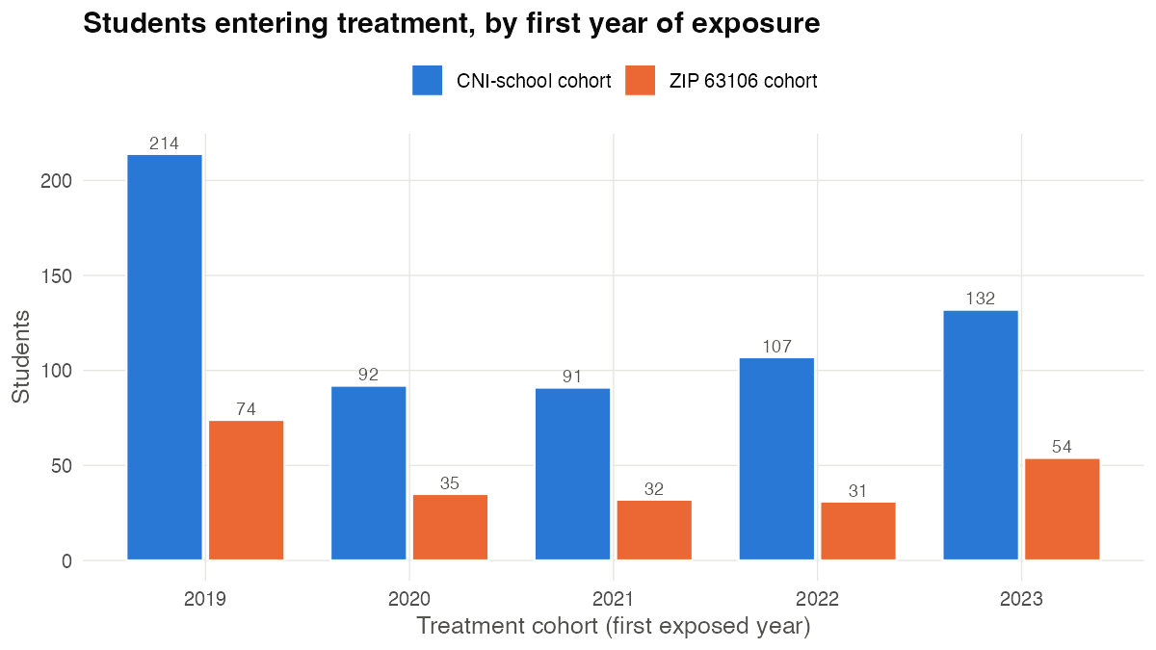
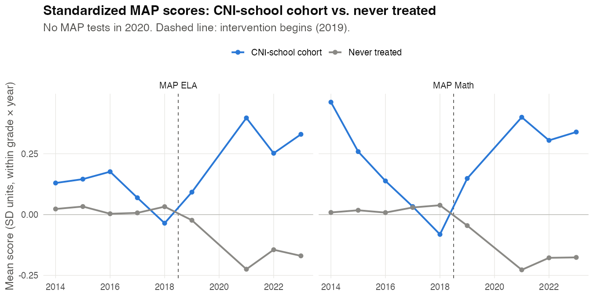
B3 · Descriptives
Backup · use only if the live demo stalls
Staggered timing; noisy pre-2019 trends are a picture, not an estimate
Notes:
[Backup B3 (use only if the live demo stalls)]
Descriptives (answer_key/outputs/figures/2000_*). Treatment timing is staggered (2019–2023), which motivates Callaway & Sant'Anna. MAP trends are noisy before 2019 because few cohort students were tested early; a picture, not an estimate.

Slide 15
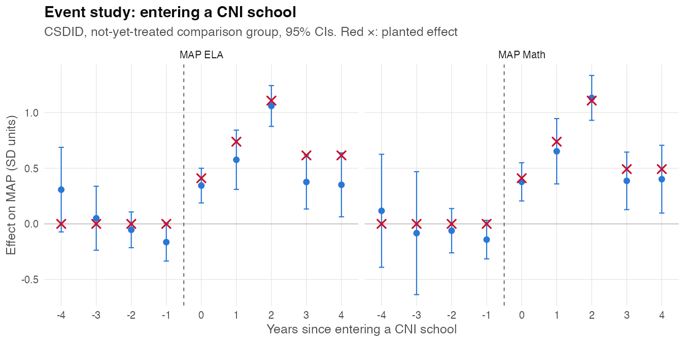
B4 · Students: CSDID
Backup · use only if the live demo stalls
MAP standardized within grade × year; not-yet-treated controls
Since entry | ELA (pts) | Math (pts)
Year 1 | +4.2 | +4.6
Year 2 | +7.0 | +8.0
Year 3 | +12.9 | +13.8
Year 4 | +4.6 | +4.7
Year 5 | +4.3 | +4.9
Pitfall, raw points, year 3:
ELA +23 · Math +25
vs. the standardized row above (Slide 7)
Notes:
[Backup B4 (use only if the live demo stalls)]
CSDID (3000_event_study_school.png, 3000_pitfall_by_year.csv). The effect rises for three years after entering a CNI school and then settles: in points, ELA +4.2, +7.0, +12.9, then +4.6 and +4.3; Math +4.6, +8.0, +13.8, then +4.7 and +4.9. Red × marks are the planted values (ELA's year-4+ value is planted at 7.5 because this estimator understates later ELA years by about 3 points; see ground_truth.md). Raw-points pitfall in year 3: +23 / +25 vs. +13 / +14 standardized. Use with Slide 7.

Slide 16
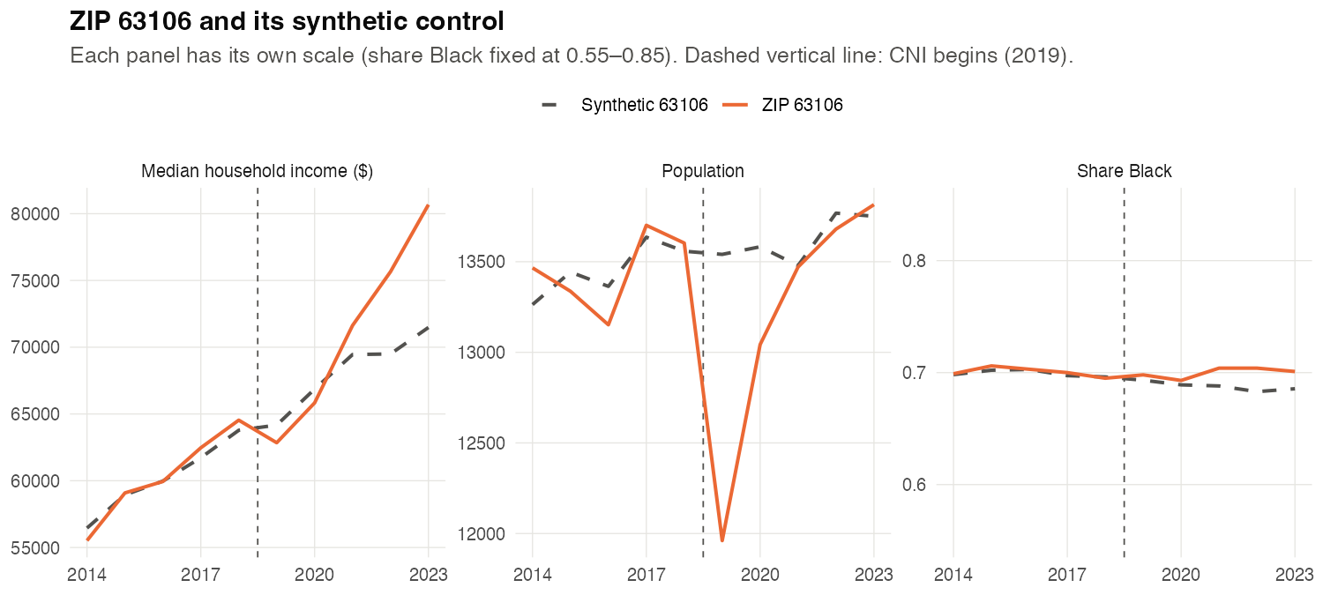
B5 · Neighborhood: synthetic control
Backup · use only if the live demo stalls
ZIP 63106 vs. a weighted combination of 43 donor ZIPs
Year | Pop. | Share Black | Income
2019 | -11.7% | +0.005 | -2.1%
2020 | -4.0% | +0.004 | -1.5%
2021 | -0.1% | +0.016 | +3.1%
2022 | -0.6% | +0.021 | +8.9%
2023 | +0.5% | +0.015 | +12.9%
Rank of 44 (Fisher p)
Pop. 2 (0.045) · Black 6 (0.14) · Income 1 (0.023)
Notes:
[Backup B5 (use only if the live demo stalls)]
Synthetic control (3100_synth_trends.png, 3100_synth_gaps_by_year.csv, 3100_synth_results.csv). Population dips about 12% in 2019 and 4% in 2020, then matches its synthetic (rank 2 of 44, p = 0.045). Share Black does not change (rank 6, p = 0.14). Income rises from 2021: +3%, +9%, +13% (rank 1, p = 0.023 = 1/44, the floor). It shows that 63106 diverged, not why: displacement then recovery? who benefits from rising incomes? Those are researcher questions.

Slide 17
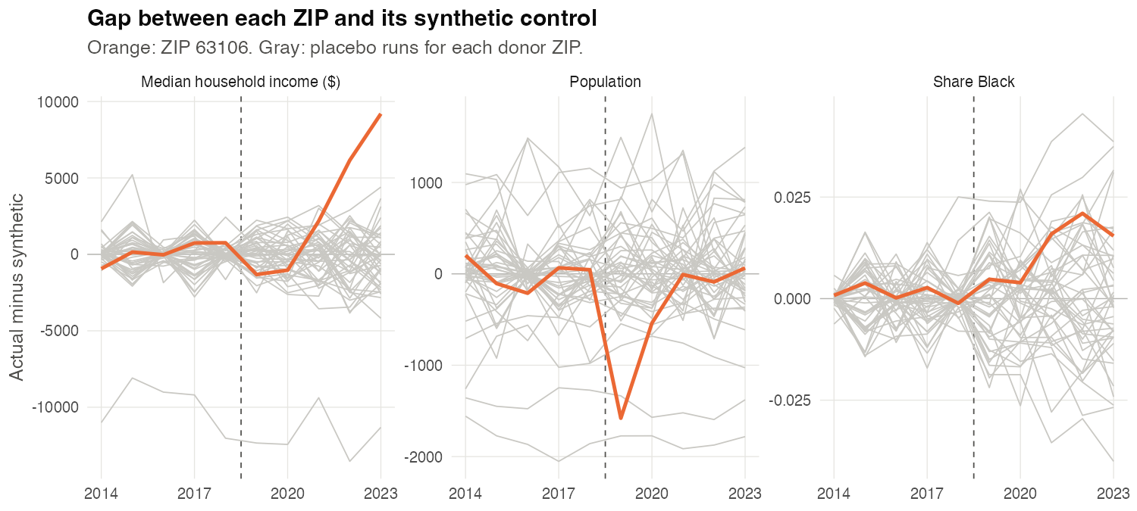
B6 · Placebo ZIPs
Backup · use only if the live demo stalls
Each gray line is a donor ZIP run as if it were treated
The 2019 population dip and the income rise from 2021 stand out from the placebo ZIPs.
Share Black stays inside the gray cloud: no change, as planted. A null result is a result.
Notes:
[Backup B6 (use only if the live demo stalls)]
Placebo-in-space (3100_synth_placebos.png). Each donor ZIP is run as if treated. The 2019 population dip and the 2021–23 income rise stand outside the gray cloud; share Black stays inside it (no effect, as planted).

Slide 18
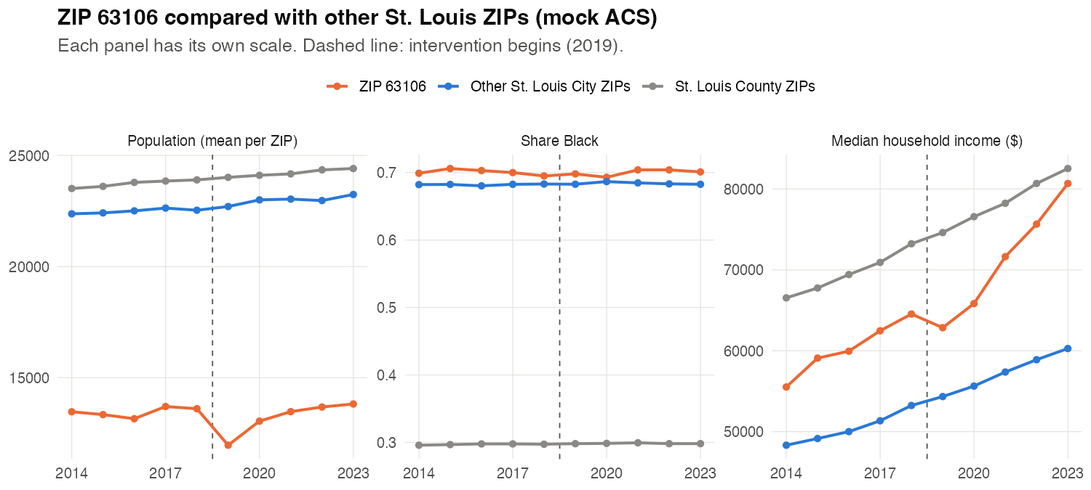
B7 · Raw ZIP trends
Backup · use only if the live demo stalls
ZIP 63106 vs. other St. Louis City and County ZIPs (mock ACS)
A picture, not an estimate.
The synthetic control (B5) is the comparison; these raw trends show why 63106 needed a matched counterfactual.
Notes:
[Backup B7 (use only if the live demo stalls)]
Raw ACS trends (2000_zip_trends.png): ZIP 63106 against averages of other St. Louis City and County ZIPs. Descriptive only; the synthetic control in B5 is the comparison. Student-level ZIP aggregates are too thin (median about 30 students per ZIP-year), which is why the neighborhood question uses the ACS panel.

