Slide 1
CS 3358: Data Structures and Algorithms
Jishnu Banerjee

Slide 2
Last Class Summary
Appointment Scheduler Problem
Binary Search Tree

Slide 3
BST: Possible Case
1 2 3 4 5 6 7 8 9 …..
1
2
3
4
Height of the tree: n
Complexity: O(n)
5
6
…..

Slide 4
What is the Solution?
Balancing!

Slide 5
Regular BST
h = Height of Tree
Complexity
Searching is O(h)
Deleting is O(h)
Insertion is O(h)
h is between ⌊log₂(N) ⌋ and N-1
best case O(log N),
worst case O(N)

Slide 6
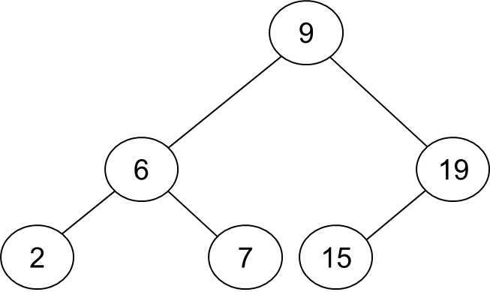
Example Best Case
"Somewhat" balanced

Slide 7
"Somewhat" Balanced Trees
AVL Tree
O(logn)
Red-Black Tree
O(logn)
B-Tree (Not Binary Tree)
O(logn)
Splay Tree
Single Operation could be O(N)
O(logn) overall

Slide 8
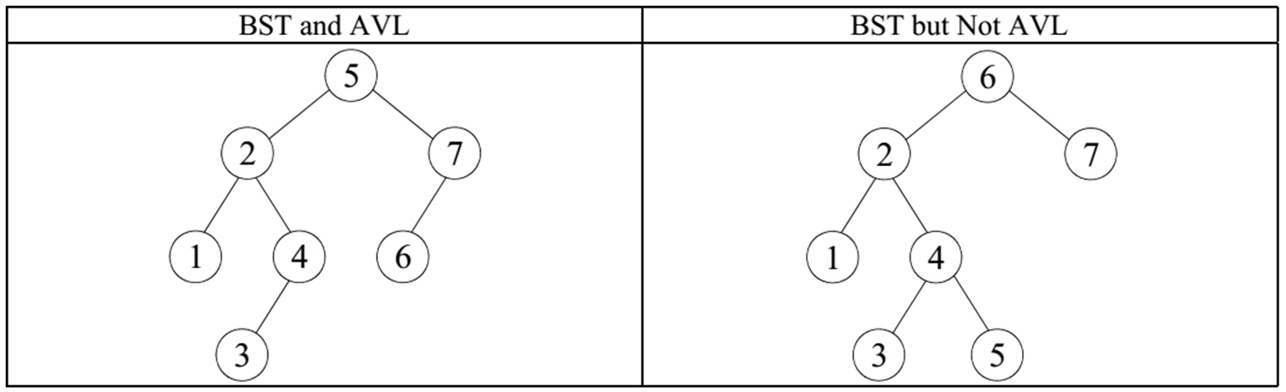
AVL Tree
For any node, the height difference between left and right-subtrees is at most 1.

Slide 9
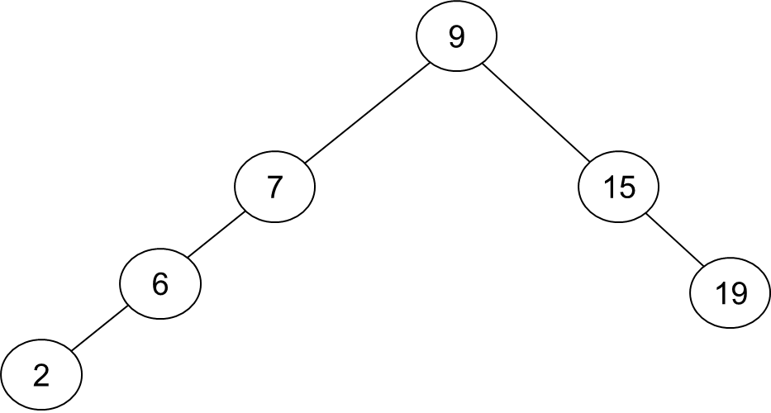
AVL Tree?
NO!
Not Balanced

Slide 10
Balance of a Tree
Balance(x) =
x->left->height – x->right-height
Balance(7) = 2 – 0 = 2

Slide 11
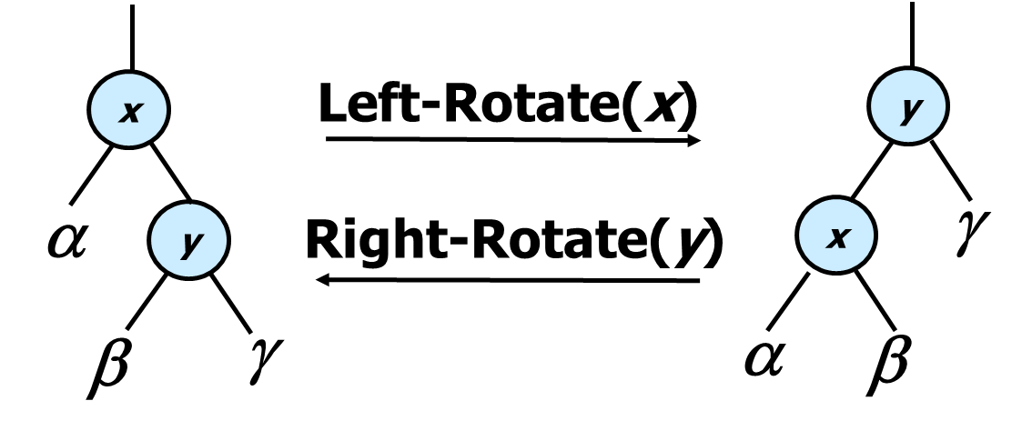
Balancing (aka Rotation)
Rotations are the basic tree-restructuring operation for almost all balanced search trees
Won’t violate the binary-search-tree property.
O(1)

Slide 12
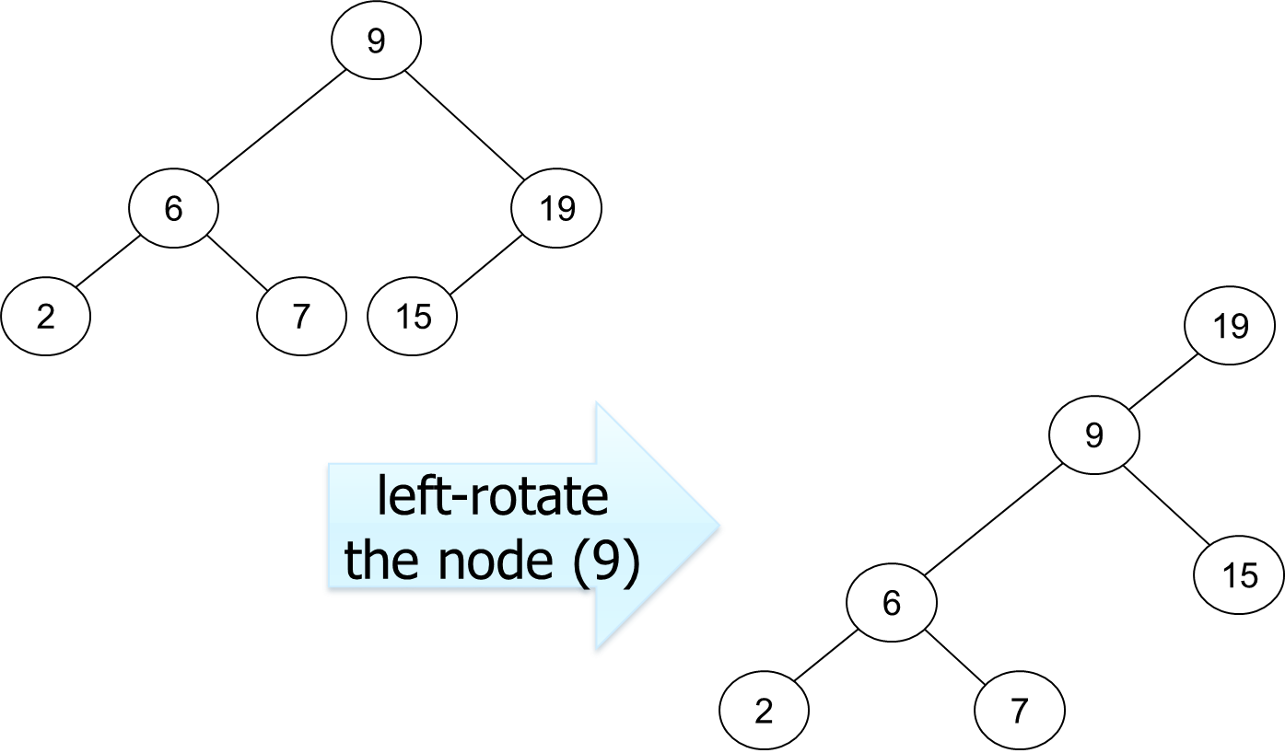
Rotation Example

Slide 13
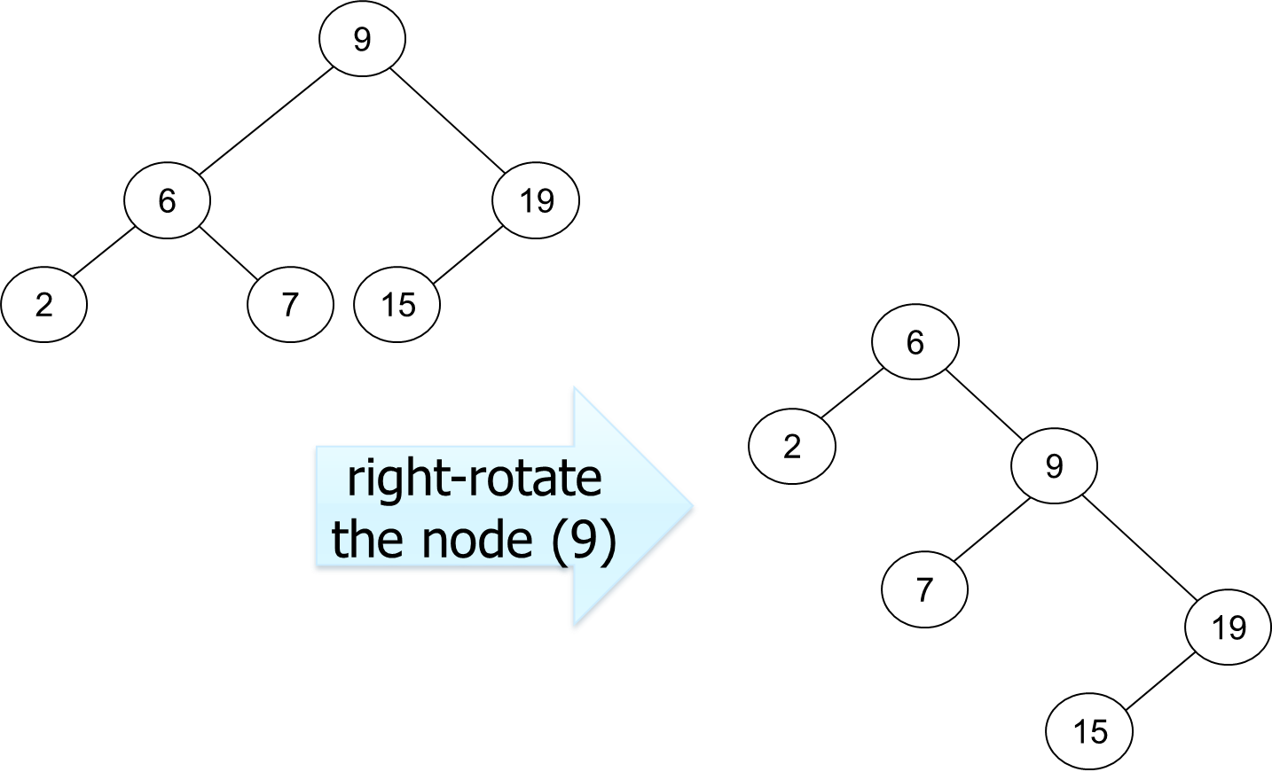
Rotation Example

Slide 14
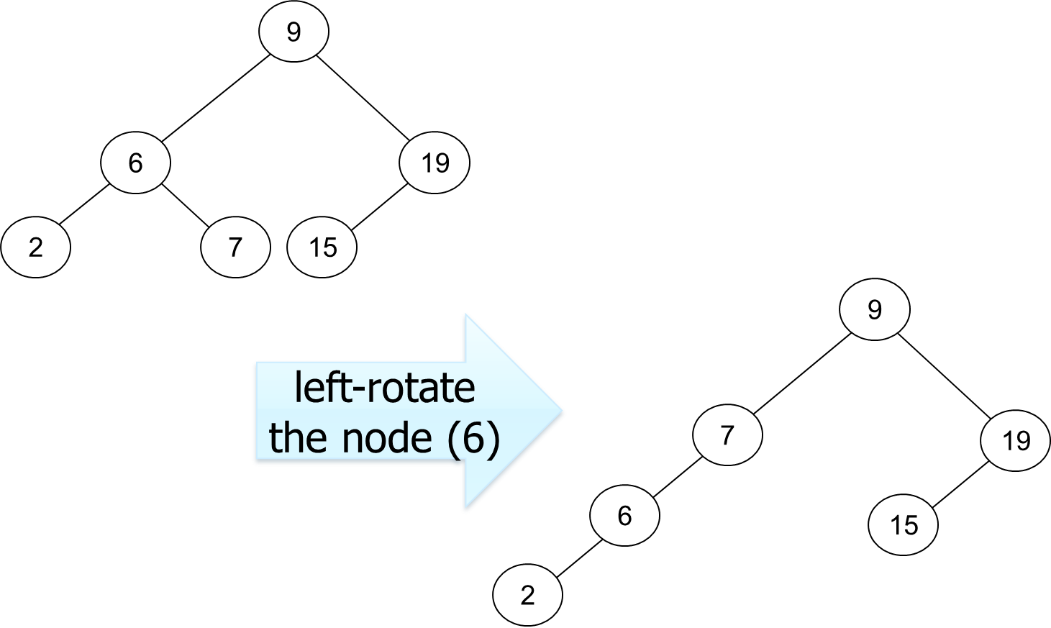
Rotation Example

Slide 15
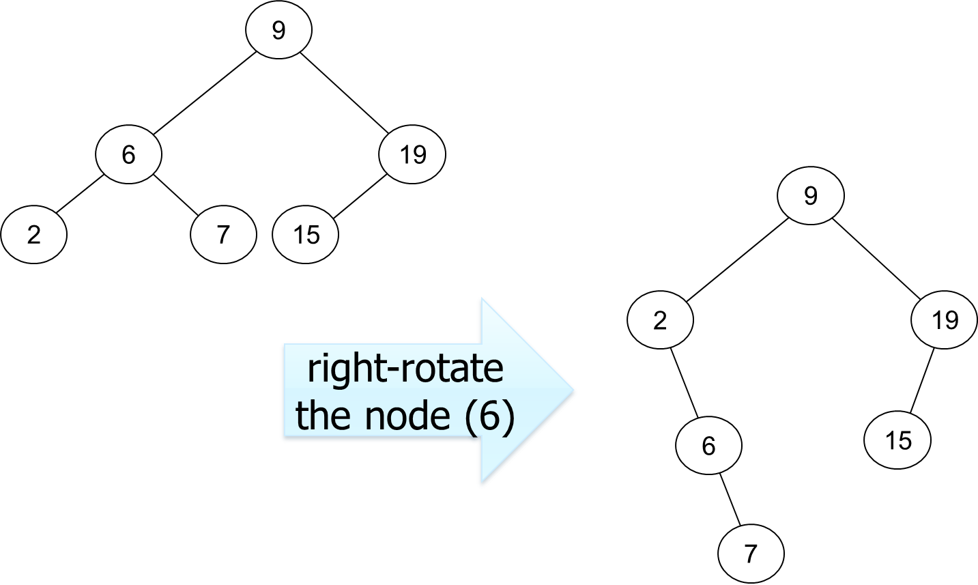
Rotation Example

Slide 16
Insertion in AVL Tree
Perform the normal BST insertion.
Starting from the new node, travel up and find the first unbalanced node.
Perform Appropriate rotation(s)

Slide 17
Insertion in AVL Tree
Insert 2 in this AVL tree
10
8
13
5

Slide 18
Insertion in AVL Tree
Insert 2 in this AVL tree
10
8
13
5
2

Slide 19
Insertion in AVL Tree
Node 8 is imbalanced
10
8
13
5
2

Slide 20
Insertion in AVL Tree
Right-Rotate(8)
10
5
13
2
8

Slide 21
Deletion in AVL Tree
Perform the normal BST deletion on the node.
Starting from that node, travel up and find the first unbalanced node.
Perform Appropriate rotation(s)

Slide 22
Deletion in AVL Tree
Delete 2
10
5
13
2
8
9

Slide 23
Deletion in AVL Tree
Delete 10
10
5
13
NULL
8
9

Slide 24
Deletion in AVL Tree
Left-Rotate(5)
10
8
13
5
9

Slide 25
Rotation Cases
Left-Left Case(Straight Line)
Right-Right Case (Straight Line)
Left-Right Case (Zig Zag)
Right-Left Case (Zag Zig)

Slide 26
(1)Left-Left Case
Right Rotate(8)
10
8
5

Slide 27
(1)Left-Left Case
Right Rotate(8)
8
5
10

Slide 28
(2)Right-Right Case
Left Rotate(8)
5
8
10

Slide 29
(2)Right-Right Case
Right Rotate(8)
8
5
10

Slide 30
(3)Left-Right Case
Left Rotate(5)
10
5
8

Slide 31
(3)Left-Right Case
Right Rotate(8)
10
8
5

Slide 32
(3)Left-Right Case
Right Rotate(8)
8
5
10

Slide 33
(4)Right-Left Case
Right Rotate(10)
5
10
8

Slide 34
(4)Right-Left Case
Left Rotate(8)
5
8
10

Slide 35
(4)Right-Left Case
Left Rotate(8)
8
5
10

Slide 36
AVL Tree Code
struct Node {
int key;
Node *left;
Node *right;
int height;
Node(int k) {
key = k;
left = nullptr;
right = nullptr;
height = 1;
}
}

Slide 37
Left-Rotate Code
Node *leftRotate(Node *x) {
Node *y = x->right;
Node *T2 = y->left;
y->left = x; /// ROTATION
x->right = T2; /// ROTATION
x->height = 1 + max(height(x->left), height(x->right)); /// UPDATE HEIGHT
y->height = 1 + max(height(y->left), height(y->right)); /// UPDATE HEIGHT
return y;
}

Slide 38
Right-Rotate Code
Node *rightRotate(Node *x) {
Node *x = y->left;
Node *T2 = x->right;
x-> right = y; /// ROTATION
y-> left = T2; /// ROTATION
y->height = 1 + max(height(y->left), height(y->right)); /// UPDATE HEIGHT
x->height = 1 + max(height(x->left), height(x->right)); /// UPDATE HEIGHT
return x;
}

Slide 39
Insertion Code
Node* insert(Node* node, int key) { if (node == nullptr) return new Node(key); if (key < node->key) node->left = insert(node->left, key); else if (key > node->key) node->right = insert(node->right, key); else return node; node->height = 1 + max(height(node->left), height(node->right)); int balance = getBalance(node);

Slide 40
Insertion Code
if (balance > 1 && key < node->left->key) /// Left-Left return rightRotate(node); if (balance < -1 && key > node->right->key) /// Right-Right return leftRotate(node);
if (balance > 1 && key > node->left->key) { /// Left-Right node->left = leftRotate(node->left); return rightRotate(node); } if (balance < -1 && key < node->right->key) { /// Right-Left node->right = rightRotate(node->right); return leftRotate(node); } return node; }

Slide 41
AVL Tree Summary
Search – O(logn)
Insertion – O(logn)
Deletion – O(logn)
Advantage: Always ensures O(logn)
Disadvantage: Difficult to implement

Slide 42
Today's Summary
AVL Tree

