Slide 1
CS 3358: Data Structures and Algorithms
Jishnu Banerjee

Slide 2
Last Class Summary
Templates
Asymptotic Notations
Runtime
Coding Example
Binary Search

Slide 3
Sorting
Sorting rearranges the elements into either ascending or descending order within the array
we’ll use ascending order

Slide 4
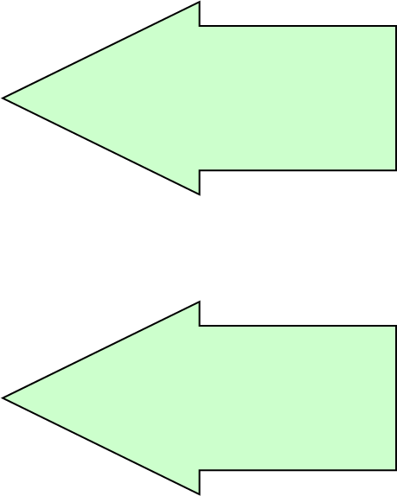
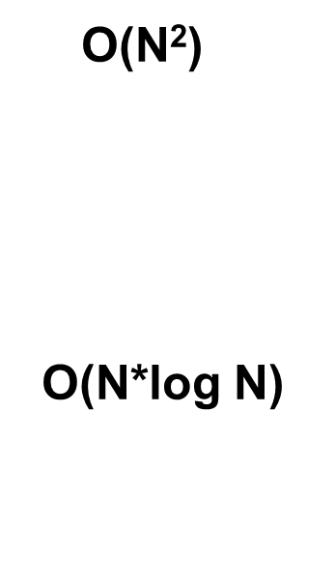
Sorting Algorithms
Simple Sorts
Bubble Sort
Selection Sort
Insertion Sort
More Complex Sorts
Merge Sort
Quick Sort
Heap Sort

Slide 5
Today's Topic
Quadratic Sorting

Slide 6
Bubble Sort
Index [0]
36
Compares each pair of adjacent items and swaps them if they are in the wrong order
The k^{th} pass will “bubble” the k^{th} largest element to its right position.
Index [1]
24
Index [2]
10
Index [3]
6
Index [4]
12

Slide 7
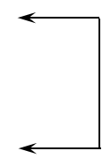
Bubble Sort
Index [0]
36
Index [1]
Swap?
24
Index [2]
10
Index [3]
6
Index [4]
12

Slide 8
Bubble Sort
Index [0]
24
Index [1]
36
Index [2]
Swap?
10
Index [3]
6
Index [4]
12

Slide 9
Bubble Sort
Index [0]
24
Index [1]
10
Index [2]
36
Swap?
Index [3]
6
Index [4]
12

Slide 10
Bubble Sort
Index [0]
24
Index [1]
10
Index [2]
6
Index [3]
36
Index [4]
Swap?
12

Slide 11
Bubble Sort
Index [0]
24
Index [1]
10
Index [2]
6
Index [3]
12
Index [4]
36

Slide 12
Bubble Sort
Index [0]
24
Index [1]
Swap?
10
Index [2]
6
Index [3]
12
Index [4]
36

Slide 13
Bubble Sort
Index [0]
10
Index [1]
24
Index [2]
Swap?
6
Index [3]
12
Index [4]
36

Slide 14
Bubble Sort
Index [0]
10
Index [1]
6
Index [2]
24
Index [3]
Swap?
12
Index [4]
36

Slide 15
Bubble Sort
Index [0]
10
Index [1]
6
Index [2]
12
Index [3]
24
Index [4]
36

Slide 16
Bubble Sort
Index [0]
10
Index [1]
Swap?
6
Index [2]
12
Index [3]
24
Index [4]
36

Slide 17
Bubble Sort
Index [0]
6
Index [1]
10
Index [2]
Swap?
12
Index [3]
24
Index [4]
36

Slide 18
Bubble Sort
Index [0]
6
Index [1]
10
Index [2]
12
Index [3]
24
Index [4]
36

Slide 19
Bubble Sort
Index [0]
6
Index [1]
Swap?
10
Index [2]
12
Index [3]
24
Index [4]
36

Slide 20
Bubble Sort
Index [0]
6
Index [1]
10
Index [2]
12
Index [3]
24
Index [4]
36

Slide 21
Bubble Sort
void bubbleSort(int arr[], int n) {
int i, j;
for (i = 0; i < n-1; i++)
for (j = 0; j < n-i-1; j++)
if (arr[j] > arr[j+1])
swap(&arr[j], &arr[j+1]);
}

Slide 22
Bubble Sort
void bubbleSort(int arr[], int n) {
int i, j;
bool swapped;
for (i = 0; i < n-1; i++) {
swapped = false;
for (j = 0; j < n-i-1; j++) {
if (arr[j] > arr[j+1]) {
swap(&arr[j], &arr[j+1]);
swapped = true;
}
}
// IF no two elements were swapped by inner loop, then break
if (swapped == false)
break;
}
}

Slide 23
Selection Sort
Index [0]
36
Divides the array into two parts: already sorted, and not yet sorted.
On each pass, finds the smallest of the unsorted elements, and swaps it into its correct place, thereby increasing the number of sorted elements by one.
Index [1]
24
Index [2]
10
Index [3]
6
Index [4]
12

Slide 24
Selection Sort
Index [0]
36
Index [1]
24
Index [2]
Swap
10
Unsorted
Index [3]
6
Index [4]
12

Slide 25
Selection Sort
Index [0]
Sorted
6
Index [1]
24
Index [2]
10
Index [3]
Unsorted
36
Index [4]
12

Slide 26
Selection Sort
Index [0]
Sorted
6
Index [1]
24
Index [2]
Swap
10
Index [3]
Unsorted
36
Index [4]
12

Slide 27
Selection Sort
Index [0]
6
Index [1]
Sorted
10
Index [2]
24
Index [3]
36
Unsorted
Index [4]
12

Slide 28
Selection Sort
Index [0]
6
Index [1]
Sorted
10
Index [2]
24
Index [3]
36
Swap
Unsorted
Index [4]
12

Slide 29
Selection Sort
Index [0]
6
Index [1]
10
Sorted
Index [2]
12
Index [3]
36
Index [4]
Unsorted
24

Slide 30
Selection Sort
Index [0]
6
Index [1]
10
Sorted
Index [2]
12
Index [3]
36
Index [4]
Swap
Unsorted
24

Slide 31
Selection Sort
Index [0]
6
Index [1]
10
Index [2]
12
Sorted
Index [3]
24
Index [4]
36

Slide 32
Selection Sort
Index [0]
4 compares for values[0]
3 compares for values[1]
2 compares for values[2]
1 compare for values[3]
-----------------------------------------
= 4 + 3 + 2 + 1
6
Index [1]
10
Index [2]
12
Index [3]
24
Index [4]
36

Slide 33
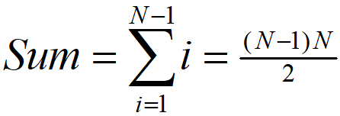

Selection Sort
The number of comparisons when the array contains N elements is
Sum = (N-1) + (N-2) + . . . + 2 + 1

Slide 34
Selection Sort
void selectionSort(int arr[], int n) {
int i, j, min_idx;
// One by one move boundary of unsorted subarray
for (i = 0; i < n-1; i++){
// Find the minimum element in unsorted array
min_idx = i;
for (j = i+1; j < n; j++)
if (arr[j] < arr[min_idx])
min_idx = j;
// Swap the found minimum element with the first element
swap(&arr[min_idx], &arr[i]);
}
}

Slide 35
Insertion Sort
Index [0]
36
One by one, each as yet unsorted array element is inserted into its proper place with respect to the already sorted elements.
On each pass, this causes the number of already sorted elements to increase by one.
Index [1]
24
Index [2]
10
Index [3]
6
Index [4]
12

Slide 36
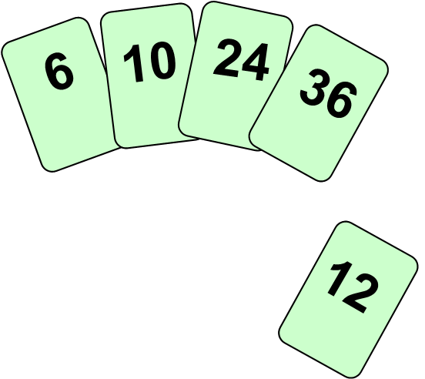
Insertion Sort
Works like someone who “inserts” one more card at a time into a hand of cards that are already sorted.
To insert 12, we need to make room for it by moving first 36 and then 24.

Slide 37
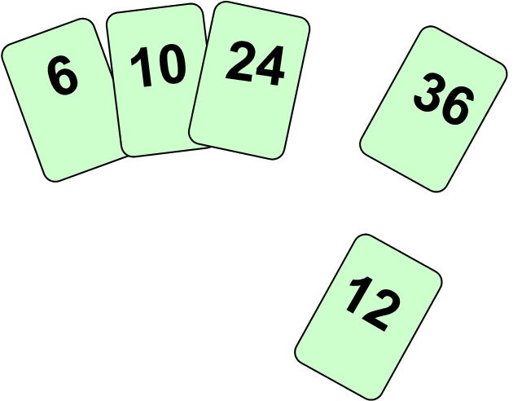
Insertion Sort
Works like someone who “inserts” one more card at a time into a hand of cards that are already sorted.
To insert 12, we need to make room for it by moving first 36 and then 24.

Slide 38
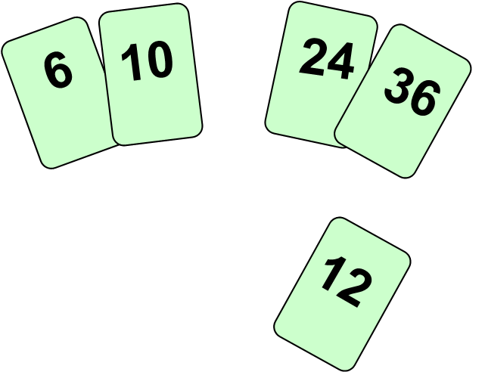
Insertion Sort
Works like someone who “inserts” one more card at a time into a hand of cards that are already sorted.
To insert 12, we need to make room for it by moving first 36 and then 24.

Slide 39
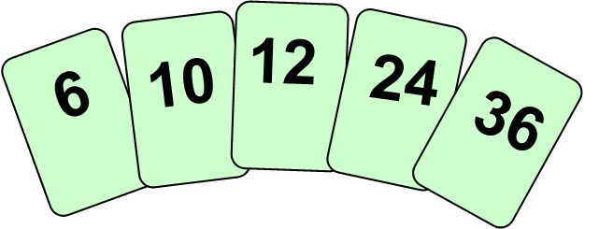
Insertion Sort
Works like someone who “inserts” one more card at a time into a hand of cards that are already sorted.
To insert 12, we need to make room for it by moving first 36 and then 24.

Slide 40
Insertion Sort
Index [0]
Sorted
36
Index [1]
24
Index [2]
10
Index [3]
Unsorted
6
Index [4]
12

Slide 41
Insertion Sort
Index [0]
Sorted
36
Index [1]
24
Index [2]
10
Index [3]
Unsorted
6
Index [4]
12

Slide 42
Insertion Sort
Index [0]
24
Index [1]
Sorted
36
Index [2]
10
Index [3]
6
Unsorted
Index [4]
12

Slide 43
Insertion Sort
Index [0]
24
Index [1]
Sorted
36
Index [2]
10
Index [3]
6
Unsorted
Index [4]
12

Slide 44
Insertion Sort
Index [0]
10
Index [1]
24
Sorted
Index [2]
36
Index [3]
6
Index [4]
Unsorted
12

Slide 45
Insertion Sort
Index [0]
10
Index [1]
24
Sorted
Index [2]
36
Index [3]
6
Index [4]
Unsorted
12

Slide 46
Insertion Sort
Index [0]
6
Index [1]
10
Index [2]
Sorted
24
Index [3]
36
Index [4]
12
Unsorted

Slide 47
Insertion Sort
Index [0]
6
Index [1]
10
Index [2]
Sorted
24
Index [3]
36
Index [4]
12
Unsorted

Slide 48
Insertion Sort
Index [0]
6
Index [1]
10
Index [2]
12
Sorted
Index [3]
24
Index [4]
36

Slide 49
Insertion Sort
void insertionSort(int arr[], int n) {
int i, key, j;
for (i = 1; i < n; i++) {
key = arr[i];
j = i-1;
/* Move elements of arr[0..i-1], that are
greater than key, to one position ahead
of their current position */
while (j >= 0 && arr[j] > key) {
arr[j+1] = arr[j];
j = j-1;
}
arr[j+1] = key;
}
}

Slide 50
Time Complexity
Algorithms | Best Case | Average Case | Worst Case
Bubble Sort | O(n) /* O(n²) for the simplest version */ | O(n²) | O(n²)
Selection Sort | O(n²) | O(n²) | O(n²)
Insertion Sort | O(n) | O(n²) | O(n²)

Slide 51
Today's Summary
Bubble Sort
Selection Sort
Insertion Sort

