Slide 1
CS 3358: Data Structures and Algorithms
Jishnu Banerjee

Slide 2
Last Class Summary
Bubble Sort
Selection Sort
Insertion Sort

Slide 3
First Midterm on 27th Feb
List of topics -
Introduction
List, Stack, Queue
Templates
Asymptotic Notations
All Sorting Algorithms

Slide 4
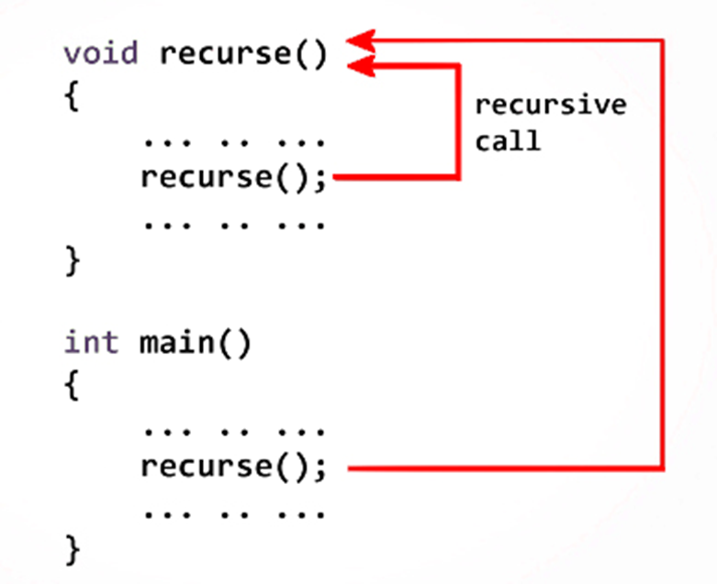
What is Recursion?
Recursion is a technique where a procedure invokes itself
In computer Science, the procedure of calling a function from inside the very same function is called recursion

Slide 5
Recursion Example
"To understand recursion,
you must understand recursion."

Slide 6
Subproblems
Sometimes, the best way to solve a problem is by solving a smaller version of the exact same problem first
Recursion is a technique that solves a problem by solving a smaller problem (or subproblem) of the same type

Slide 7
Mathematical Induction
Some statement is -
Base Case:
True for F(0), F(1), etc.
Inductive Step:
if it's true for F(n), then it's true for F(n+1)

Slide 8
Sum of Numbers from 1 to n
int sum = 0;
for(int i=1; i<=n; i++)
{
sum += i;
}
printf("The sum is: %d\n", sum);

Slide 9
Sum of Numbers from 1 to n
Recursive Definition: sum(n) = n + sum(n-1)
int sum(int n)
{
return n + sum(n-1);
}

Slide 10
Sum of Numbers from 1 to n
Recursive Definition: sum(n) = n + sum(n-1)
int sum(int n)
{
if(n==0) return 0;
return n + sum(n-1);
}

Slide 11
Example: n=4
Recursive Definition: sum(n) = n + sum(n-1)
When n=4; sum(4) = 4 + sum(3)
When n=3; sum(3) = 3 + sum(2)
When n=2; sum(2) = 2 + sum(1)
When n=1; sum(1) = 1 + sum(0)
When n=0; return 0

Slide 12
Example: n=4
Recursive Definition: sum(n) = n + sum(n-1)
When n=4; sum(4) = 4 + sum(3)
When n=3; sum(3) = 3 + sum(2)
When n=2; sum(2) = 2 + sum(1)
When n=1; sum(1) = 1 + 0

Slide 13
Example: n=4
Recursive Definition: sum(n) = n + sum(n-1)
When n=4; sum(4) = 4 + sum(3)
When n=3; sum(3) = 3 + sum(2)
When n=2; sum(2) = 2 + sum(1)
When n=1; sum(1) = 1

Slide 14
Example: n=4
Recursive Definition: sum(n) = n + sum(n-1)
When n=4; sum(4) = 4 + sum(3)
When n=3; sum(3) = 3 + sum(2)
When n=2; sum(2) = 2 + 1

Slide 15
Example: n=4
Recursive Definition: sum(n) = n + sum(n-1)
When n=4; sum(4) = 4 + sum(3)
When n=3; sum(3) = 3 + sum(2)
When n=2; sum(2) = 3

Slide 16
Example: n=4
Recursive Definition: sum(n) = n + sum(n-1)
When n=4; sum(4) = 4 + sum(3)
When n=3; sum(3) = 3 + 3

Slide 17
Example: n=4
Recursive Definition: sum(n) = n + sum(n-1)
When n=4; sum(4) = 4 + sum(3)
When n=3; sum(3) = 6

Slide 18
Example: n=4
Recursive Definition: sum(n) = n + sum(n-1)
When n=4; sum(4) = 4 + 6

Slide 19
Example: n=4
Recursive Definition: sum(n) = n + sum(n-1)
When n=4; sum(4) = 10

Slide 20
Follow Up: n!
Recursive Definition: fact(n) = n * fact(n-1)
int fact(int n)
{
if(n==0) return 1;
return n * fact(n-1);
}

Slide 21
Divide and Conquer
divide-and-conquer algorithm: A way to solve a problem that first separates the main problem into smaller sub-problems, then solves each of the sub-problems, then uses those sub-solutions to solve the original problem.
1: "divide" the problem up into pieces
2: "conquer" each smaller piece
3: (if necessary) combine the pieces at the end to produce the overall solution

Slide 22
Divide and Conquer
Recursive Definition: fact(n) = n * fact(n-1)
Recursive Definition: fact(n-1) = (n-1) * fact(n-2)
Recursive Definition: fact(n-2) = (n-2) * fact(n-3)
… … …
… … …
… … …
Recursive Definition: fact(1) = 1 * fact(0)

Slide 23
Binary Search
binary search array a for value i:
if all elements have been searched,
result is -1.
examine middle element a[mid].
if a[mid] equals i,
result is mid.
if a[mid] is greater than i,
binary search left half of a for i.
if a[mid] is less than i,
binary search right half of a for i.

Slide 24
Iterative Binary Search
int binSearch(double data[], int len, double x) {
int lo = 0, hi = len-1;
int mid;
while (lo <= hi) {
mid = (lo + hi) / 2;
if (data[mid] == x)
return mid;
else if (data[mid] > x)
hi = mid – 1;
else
lo = mid + 1;
}
return -1;
}

Slide 25
Recursive Binary Search
What is the size factor?
The number of elements in (info[1st] ... info[last])
What is the base case(s)?
if first > last, return -1
if item==info[midPoint], return midPoint
What is the general case?
if item < info[midPoint] search the 1st half
if item > info[midPoint], search the 2nd half

Slide 26
Recursive Binary Search
int binSearchRecursive(double data[], double x, int lo, int hi) {
if (lo > hi)
return -1;
else {
int mid = (lo + hi) / 2;
if (data[mid] == x)
return mid;
else if (data[mid] > x)
return binSearchRecursive(data, x, lo, mid - 1);
else
return binSearchRecursive(data, x, mid + 1, hi);
}
}
int binSearch(double data[], int len, double x) {
return binSearchRecursive(data, x, 0, len - 1);
}

Slide 27
A Classic Recursion Problem
Fibonacci Sequence
0, 1, 1, 2, 3, 5, 8, 13, 21, 34 ….....
Given the first 2 terms, can you write a recursive solution to determine the n-th term of a Fibonacci sequence?
Recursive Definition:
if n=0, fibo(n) = 0
if n=1, fibo(n) = 1
else: fibo(n) = fibo(n-1) + fibo(n-2)

Slide 28
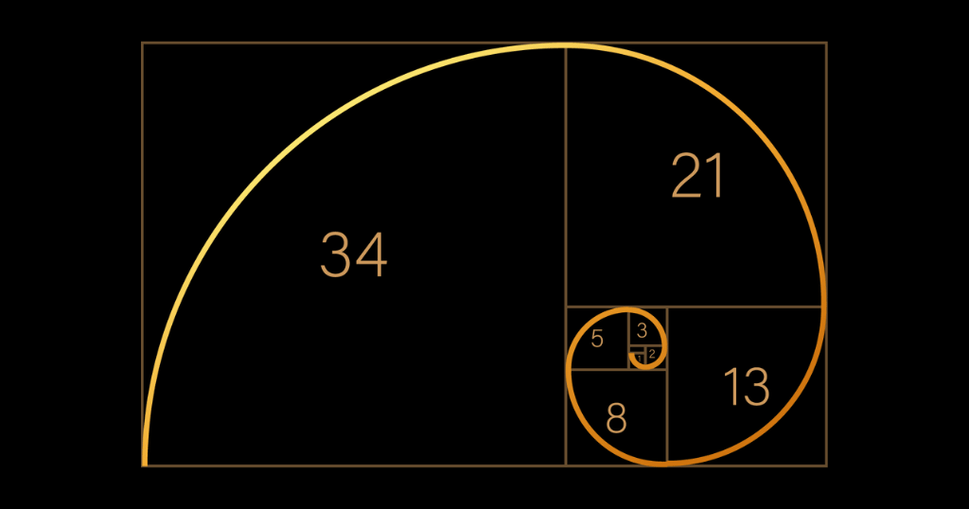
Fibonacci in Real Life
Golden
Ratio
1.61

Slide 29
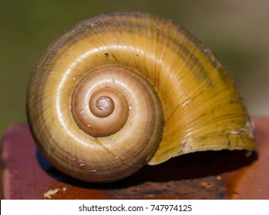
Fibonacci in Real Life
Golden
Ratio
1.61

Slide 30
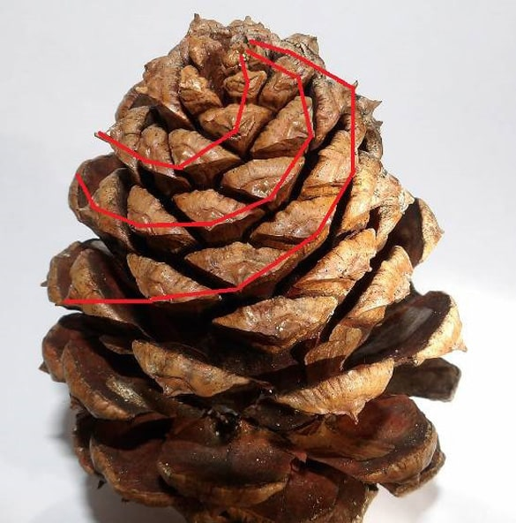
Fibonacci in Real Life
Golden
Ratio
1.61

Slide 31
Fibonacci Sequence
Recursive Definition:
if n=0, fibo(n) = 0
if n=1, fibo(n) = 1
else: fibo(n) = fibo(n-1) + fibo(n-2)
int fibo(int n)
{
if(n==0) return 0;
if(n==1) return 1;
return fibo(n-1) + fibo(n-2);
}

Slide 32
Fibonacci Sequence
Recursive Definition:
if n=0, fibo(n) = 0
if n=1, fibo(n) = 1
else: fibo(n) = fibo(n-1) + fibo(n-2)
Fibo(4)
Fibo(3)
Fibo(2)
+
Fibo(2)
+
Fibo(1)
Fibo(1)
Fibo(0)
+
Fibo(1)
+
Fibo(0)

Slide 33
Fibonacci Sequence
Recursive Definition:
if n=0, fibo(n) = 0
if n=1, fibo(n) = 1
else: fibo(n) = fibo(n-1) + fibo(n-2)
Fibo(4)
Fibo(3)
Fibo(2)
+
Fibo(2)
+
Fibo(1)
Fibo(1)
Fibo(0)
+
1
+
Fibo(0)

Slide 34
Fibonacci Sequence
Recursive Definition:
if n=0, fibo(n) = 0
if n=1, fibo(n) = 1
else: fibo(n) = fibo(n-1) + fibo(n-2)
Fibo(4)
Fibo(3)
Fibo(2)
+
Fibo(2)
+
Fibo(1)
Fibo(1)
Fibo(0)
+
1
+
0

Slide 35
Fibonacci Sequence
Recursive Definition:
if n=0, fibo(n) = 0
if n=1, fibo(n) = 1
else: fibo(n) = fibo(n-1) + fibo(n-2)
Fibo(4)
Fibo(3)
Fibo(2)
+
1
+
Fibo(1)
Fibo(1)
Fibo(0)
+
1
+
0

Slide 36
Fibonacci Sequence
Recursive Definition:
if n=0, fibo(n) = 0
if n=1, fibo(n) = 1
else: fibo(n) = fibo(n-1) + fibo(n-2)
Fibo(4)
Fibo(3)
Fibo(2)
+
1
+
Fibo(1)
Fibo(1)
Fibo(0)
+

Slide 37
Fibonacci Sequence
Recursive Definition:
if n=0, fibo(n) = 0
if n=1, fibo(n) = 1
else: fibo(n) = fibo(n-1) + fibo(n-2)
Fibo(4)
Fibo(3)
Fibo(2)
+
1
+
1
Fibo(1)
Fibo(0)
+

Slide 38
Fibonacci Sequence
Recursive Definition:
if n=0, fibo(n) = 0
if n=1, fibo(n) = 1
else: fibo(n) = fibo(n-1) + fibo(n-2)
Fibo(4)
2
Fibo(2)
+
1
+
1
Fibo(1)
Fibo(0)
+

Slide 39
Fibonacci Sequence
Recursive Definition:
if n=0, fibo(n) = 0
if n=1, fibo(n) = 1
else: fibo(n) = fibo(n-1) + fibo(n-2)
Fibo(4)
2
Fibo(2)
+
Fibo(1)
+
Fibo(0)

Slide 40
Fibonacci Sequence
Recursive Definition:
if n=0, fibo(n) = 0
if n=1, fibo(n) = 1
else: fibo(n) = fibo(n-1) + fibo(n-2)
Fibo(4)
2
Fibo(2)
+
1
+
Fibo(0)

Slide 41
Fibonacci Sequence
Recursive Definition:
if n=0, fibo(n) = 0
if n=1, fibo(n) = 1
else: fibo(n) = fibo(n-1) + fibo(n-2)
Fibo(4)
2
Fibo(2)
+
1
+
0

Slide 42
Fibonacci Sequence
Recursive Definition:
if n=0, fibo(n) = 0
if n=1, fibo(n) = 1
else: fibo(n) = fibo(n-1) + fibo(n-2)
Fibo(4)
2
1
+
1
+
0

Slide 43
Fibonacci Sequence
Recursive Definition:
if n=0, fibo(n) = 0
if n=1, fibo(n) = 1
else: fibo(n) = fibo(n-1) + fibo(n-2)
Fibo(4)
2
1
+

Slide 44
Fibonacci Sequence
Recursive Definition:
if n=0, fibo(n) = 0
if n=1, fibo(n) = 1
else: fibo(n) = fibo(n-1) + fibo(n-2)
3
2
1
+

Slide 45
Fibonacci Sequence
Recursive Definition:
if n=0, fibo(n) = 0
if n=1, fibo(n) = 1
else: fibo(n) = fibo(n-1) + fibo(n-2)
3
Therefore, Fibo(4) = 3

Slide 46
Recursion can perform badly!
Fibo(4)
Fibo(3)
Fibo(2)
+
Fibo(2)
+
Fibo(1)
Fibo(1)
Fibo(0)
+
Fibo(1)
+
Fibo(0)

Slide 47
Recursion can perform badly!
Fibo(4)
Fibo(3)
Fibo(2)
+
Fibo(2)
+
Fibo(1)
Fibo(1)
Fibo(0)
+
Fibo(1)
+
Fibo(0)

Slide 48
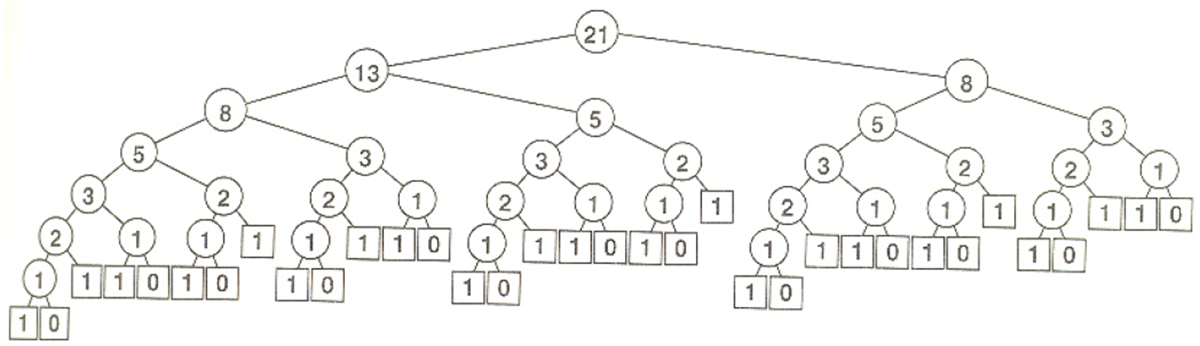
Recursion can perform badly!

Slide 49
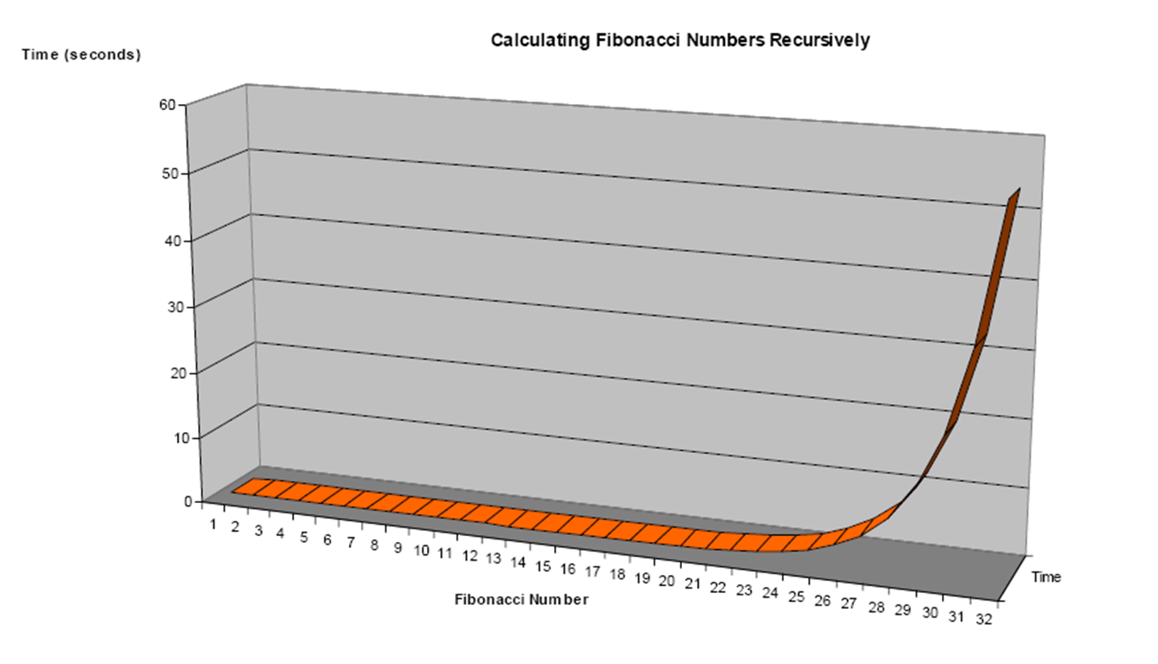
Recursion can perform badly!

Slide 50
Dynamic Programming
dynamic programming: saving results of sub-problems so that they do not need to be recomputed, and can be used in solving other sub-problems
example: saving results from sub-calls in a list or table
can dramatically speed up the number of calls for a recursive function with overlapping sub-problems

Slide 51
Dynamic Programming: Fibo
int res[50];
memset(res, -1, 50*sizeof(int));
int fibo(int n)
{
if(res[n] != -1) return res[n];
if(n==0) return 0;
if(n==1) return 1;
res[n] = fibo(n-1) + fibo(n-2);
return res[n];
}

Slide 52
Towers of Hanoi

Slide 53
Today's Summary
Recursion

