Slide 1
CS 3358: Data Structures and Algorithms
Jishnu Banerjee

Slide 2
Office Hour
COMAL 207J
Office Days: Tues & Thu
Office Hours: 11:00 AM – 12:00 PM
Jishnu.banerjee@txstate.edu
Email format: [CS 3358] "A few words"

Slide 3
Lists
Regular Lists
Linked Lists
Basic operations of Linked Lists
Inset, Delete, Find
Variations of Linked Lists
Circular Linked Lists
Doubly Linked Lists

Slide 4
List Definition
A sequence of zero or more elements
A₀, A₁, A₂, … A_{N-1}
N: length of the list
A₀: first element
A_{N-1}: last element
A_{i}: the (i+1)th element (with index i, or, at position i)
Linearly ordered

Slide 5
List Operations
PrintList() : print the list
MakeEmpty() : create an empty list
Find(n) : locate the position of n in a list
list: 34, 12, 52, 16, 12
find(52) -> A₂
Insert(n, k) : insert n to the k-th position of the list
insert(100, A₃) -> 34, 12, 52, 100, 16, 12
Remove(k) : delete the k-th element from the list
remove(A₂) -> 34, 12, 100, 16, 12
FindKth(k) : Find the element at k-th position
FindKth(2) -> 12

Slide 6
List Implementations
There are two standard implementations for Lists
Array based
Linked-List based

Slide 7
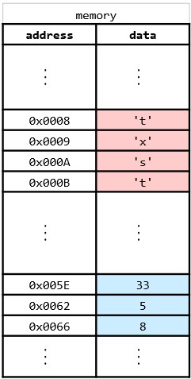
Array Implementation
Elements are stored in contiguous array positions
char a1[4] = {'t', 'x', 's', 't'};
int a2[3] = {33, 5, 8};

Slide 8
Array Implementation
Requires an estimate of the maximum size of the list
may waste space
printList and find: O(n)
findKth: O(1)
insert and delete: O(n)

Slide 9
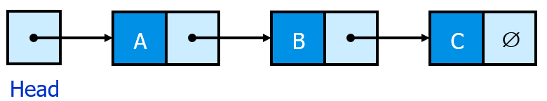
Linked List Implementation
A linked list is a series of connected nodes
Each node contains at least
A piece of data (any type)
Pointer to the next node in the list
Head: pointer to the first node
The last node points to NULL

Slide 10
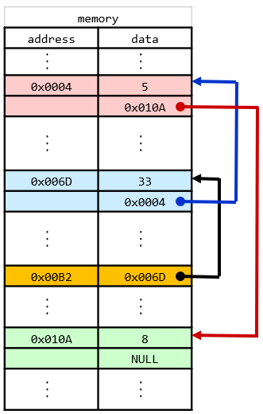
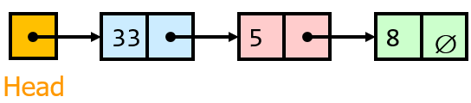
Linked List Implementation
struct Node {
int value;
Node* next;
};

Slide 11
Linked List Implementation
Requires no estimate of the maximum size of the list
no wasted space
printList and find: O(n)
findKth: O(k)
insert and delete: O(1)

Slide 12
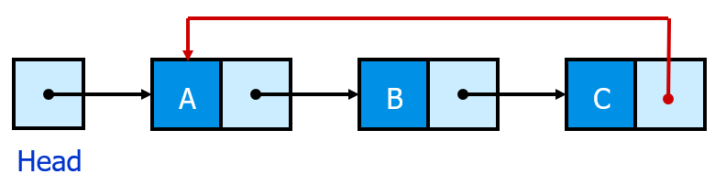
Circular Linked List
The last node points to the first node of the list.
How do we know when we have finished traversing the list?

Slide 13
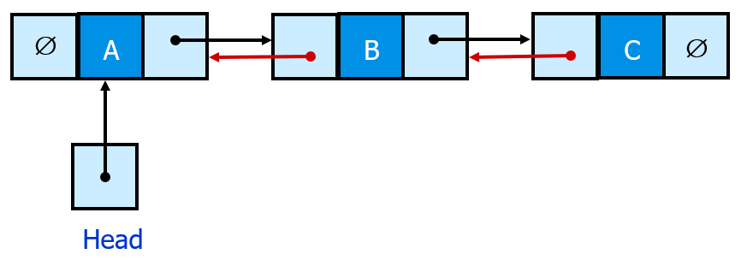
Doubly Linked List
Each node points to not only successor but the predecessor
There are two NULL: at the first and last nodes in the list
Advantages:
Given a node, it is easy to visit its predecessor
Convenient to traverse lists backwards

Slide 14
Array vs Linked List
Linked lists are more complex to code and manage than arrays, but they have some distinct advantages.
Dynamic: a linked list can easily grow and shrink in size.
We don’t need to know how many nodes will be in the list. They are created in memory as needed
In contrast, the size of a C++ array is fixed at compilation time.
Easy and fast insertions and deletions, when a reference to the position of inserting/deleting is given
To insert or delete an element in an array, we need to copy to temporary variables to make room for new elements or close the gap caused by deleted elements.
With a linked list, no need to move other nodes. Only need to reset some pointers.

Slide 15
Array vs Linked List
Memory space consumption
A linked list uses only as much space as is needed for the elements currently on the list
but it requires extra space for the pointers in each cell

Slide 16

Stack
Ordered group of homogeneous items of elements
Elements are added to and removed from the top of the stack (the most recently added items are at the top of the stack).
LIFO: Last In, First Out

Slide 17
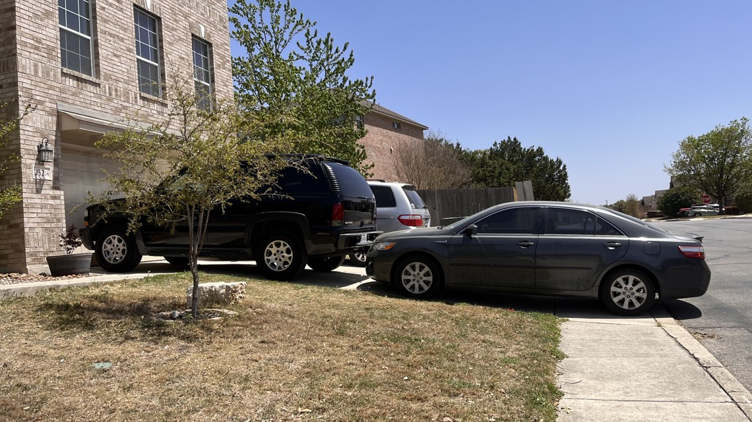
Stack

Slide 18
Stack Operations
Push() : Inserts an element at the top of the stack
Pop() : Removes an element from the top of the stack
Top() : Simply returns the element from the top of the stack, doesn't remove.
Size() : Returns the number of elements in the stack
Empty() : Returns true is the stack is empty, false otherwise.

Slide 19
Visualizing Stack Operations
Function: size()
Return: 0

Slide 20
Visualizing Stack Operations
Function: empty()
Return: true

Slide 21
Visualizing Stack Operations
Function: push(8)
8
Return: void

Slide 22
Visualizing Stack Operations
Function: push(3)
8
3
Return: void

Slide 23
Visualizing Stack Operations
Function: push(4)
8
3
4
Return: void

Slide 24
Visualizing Stack Operations
Function: size()
8
3
4
Return: 3

Slide 25
Visualizing Stack Operations
Function: empty()
8
3
4
Return: false

Slide 26
Visualizing Stack Operations
Function: top()
8
3
4
Return: 4

Slide 27
Visualizing Stack Operations
Function: pop()
8
3
Return: 4

Slide 28
Visualizing Stack Operations
Function: push(2)
8
3
2
Return: void

Slide 29
Today's Summary
List
Linked List
Linked List Operations
Different List Implementations
Merits and Demerits
Stack
Stack Operations
Stack Visualizations

Slide 30
Next Class
Stack Implementation
Queue

