Slide 1
CS 3358: Data Structures and Algorithms
Jishnu Banerjee

Slide 2
Last Class Summary
List
Linked List
Linked List Operations
Stack
Stack Operations

Slide 3
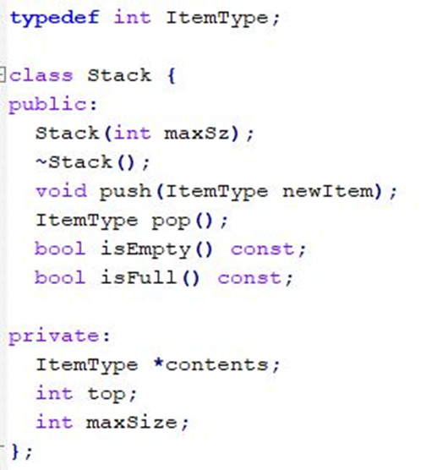
Implement Stack with Array
To record the top index

Slide 4
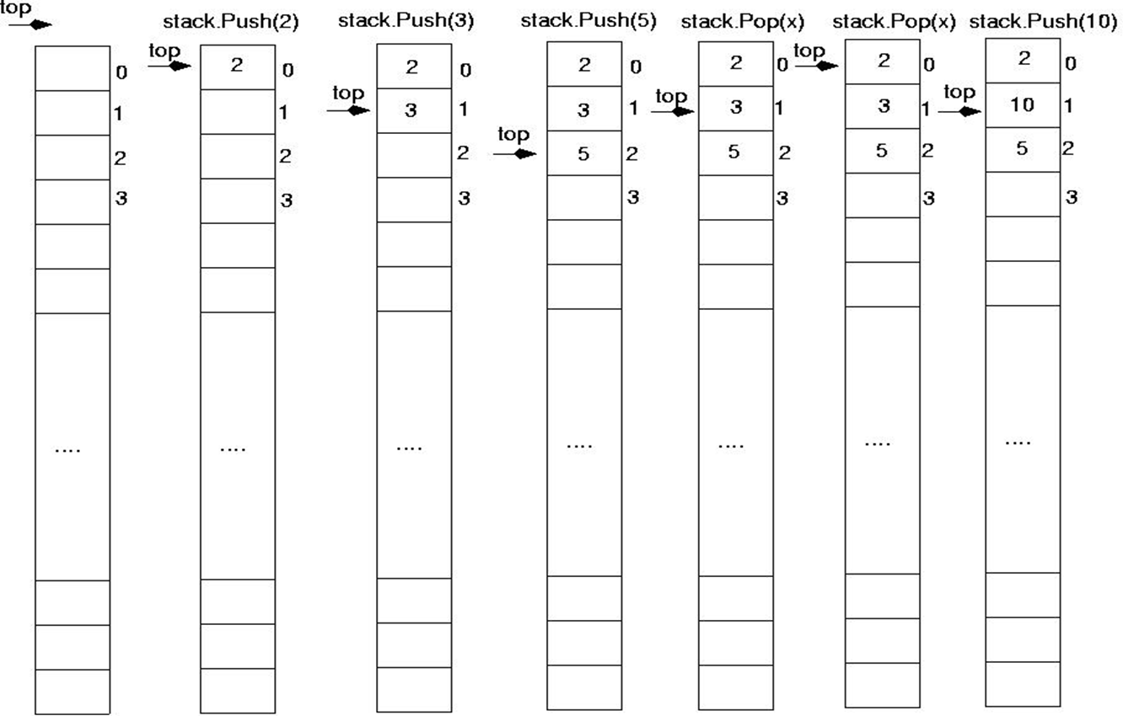
Implement Stack with Array

Slide 5
Implement Stack with Array

Slide 6
Implement Stack with Array

Slide 7
Implement Stack with Array

Slide 8
Implement Stack with Array

Slide 9
Implement Stack with Array

Slide 10
Implement Stack with Array

Slide 11
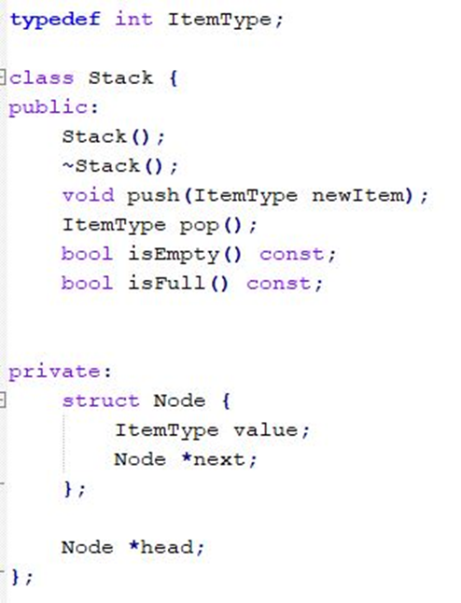
Implement Stack with Linked List
To record the top of the Stack

Slide 12
Overflow and underflow
Overflow: Trying to push in a full stack
if(!stack.isFull())
stack.push(item);
Underflow: Trying to pop an empty stack
if(!stack.isEmpty())
stack.pop();

Slide 13
Implement Stack with STL
#include <stack>
stack <data_type> S;
S.push();
S.pop();
S.top();
S.empty();
S.size()

Slide 14
Example: Convert into Binary
int n = 35;
while (n > 0) {
a = n % 2;
n = n / 2;
S.push(a);
}
while (!S.empty()) {
cout << S.pop();
}

Slide 15
Example: Postfix Expression
In postfix notation, the operator is written after the two operands.
infix: 2 + 5 postfix: 2 5 +
infix: 8 − 3 postfix: 8 3 −
Expressions are evaluated from left to right.

Slide 16
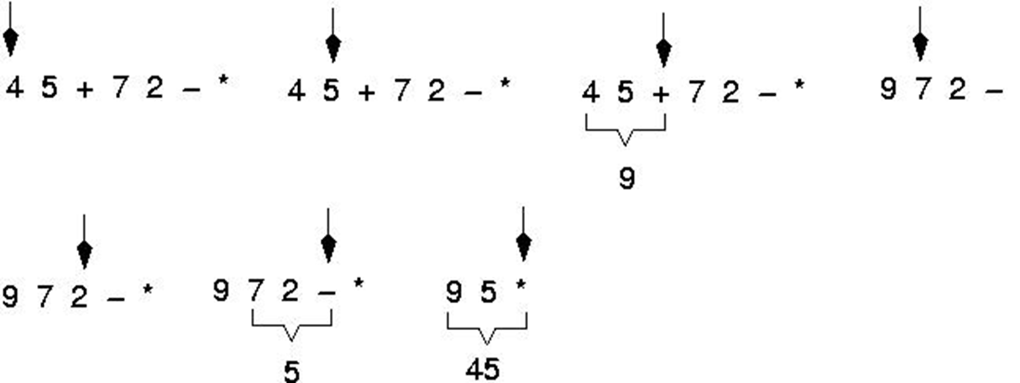
Example: Postfix Expression

Slide 17
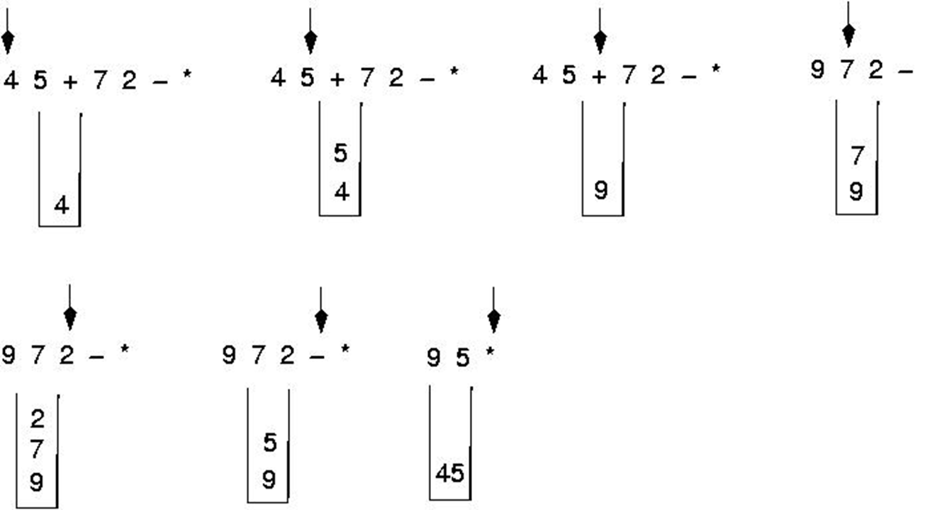
Example: Postfix Expression

Slide 18
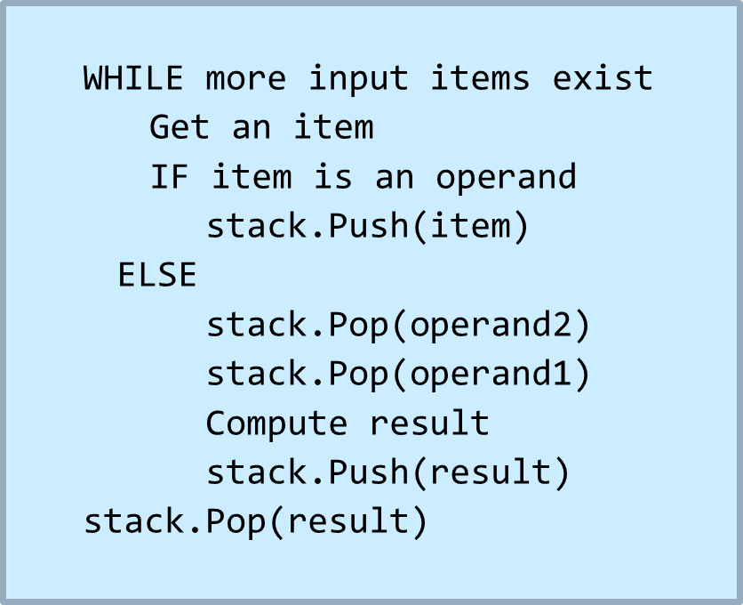
Example: Postfix Algorithm

Slide 19
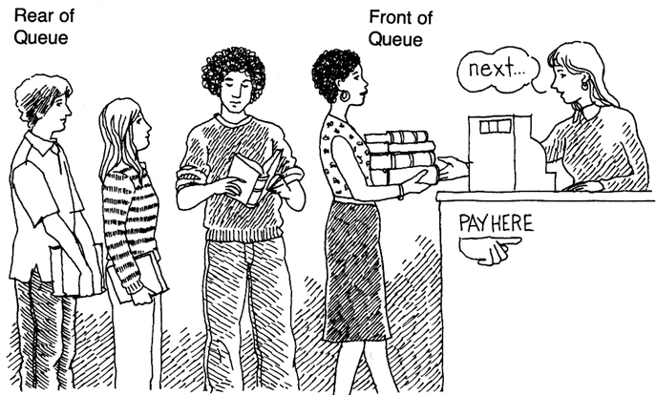
Queue
Ordered group of items or elements.
Queues have two ends.
Elements are added at one end.
Elements are removed from the other end.
The element added first is also removed first
(FIFO: First In, First Out).

Slide 20
Queue Operations
Enqueue(n): Insert element n at the rear of the queue
Dequeue(): Remove element at the front of the queue
Front(): Return, but do not remove, the front element in the queue
Size(): Return the number of elements in the queue
Empty(): Return true if the queue is empty and false otherwise

Slide 21
Visualizing Queue Operations
front
back
Function: size()
Return: 0

Slide 22
Visualizing Queue Operations
front
back
Function: empty()
Return: true

Slide 23
Visualizing Queue Operations
front
back
Function: enqueue(1)
1
Return: void

Slide 24
Visualizing Queue Operations
front
back
Function: enqueue(4)
1
4
Return: void

Slide 25
Visualizing Queue Operations
front
back
Function: enqueue(6)
1
4
6
Return: void

Slide 26
Visualizing Queue Operations
front
back
Function: front()
1
4
6
Return: 1

Slide 27
Visualizing Queue Operations
front
back
Function: dequeue()
4
6
Return: 1
1

Slide 28
Visualizing Queue Operations
front
back
Function: dequeue()
6
Return: 4
4

Slide 29
Visualizing Queue Operations
front
back
Function: enqueue(9)
6
9
Return: void

Slide 30
Visualizing Queue Operations
front
back
Function: front()
6
9
Return: 6

Slide 31
Visualizing Queue Operations
front
back
Function: size()
6
9
Return: 2

Slide 32
Visualizing Queue Operations
front
back
Function: empty()
6
9
Return: false

Slide 33
Implement Queue with Array
This queue contains the integers 4 (at the front), 8 and 6 (at the rear).
Also keeps track of the first index, the last index and size.
front_idx | rear_idx | size
0 | 2 | 3
Index | [0] | [1] | [2] | [3] | [4] | [5] | …
Value | 4 | 8 | 6 |  |  |  | …

Slide 34
Dequeue with Array
Changing the front index
Changing the size
front_idx | rear_idx | size
1 | 2 | 2
Index | [0] | [1] | [2] | [3] | [4] | [5] | …
Value | 4 | 8 | 6 |  |  |  | …

Slide 35
Enqueue with Array
This queue contains the integers 4 (at the front), 8 and 6 (at the rear).
Also keeps track of the first index, the last index and size.
front_idx | rear_idx | size
1 | 3 | 3
Index | [0] | [1] | [2] | [3] | [4] | [5] | …
Value | 4 | 8 | 6 | 2 |  |  | …

Slide 36
Reaching the End
The new element goes at the front of the array
i:e: Circular
front_idx | rear_idx | size
3 | 0 | 4
[0] | [1] | [2] | [3] | [4] | [5]
7 | 8 | 6 | 2 | 6 | 1

Slide 37
Reaching the End
The new element goes at the front of the array
i:e: Circular
Do we need to keep the size?
front_idx | rear_idx | size
3 | 0 | 4
[0] | [1] | [2] | [3] | [4] | [5]
7 | 8 | 6 | 2 | 6 | 1

Slide 38
Reaching the End
Enqueue(11)
front_idx | rear_idx | size
3 | 1 | 5
[0] | [1] | [2] | [3] | [4] | [5]
7 | 11 | 6 | 2 | 6 | 1

Slide 39
Reaching the End
Enqueue(58)
front_idx | rear_idx | size
3 | 2 | 6
[0] | [1] | [2] | [3] | [4] | [5]
7 | 11 | 58 | 2 | 6 | 1

Slide 40
Reaching the End
Dequeue()
front_idx | rear_idx | size
4 | 2 | 5
[0] | [1] | [2] | [3] | [4] | [5]
7 | 11 | 58 | 2 | 6 | 1

Slide 41
Reaching the End
Dequeue()
front_idx | rear_idx | size
5 | 2 | 4
[0] | [1] | [2] | [3] | [4] | [5]
7 | 11 | 58 | 2 | 6 | 1

Slide 42
Reaching the End
Dequeue()
front_idx | rear_idx | size
0 | 2 | 3
[0] | [1] | [2] | [3] | [4] | [5]
7 | 11 | 58 | 2 | 6 | 1

Slide 43
Reaching the End
Dequeue()
front_idx | rear_idx | size
1 | 2 | 2
[0] | [1] | [2] | [3] | [4] | [5]
7 | 11 | 58 | 2 | 6 | 1

Slide 44
Reaching the End
Dequeue()
front_idx | rear_idx | size
2 | 2 | 1
[0] | [1] | [2] | [3] | [4] | [5]
7 | 11 | 58 | 2 | 6 | 1

Slide 45
Reaching the End
Dequeue()
front_idx | rear_idx | size
3 | 2 | 0
[0] | [1] | [2] | [3] | [4] | [5]
7 | 11 | 58 | 2 | 6 | 1

Slide 46
Reaching the End
front_idx | rear_idx | size
3 | 2 | 6
[0] | [1] | [2] | [3] | [4] | [5]
7 | 11 | 58 | 2 | 6 | 1
front_idx | rear_idx | size
3 | 2 | 0
[0] | [1] | [2] | [3] | [4] | [5]
7 | 11 | 58 | 2 | 6 | 1

Slide 47
Overflow and underflow
Overflow: Trying to push in a full queue
if(!queue.isFull())
queue.push(item);
Underflow: Trying to deque an empty queue
if(!queue.isEmpty())
queue.pop();

Slide 48
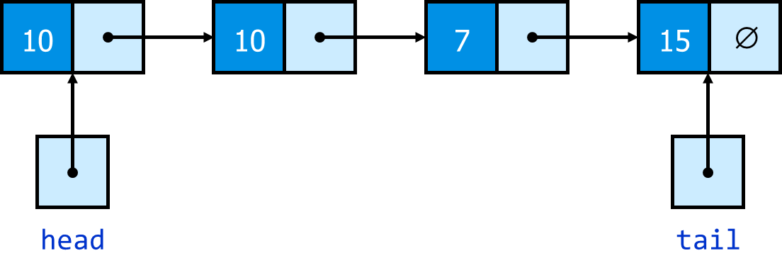
Implement Queue with Linked List
A queue can be implemented with a linked list with two pointers:
a head pointer
a tail pointer

Slide 49
Implement Queue with STL
#include <queue>
queue <data_type> Q;
Q.push();
Q.pop();
Q.front();
Q.empty();
Q.size();

Slide 50
Today's Summary
Implementing Stack with Array
Implementing Stack with Linked List
Queue
Implementing Queue with Array
Implementing Queue with Linked List

