Slide 1

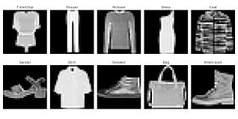
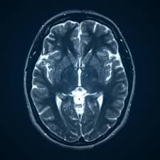
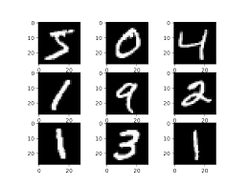
Image analysis: anomaly detection
Handwriting detection, credit card fraud prevention, and fashion helper
LES STAGIAIREs

Slide 2
Outline
Introduction: what is image analysis
Motivation:
Why analyze images
Why detect anomalies
Method: demonstration of our pipeline
Results
Discussion

Slide 3
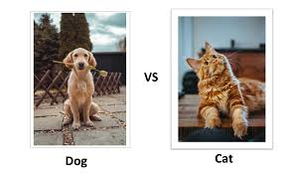
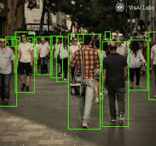
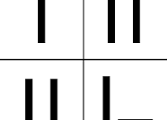
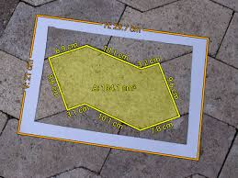
What is image analysis?
Extraction of meaningful information from digital images
detect objects
recognize patterns
measure features
classify visual data

Slide 4
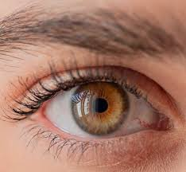
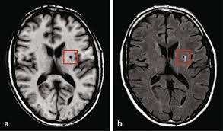
Why analyze images?
Humans love to look at things
Images contain rich information
To extract useful measurements
To automate visual tasks
To find patterns that are hard to see

Slide 5
Why detect anomalies?
Humans love to categorize things
Often, humans have a hard time detecting small differences which can aid in understanding some systems

Slide 6
Literature motivation:
The analysis includes experimental results showing that quantum kernels outperform classical methods in certain industrial applications. [1]
anomaly detection represents an important problem crossing several disciplines from cybersecurity, to fraud detection to particle physics [2]
Kernel methods for machine learning are ubiquitous for pattern recognition, with support vector machines (SVMs) being the most well-known method for classification problems. [3]
However, there are limitations to the successful solution to such problems when the feature space becomes large, and the kernel functions become computationally expensive to estimate[3]
the quantum device estimates inner products of quantum states to compute a classically intractable kernel. [4]

Slide 7
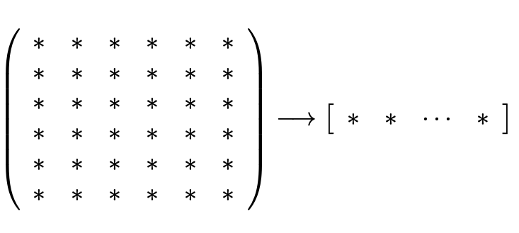
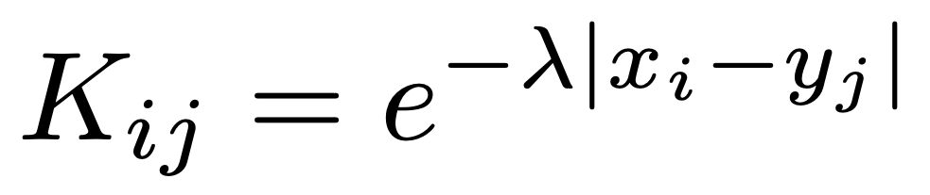
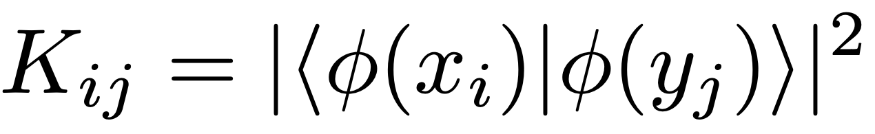
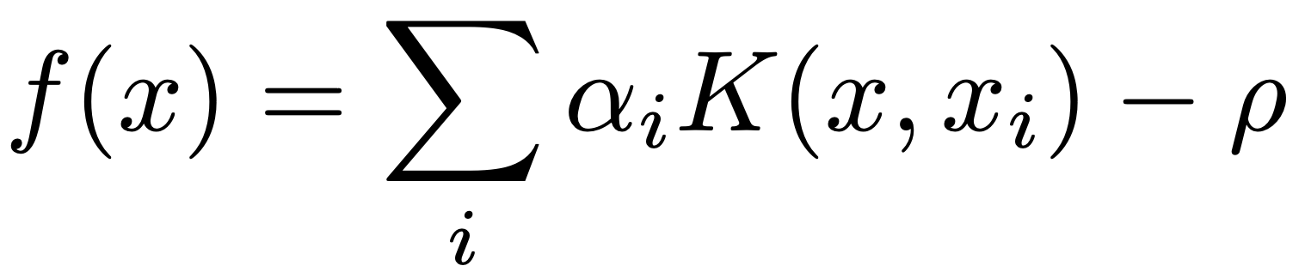
How do we analyze images?
Load data:
Preprocess & encode:
Build kernel matrix:
(classical)
(quantum)
Classify results:
Train SVM:
(now has access to testing samples)
(Only has access to training samples)

Slide 8
Metrics that we are using
Precision:
of the things I predicted as anomalies how many were actually anomalies
Recall:
of all the real anomalies how many did I catch
F1:
balance between precision and recall
AUC:
ranking quality across all thresholds

Slide 9
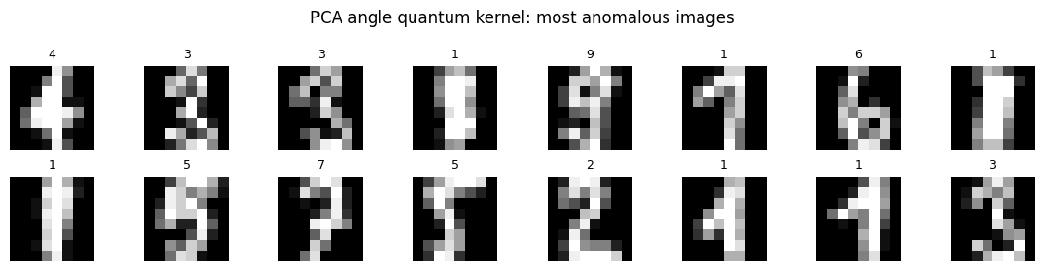
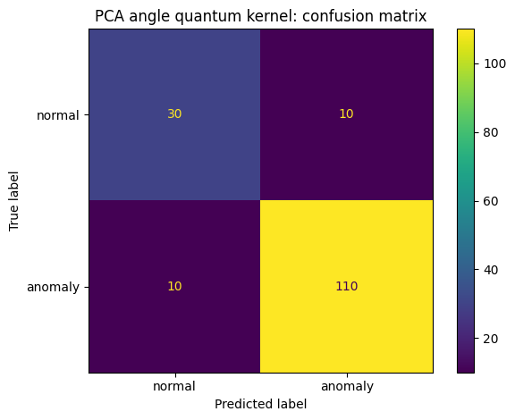
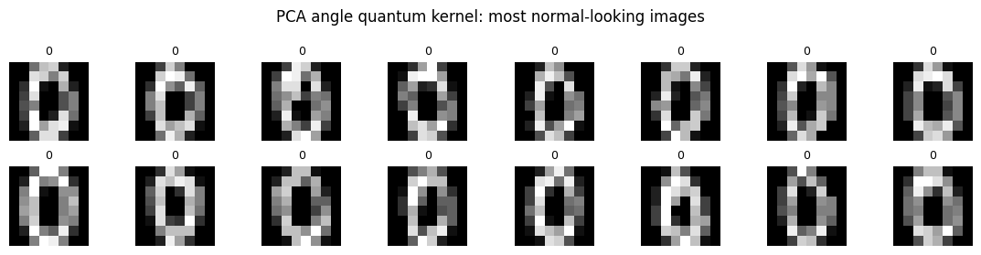
PCA quantum

Slide 10
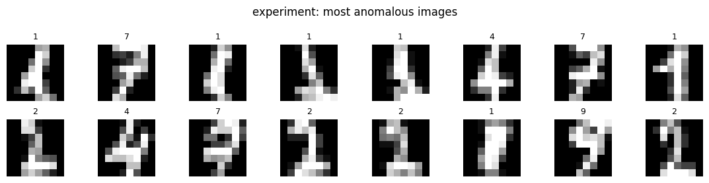
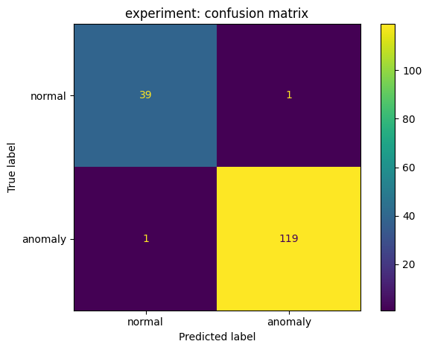
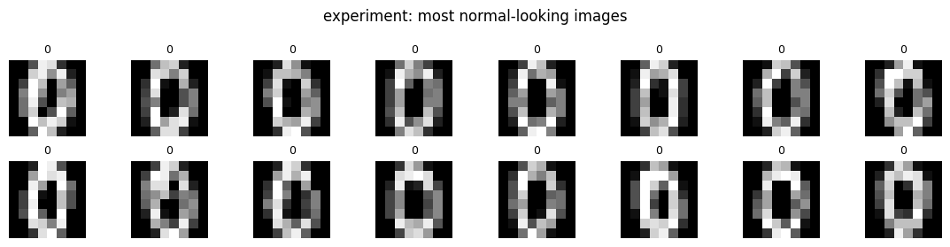
PCA classical

Slide 11
Amplitude quantum

Slide 12
Amplitude classical

Slide 13
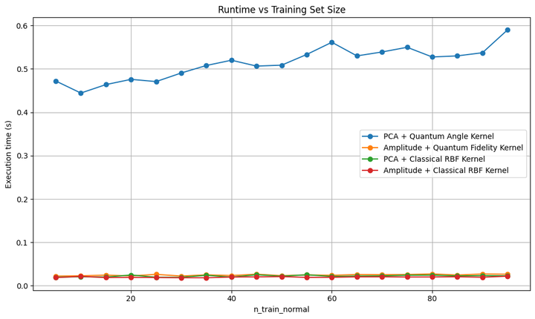

Slide 14
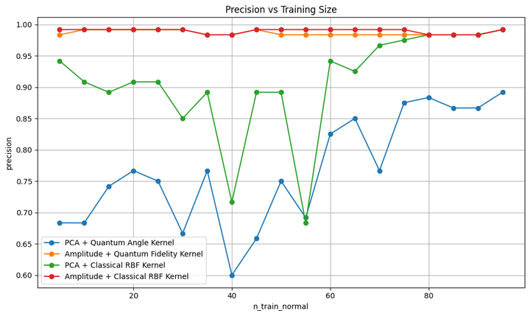
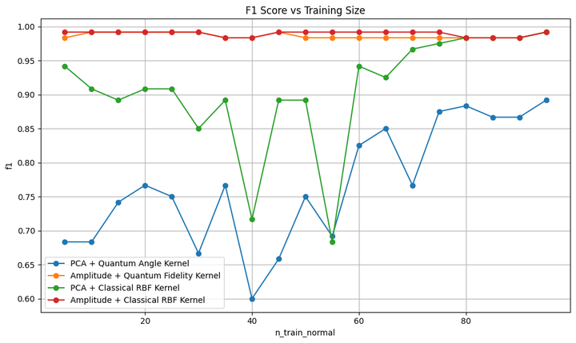
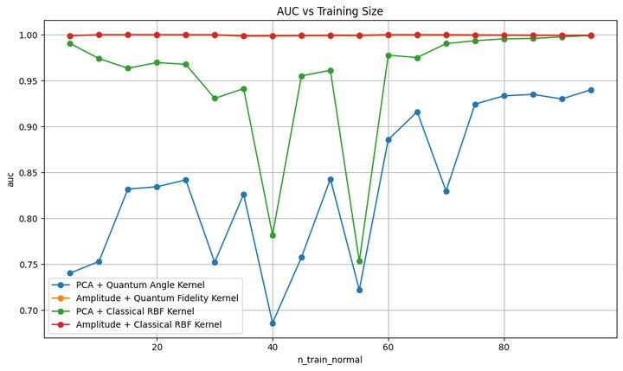
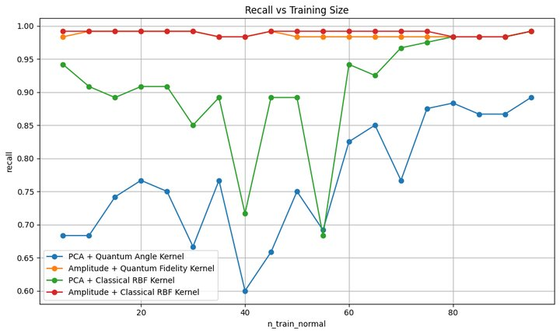
Results

Slide 15
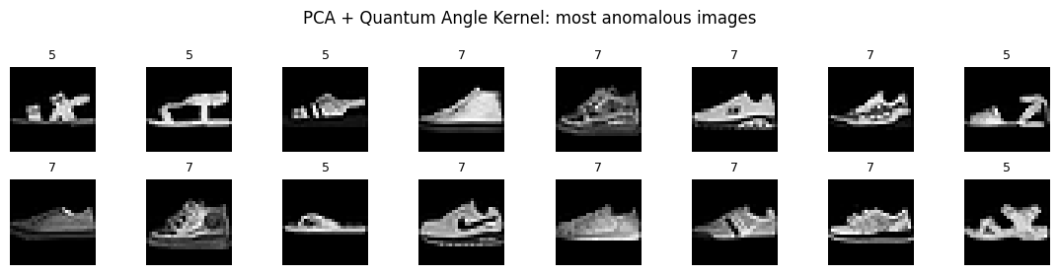
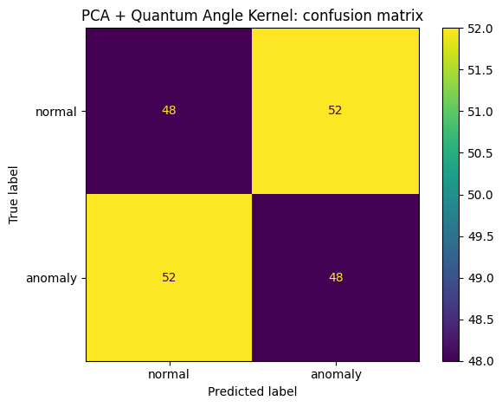
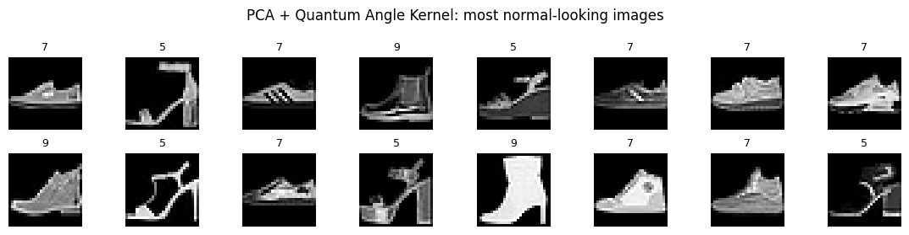
Normal: sneaker Anomaly: sandal and heel

Slide 16
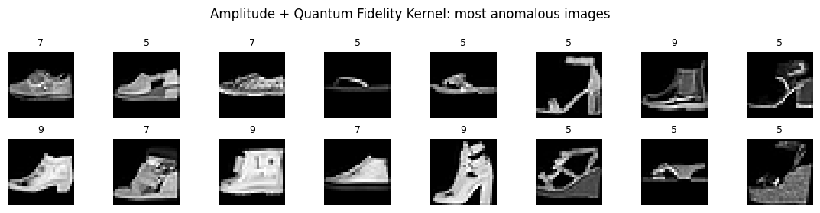
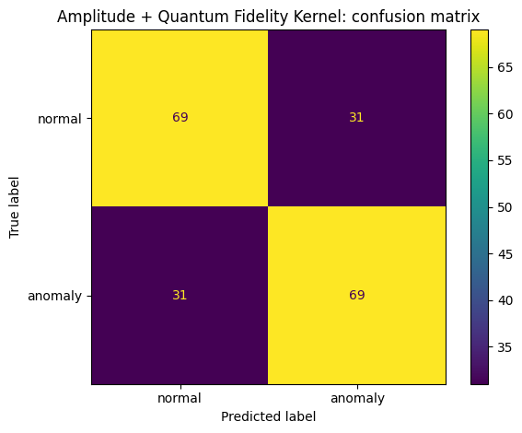
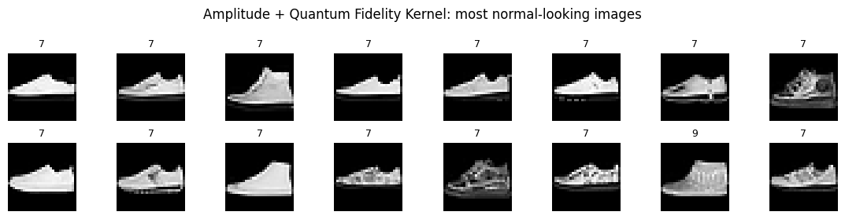
Normal: sneaker Anomaly: sandal and heel

Slide 17
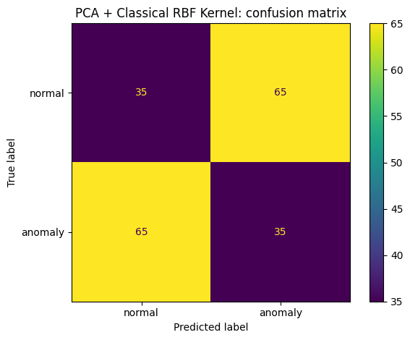


Slide 18
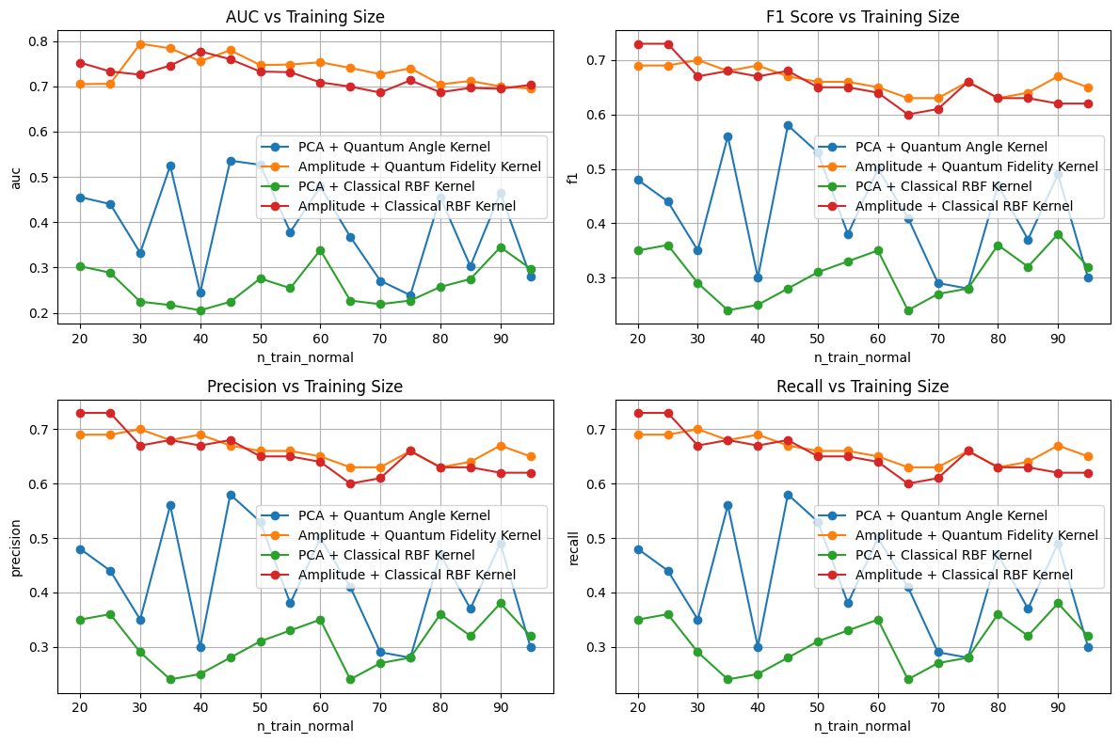

Slide 19
Discussion: why go quantum?
Many experts are pushing to combine quantum algorithms and machine learning techniques motivated by intuition and educated guesses.
Our tests are inconclusive and we have NOT found any quantum advantage
Although we can visually see that our classifier works better than chance, the metrics used are inconsistent and cannot be used to claim functionality.

Slide 20
References:
Tomono, T. (n.d.). Quantum Kernel Methods for Industrial Anomaly Detection.
Corli, S., Moro, L., Dragoni, D., Dispenza, M., & Prati, E. (2025). Quantum machine learning algorithms for anomaly detection: A review. Future Generation Computer Systems, 166, 107632. https://doi.org/10.1016/j.future.2024.107632
Schuld, M., & Killoran, N. (2019). Quantum machine learning in feature Hilbert spaces. Physical Review Letters, 122(4), 040504. https://doi.org/10.1103/PhysRevLett.122.040504
Havlíček, V., Córcoles, A. D., Temme, K., Harrow, A. W., Kandala, A., Chow, J. M., & Gambetta, J. M. (2019). Supervised learning with quantum enhanced feature spaces. Nature, 567(7747), 209–212. https://doi.org/10.1038/s41586-019-0980-2

