Slide 1

Inferencing Cyber Attack Causal Relationship Using Cyber Threat Intelligence
Student:
Chih-Chien Cheng (Anson)
Advisor:
Professor Ying-Dar Lin
High Speed Network Lab
National Yang Ming Chiao Tung University, Taiwan

Slide 2
Outline
Motivation
Background
Issues
Automated inference causal relationship with CTI
Problem statements
Node expansion
Status evaluation
Result analysis
Related work
Generate and use CTI
Solution approach
Evaluate the current status
infer causal relationship

Slide 3
Motivation
CTI
knowledge, skills and experience-based information
help mitigate potential attacks and harmful events
Forensics with CTI
manual, time consuming
large amount of data
Automatic use of CTI
Search, analyze and infer
Automation produces results

Slide 4
Background ─ CTI
Has become an important issue for organizations[1]
There are three overarching
Tactical: technical intelligence (IoC) which can be used to identify threat actors
Operational: details of the threat actors, including their tools, techniques and procedures
Strategic: intelligence about the overarching risks associated with cyber threats
CTI application scenarios
Forensics and inference using CTI[5]

Slide 5
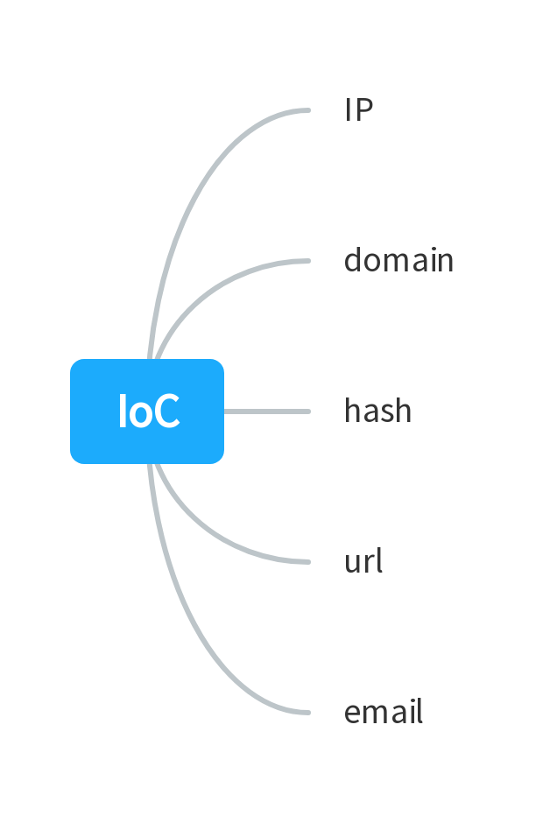
Background ─ CTI Unit
CTI search output
Input
IoC children
1~n
search
Input IoC’s information
severity
confidence
activity history
reputation
label
…

Slide 6
Issues – Automated inference causal relationship with CTI
Basic vs. Expand steps
Basic vs. Analyze result
Basic vs. Inference
Degree of automation
Inference result
Approach | manual vs. automatic expand node | automatic analysis | manual vs. semi-automatic
basic | manual | No | manual
Expand steps | automatic | No | semi-automatic
Analyze result | manual | Yes | semi-automatic
Inference | automatic | Yes | automatic

Slide 7
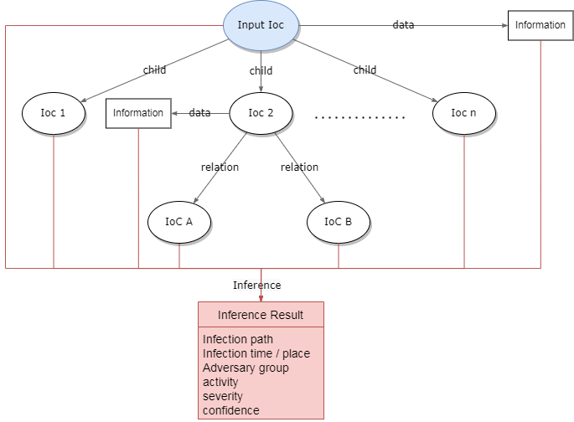
Problem – Overview
Evaluate status
Analyze result

Slide 8
Subproblem 0 – Node Expansion (development track)
Subproblem
Input
target IoC to expand
Output
this node's children (other expandable IoCs)
information about target IoC
Objective
explore the profile of the target node
maintain all queried data on dynamic table
Constraint
None

Slide 9
Subproblem 1 – Status Evaluation
Subproblem
Input
all queried data so far (current status)
Output
Determines the next node to be expanded
Objective
Analyze the results with the least number of expands
Constraint
None

Slide 10
Subproblem 2 – Result Analysis
Subproblem
Input
all queried data so far (current status)
Output
Infection path
Infection time / location
Adversary group
Activity
Severity
Confidence
Objective
get inferences from the queried data
automate the inference process
Constraint
None

Slide 11
Related work ─ Generate and use CTI
paper | Input | Output | Objective |  |  | Method
 | Structured CTI |  | Extract Information | Automation | efficiency
[6] | X | threat action & TTPs | O | O | X | ．context aware analytics ．NLP ．IR (Information Retrieval)
[7] | O | ．standard CTI ．detected threat | X | O | X | ．automated threat detection tools ．antivirus software
[8] | X | analyze result | O | X | X | ．Open-CyKG : CTI KG
[9] | O | Maximum Entropy Model | X | O | X | ．automatically label text ．by leveraging related, domain-specific, structured data
[10] | X | automation CTI service platform | X | O | O | machine learning-based integrated framework
Ours | O | ．causal relationship ．confidence score | O | O | O | ．search contacted IoCs ．Infer from all queried data

Slide 12
Solution Approach
There are two sections in this solution:
Evaluate the current status
Find the next node to expand
more than two input IoCs
AI solution
infer causal relationship
Notes:
This is the overview solution for our work. The solution is divided into 3 sections each of them addresses a problem. Inside of each solution, we have subsolution which answers each subproblem. The first solution is ensemble sdversarial trained optimal ML-based NIDS model. The second solution is ensemble adversarial trained dataset. The third solution is cosine similarity for predicting the model.

Slide 13
Sub-Solution 1 ─ Status Evaluation Method
Find the next node to expand
more than two input IoCs
bidirectional depth limit search
AI solution
Use the expanded data as dataset
Train the model to output predicted high-value nodes
Algorithm | AI | Off-line learning | On-line learning
Calculation | - | - | -
Off-line learning | V | V | -
On-line learning | V | - | V
Off-line + On-line learning | V | V | V
Notes:
This is the overview solution for our work. The solution is divided into 3 sections each of them addresses a problem. Inside of each solution, we have subsolution which answers each subproblem. The first solution is ensemble sdversarial trained optimal ML-based NIDS model. The second solution is ensemble adversarial trained dataset. The third solution is cosine similarity for predicting the model.

Slide 14
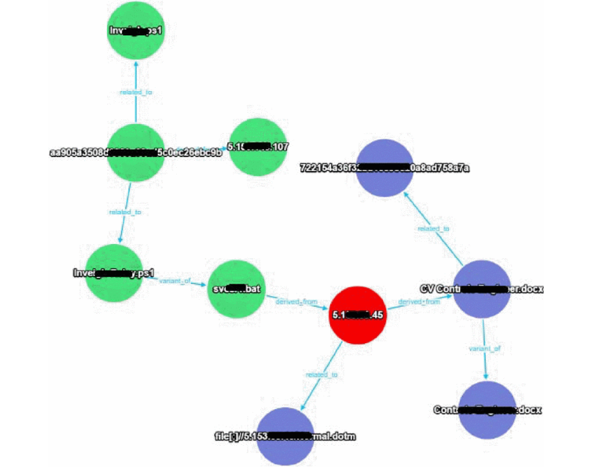
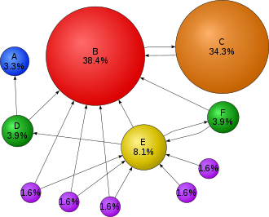

Sub-Solution 2 ─ Result Analysis Method
Infer causal relationship
Find the intersection of attack types
PageRank calculation
Betweenness centrality calculation
The above method is currently used to find important nodes in graph.
Algorithm | intersection of attack types | PageRank | Betweenness
Description
Notes:
This is the overview solution for our work. The solution is divided into 3 sections each of them addresses a problem. Inside of each solution, we have subsolution which answers each subproblem. The first solution is ensemble sdversarial trained optimal ML-based NIDS model. The second solution is ensemble adversarial trained dataset. The third solution is cosine similarity for predicting the model.

Slide 15
Reference
[1] 2021 SANS Cyber Threat Intelligence (CTI) Survey Rebekah Brown and Robert M. Lee, SANS Institute 2021 https://assets.contentstack.io/v3/assets/blt36c2e63521272fdc/blt43a990b140efaa96/6112a525f0c97e39497dc96d/40080.pdf
[2] TIMiner: Automatically extracting and analyzing categorized cyber threat intelligence from social data, Jun Zhao, Qiben Yan, Jianxin Li, Minglai Shao, Zuti He, Bo Li, Computers & Security Volume 95, August 2020, 101867
https://www.ciencedirect.com/science/article/pii/S0167404820301395
[3] A Framework for Cyber Threat Intelligence Extraction from Raw Log Data, Max Landauer; Florian Skopik; Markus Wurzenberger; Wolfgang Hotwagner; Andreas Rauber, 2019 IEEE International Conference on Big Data (Big Data)
https://ieeexplore.ieee.org/abstract/document/9006328
[4] A Supervised Machine Learning Based Approach for Automatically Extracting High-Level Threat Intelligence from Unstructured Sources, Yumna Ghazi; Zahid Anwar; Rafia Mumtaz; Shahzad Saleem; Ali Tahir, 2018 International Conference on Frontiers of Information Technology (FIT)
https://ieeexplore.ieee.org/abstract/document/8616979

Slide 16
Reference
[5] Ontology-based Cyber Risk Monitoring Using Cyber Threat Intelligence, Yazid Merah, Tayeb Kenaza, ARES 2021: The 16th International Conference on Availability, Reliability and Security
https://dl.acm.org/doi/abs/10.1145/3465481.3470024
[6] TTPDrill: Automatic and Accurate Extraction of Threat Actions from Unstructured Text of CTI Sources, Ghaith Husari, Ehab Al-Shaer, Mohiuddin Ahmed, Bill Chu, Xi Niu, ACSAC 2017: Proceedings of the 33rd Annual Computer Security Applications ConferenceDecember 2017 Pages 103–115
[7] Toward Automated Cyber Defense with Secure Sharing of Structured Cyber Threat Intelligence, Md. Farhan Haque & Ram Krishnan , Information Systems Frontiers volume 23, pages883–896 (2021)
[8] Open-CyKG: An Open Cyber Threat Intelligence Knowledge Graph, Injy Sarhanab, Marco Spruitbcd, Knowledge-Based Systems, Volume 233, 5 December 2021, 107524

Slide 17
Reference
[9] Automatic Labeling for Entity Extraction in Cyber Security, Bridges, Robert A; Jones, Corinne L; Iannacone, Michael D; Testa, Kelly M; Goodall, John R, Conference: 2014 ASE International Conference on Cyber Security, Stanford, CA, USA, 20140527, 20140331
[10] inTIME: A Machine Learning-Based Framework for Gathering and Leveraging Web Data to Cyber-Threat Intelligence, Paris Koloveas, Sofia Alevizopoulou, Christos
[11] Enabling Efficient Cyber Threat Hunting With Cyber Threat Intelligence, Peng Gao; Fei Shao; Xiaoyuan Liu; Xusheng Xiao; Zheng Qin; Fengyuan Xu, 2021 IEEE 37th International Conference on Data Engineering (ICDE)
[12] Generating Fake Cyber Threat Intelligence Using Transformer-Based Models, Priyanka Ranade; Aritran Piplai; Sudip Mittal; Anupam Joshi, 2021 International Joint

Slide 18

High Speed Network Lab
National Yang-Ming Chiao-Tung University, Taiwan

