Slide 1

Multi-stage Multi-datasource Stacked Learning for Attack Techniques and Lifecycles
Student:
Shin-Yi Yang
Advisor:
Professor Ying-Dar Lin,
Professor Yu-Sung Wu
High Speed Network Lab
National Yang Ming Chiao-Tung University, Taiwan

Slide 2
Outline
Motivation
Background
Network Security
ATT&CK
CREME toolchain
Issues
Notations
Problem Statements
Performance Comparison between Different Classifier Structure
Single-stage and Multi-stage
Single-datasource and Multi-datasource
Related Works
Solution Approach
Classifier Structure of Different Combinations
Single-stage Single-datasource Structure
Multi-stage Single-datasource Structure
Single-stage Multi-datasource Structure
Multi-stage Multi-datasource Structure
Implementation
References
Notes:
title
motivation
background
issues
problem statement(input, output, objective, constraint)
related works
solution approach
implementation
references

Slide 3
Motivation
ML-based IDS
Detect intrusion from features of data source
Can detect unknown attacks
Comprehensive and stable detection results of ML-based IDS
System logs
Network traffic
System statistics
Recognize an attack lifecycle from its related attack techniques

Slide 4
Background - Network Security
Has become an important issue for everyone’s life [1]
Intrusion Detection System (IDS):
Traditional IDS
Signature-based
Anomaly-based
Classification-based
ML-based IDS
Has a satisfactory detection level
Detect more attack variants

Slide 5
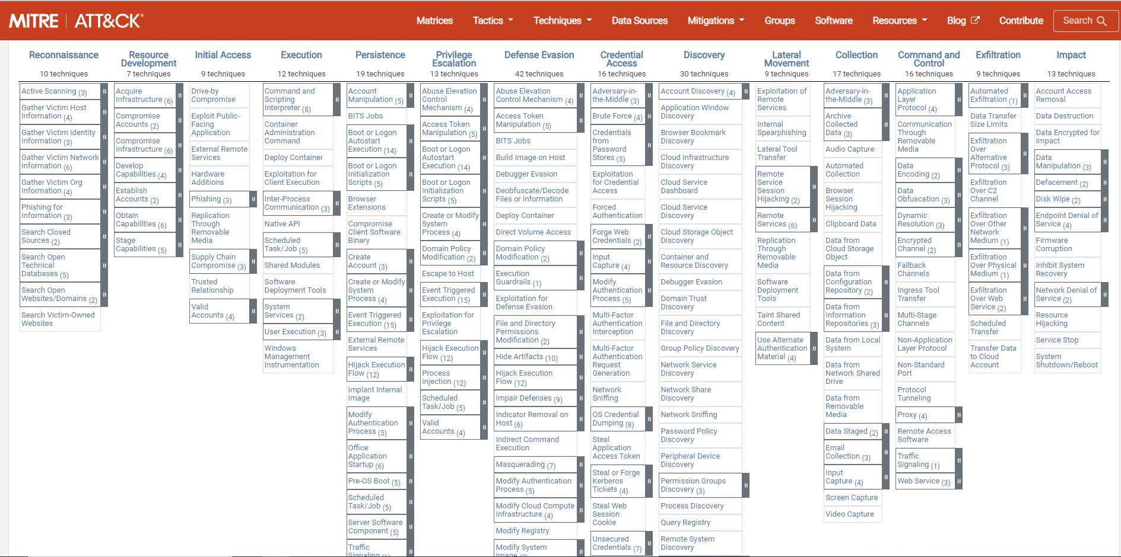
Background - ATT&CK
Adversarial Tactics, Techniques, and Common Knowledge (ATT&CK) [2] is a knowledge base designed by MITRE corporation
ATT&CK is a project aiming to describe attacks’ behaviors as well as their target platforms and provide a taxonomy for both offense and defense

Slide 6
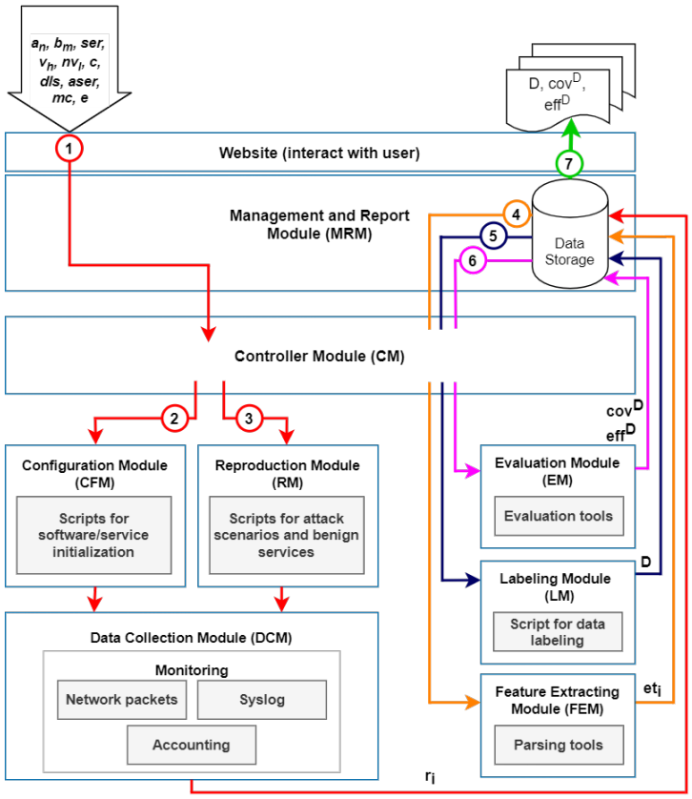
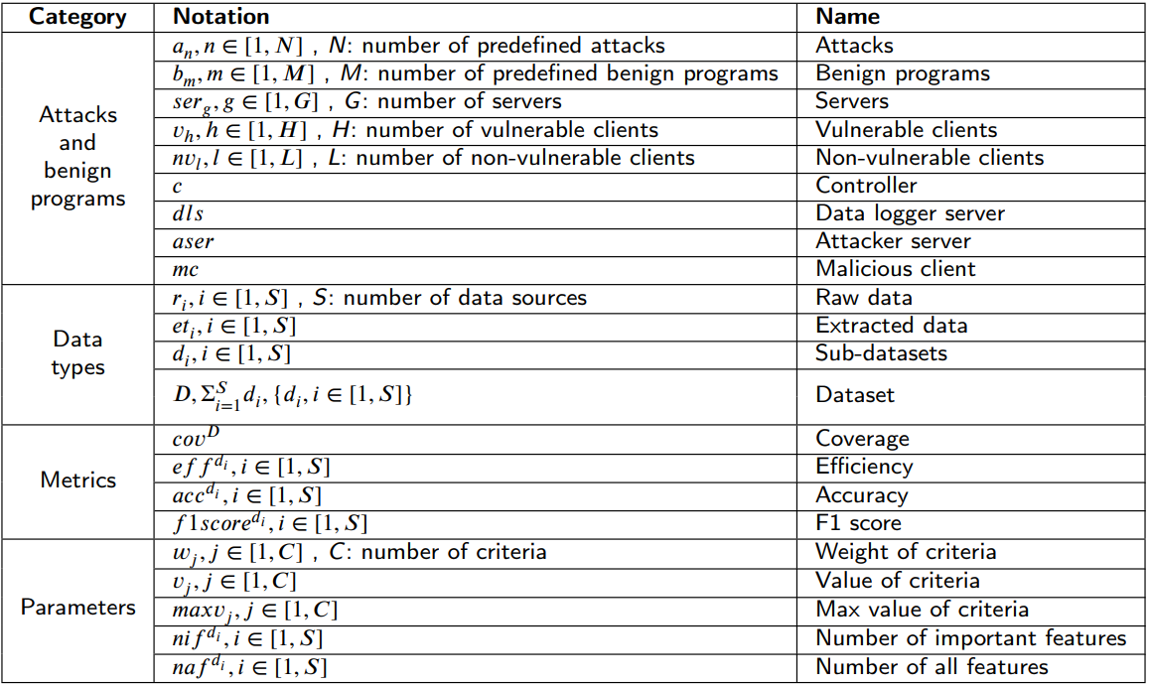
Background - CREME toolchain
CREME (Configuration, REproduction, Multi-dataset, and Evaluation)[3], an automated toolchain to generate a dataset and measure its quality and efficiency
Dataset types
Traffic flow
System log
Resource usage statistics

Slide 7
Issues
Multi-source model vs. Single-source model
Detection performance
execution time
Multi-stage model vs. Single-stage model
Detection performance
execution time

Slide 8
Notations (1/3)
Category | Name | Notation | Description
Dataset | Datasource | D | D = D^{NT} ∨ D^{SL} ∨ D^{HS}; D = D^{R} ∪ D^{T} ; R ∪ T = {1, 2, 3, …, n}
 | Network traffic datasource | D^{NT} | D^{NT} = {(x_{i}, y^{T}_{i}, y^{A}_{i}), i ∈ [1, F]}; F: number of network flows
 | System logs datasource | D^{SL} | D^{SL} = {(x_{i}, y^{T}_{i}, y^{A}_{i}), i ∈ [1, L]}; L: number of system logs
 | Host statistics datasource | D^{HS} | D^{HS} = {(x_{i}, y^{T}_{i}, y^{A}_{i}), i ∈ [1, H]}; H: number of host statistics
 | Training dataset | D^{R} | D^{R} = {(x_{i}, y^{T}_{i}, y^{A}_{i}), i ∈ [1, R]}
 | Testing dataset | D^{T} | D^{T} = {(x_{i}, y^{T}_{i}, y^{A}_{i}), i ∈ [1, T]}
 | Data input | x_{i} | x_{i} ∈ ℝ^{n}, n: number of features
 | Technique label | y^{T}_{i} | y^{T}_{i} ∈ [0, T]; T: number of predefined techniques, 0 is normal data
 | Attack lifecycle types label | y^{A}_{i} | y^{A}_{i} ∈ [0, A]; A: number of predefined attack lifecycle types, 0 is normal data

Slide 9
Notations (2/3)
Category | Name | Notation | Description
Machine learning | Pre-trained model | M^{PT} | A saved model that was previously trained on the other related dataset
 | Ensemble model | ME | Gather results from different classifier
 | Technique classifier | M^{T} | ML model that classify the pre-defined ATT&CK attack technique types
 | Attack lifecycle classifier | M^{A} | ML model that classify the pre-defined attack lifecycle types
 | Single-stage ML-IDS model | M^{SS} | Classifier model of M^{SS} = M^{A}
 | Best single-stage model | M^{SS*} | M^{SS} with R^{B}
 | Multi-stage ML-IDS model | M^{MS} | Classifier model of M^{MS} = M^{T} ∧ M^{A}
 | Best multi-stage model | M^{MS*} | M^{MS} with R^{B}
 | Single-datasource ML-IDS model | M^{SD} | Input datasource of M^{SD} = D^{NT} ⊕ D^{SL} ⊕ D^{HS}
 | Best single-datasource model | M^{SD*} | M^{SD} with R^{B}
 | Multi-datasource ML-IDS model | M^{MD} | Input datasource of M^{MD} = D^{NT} ∧ D^{SL} ∧ D^{HS}
 | Best multi-datasource model | M^{MD*} | M^{MD} with R^{B}

Slide 10
Notations (3/3)
Category | Name | Notation | Description
Machine learning | Measurement result | R | R ⊆ {F1 score, recall, …}
 | Best measurement result | R^{B} | R with highest F1 score or highest AUC or…

Slide 11
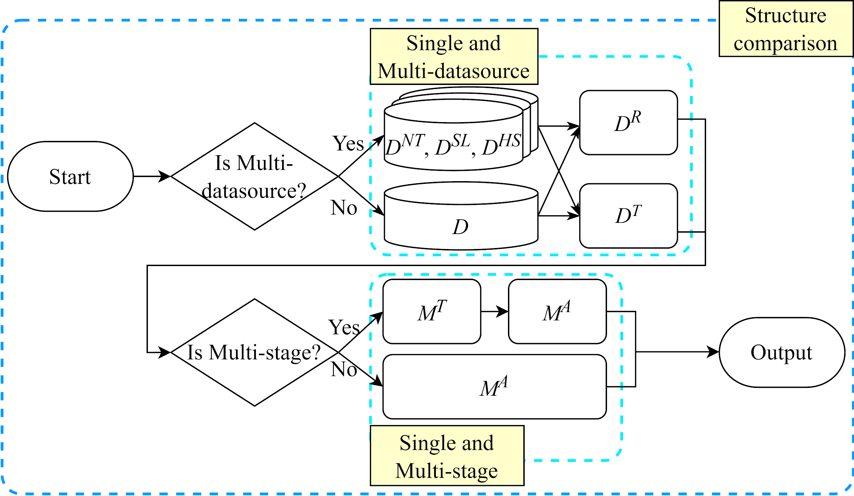
Problem Statement - Overview

Slide 12
Problem 1 - Performance Comparison between Different Classifier Structure
Subproblem 1.1 - Single-stage and Multi-stage
Input:
Datasource (D)
Output:
Single-stage ML-IDS model (M^{SS})
Multi-stage ML-IDS model (M^{MS})
Measurement results (R)
Objective:
Best Single-stage ML-IDS model (M^{SS*})
Best Multi-stage ML-IDS model (M^{MS*})
Constraint:
None

Slide 13
Problem 1 - Performance Comparison between Different Classifier Structure
Subproblem 1.2 - Single-datasource and Multi-datasource
Input:
Datasource (D)
Output:
Single-datasource ML-IDS model (M^{SD})
Multi-datasource ML-IDS model (M^{MD})
Measurement results (R)
Objective:
Best Single-datasource ML-IDS model (M^{SD*})
Best Multi-datasource ML-IDS model (M^{MD*})
Constraint:
None

Slide 14
Related Works
還沒弄好

Slide 15
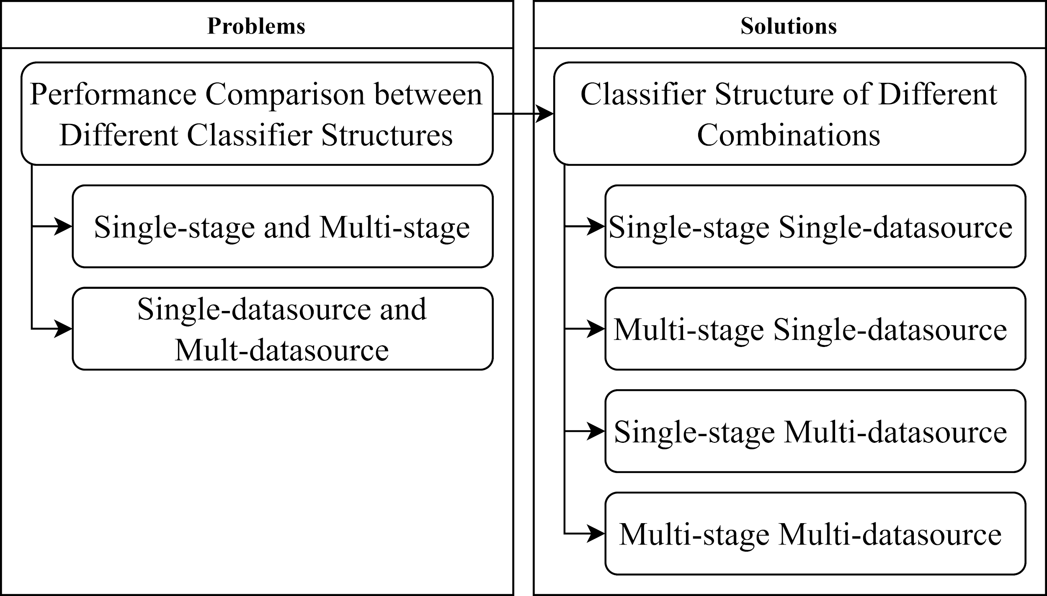
Solution idea - overview

Slide 16
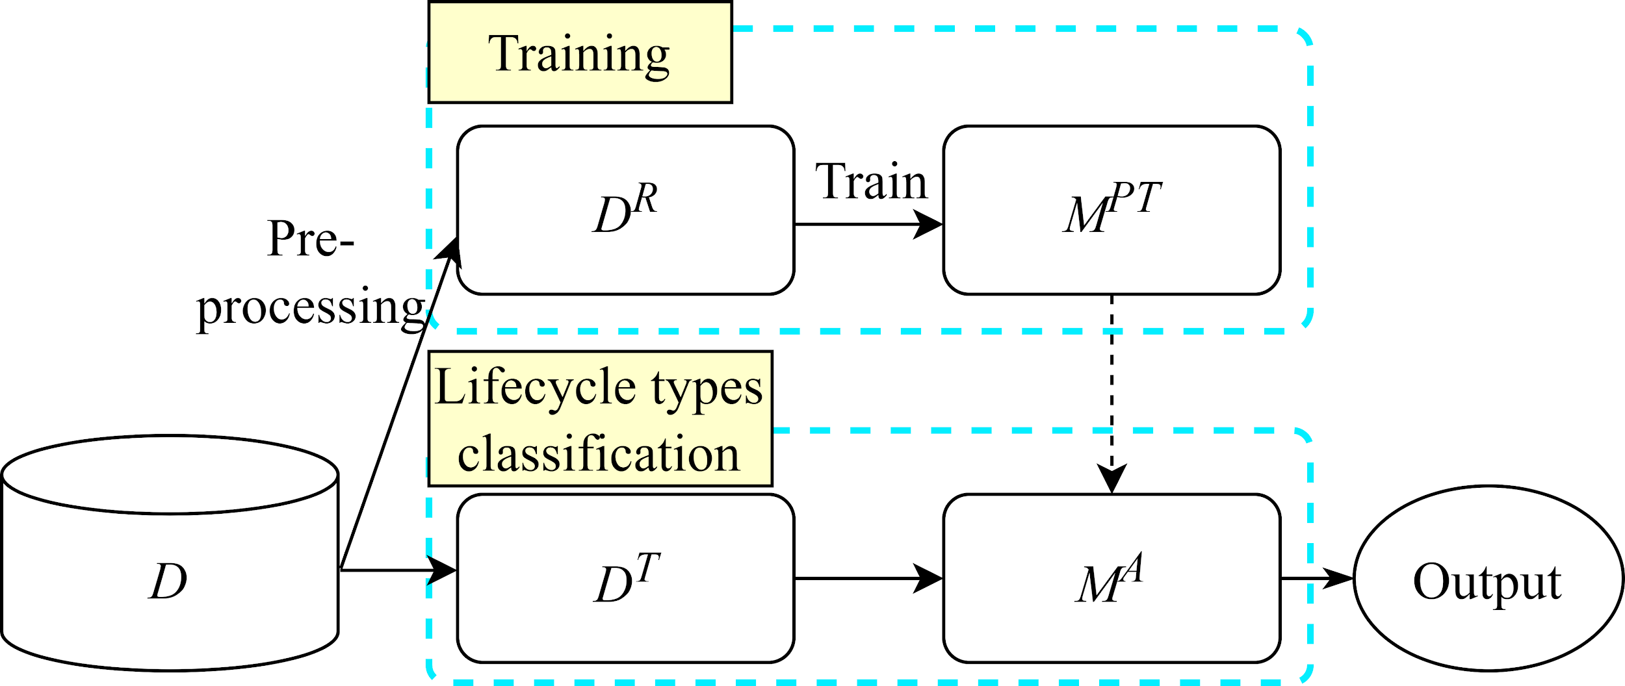
Solution 1 - Classifier Structure of Different Combinations
Sub-solution 1.1 - Single-stage Single-datasource Structure

Slide 17
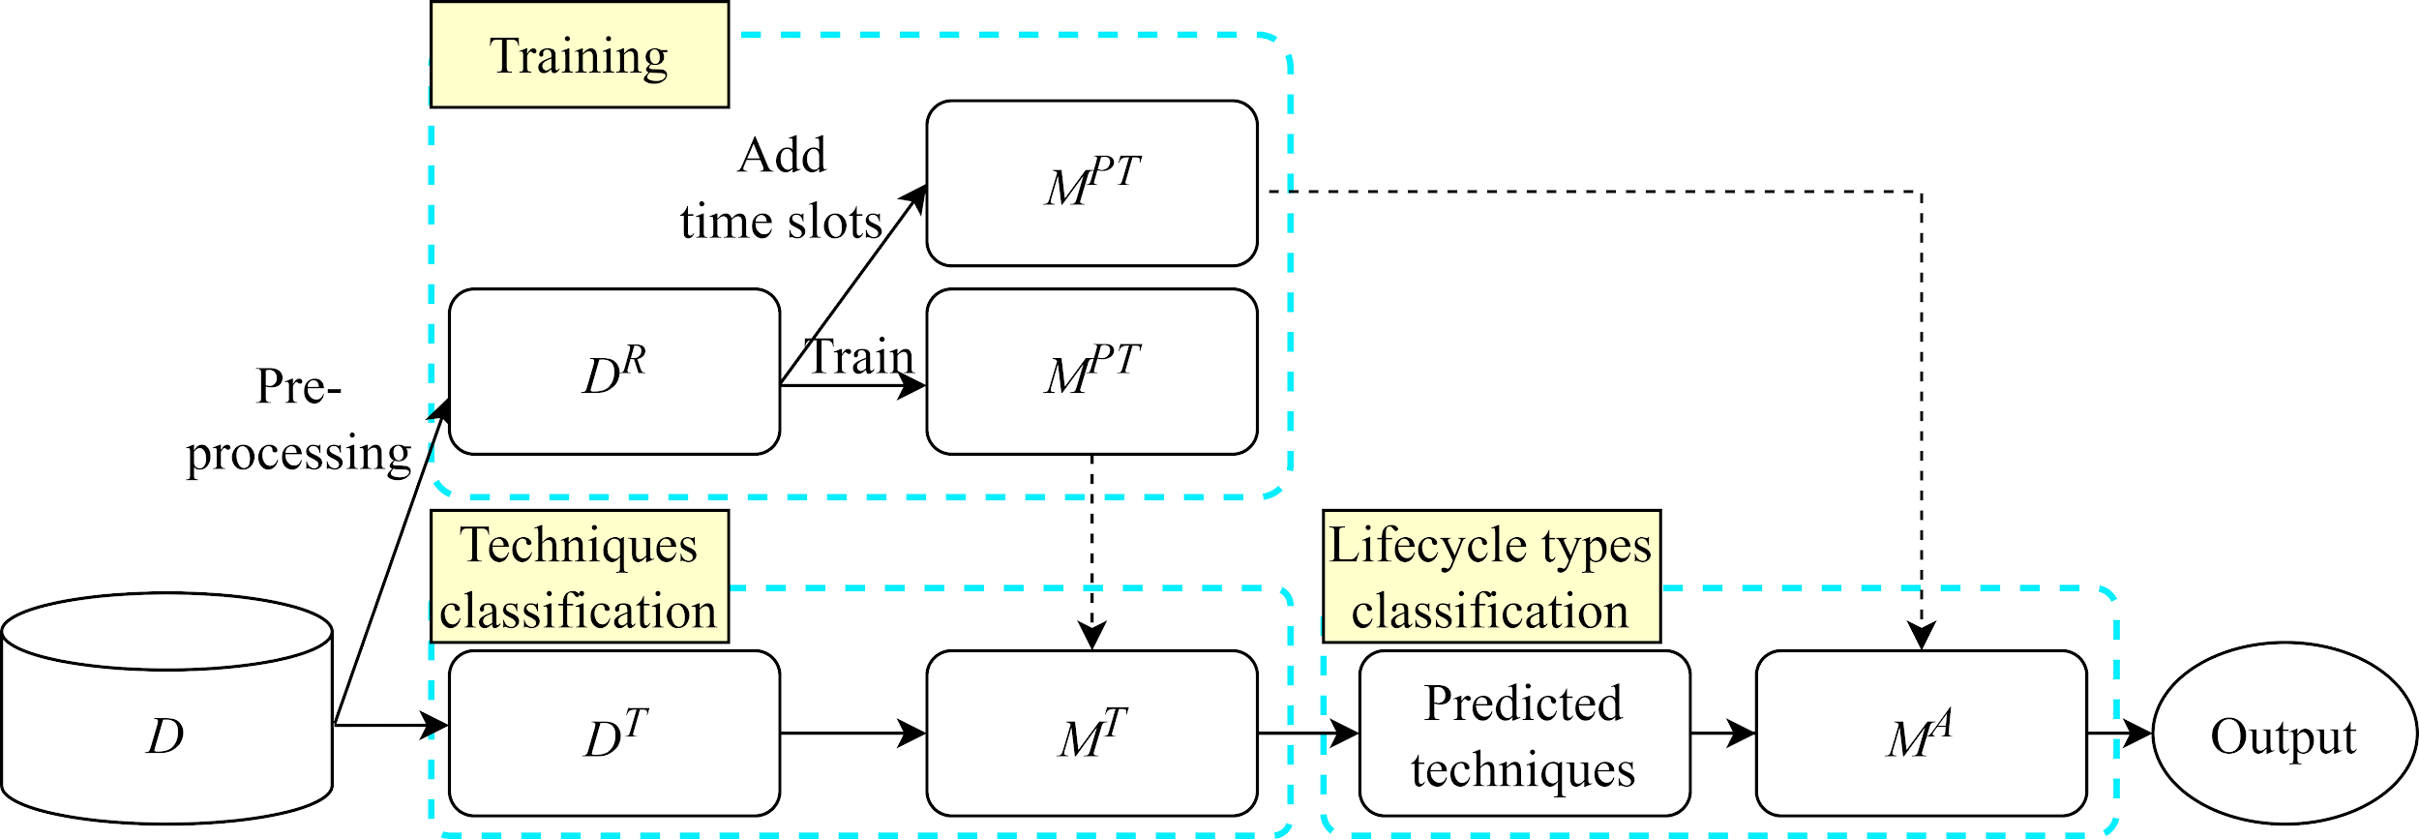
Solution 1 - Classifier Structure of Different Combinations
Sub-solution 1.2 - Multi-stage Single-datasource Structure

Slide 18
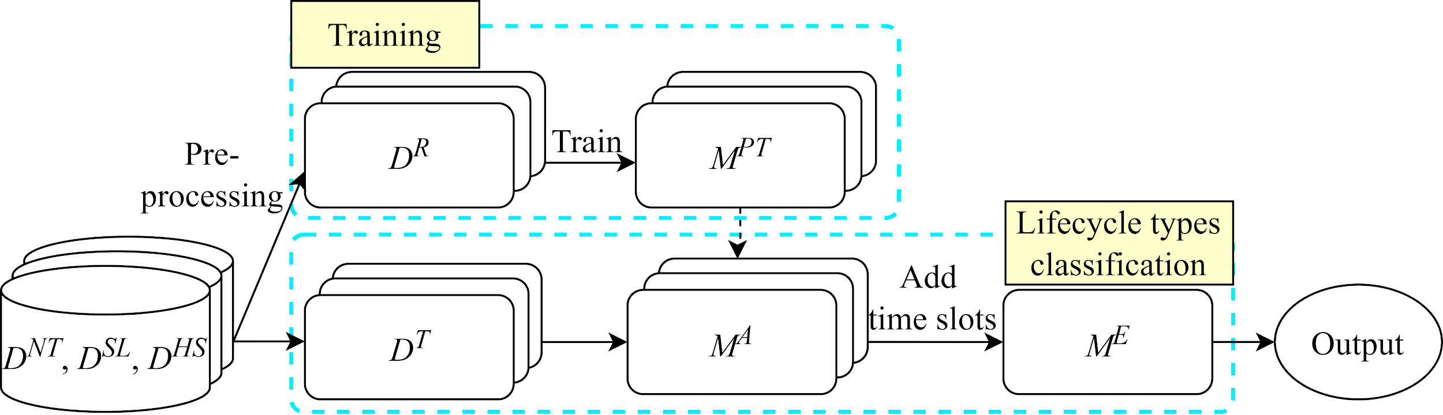
Solution 1 - Classifier Structure of Different Combinations
Sub-solution 1.3 - Single-stage Multi-datasource Structure

Slide 19
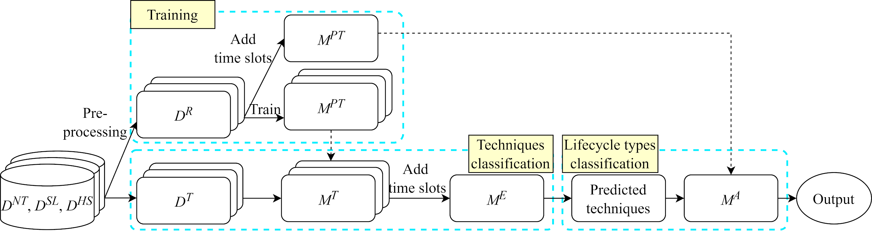
Solution 1 - Classifier Structure of Different Combinations
Sub-solution 1.4 - Multi-stage Multi-datasource Structure

Slide 20
Implementation

Slide 21
References
[1] Pandey, Shailja. "Modern network security: Issues and challenges." International Journal of Engineering Science and Technology 3.5 (2011): 4351-4357.
[2] Strom, Blake E., et al. "Mitre att&ck: Design and philosophy." Technical report. The MITRE Corporation, 2018.
[3] Bui, Huu-Khoi, et al. "CREME: A toolchain of automatic dataset collection for machine learning in intrusion detection." Journal of Network and Computer Applications 193 (2021): 103212.
[] Lin, Ying-Dar, et al. "Multi-datasource machine learning in intrusion detection: Packet flows, system logs and host statistics." Journal of Information Security and Applications 68 (2022): 103248.

