Slide 1

Madrid Fluye
Grupo 19: José Ángel Galán, Juan Badía, Cristina García , Marcos Peralta
Asignatura: Web Semántica, Linked Data y Grafos de Conocimientos

Slide 2

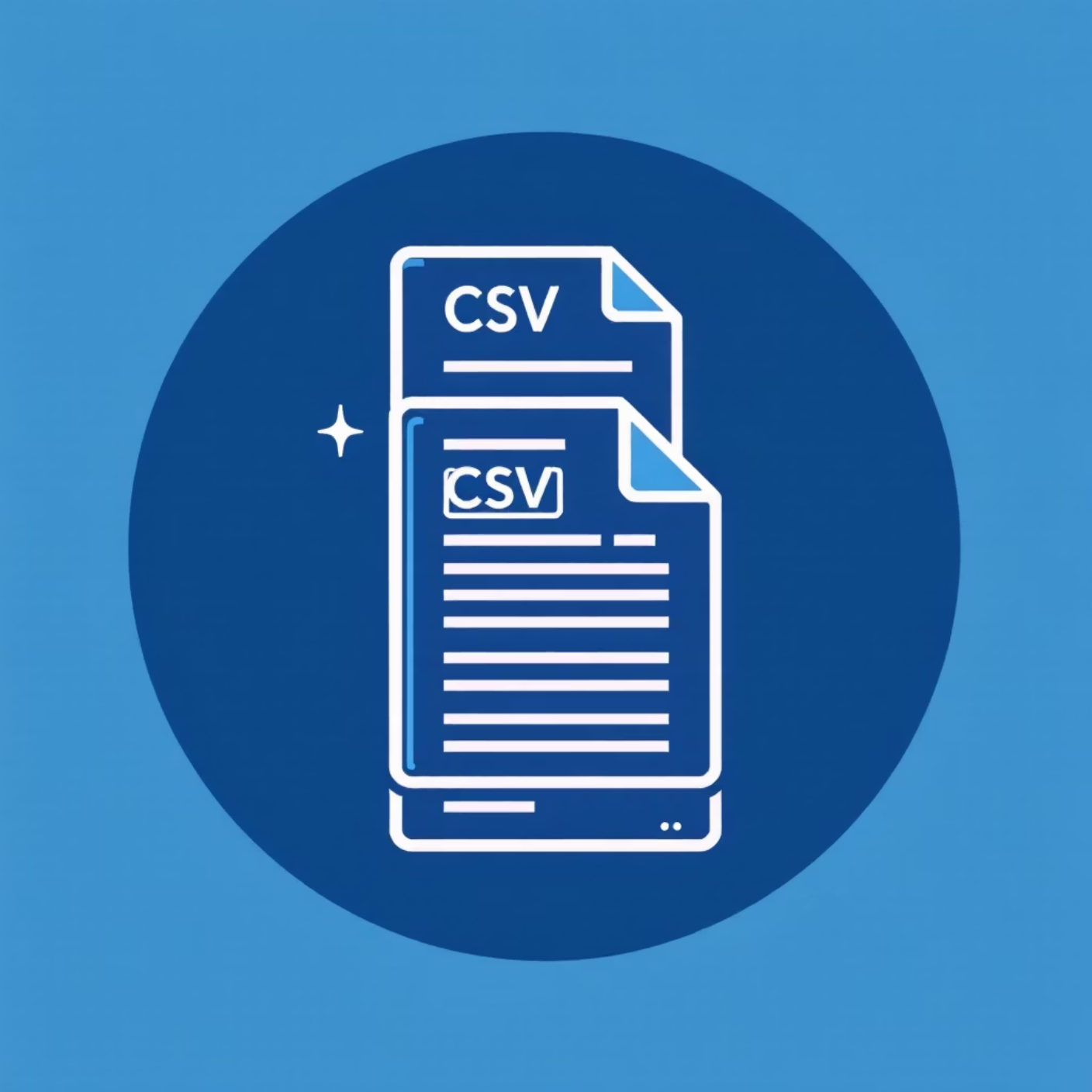
The Concept & Data: Madrid Fluye
The Challenge
Navigating Madrid's urban mobility is complex. Car or bike? Decisions hinge on real-time traffic and
availability of parking or bike stations.
Our Solution: "Madrid Fluye"
A conceptual app recommending optimal transport. High traffic? BiciMAD. Low traffic? Car.
Source Data (CSVs)
Public Parking (Geo, static)
BiciMAD Stations (Geo, capacity, availability)
Traffic Intensity (Aggregated by zone and month)

Slide 3
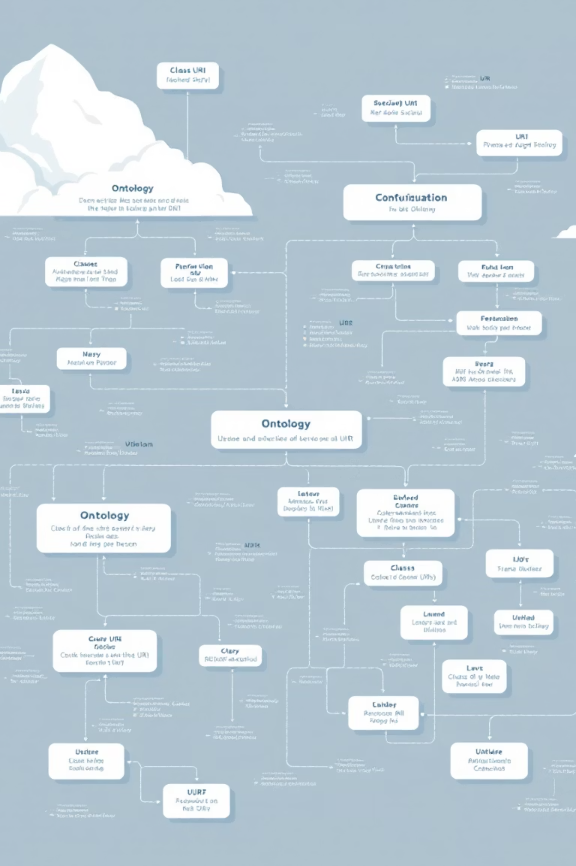
The Blueprint: Ontology & Naming
Crafting the "schema" (TBox) and "naming strategy" (URIs) for our knowledge graph.
Ontology (ontology.ttl)
Classes: ont:TransportFacility (superclass) including ont:ParkingFacility and ont:BikeStation. Also ont:MobilityIntensity.
1
Hierarchy: rdfs:subClassOf connects classes (e.g., ont:BikeStation rdfs:subClassOf ont:TransportFacility).
URI Strategy
2
TBox (Ontology): http://group19.linkeddata.es/def/transport# (Prefix ont:)
ABox (Data): http://group19.linkeddata.es/resource/ (Prefix ex:)

Slide 4




Vocabulary Reuse: Interoperability
Adhering to the principle of interoperability by leveraging industry-standard vocabularies.
Schema.org
For universal properties like schema:name, schema:address, and schema:capacity.
W3C Basic Geo
Standard for geolocation, using wgs:lat and wgs:long.
XSD
For data types such as xsd:integer and xsd:float.

Slide 5


Data Preparation with OpenRefine
Cleaning "dirty" CSVs to ensure coherence and mappability.
OpenRefine Actions
Rename Columns: (e.g., PK to id, TotalBases to totalDocks).
Clean Text: Remove spaces (value.trim()).
Correct Data Types: Replace commas with periods in decimals (grel:value.replace(',', '.')) for xsd:float.
Key Transformation: Wide-to-Long
Traffic data with zones in columns (wide format) was pivoted to a long format (with zone and intensity columns), creating one measurement per row.

Slide 6
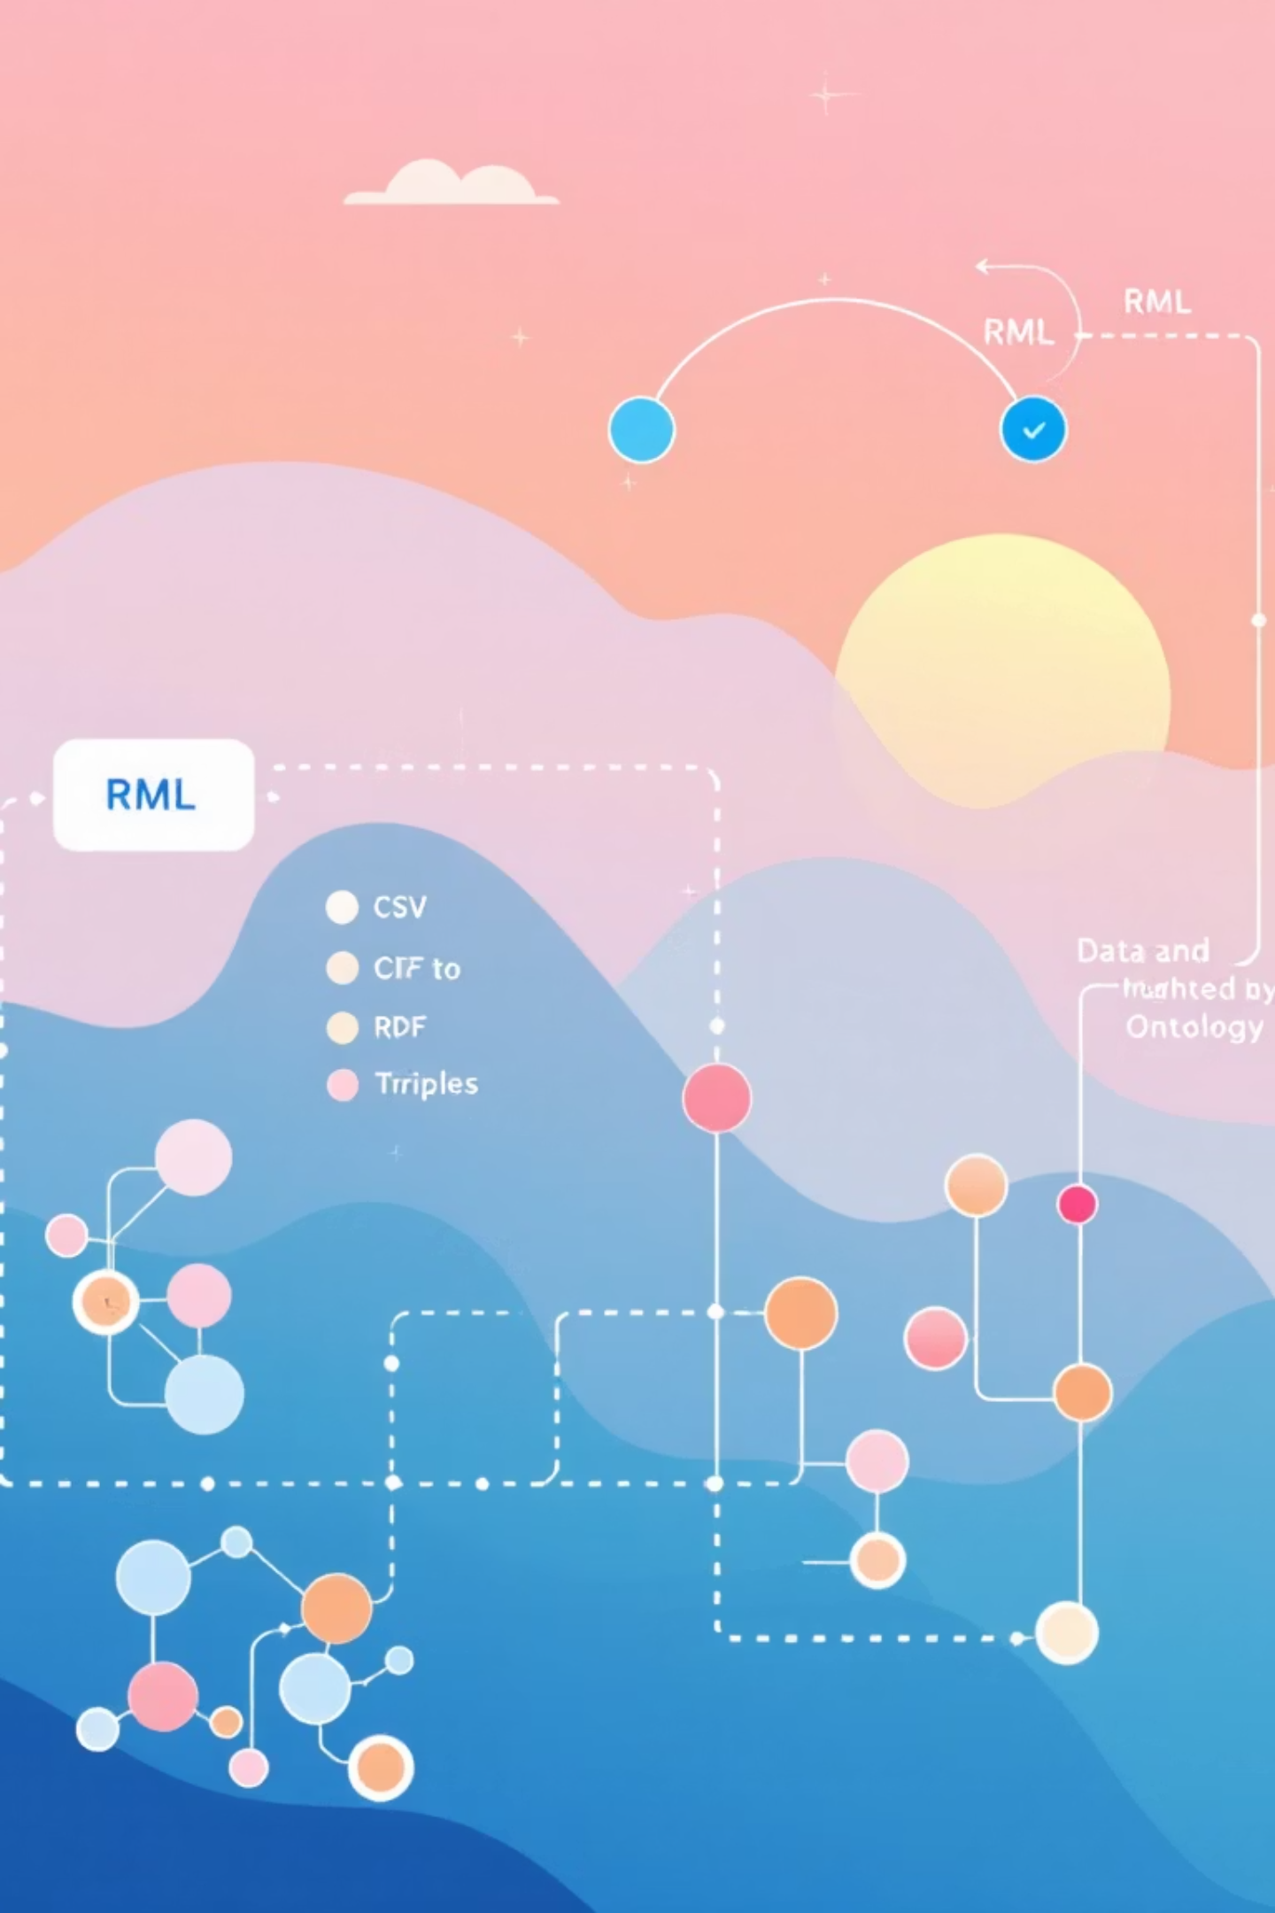


Graph Generation with RML
Converting clean CSVs into a unified RDF Knowledge Graph.
Objective
Transform the three cleaned CSVs into a single RDF Knowledge Graph ( rdf/data.ttl).
Technology
RML (RDF Mapping Language) via the mappings/mapping.rml file.
Process
Created a rr:TriplesMap (rule block) for each CSV.
rr:subjectMap: Generates resource URI (e.g., ex:parking/{id}) and assigns its class (ont:ParkingFacility).
rr:predicateObjectMap: Connects each CSV column to an ontology property (e.g., rml:reference "latitud" maps to wgs:lat).

Slide 7




Conclusion & SPARQL Exploitation
The complete Linked Data lifecycle, from CSV to a Knowledge Graph.
Project Completed
Transformed 3 heterogeneous CSVs into a unified, clean, and connected Knowledge Graph.
Result
rdf/data-with-links.ttl – a rich, interconnected dataset.
SPARQL Exploitation
Execute queries (queries-with-links.sparql) across all sources.
Example Query
"Select the name of all BiciMAD stations (ont:BikeStation) whose provider (schema:provider) is the Wikidata entity for EMT Madrid (wd:Q1094755)."

