Slide 1
Assembly Language
Lab 4
2023/10/16

Slide 2
Objectives
There are two PROC, Convert and Convert2
store a value in esi register then change 0 to A, 1 to B, 2 to C and so on,
Convert PROC USES ___ ;Convert change myID value 0-A 1-B and so on.
L1:
;Do something
loop L1
ret
Convert ENDP
Convert2 PROC ;Convert2 do the same thing as ConvertL1:
L1:
;Do something
loop L1
ret
Convert2 ENDP

Slide 3
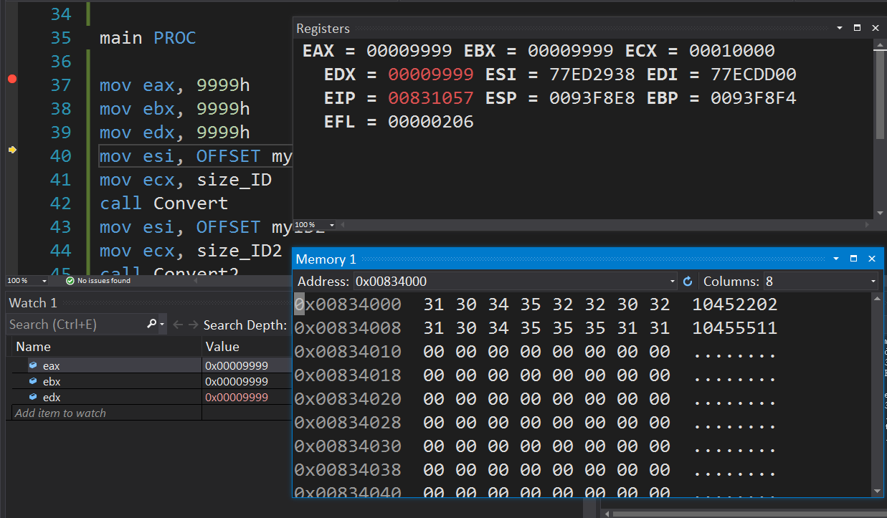
Initial State
Set eax, ebx and edx values to 9999h at the beginning.
Make sure the eax, ebx and edx values do not change after converting all IDs

Slide 4
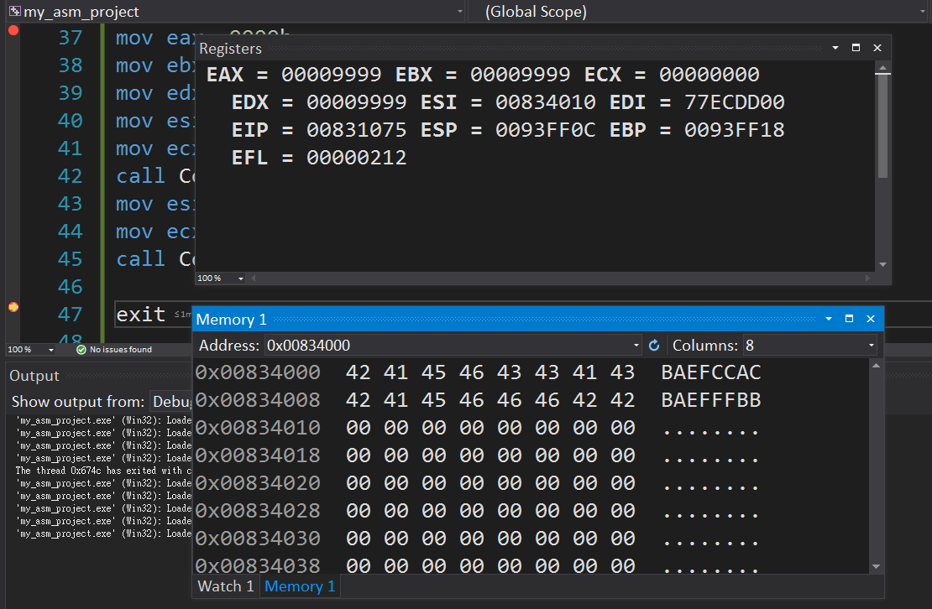
Program Result

Slide 5
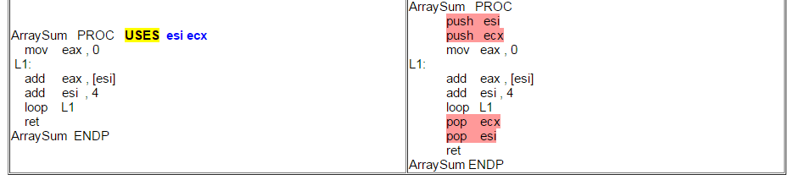
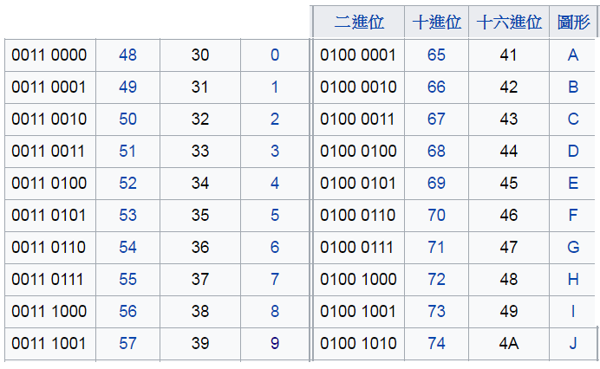
Hint
The use of push and pop instructions needs to be considered to avoid repeated execution of unnecessary instructions
USES operator: List the temporary registers used in the program, generate a push instruction in the beginning of the program, store value of the temporary register into the stack, generate a pop instruction reply at the end of the program
Sample Program | The code will be generated by the assembler
Binary | Decimal | Hexadecimal | Character
Binary | Decimal | Hexadecimal | Character
ASCII CODE

Slide 6
Report
Due to 2023/10/17
Before 12:00
If you submit late, please send a letter to the teaching assistant, points will be deducted
Group Task
Compress(.zip,.rar) the following file with the name of the group ( e.g. lab4_01.zip)
Code(lab4_01.asm)
Report(lab4_01.doc or lab4_01.pdf)
Report Title
Group, name, student ID
Step by step of program execution flow, memory (register) status
Screenshots description, code Description
Reviews for the class, lesson learned, the tools we used, TA, etc

