Slide 1
Vectors, Matrices and their Products
Hung-yi Lee

Slide 2
Learning Target
A system of linear equations:
Describe a system of linear equations by Matrix-Vector Products

Slide 3
Vectors, Matrices and their Products
Vector

Slide 4


Vectors
A vector v is a set of numbers
$$\left[\begin{matrix}1 \\ 2 \\ 3\end{matrix}\right]$$
v=
v=
$$\left[\begin{matrix}1 & 2 & 3\end{matrix}\right]$$
Row vector
Column vector
In this course, the term vector refers to a column vector unless being explicitly mentioned otherwise.

Slide 5
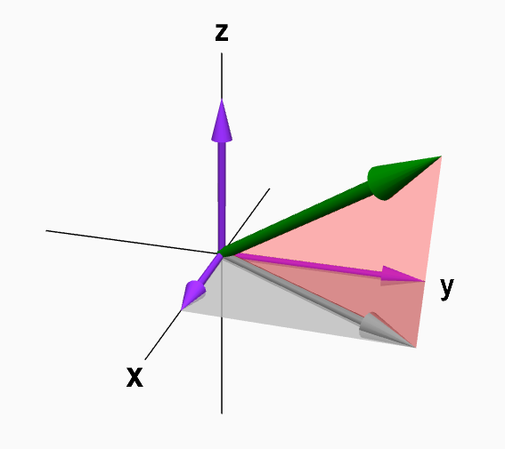
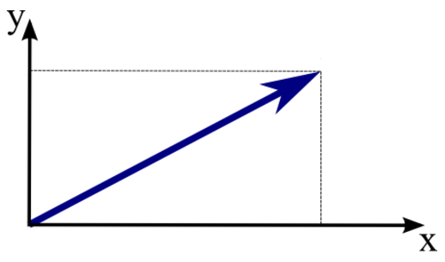

Vectors
$$\left[\begin{matrix}1 \\ 2 \\ 3\end{matrix}\right]$$
v=
components: the entries of a vector.
The i-th component of vector v refers to v_{i}
v₁=1, v₂=2, v₃=3
If a vector only has less than three components, you can visualize it.
v₃
v
v₂
v
v₂
v₁
v₁
http://mathinsight.org/vectors_cartesian_coordinates_2d_3d#vector3D

Slide 6

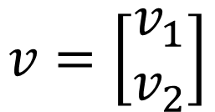






Scalar Multiplication
$$v=\left[\begin{matrix}v_{1} \\ v_{2}\end{matrix}\right]$$
$${2v}_{2}$$
$$2v$$
$$v_{2}$$
$$v$$
$$cv=\left[\begin{matrix}cv_{1} \\ cv_{2}\end{matrix}\right]$$
$$v_{1}$$
$${2v}_{1}$$
Notes:
scalar multiplication for a vector

Slide 7
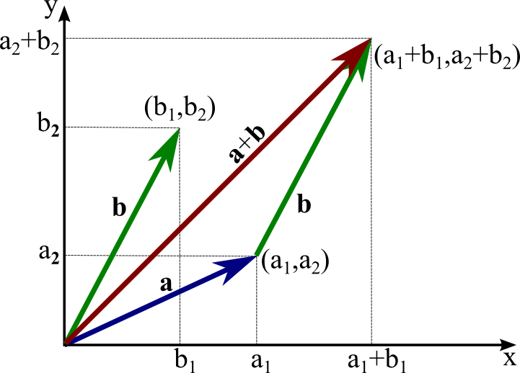
Vector Addition
http://mathinsight.org/vectors_cartesian_coordinates_2d_3d#vector3D

Slide 8




Special Vectors
zero vector $0$
Standard vectors
$$0=\left[\begin{matrix}0 \\ ⋮ \\ 0\end{matrix}\right]$$
$$0+v=v$$
$$0v=0$$
Can be any size

Slide 9
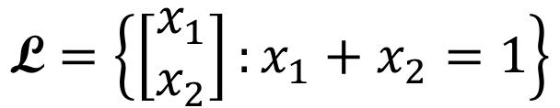

Vector Set
$$\left\{\left[\begin{matrix}1 \\ 2 \\ 3\end{matrix}\right],\left[\begin{matrix}4 \\ 5 \\ 6\end{matrix}\right],\left[\begin{matrix}6 \\ 8 \\ 9\end{matrix}\right],\left[\begin{matrix}9 \\ 0 \\ 2\end{matrix}\right]\right\}$$
A vector set with 4 elements
A vector set can contain infinite elements
$$\text{L}=\left\{\left[\begin{matrix}x_{1} \\ x_{2}\end{matrix}\right]:x_{1}+x_{2}=1\right\}$$
……
……

Slide 10
Vector Set
R^{n} :We denote the set of all vectors with n entries by R^{n} .

Slide 11
Vectors, Matrices and their Products
Matrix

Slide 12





Matrix
A matrix is a set of vectors
$$a_{1}=\left[\begin{matrix}2 \\ 3 \\ −2\end{matrix}\right]$$
$$a_{2}=\left[\begin{matrix}3 \\ 1 \\ 1\end{matrix}\right]$$
$$a_{3}=\left[\begin{matrix}5 \\ −1 \\ 1\end{matrix}\right]$$
$$=\left[\begin{matrix}2 & 3 & 5 \\ 3 & 1 & −1 \\ −2 & 1 & 1\end{matrix}\right]$$
$$A=\left[\begin{matrix}a_{1} & a_{2} & a_{3}\end{matrix}\right]$$

Slide 13


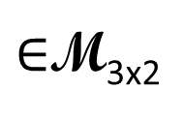
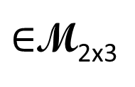
Matrix
If the matrix has m rows and n columns, we say the size of the matrix is m by n, written m x n
The matrix is called square if m=n
We use M_{mxn} to denote the set that contains all matrices whose size is m x n
2 columns
3 columns
$$\left[\begin{matrix}1 & 4 \\ 2 & 5 \\ 3 & 6\end{matrix}\right]$$
2 rows
$$\left[\begin{matrix}1 & 2 & 3 \\ 4 & 5 & 6\end{matrix}\right]$$
3 rows
$∈$M_{3x2}
$∈$M_{2x3}
2 X 3
3 X 2
先 Row 再 Column

Slide 14

Matrix
Index of component: the scalar in the i-th row and j-th column is called (i,j)-entry of the matrix
(1,2)-entry
$$A=\left[\begin{matrix}2 & 3 & 5 \\ 3 & 1 & −1 \\ −2 & 1 & 1\end{matrix}\right]$$
(3,1)-entry
先 Row 再 Column
(3,3)-entry

Slide 15





Matrix
Two matrices with the same size can add or subtract.
Matrix can multiply by a scalar
$$A=\left[\begin{matrix}1 & 4 \\ 2 & 5 \\ 3 & 6\end{matrix}\right]$$
$$B=\left[\begin{matrix}6 & 9 \\ 8 & 0 \\ 9 & 2\end{matrix}\right]$$
$$9B=\left[\begin{matrix}54 & 81 \\ 72 & 0 \\ 81 & 18\end{matrix}\right]$$
$$A+B=\left[\begin{matrix}7 & 13 \\ 10 & 5 \\ 12 & 8\end{matrix}\right]$$
$$A−B=\left[\begin{matrix}−5 & −5 \\ −6 & −5 \\ −6 & 4\end{matrix}\right]$$

Slide 16



Zero Matrix
zero matrix: matrix with all zero entries, denoted by O (any size) or O_{m×n}.
For example, a 2-by-3 zero matrix can be denoted
Identity matrix: must be square
對角線是 1, 其它都是 0
$$A+O=A$$
$$0A=O$$
$$A−A=O$$
Sometimes I_{n} is simply written as I (any size).

Slide 17
Properties
A, B, C are mxn matrices, and s and t are scalars
A + B = B + A
(A + B) + C = A + (B + C)
(st)A = s(tA)
s(A + B) = sA + sB
(s+t)A = sA + tA

Slide 18


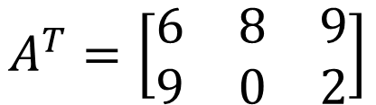
Transpose
If A is an mxn matrix
$A^{T}$ (transpose of A) is an nxm matrix whose (i,j)-entry is the (j-i)-entry of A
(1,2)
$$A=\left[\begin{matrix}6 & 9 \\ 8 & 0 \\ 9 & 2\end{matrix}\right]$$
Transpose
$$A^{T}=\left[\begin{matrix}6 & 8 & 9 \\ 9 & 0 & 2\end{matrix}\right]$$
(2,1)
(2,3)
(3,2)
以左上到右下的對角線為軸進行翻轉

Slide 19

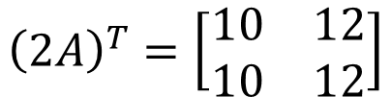

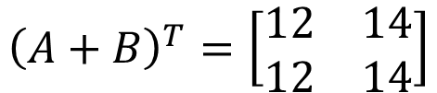
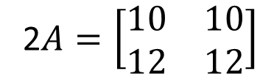
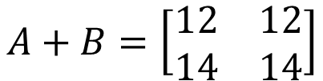

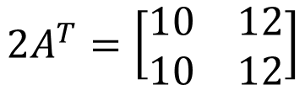
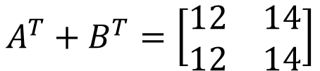



Transpose
$$A=\left[\begin{matrix}5 & 5 \\ 6 & 6\end{matrix}\right]$$
$$B=\left[\begin{matrix}7 & 7 \\ 8 & 8\end{matrix}\right]$$
A and B are mxn matrices, and s is a scalar
${\left(A^{T}\right)}^{T}=A$
${\left(sA\right)}^{T}=sA^{T}$
${\left(A+B\right)}^{T}=A^{T}+B^{T}$
2$A=\left[\begin{matrix}10 & 10 \\ 12 & 12\end{matrix}\right]$
$${\left(2A\right)}^{T}=\left[\begin{matrix}10 & 12 \\ 10 & 12\end{matrix}\right]$$
$$A^{T}=\left[\begin{matrix}5 & 6 \\ 5 & 6\end{matrix}\right]$$
$$2A^{T}=\left[\begin{matrix}10 & 12 \\ 10 & 12\end{matrix}\right]$$
$$A+B=\left[\begin{matrix}12 & 12 \\ 14 & 14\end{matrix}\right]$$
$${\left(A+B\right)}^{T}=\left[\begin{matrix}12 & 14 \\ 12 & 14\end{matrix}\right]$$
$$A^{T}=\left[\begin{matrix}5 & 6 \\ 5 & 6\end{matrix}\right]$$
$$B^{T}=\left[\begin{matrix}7 & 8 \\ 7 & 8\end{matrix}\right]$$
$$A^{T}+B^{T}=\left[\begin{matrix}12 & 14 \\ 12 & 14\end{matrix}\right]$$

Slide 20
Vectors, Matrices and their Products
Matrix-Vector Products

Slide 21
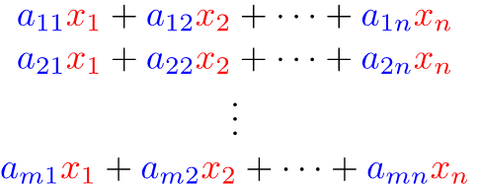



Matrix-Vector Product
$$A=\left[\begin{matrix}\begin{matrix}a_{11} & a_{12} \\ a_{21} & a_{22}\end{matrix} & \begin{matrix}⋯ & a_{1n} \\ ⋯ & a_{2n}\end{matrix} \\ \begin{matrix}⋮ & ⋮ \\ a_{m1} & a_{m2}\end{matrix} & \begin{matrix}⋱ & ⋮ \\ ⋯ & a_{mn}\end{matrix}\end{matrix}\right]$$
$$x=\left[\begin{matrix}\begin{matrix}x_{1} \\ x_{2}\end{matrix} \\ \begin{matrix}⋮ \\ x_{n}\end{matrix}\end{matrix}\right]$$
m x n
$$Ax=$$
Notes:
Familiar?
A is an mxn matrix, and x is an vector with n components

Slide 22



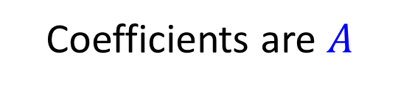


Matrix-Vector Product
$$Ax$$
$$=$$
$$b$$
Linear System
$$x$$
$$Ax$$
Coefficients are $A$

Slide 23


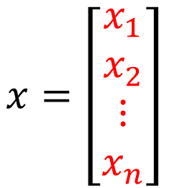
Row Aspect
$$A=\left[\begin{matrix}\begin{matrix}a_{11} & a_{12} \\ a_{21} & a_{22}\end{matrix} & \begin{matrix}⋯ & a_{1n} \\ ⋯ & a_{2n}\end{matrix} \\ \begin{matrix}⋮ & ⋮ \\ a_{m1} & a_{m2}\end{matrix} & \begin{matrix}⋱ & ⋮ \\ ⋯ & a_{mn}\end{matrix}\end{matrix}\right]$$
$$x=\left[\begin{matrix}\begin{matrix}x_{1} \\ x_{2}\end{matrix} \\ \begin{matrix}⋮ \\ x_{n}\end{matrix}\end{matrix}\right]$$
$$Ax=$$

Slide 24

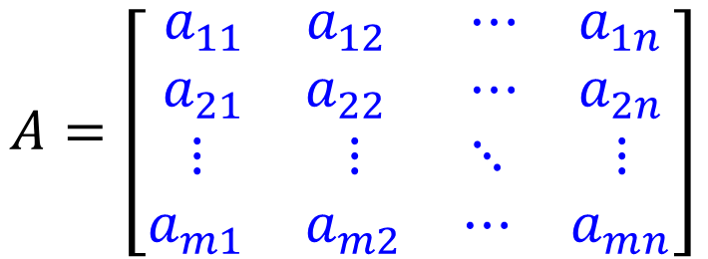
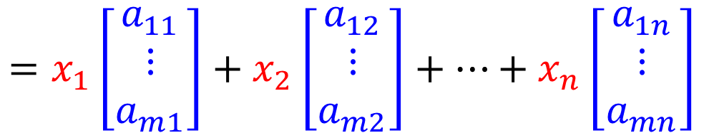

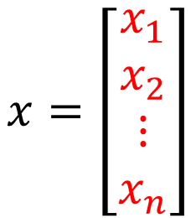
Column Aspect
$$A=\left[\begin{matrix}\begin{matrix}a_{11} & a_{12} \\ a_{21} & a_{22}\end{matrix} & \begin{matrix}⋯ & a_{1n} \\ ⋯ & a_{2n}\end{matrix} \\ \begin{matrix}⋮ & ⋮ \\ a_{m1} & a_{m2}\end{matrix} & \begin{matrix}⋱ & ⋮ \\ ⋯ & a_{mn}\end{matrix}\end{matrix}\right]$$
$$x=\left[\begin{matrix}\begin{matrix}x_{1} \\ x_{2}\end{matrix} \\ \begin{matrix}⋮ \\ x_{n}\end{matrix}\end{matrix}\right]$$
$$=x_{1}\left[\begin{matrix}a_{11} \\ ⋮ \\ a_{m1}\end{matrix}\right]+x_{2}\left[\begin{matrix}a_{12} \\ ⋮ \\ a_{m2}\end{matrix}\right]+…+x_{n}\left[\begin{matrix}a_{1n} \\ ⋮ \\ a_{mn}\end{matrix}\right]$$
$$Ax$$
$$=$$
Notes:
Linear combination of columns of A whose coefficients are the components in x

Slide 25















Example
$$A=\left[\begin{matrix}1 & 4 \\ −3 & 2\end{matrix}\right]$$
$$x_{1}+4x_{2}=b_{1}$$
-2
$$x_{1}$$
A
$$b_{1}$$
$$=Ax$$
$$−3x_{1}+2x_{2}=b_{2}$$
0.5
$$x_{2}$$
$$b_{2}$$
Row 1
$$\left[\begin{matrix}−2 \\ 6\end{matrix}\right]$$
Row 2
column 2
$$\left[\begin{matrix}1 \\ 4\end{matrix}\right]$$
$$\left[\begin{matrix}−3 \\ 2\end{matrix}\right]$$
$$\left[\begin{matrix}4 \\ 2\end{matrix}\right]$$
$$\left[\begin{matrix}2 \\ 1\end{matrix}\right]$$
$$\left[\begin{matrix}−2 \\ 0.5\end{matrix}\right]$$
Column
Aspect
Row
Aspect
$$\left[\begin{matrix}1 \\ −3\end{matrix}\right]$$
column 1
Notes:
$$\left[\begin{matrix}0 \\ 7\end{matrix}\right]$$

Slide 26




Matrix-vector Product
The size of matrix and vector should be matched.
$$A=\left[\begin{matrix}2 & 3 & 5 \\ 3 & 1 & −1 \\ −2 & 1 & 1\end{matrix}\right]$$
$$x=\left[\begin{matrix}1 \\ −1\end{matrix}\right]$$
$$A^{''}=\left[\begin{matrix}\begin{matrix}2 \\ 3\end{matrix} & \begin{matrix}1 \\ 2\end{matrix} \\ \begin{matrix}0 \\ 1\end{matrix} & \begin{matrix}−1 \\ −3\end{matrix}\end{matrix}\right]$$
$$A′=\left[\begin{matrix}1 & −1 \\ 2 & 3 \\ 1 & 4\end{matrix}\right]$$

Slide 27

Properties of Matrix-vector Product
A and B are mxn matrices, u and v are vectors in R^{n}, and c is a scalar.
$A\left(u+v\right)=Au+Av$
$A\left(cu\right)=c\left(Au\right)=\left(cA\right)u$
$\left(A+B\right)u=Au+Bu$
$A0$ is the mx1 zero vector
$Ov$ is also the mx1 zero vector
$I_{n}v=v$
Notes:
The last one can say something.

Slide 28












Properties of Matrix-vector Product
A and B are mxn matrices. If $Aw=Bw$ for all $w$ in R^{n}. Is it true that $A=B$?
$Ae_{j}=a_{j}$ for $j=1,2,⋯,n$, where $e_{j}$ is the j-th standard vector in R^{n}
$$e_{1}=\left[\begin{matrix}1 \\ ⋮ \\ 0\end{matrix}\right]$$
$$Ae_{1}=\left[\begin{matrix}a_{1} & ⋯ & a_{n}\end{matrix}\right]\left[\begin{matrix}1 \\ ⋮ \\ 0\end{matrix}\right]$$
$$=1∙a_{1}+0∙a_{2}+⋯+0∙a_{n}$$
$$=a_{1}$$
$$Ae_{1}=Be_{1}$$
$$Ae_{2}=Be_{2}$$
$$Ae_{n}=Be_{n}$$
……
$$A=B$$
$$a_{1}=b_{1}$$
$$a_{2}=b_{2}$$
$$a_{n}=b_{n}$$
Notes:
http://betterexplained.com/articles/linear-algebra-guide/

Slide 29





Concluding Remarks
$$A=\left[\begin{matrix}\begin{matrix}a_{11} & a_{12} \\ a_{21} & a_{22}\end{matrix} & \begin{matrix}⋯ & a_{1n} \\ ⋯ & a_{2n}\end{matrix} \\ \begin{matrix}⋮ & ⋮ \\ a_{m1} & a_{m2}\end{matrix} & \begin{matrix}⋱ & ⋮ \\ ⋯ & a_{mn}\end{matrix}\end{matrix}\right]$$
$$x=\left[\begin{matrix}\begin{matrix}x_{1} \\ x_{2}\end{matrix} \\ \begin{matrix}⋮ \\ x_{n}\end{matrix}\end{matrix}\right]$$
Row
Aspect
$$Ax$$
$$=$$
$$=x_{1}\left[\begin{matrix}a_{11} \\ ⋮ \\ a_{m1}\end{matrix}\right]+x_{2}\left[\begin{matrix}a_{12} \\ ⋮ \\ a_{m2}\end{matrix}\right]+…+x_{n}\left[\begin{matrix}a_{1n} \\ ⋮ \\ a_{mn}\end{matrix}\right]$$
Column
Aspect
Notes:
Matrix-vector Product Ax
Row Aspect
Inner project of x to each row of A
Column Aspect
The combination of columns of A
The elements in x is the coefficients

