Slide 1

EXPLORING COLUMNAR EXECUTION IN DUCKDB THROUGH A SALES ANALYTICS APPLICATION
Yunhui Dong

Slide 2
INTRODUCTION
Built a sales analytics application using DuckDB and Python
Goal: connect DuckDB internals to analytical application behavior
Dataset: supermarket sales data

Slide 3
CORE INTERNAL FOCUS AREAS
Columnar storage
Vectorized query execution
DuckDB is designed for analytical / OLAP workloads
Good fit for scans, filtering, and grouped aggregation

Slide 4
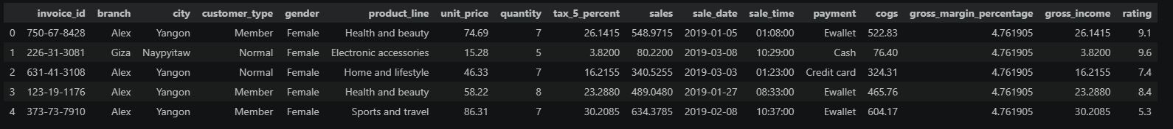
APPLICATION OVERVIEW
Main table: supermarket_sales
Key columns: city, product_line, sales, sale_date, payment
Main operations:
total sales by city
sales in a date range
average sales by product line

Slide 5
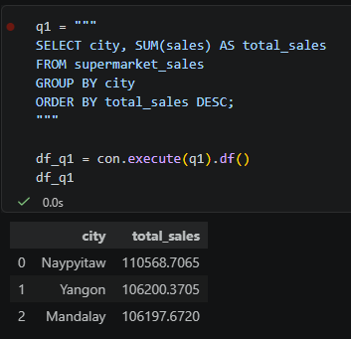
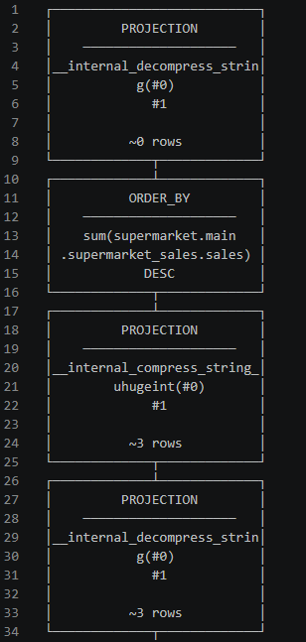
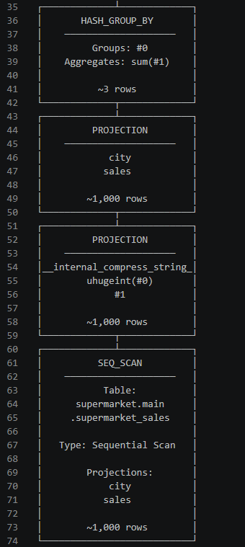
MAJOR OPERATION 1: TOTAL SALES BY CITY
What the application does
Computes total sales for each city
What the database does internally
Reads city and sales
Performs grouped aggregation
EXPLAIN shows HASH_GROUP_BY
Why that internal behavior matters
The query does not need all columns in the table
This shows how DuckDB supports analytical aggregation efficiently
Sequential scan of city and sales → hash-based grouping by city →
sum sales for each group → sort results by total sales descending

Slide 6
MORE MAJOR OPERATIONS AND INTERNAL MAPPINGS
Operation 2: Sales in a Date Range
Application: computes total sales in a selected time window
Database: filters rows on sale_date and aggregates sales
Why it matters: shows how filtering and aggregation support reporting workloads
Operation 3: Average Sales by Product Line
Application: compares product categories by average sales
Database: groups by product_line and aggregates sales
Why it matters: shows another analytical query pattern supported by DuckDB

Slide 7
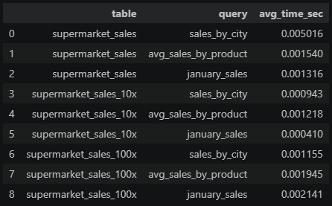
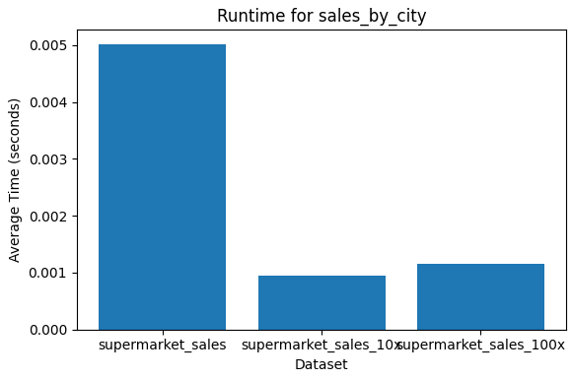
VALIDATION AND CONCLUSION
Validation
Used EXPLAIN and EXPLAIN ANALYZE to inspect query behavior
Created scaled datasets: original / 10x / 100x
Compared runtime for representative analytical queries
Key Takeaways
DuckDB is a good fit for analytical workloads
Grouped aggregation and filtering map naturally to its execution model
The application demonstrates how database internals affect query behavior

Slide 8
THANK
YOU

