Slide 1








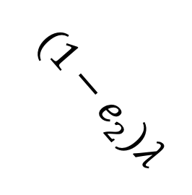




$$S$$
$$λ$$
$$E$$
$$κ$$
$$I$$
$$α$$
$$H$$
$$γ$$
$$R$$
$$(1−e_{1})λ$$
$$(1−e_{2})λ$$
# of vaccinated
(1st dose)
$$V_{1}$$
$$V_{2}$$
# of vaccinated
(2nd dose)

