Slide 1

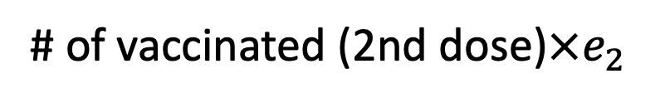


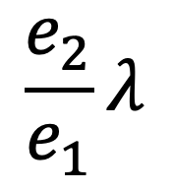







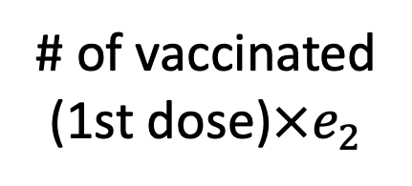
$$S$$
$$λ$$
$$E$$
$$κ$$
$$I$$
$$α$$
$$H$$
$$γ$$
$$R$$
$$\frac{e_{2}}{e_{1}}λ$$
# of vaccinated
(1st dose)$×e_{2}$
$$V$$
# of vaccinated (2nd dose)$×e_{2}$

