Slide 1

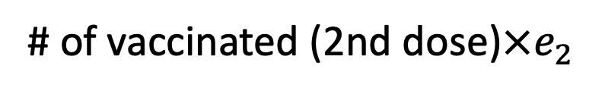


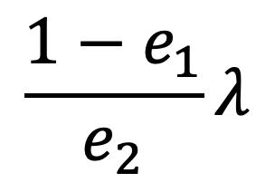







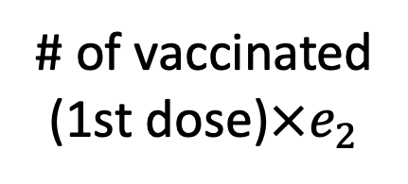
$$S$$
$$λ$$
$$E$$
$$κ$$
$$I$$
$$α$$
$$H$$
$$γ$$
$$R$$
$$\frac{{1−e}_{1}}{e_{2}}λ$$
# of vaccinated
(1st dose)$×e_{2}$
$$V$$
# of vaccinated (2nd dose)$×e_{2}$

