Slide 1

Tensorflow tutorial
Yoon-gu Hwang

Slide 2

Tensorflow?
TensorFlow was originally developed by the Google Brain team for Google's research and production purposes
TensorFlow is Google Brain's second generation machine learning syste
Under the Apache 2.0 open source license on November 9, 2015

Slide 3
Simple mathematical expression
$$Minimize_{W, b} J\left(x\right)=E(f\left(W,b,x\right)−y)$$

Slide 4
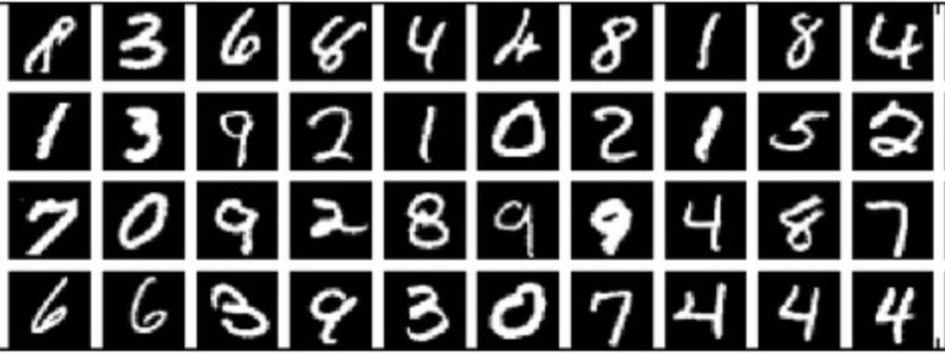
Mnist dataset

Slide 5
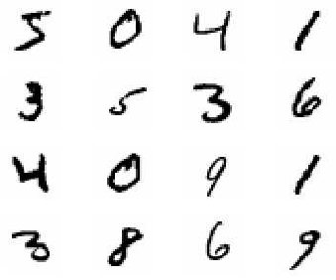
MNIST?
Mixed National Institute of Standards and Technology database
Handwritten Digits
60,000 training images
10,000 test images
28 x 28 images
28
28

Slide 6
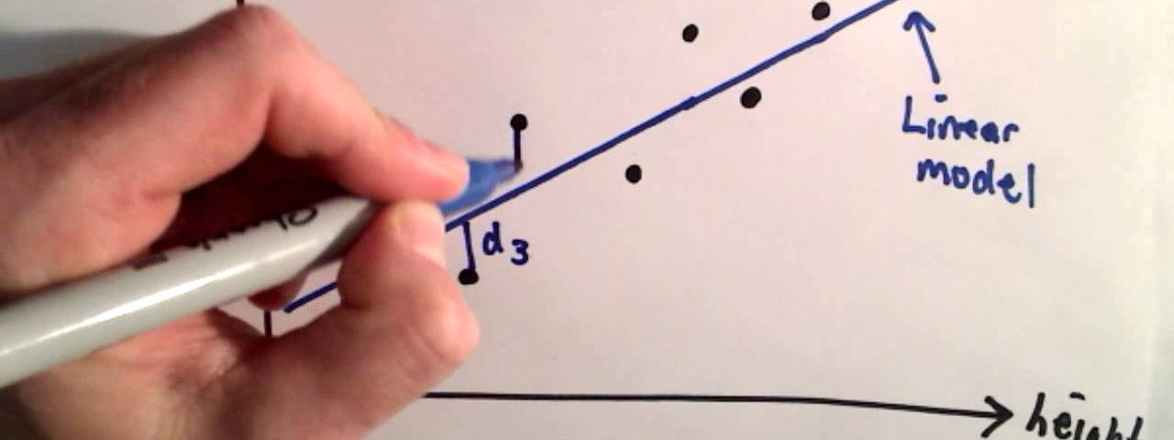
Linear regression

Slide 7
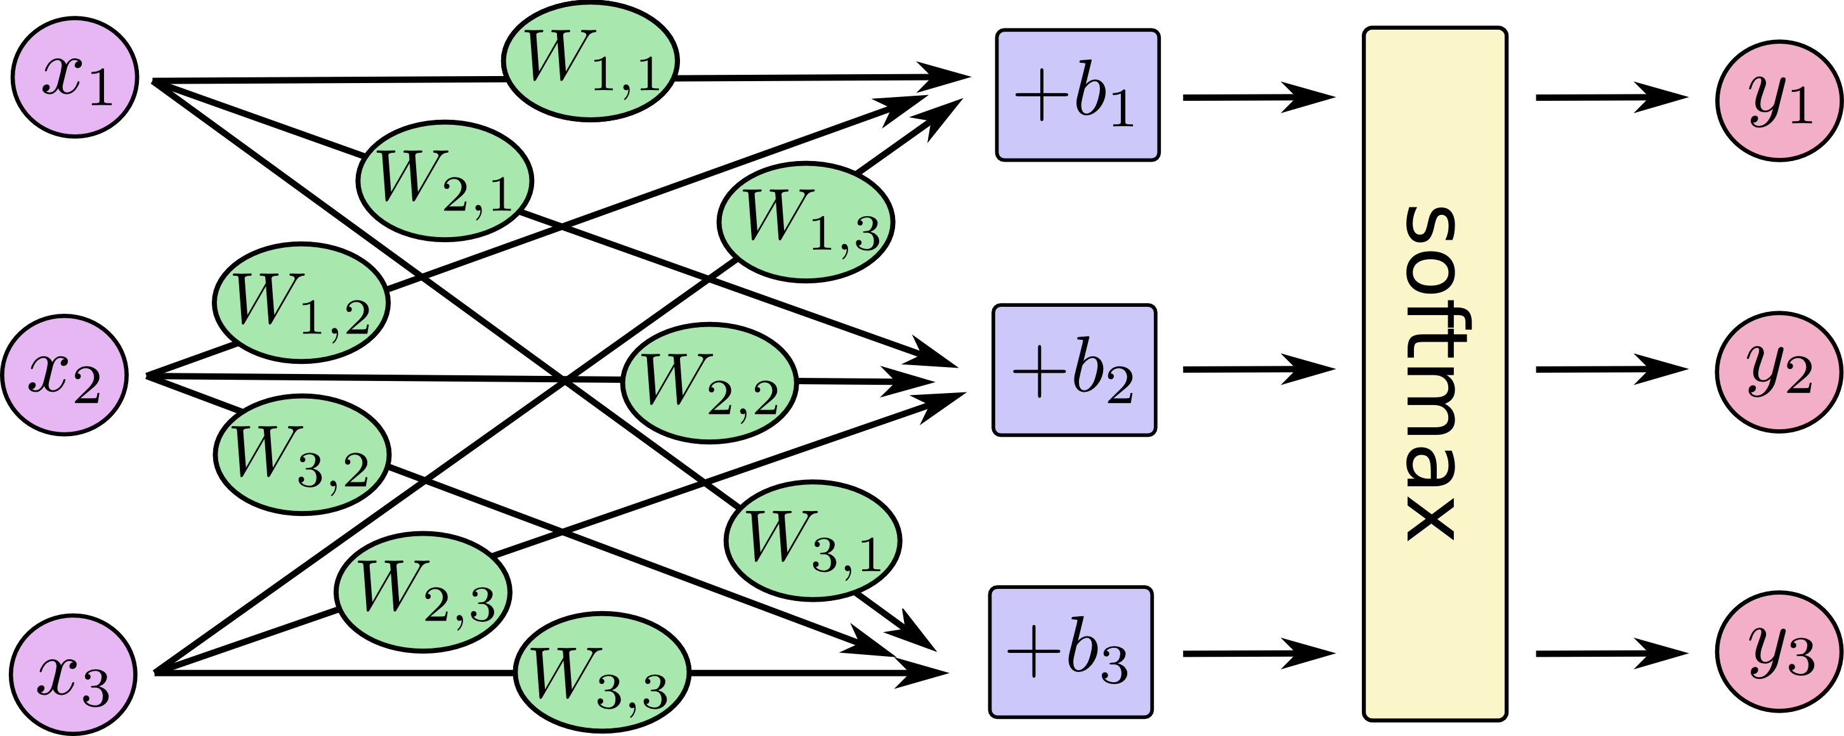

Slide 8
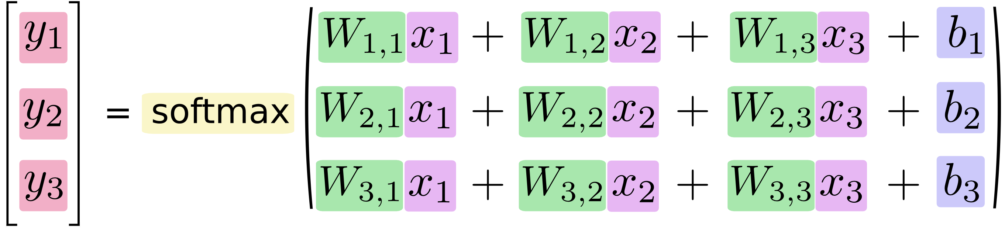

Slide 9
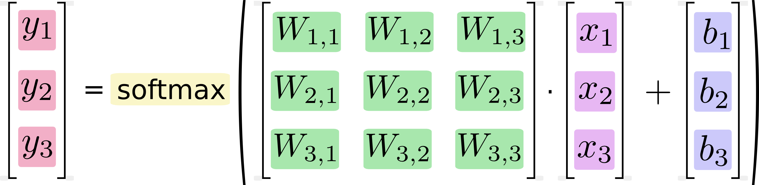

Slide 10
Variable types
x = tf.placeholder(…)
W = tf.Variable(…)
b = tf.Variable(…)
y = tf.nn.softmax(tf.matmul(x, W) + b)

Slide 11
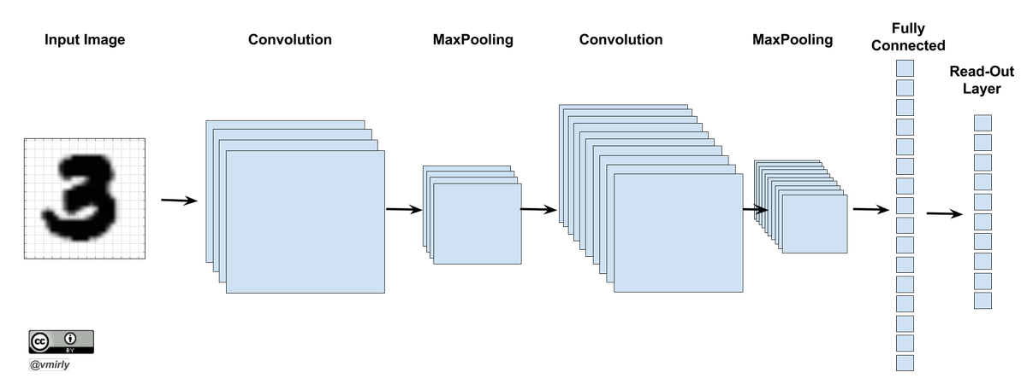
Convolutionary neural network

