Slide 1
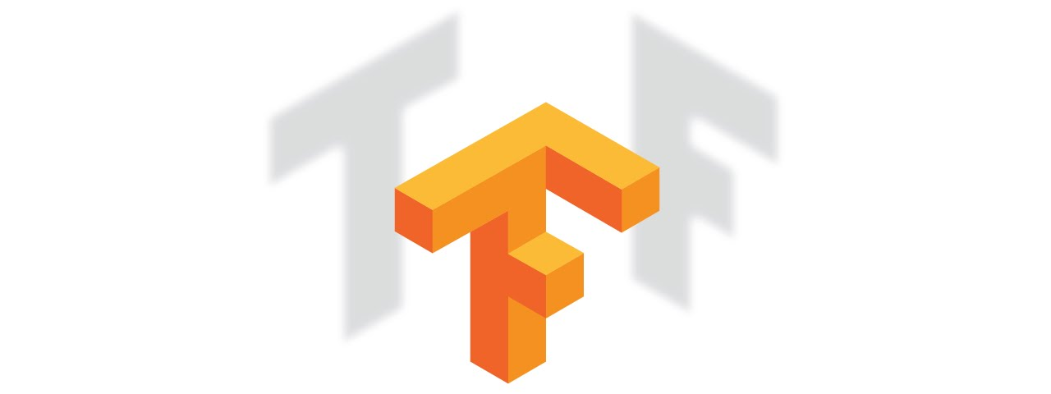
Tensorflow tutorial
Yoon-gu Hwang

Slide 2

Tensorflow?
TensorFlow was originally developed by the Google Brain team for Google's research and production purposes
TensorFlow is Google Brain's second generation machine learning syste
Under the Apache 2.0 open source license on November 9, 2015

Slide 3
Mechanics 101
Build Graph
Train the Model
Evaluate the Model

