Slide 1


Modeling Sentiment Evolution of Social Events
Yunjie Wang, Chen Lin, Hui Li
Xiamen University

Slide 2


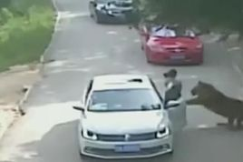


Background: public opinion for social incident
Challenge1: identify entity-level sentiment
“zoo should be responsible”
“Did anyone notice that passengers should not get off”
“The zoo has done its best, passengers leaving the car are irresponsible”
“we are so sad, RIP”
“The family should be compensated for their losses”
“No matter what, it is a tragedy for the family”
Tiger Attack in Beijing
2016.07.23
A family was attacked by a tiger. Mother was killed rescuing her daughter who left the vehicle.
Challenge2: distinguish sentiment shift from background opinion evolution
2016.07
2016.10
2016.11

Slide 3




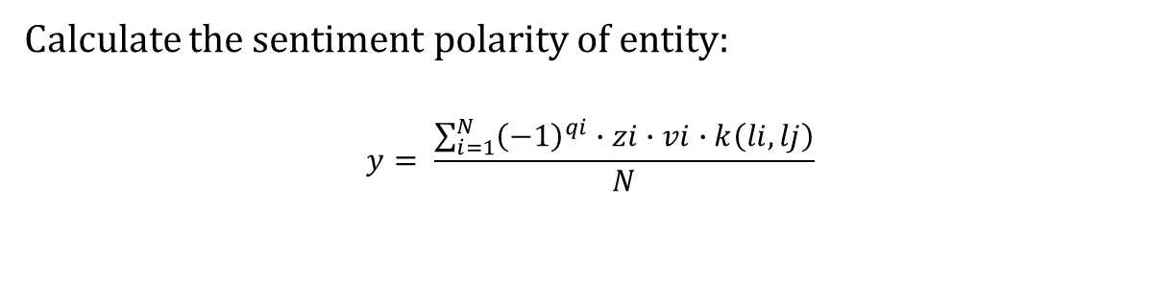




Solution1: Proximity-Based Entity-Level Sentiment Extraction (PESE)
proximity -> relevance
The zoo has done its best, and it is so irresponsible for the passengers to break the rule
$$li$$
$$lj$$
$$lj$$
$$li$$
Distance kernels:
Gaussian:
$$k\left(l_{i},lj\right)=\exp\left[\frac{−{\left(l_{i}−lj\right)}^{2}}{2σ^{2}}\right]$$
Cosine:
$$k\left(l_{i},lj\right) =\left\{\begin{aligned}\frac{1}{2}\left[1+cos\left(\frac{\left|li−lj\right|∙π}{σ}\right)\right],if\left|li−lj\right| <σ \\ & 0 otherwise\end{aligned}\right.$$
Calculate the sentiment polarity of entity:
$$y= \frac{\sum_{i=1}^{N}{{\left(−1\right)}^{qi}∙zi∙vi∙k\left(li,lj\right)}}{N}$$
Circle:
$$k\left(l_{i},lj\right) =\left\{\begin{aligned}\sqrt{1−\frac{{\left|li−lj\right|}^{2}}{σ}},if\left|li−lj\right| <σ \\ & 0 otherwise\end{aligned}\right.$$
Triangle:
$$k\left(l_{i},lj\right) =\left\{\begin{aligned}1−\frac{\left|li−lj\right|}{σ}, if\left|li−lj\right| <σ \\ & 0 otherwise\end{aligned}\right.$$
Notes:
G,I,C,T
Li, lj
进度条动画
Y in Equ. 1

Slide 4






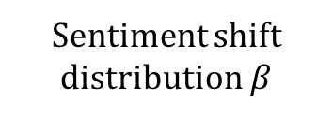


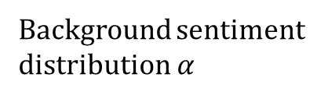

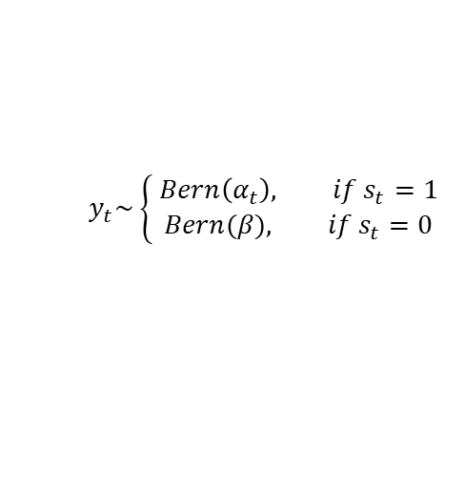
Solution2: Public Sentiment Evolution Model (PSEM)
Time $t$
201607
201610
201611
$$α_{0}\sim N\left(0,σ^{2}\right)$$
$$α_{1}\sim N\left(α_{0},σ^{2}\right)$$
$$α_{2}\sim N\left(α_{1},σ^{2}\right)$$
Background sentiment distribution $α$
+ -
+ -
+ -
$$α_{0}$$
No evidence or facts
$$α_{1}$$
$$α_{2}$$
No evidence or facts
New evidence appears
Switch $s$
Switch is OFF
Switch is OFF
Switch is ON
“zoo should be responsible”
“we are so sad, RIP”
“Did anyone notice that passengers should not get off”
“The family should be compensated for their losses”
“The zoo has done its best, passengers leaving the car are irresponsible”
“No matter what, it is a tragedy for the family”
$$y_{t}\sim \left\{\begin{aligned} Bern\left(α_{t}\right), if s_{t}=1 \\ Bern(β), if s_{t}=0\end{aligned}\right.$$
Posts $y$
Sentiment shift distribution $β$
+ -
Sentiment shift

Slide 5
Proximity-Based Entity-Level Sentiment Extraction Results
Methods | Comments Length
 | 0-20 words |  | 20-40 words |  | 40+ words
 | Positive | Negative | Positive | Negative | Positive | Negative
SentiStrength | 0.3774 | 0.5808 | 0.2254 | 0.3906 | 0.3938 | 0.3622
SentiStrength-SE | 0.6014 | 0.6951 | 0.5040 | 0.5843 | 0.5752 | 0.6467
SentiCR | 0.7953 | 0.7855 | 0.7911 | 0.7005 | 0.7404 | 0.7861
MCNN | 0.8199 | 0.8068 | 0.8019 | 0.8060 | 0.8003 | 0.8082
RCNN | 0.8284 | 0.8283 | 0.8291 | 0.8211 | 0.8393 | 0.8353
PESE-I | 0.8038 | 0.8170 | 0.8011 | 0.8032 | 0.8034 | 0.8166
PESE-C | 0.8242 | 0.8212 | 0.8269 | 0.8229 | 0.8249 | 0.8291
PESE-T | 0.8302 | 0.8342 | 0.8398 | 0.8479 | 0.8470 | 0.8486
PESE-G | 0.8477 | 0.8588 | 0.8539 | 0.8771 | 0.8862 | 0.9289
Datasets: 14 incidents from Weibo
6 incidents from Twitter
Gaussian kernel function performs best
Lower accuracy on positive posts
Longer posts, higher accuracy

Slide 6
Public Sentiment Evolution Model Results
Precision
Recall
 | POMS | LDA-KL | FB-LDA | PSEM
Precision | 0.5950 | 0.7000 | 0.7750 | 0.8950
Recall | 0.5265 | 0.6195 | 0.6858 | 0.7920
Our model PSEM achieves the best results in detecting shift points and significantly exceeds the second best method (FB-LDA) with significance level p < 0.001
Notes:
POMS, FBLDA and LDA-KL. Reference

Slide 7
Conclusion
Our work:
To improve entity-level sentiment extraction, we use distance kernels to calculate the inﬂuence of sentiment words on entities.
We consider the existence of background sentiment to propose a novel sentiment evolution model which is based on state space models.
Future work:
we plan to endow the model with the ability to explain the causes of sentiment shifts.

Slide 8
Thank you~
Notes:
Question answering
1) Data

