Slide 1

Mid-Project
EDA on Netflix Movies and TV Shows
Yunling Ge

Slide 2

Agenda
Introduction
EDA

Slide 3

DATA FEATURES
Data source -> kaggle.com
Dataset ->（8807,12）
Type (Movie / TV Show)
Title
Director
Cast
Country
Date_added
Release_year
Rating
Duration
Listed_in (Genre)
Description

Slide 4

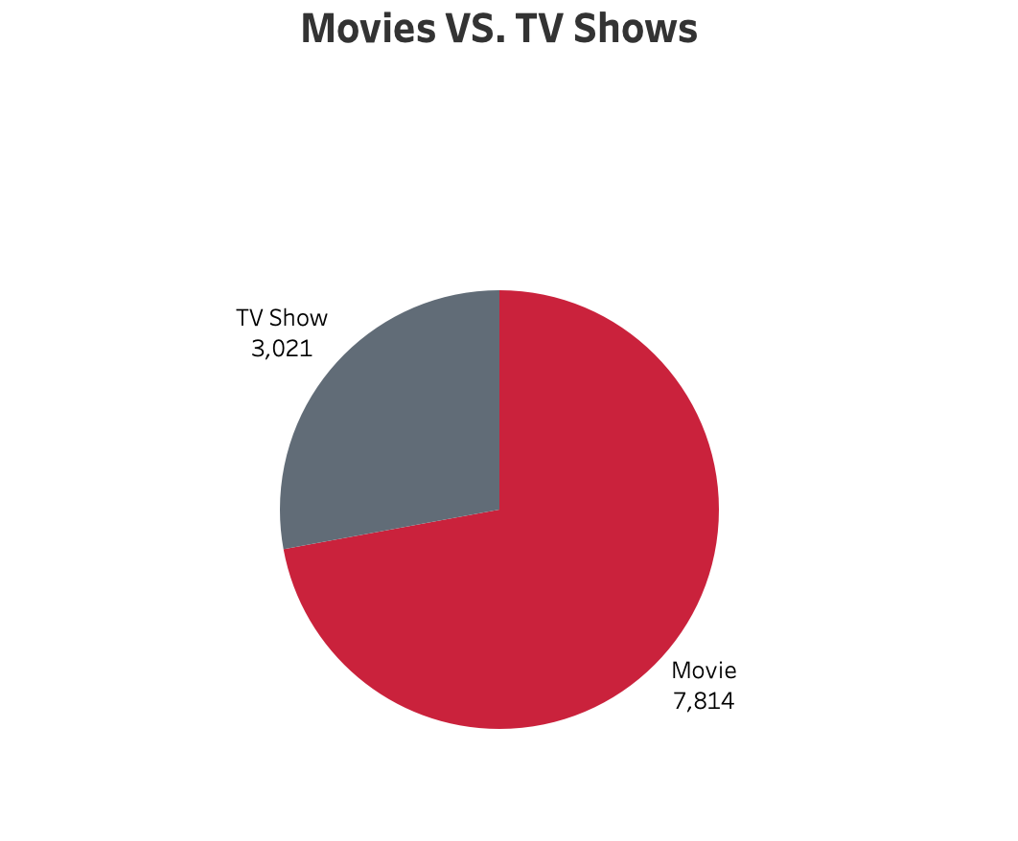

Slide 5
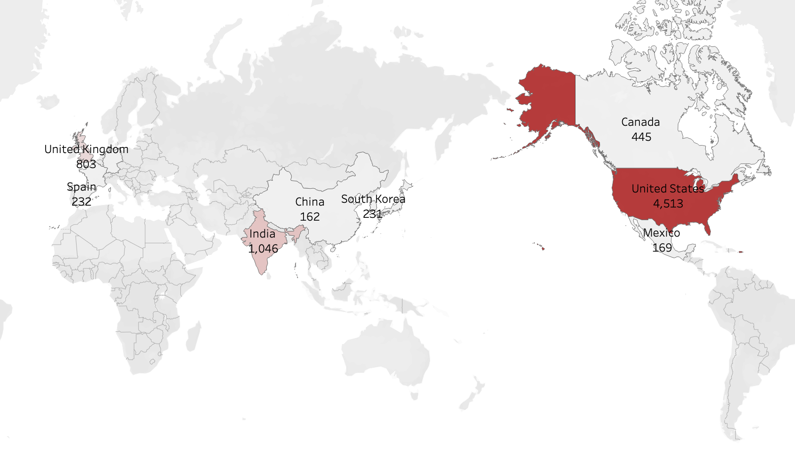
Q1: Top countries directed Movies and TV shows?

Slide 6

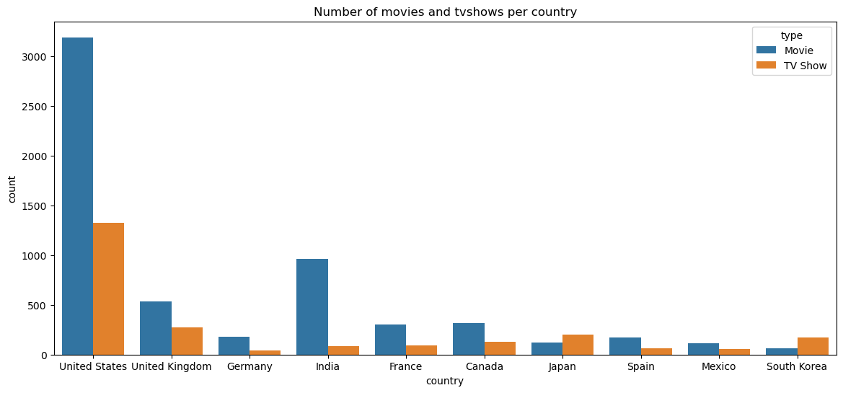
Top countries comparison in Movie and TV show filed

Slide 7

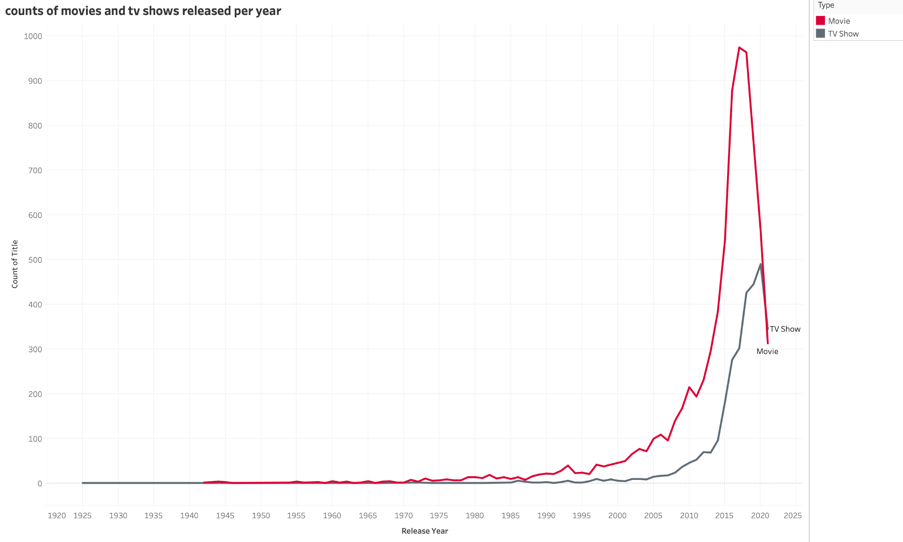
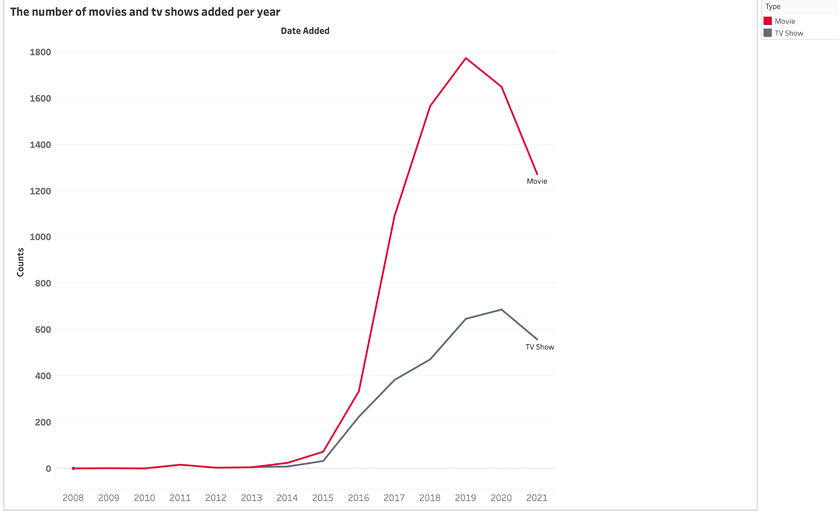
Q2: Which year released the most Movies and TV shows?

Slide 8

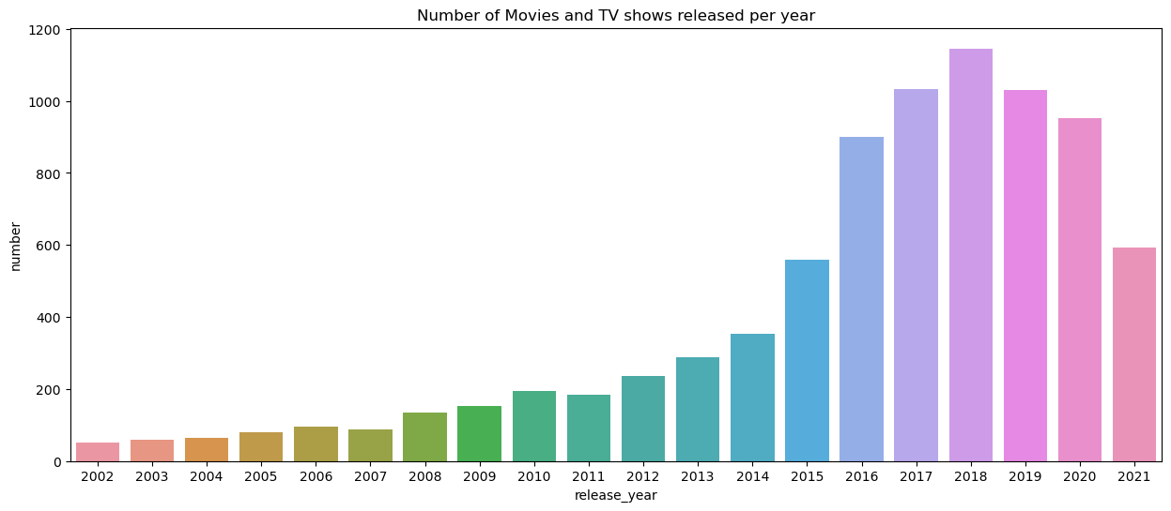

Slide 9

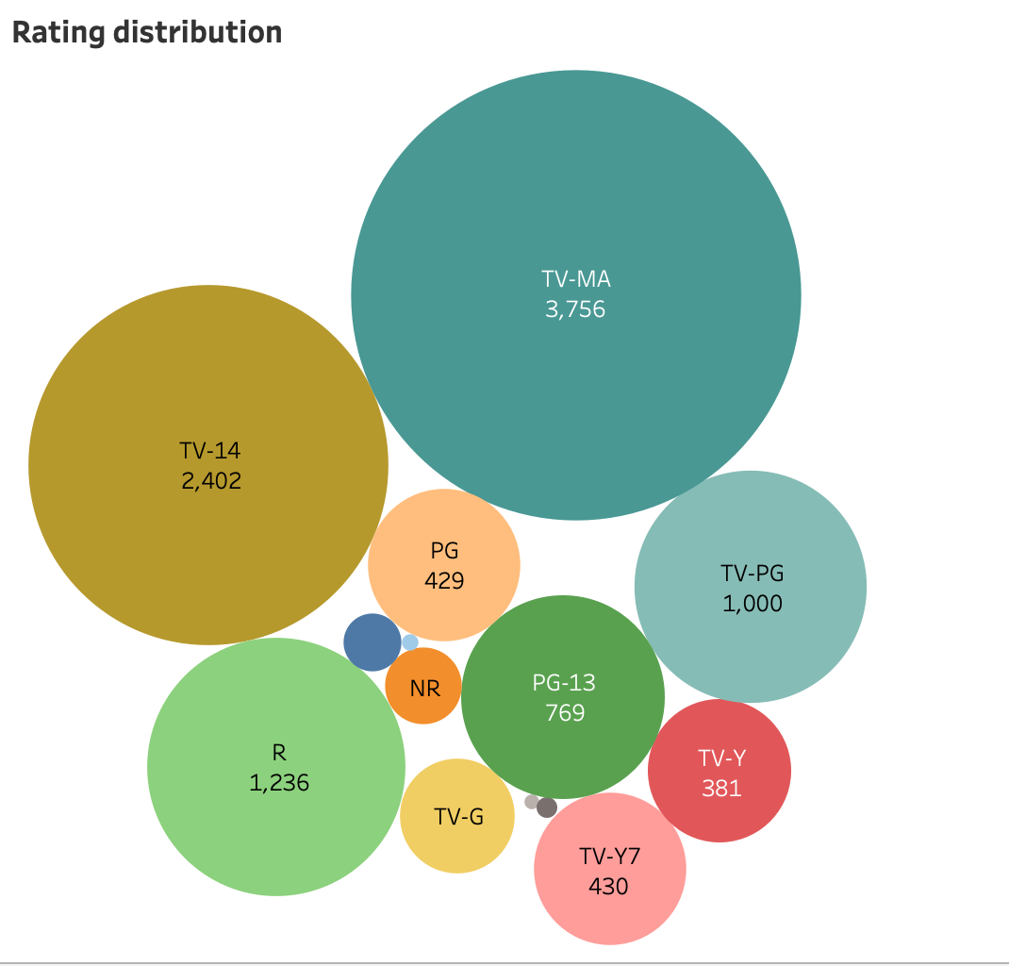
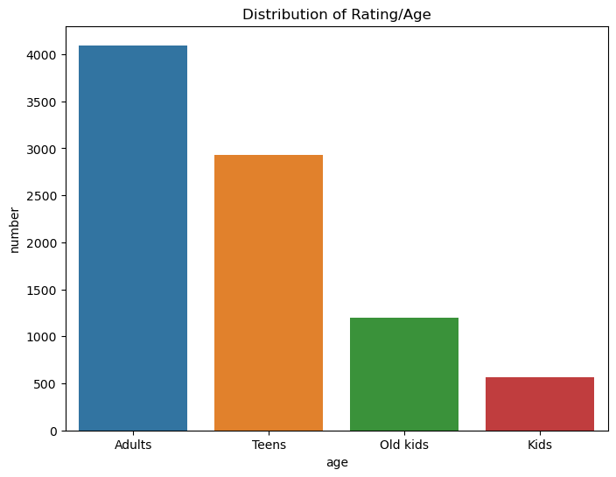
Q3: Which age group is the main audience in Netflix?
Notes:
'kids': G,TV-G,TV-Y
'Old kids': TV-Y7,TV-Y7-FV,TV-PG
'Teens': PG,PG-13,TV-14
'Adults': R,NC-17,UR,NR,TV-MA

Slide 10

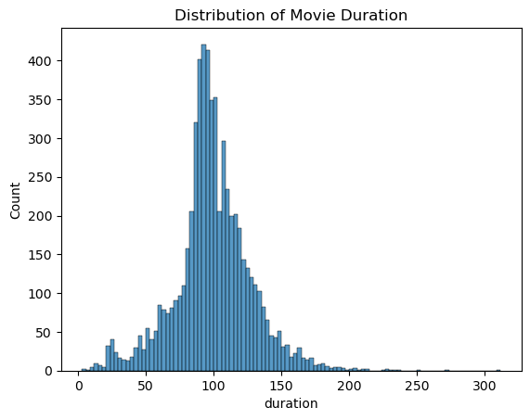
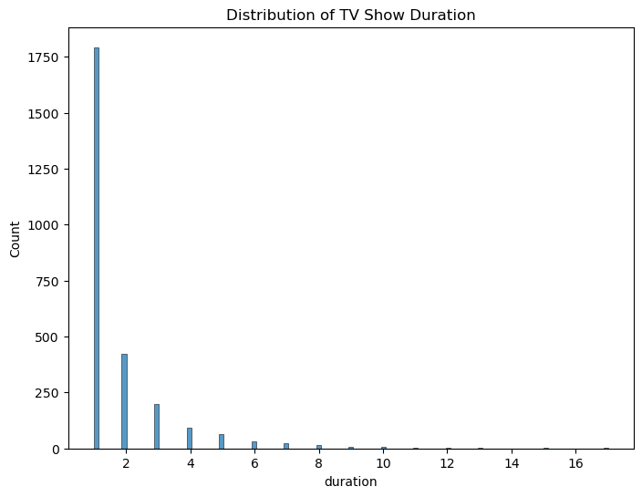
Q4: The length of most movies and TV shows in Netflix?

Slide 11

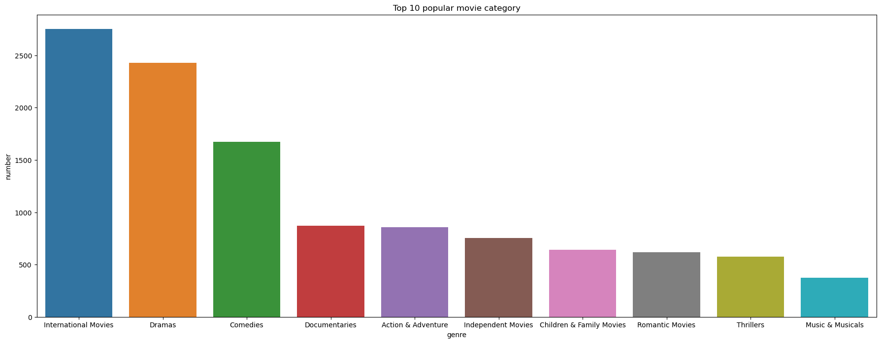
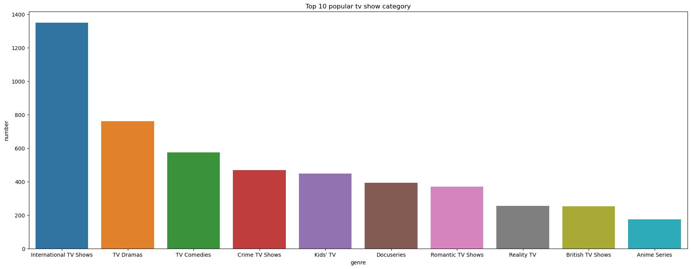
Q5: The most popular genre in Netflix?

Slide 12

Thank you for your attention!

