Slide 1

Mid-Project
EDA on Netflix Movies and TV Shows
Yunling Ge

Slide 2

Agenda
Introduction
EDA

Slide 3

DATA FEATURESES
Dataset source -> kaggle.com
Dataset ->（8807,12）
Type (Movie / TV Show)
Title
Director
Cast
Country
Date_added
Release_year
Rating
Duration
Listed_in (Genre)
Description

Slide 4

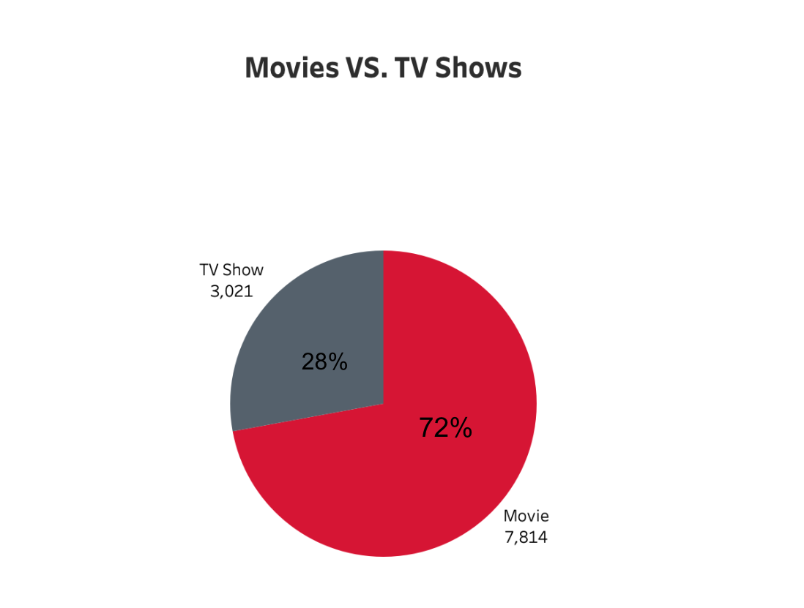

Slide 5
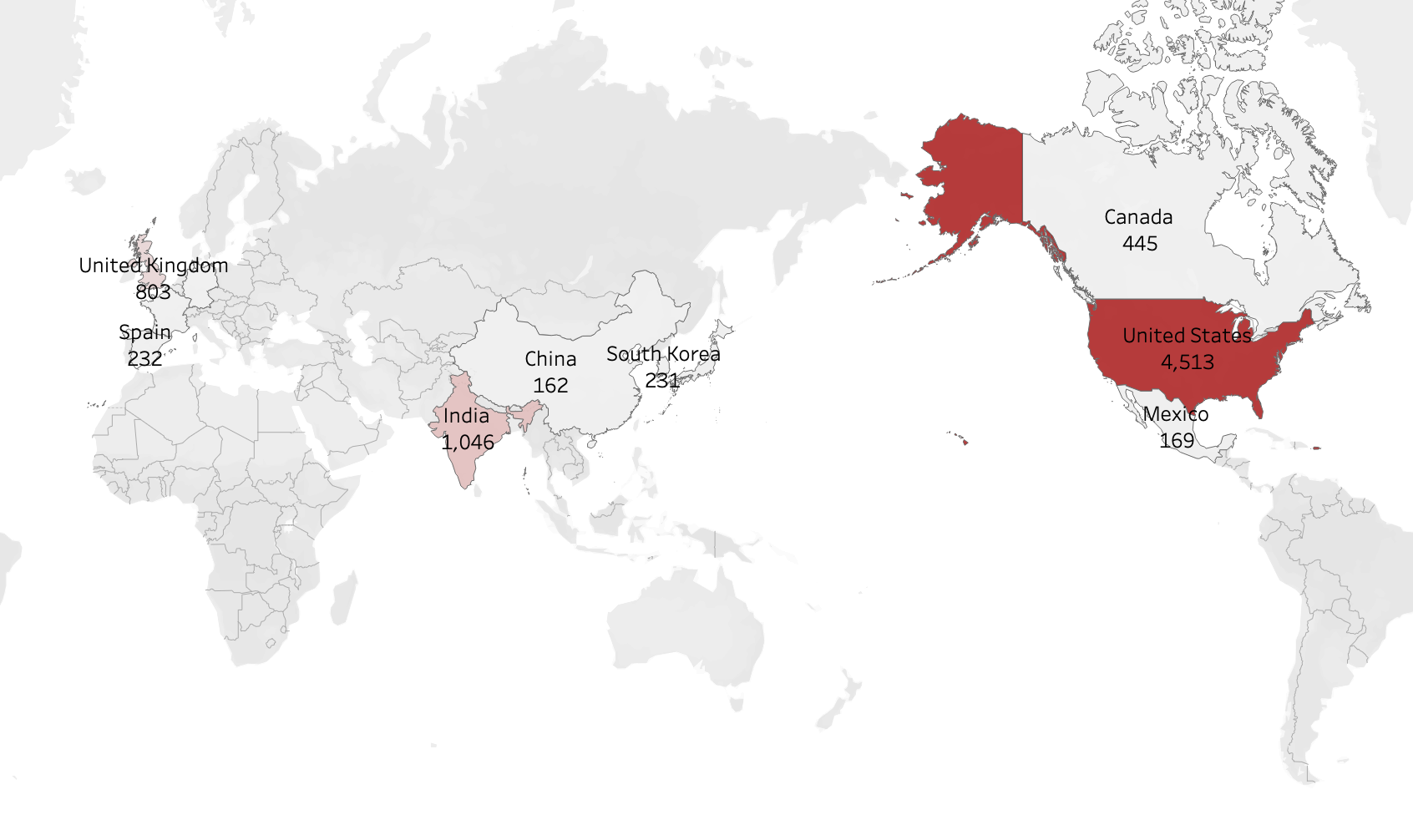
Q1: Top countries for Movies and TV shows production?

Slide 6

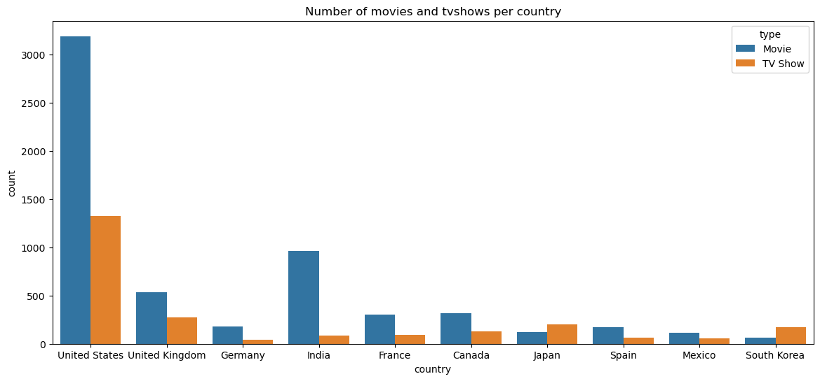
Movies VS. TV shows in top 10 countries

Slide 7

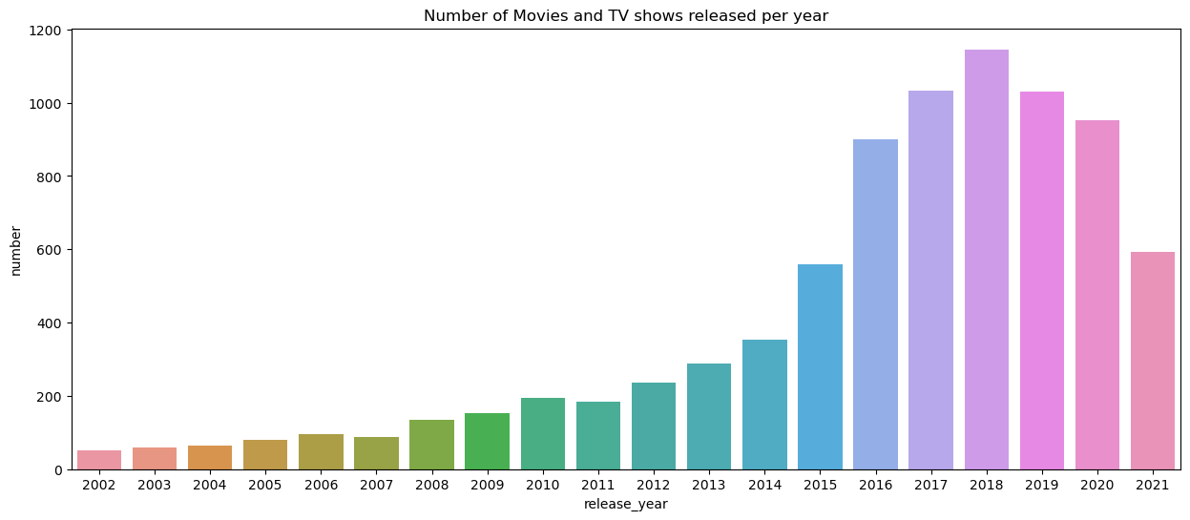
Q2: Which year released the most Movies and TV shows?

Slide 8

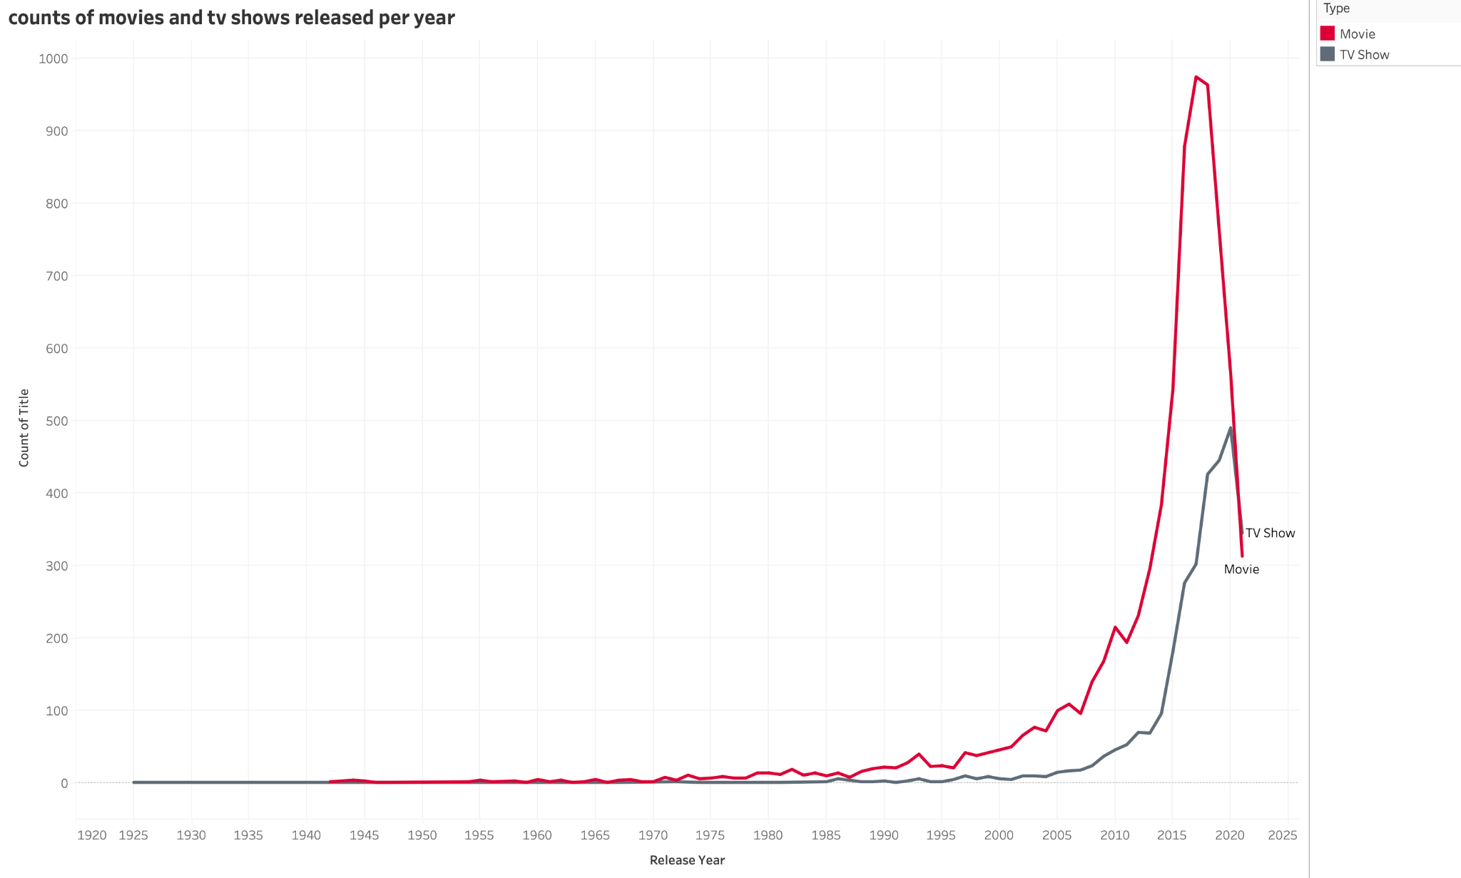
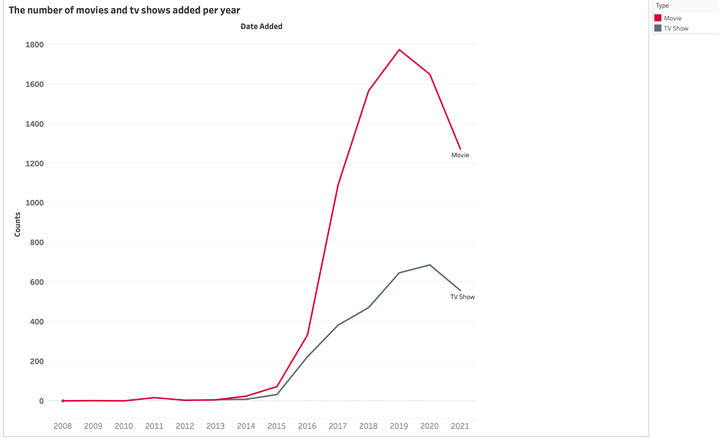

Slide 9

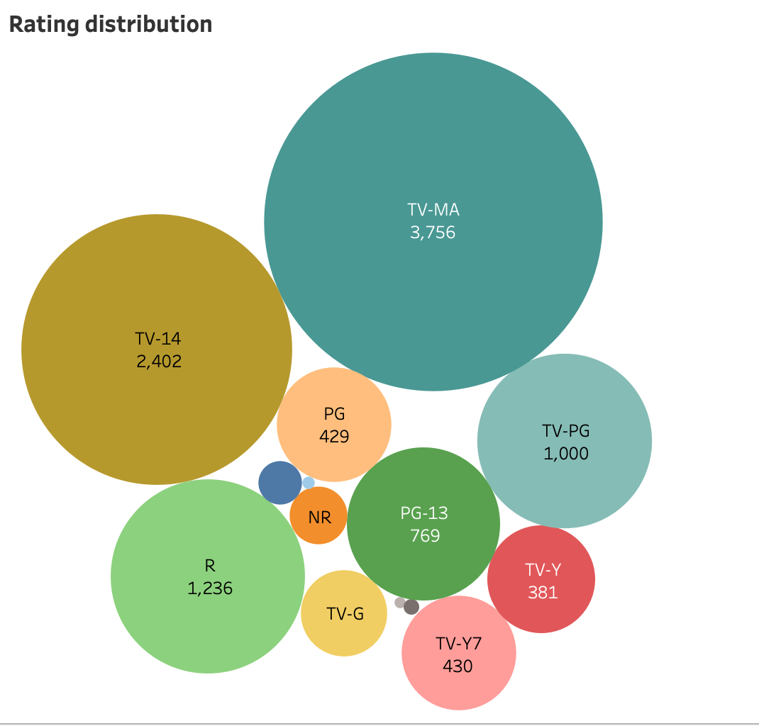
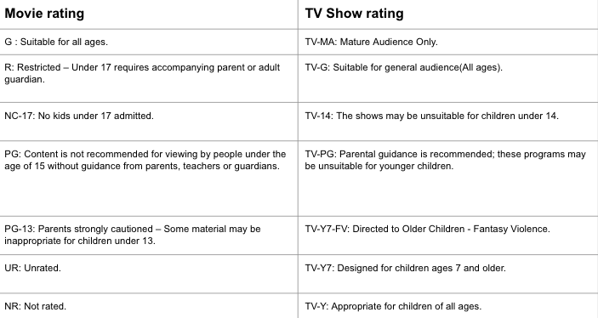
Q3: Which age group is the main audience in Netflix?
Notes:
'kids': G,TV-G,TV-Y
'Old kids': TV-Y7,TV-Y7-FV,TV-PG
'Teens': PG,PG-13,TV-14
'Adults': R,NC-17,UR,NR,TV-MA

Slide 10

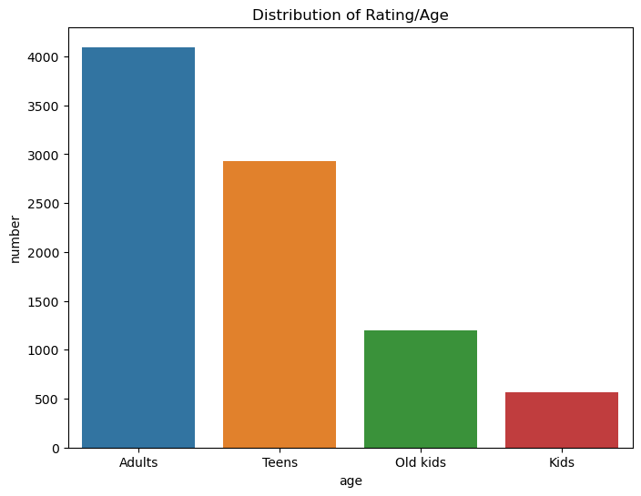
Age group | Rating
Adults | R,NC-17,UR,NR,TV-MA
Teens | PG,PG-13,TV-14
Old kids | TV-Y7,TV-Y7-FV,TV-PG
Kids | G,TV-G,TV-Y

Slide 11

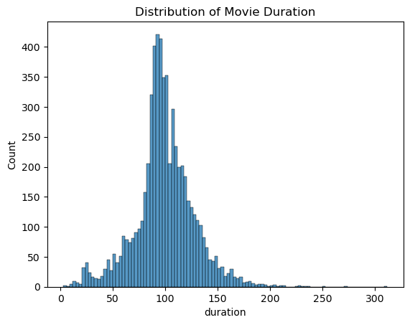
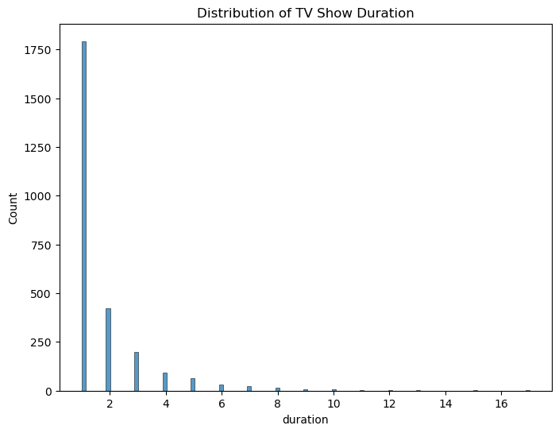
Q4: The distribution of movies and TV shows duration?

Slide 12

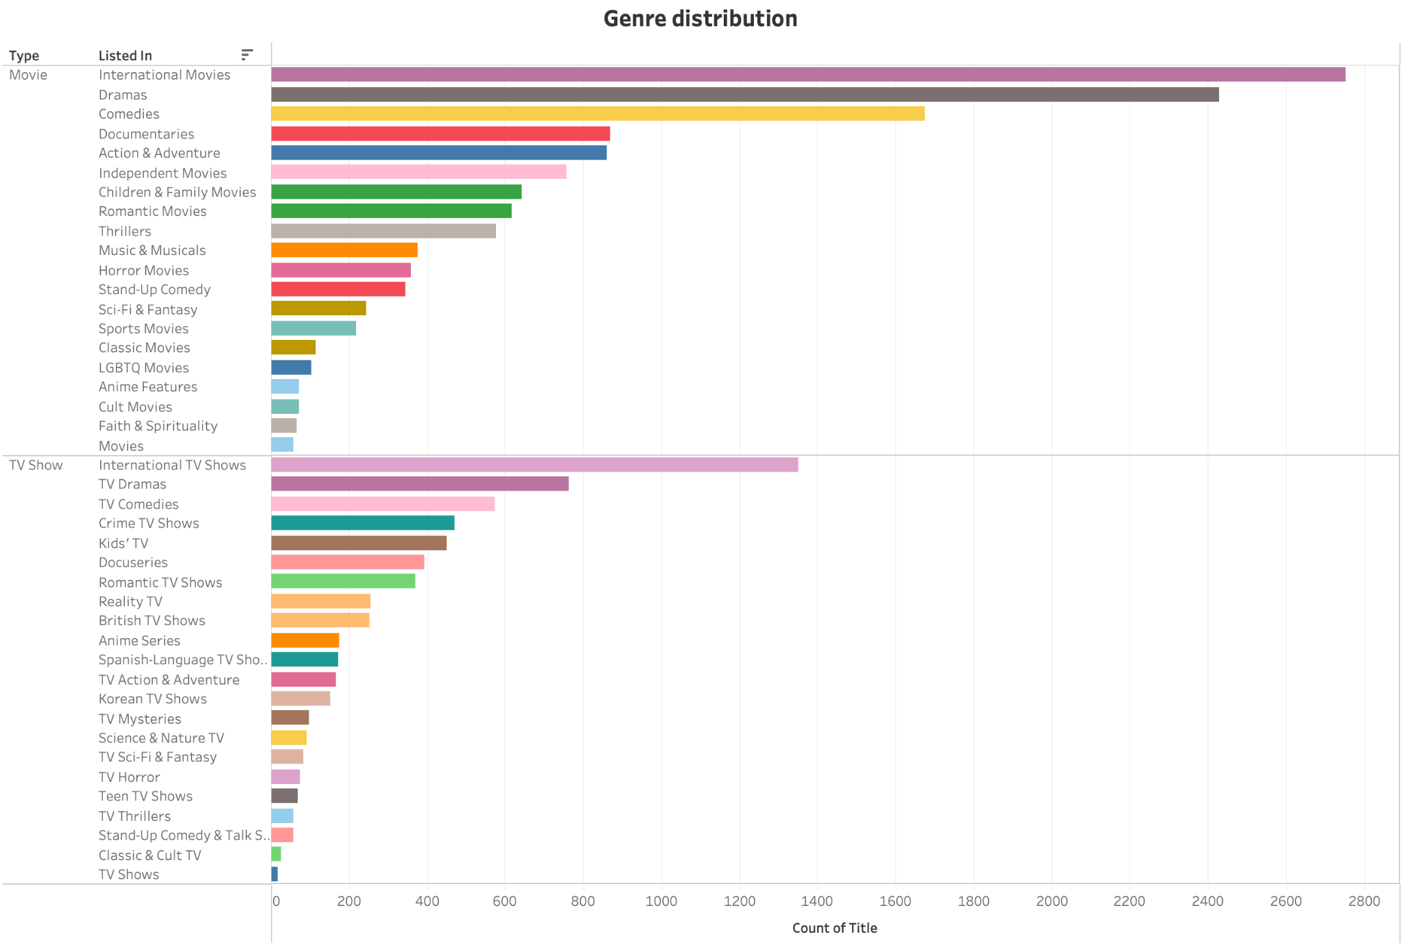
Q5: The most popular genre in Netflix?

Slide 13

Thank you for your attention!

