Slide 1
Gene expression values of a patient
New representation
Gene₁ < Gene₂?
…
Gene₁ < Gene_{n}?
Gene₂ < Gene₃?
…
Gene₂ < Gene_{n}?
…
Gene_{(n-1)} < Gene_{n}?
1
…
1
-1
…
-1
…
1
Gene₁
Gene₂
Gene₃
…
Gene_{(n-1)}
Gene_{n}
0.11
0.79
0.13
...
0.54
0.65
Length: n
Length: n(n-1)/2
Value: Real
Value: Binary

Slide 2
Gene expression ranks of a patient
New representation
Gene₁ < Gene₂?
…
Gene₁ < Gene_{n}?
Gene₂ < Gene₃?
…
Gene₂ < Gene_{n}?
…
Gene_{(n-1)} < Gene_{n}?
1
…
1
-1
…
-1
…
1
Gene₁
Gene₂
Gene₃
…
Gene_{(n-1)}
Gene_{n}
1
n
2
...
3
n-1
Length: n
Length: n(n-1)/2
Value: Ordinal
Value: Binary

Slide 3
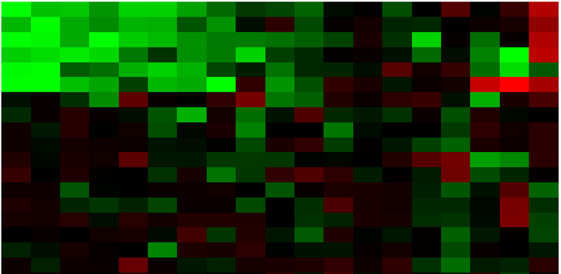
n genes
Good
1800+ days
Poor
780 days
m patients
Poor
or
459+ days
…
…
Good
1680 days
X: gene expression
y: prognosis class or survival time

Slide 4
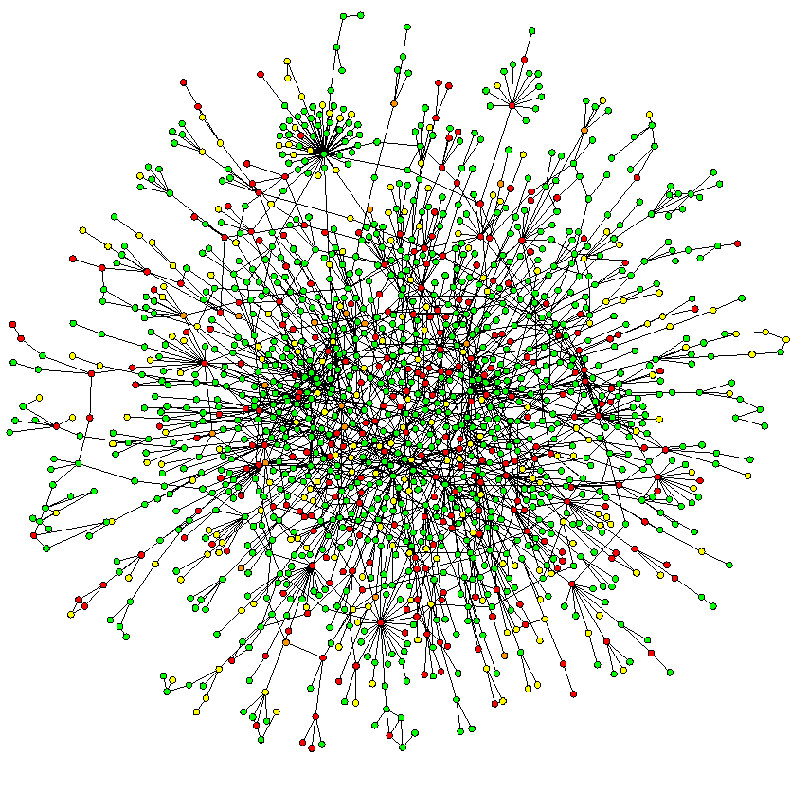

Slide 5
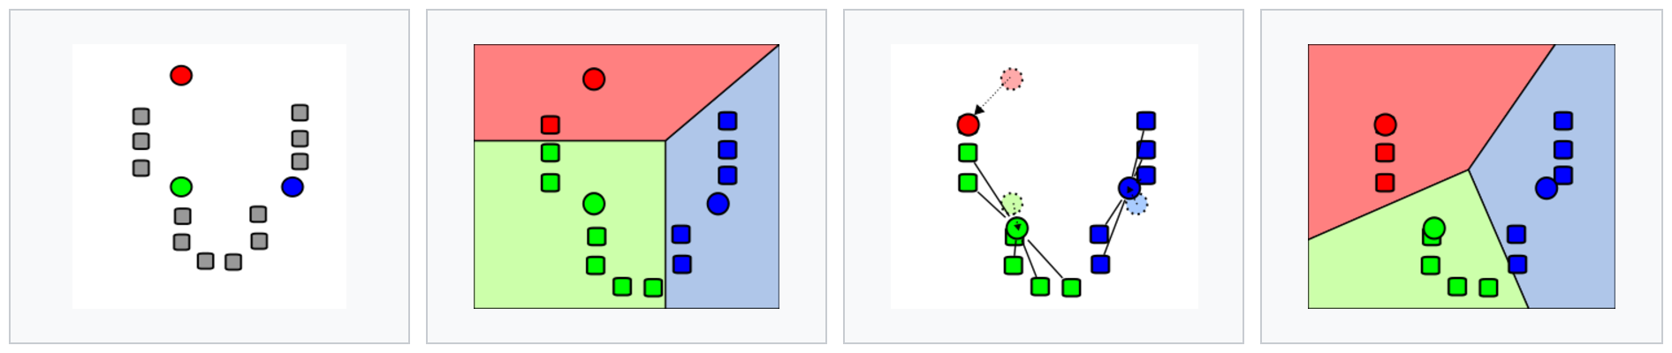
Kemeny aggregation
Optimize over S_{j}
Optimize over 𝜋_{j}

Slide 6
Kernel trick
Optimize over S_{j}
Optimize over 𝜇_{j}

