Slide 1
Week8.
Time Features (Timestamps, time diff, time gap)
Evaluation Step
Research Hypothesis & Objectives
Experiments Set up

Slide 2
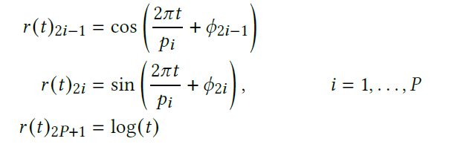
Time features
Absolute time feature:
Raw timestamps
12 Periods of real-life importance (second, hour, day, month)
Help the model take real-life situation of the current timestamp into account.
Relative time features:
Time_diff: The time since the lastest action a user has taken.
Time_gap: The time gap between actions.
32 Periods
Help the model distinguish short-distance action and long-distance action.
For each value:
Periodic Activation: cos (P dims)
Periodic Activation: sin (P dims)
Logarithm transformation: log (1 dim)
[cos1, sin1, cos2, sin2…. Log t]
This generate 2P + 1 features for value. Therefore, increase dims in total: 25 + 65 + 65 = 155

Slide 3
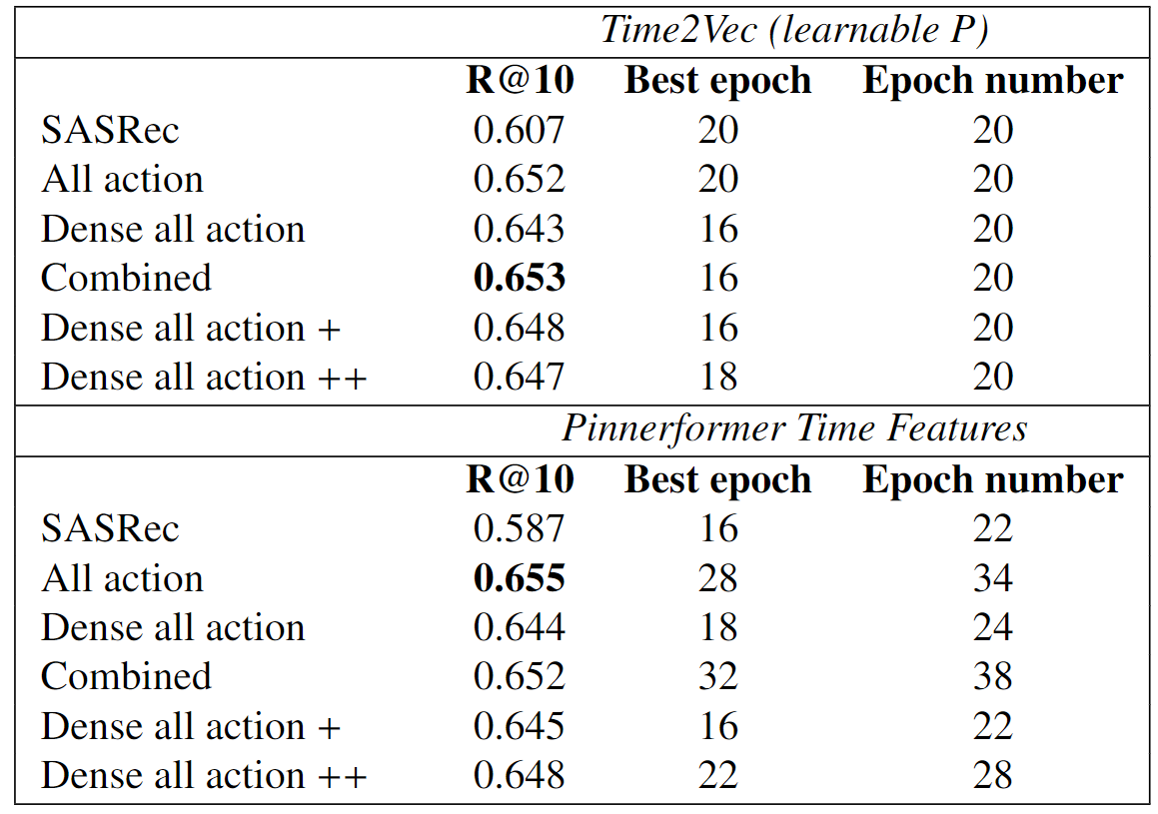
Experiment results (ML-20M split by time)
Transfer Learning
(frozen item embedding)
Learning rate = 0.001
max_len = 200
Loss = sampled softmax loss
Same frozen item embedding

Slide 4
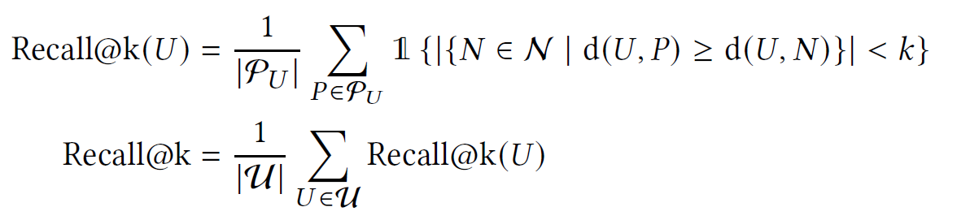
Evaluation Step
Recall @10
P90 coverage@10
P90 coverage means the smallest item sets that appear in the top k lists of at least 90% of the users. Focus on the global diversity.

Slide 5
Evaluation Step
Data Splitting strategy:
Percentage window:
(Temporal User splitting strategy)
Run the training experiments k times (5 times possibly), get the average model performance.
Temporal window:
(User based splitting strategy)
K-Fold Cross validation ([Train1, Val1]; [Train2, Val2];…).
Run each model k times (3 times possibly), get the average model performance.
Apply early stop to make sure all models trained enough and not overfitting until the lack of improvement in validation score.
Fair Comparison
Comparison Problem
Different Splitting strategy → different training set → cannot compare these two structures.
So may drop the comparison between two window structures.

Slide 6
Research Hypothesis and Objectives
Hypothesis 1
Implementing window predictor will improve the recommendation accuracy and diversity than next item prediction.
Objective 1
Evaluate the model performance on Recall@10 and P90 Coverage@10 for both next item prediction model and window prediction.
Hypothesis 2
Incorporating transfer learning will enhance the model performance (specifically say Recall or P90) of the window predictor.
Objective 2
To investigate the impact of transfer learning on the performance of the window predictor compared with models trained from scratch.
Hypothesis 3
Incorporating Time features will improve the model performance on recommendation accuracy
Objective 3
To evaluate the influence of time features on the performance of the window predictor.

Slide 7
Experiments
Experiment 1
Next-item prediction vs. percentage window predictor. (Training from scratch)
Help: hypothesis 1
Experiment 2
Next-item prediction vs. percentage window predictor. (Transfer learning)
Help: hypothesis 1, 2
Experiment 3
Next-item prediction vs. temporal window predictor. (Training from scratch & Transfer learning)
Help: hypothesis 1, 2
Experiment 4
Temporal window predictor vs T2V temporal window predictor.
(Training from scratch & Transfer learning)
Help: hypothesis 2, 3

Slide 8
Future Direction
1. Formal Experiments Running
2. Writing Dissertation

