Slide 1
Week4.
Loss Function
Hyperparameters (LR)
New models
Datasets

Slide 2
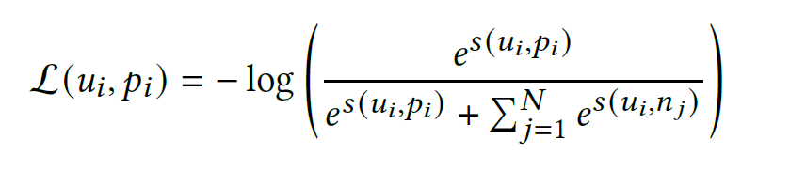
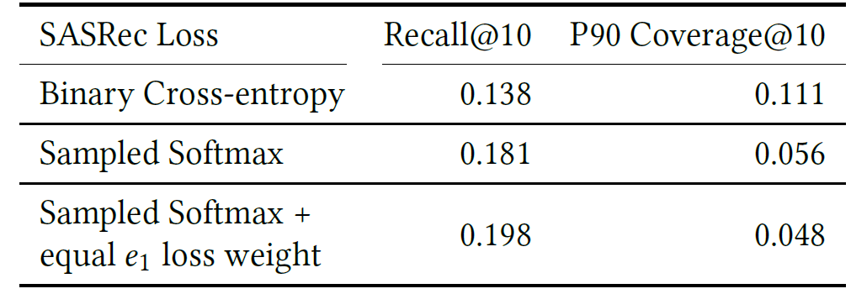
Sampled Softmax Loss
produce a set of negative embeddings {𝑛1, . . . , 𝑛𝑁 }
for a given pair of user and positive embeddings (𝑢𝑖 , 𝑝𝑖 ).
a temperature 𝜏 ∈ [0.01, ∞),
𝑠 (𝑢, 𝑝) = ⟨𝑢, 𝑝⟩/𝜏.
Negatives are randomly selected currently
PinnerFormer Result:

Slide 3
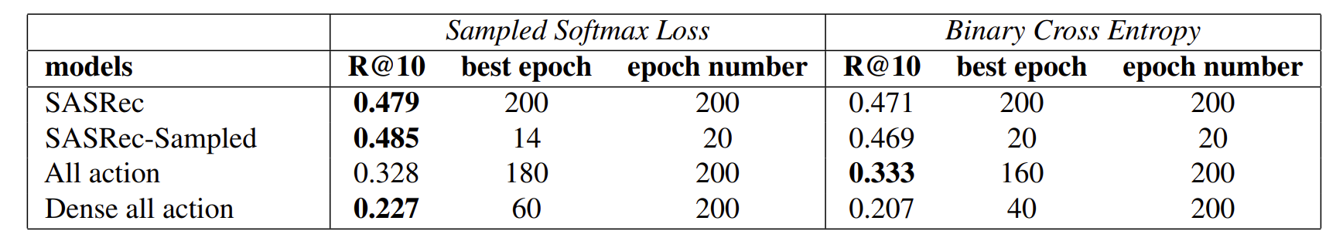
BCE v.s. Sampled Softmax Loss
10 negative samples

Slide 4
Learning rate influence (All Action)
produce a set of negative embeddings {𝑛1, . . . , 𝑛𝑁 }
for a given pair of user and positive embeddings (𝑢𝑖 , 𝑝𝑖 ).
a temperature 𝜏 ∈ [0.01, ∞),
𝑠 (𝑢, 𝑝) = ⟨𝑢, 𝑝⟩/𝜏.
Negatives are randomly selected currently
PinnerFormer Result:

Slide 5
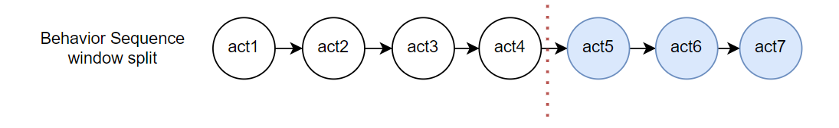
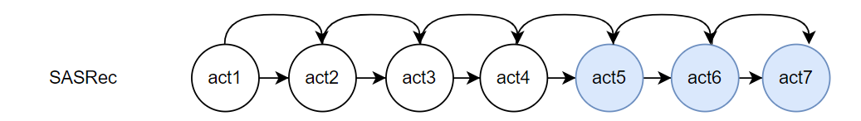
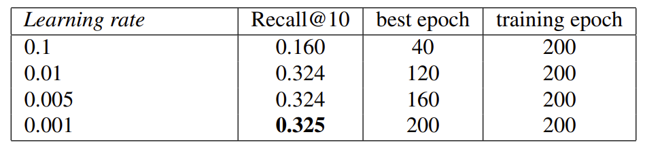
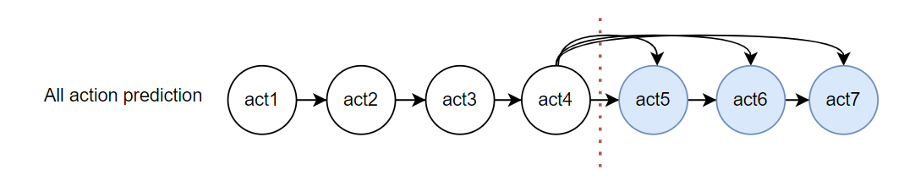
Learning Rate (All action prediction)
Train Sequence
Training objective
Experiment Results (All action)

Slide 6
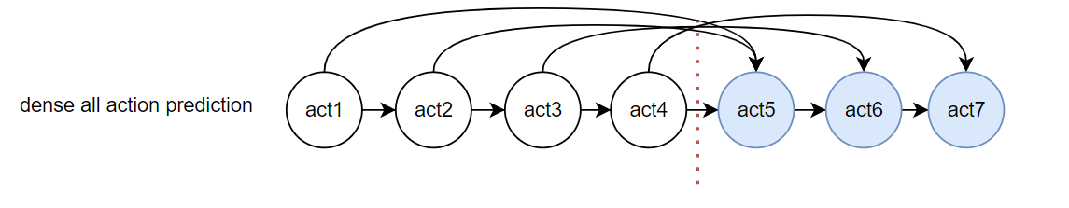
Whether it could be the signal problem (intensity)
Training objective
Num_connects = len(seq)
Has more connections
Training each time step
Num_connects = len(target _seq)
Num_connects = len(input_seq)

Slide 7
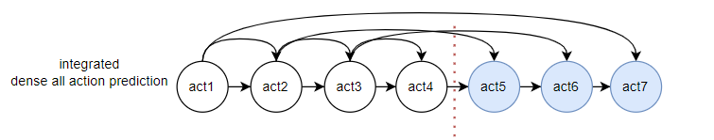
Model 1. Combined model
Train Sequence
Training objective

Slide 8
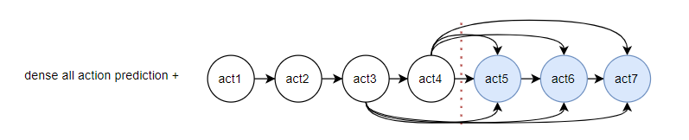
Model 2. Dense all prediction plus
Train Sequence
Training objective

Slide 9
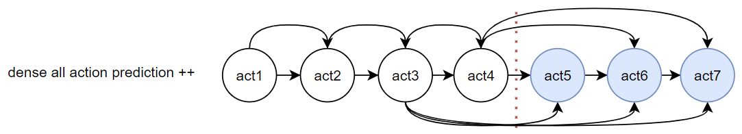
Model 3. Dense all prediction plus plus
Train Sequence
Training objective

Slide 10
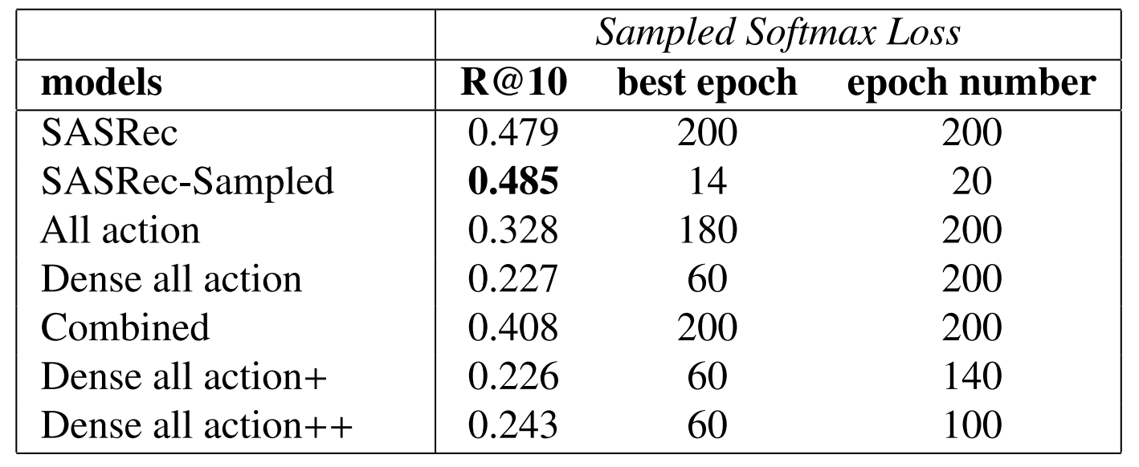
Experiments results – ML-1M

Slide 11
Result Explain
Next item of each time step is very relevant to the current user embedding. This training objective also increase the model performance for the future items prediction.
train the model to predict the item in the target window make the model perform worse: The item in the target window has weaker relationship between the items in the input sequence. (Larger distance) In this case, dense all action prediction method can sometimes make wrong connection making the model perform worse. At least in ML-1M dataset.

