Slide 1
Week5.
Transfer Learning

Slide 2
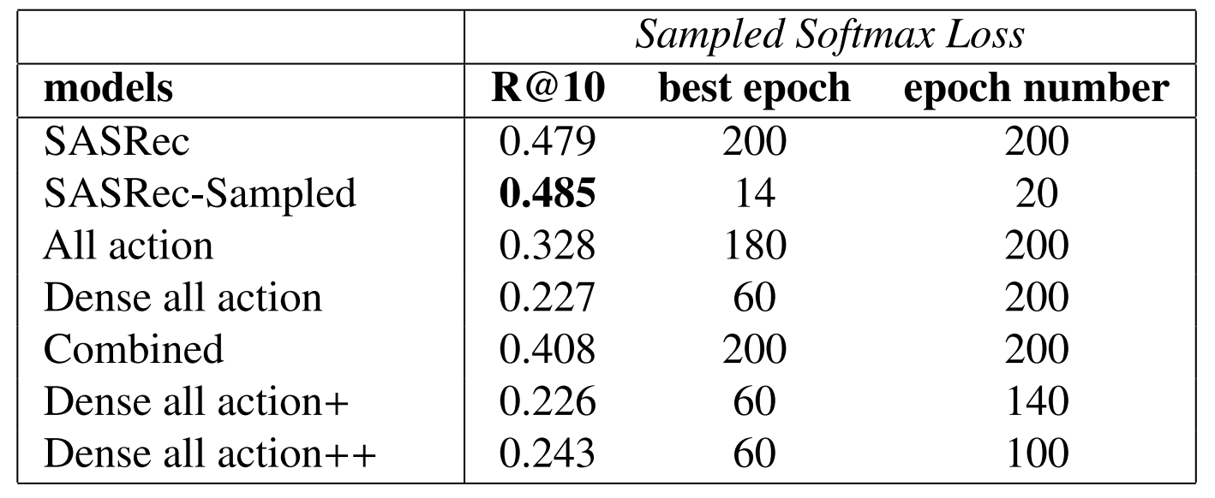
Why transfer learning
The Reason
Training from scratch harms the item embedding in some extent shown from the experiments. The next item could be the most relational item to the current time step.
PinnerFormer did not train the item embedding from scratch, They use PinnerSage static embedding for each pin (action).

Slide 3
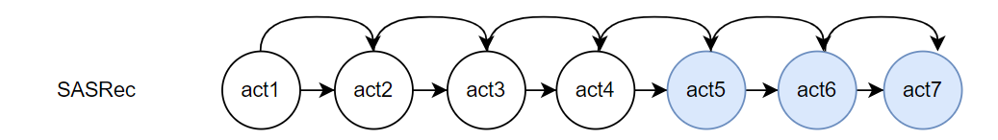
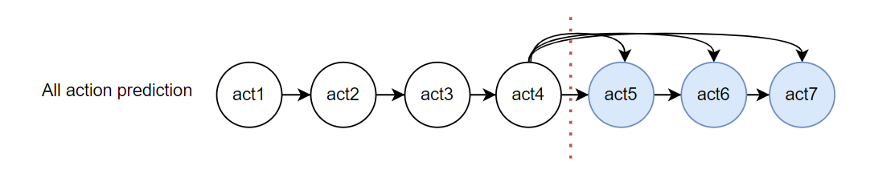
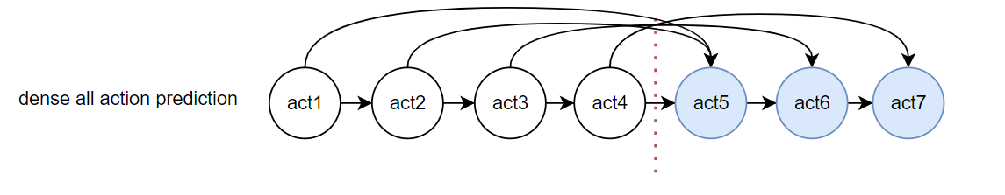
Current Method
Item embedding
Trained on the normal sasrec
Other parameters
Train from different training objectives

Slide 4
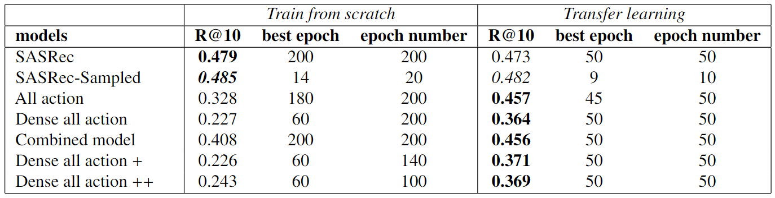
Experiment results (ML-1M)

Slide 5
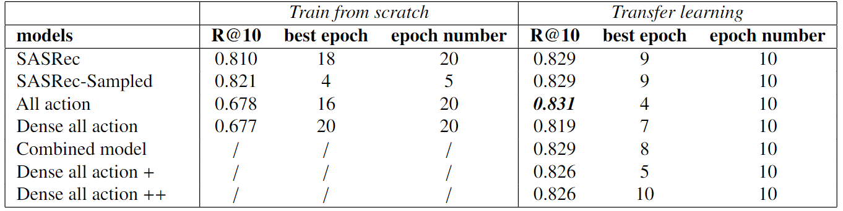
Experiment results (RetailRocket)

Slide 6
Results Analysis

Slide 7
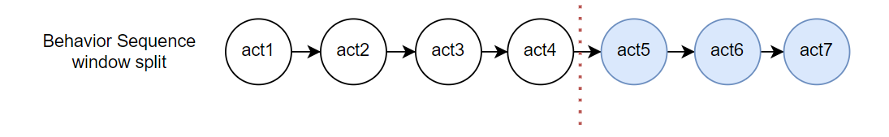
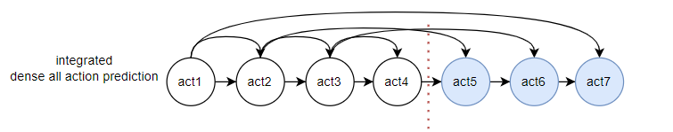
Model 1. Combined model
Train Sequence
Training objective

Slide 8
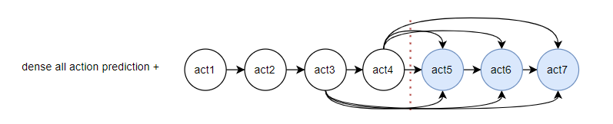
Model 2. Dense all prediction plus
Train Sequence
Training objective

Slide 9
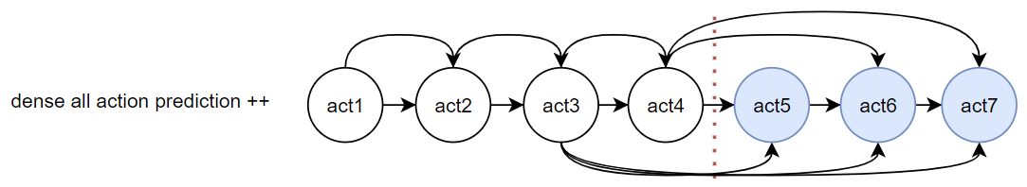
Model 3. Dense all prediction plus plus
Train Sequence
Training objective

Slide 10
Experiments results – ML-1M

Slide 11
Result Explain
Next item of each time step is very relevant to the current user embedding. This training objective also increase the model performance for the future items prediction.
train the model to predict the item in the target window make the model perform worse: The item in the target window has weaker relationship between the items in the input sequence. (Larger distance) In this case, dense all action prediction method can sometimes make wrong connection making the model perform worse. At least in ML-1M dataset.

