Slide 1
Week5.
Transfer Learning

Slide 2
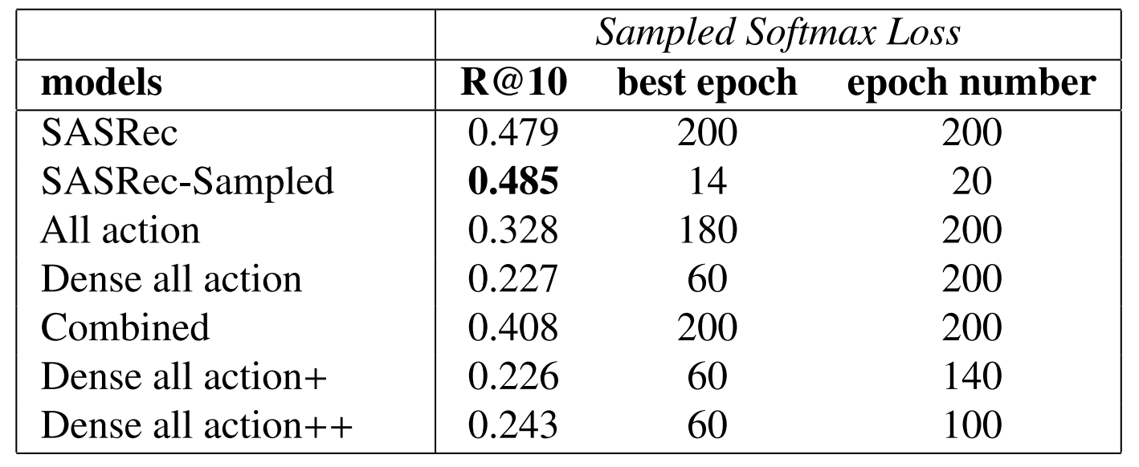
Why transfer learning
The Reason
Training from scratch harms the item embedding in some extent shown from the experiments. The next item could be the most relational item to the current time step.
PinnerFormer did not train the item embedding from scratch, They use PinnerSage static embedding for each pin (action).

Slide 3
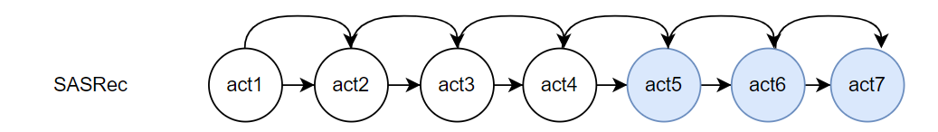
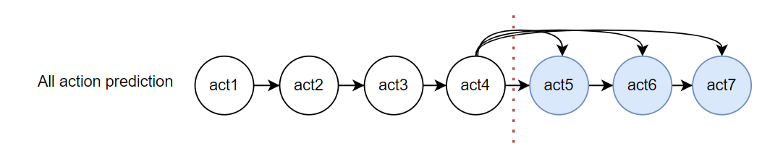
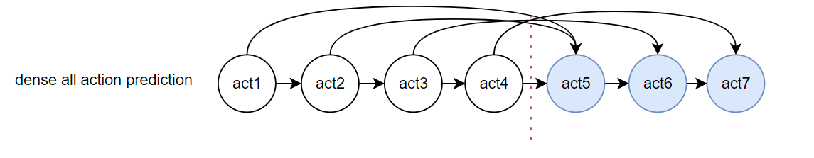
Current Method
Item embedding
Trained on the normal sasrec (Frozen)
Other parameters
Train from different training objectives

Slide 4
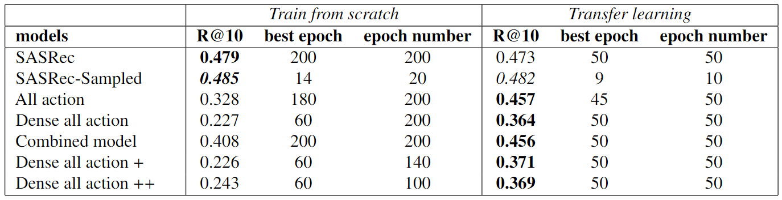
Experiment results (ML-1M)

Slide 5
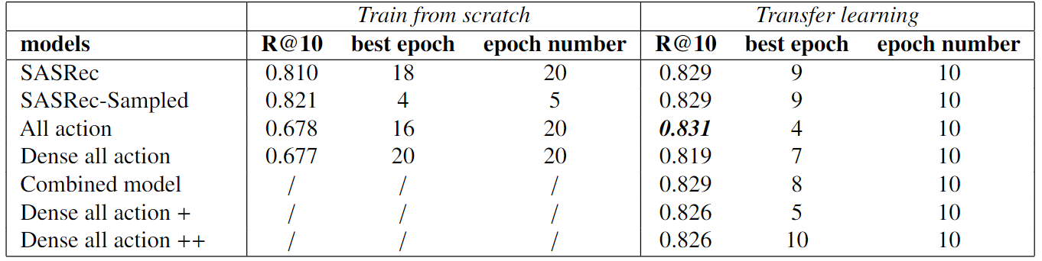
Experiment results (RetailRocket)

Slide 6
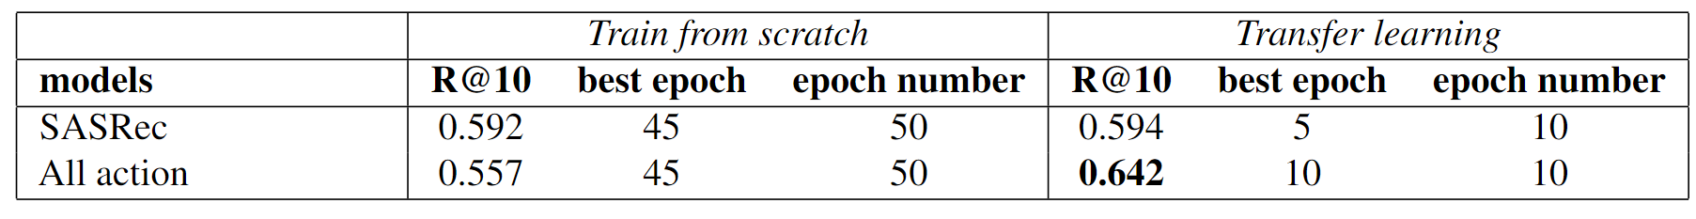
Results Analysis
With fixed item embedding, the percentage window data splitting strategy can also have a chance outperform the next item prediction.
Assumption
If we change the percentage window to temporal window, the signal between the training target and training sequence will be improved, in theory achieve a better model performance.

Slide 7
ML-20M with Temporal window
User-based split
1. Easy to implement
2. Split the train/val/test dataset by different users (randomly choosen)
3. 30000+ users with 14 days window (70% for train; 15% for val; 15% for test)
4. 18000+ unique items

Slide 8
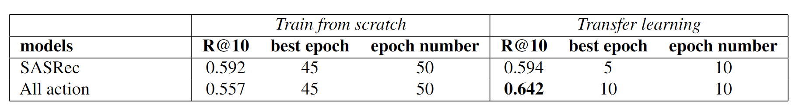
Experiment results
Future Direction
1. Make the P90 coverage evaluation metric works as expected.
2. Fix some problems in loss function.
3. Test the model performance for all proposed models.
4. Try other data splitting strategy.

