Slide 1
Week7.
Time Features

Slide 2
Time features
TiSASRec
Including
the scaled (personalised) relative time interval embedding (Time Matrix)
Learnable absolute positional embedding.
Problem:
Memory consuming
Very big relative time interval matrix
I used 128 as batch size 200 as maxlen before, but this will cause memory error using time features. Currently 64 as batch size and 50 maxlen.

Slide 3
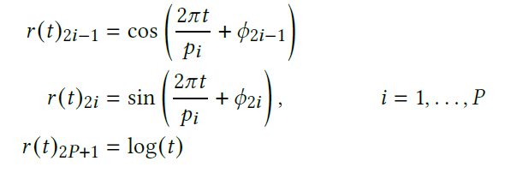
Time features
Time2Vec (Similar as PinnerFormer)
Two Time values for each action:
The time since the lastest action a user has taken.
The time gap between actions.
For each value:
Periodic Activation: cos (P dims)
Periodic Activation: sin (P dims)
Logarithm transformation: log (1 dim)
This generate 2P + 1 features for value.
Fixed P as hyperparameter, only keep one learnable parameter

Slide 4
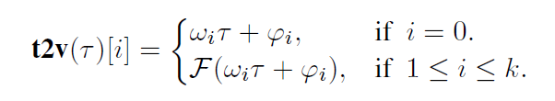
Implemented method
Have a look on the influence of time feature
One derived value from each action:
The difference between the latest timestamp in the sequence and an action’s timestamp. (absolute time stamp)
For each value:
Periodic Activation: cos (P dims)
This generate P features for value.
Increase 2P parameters (P frequency and P phase-shift)

Slide 5
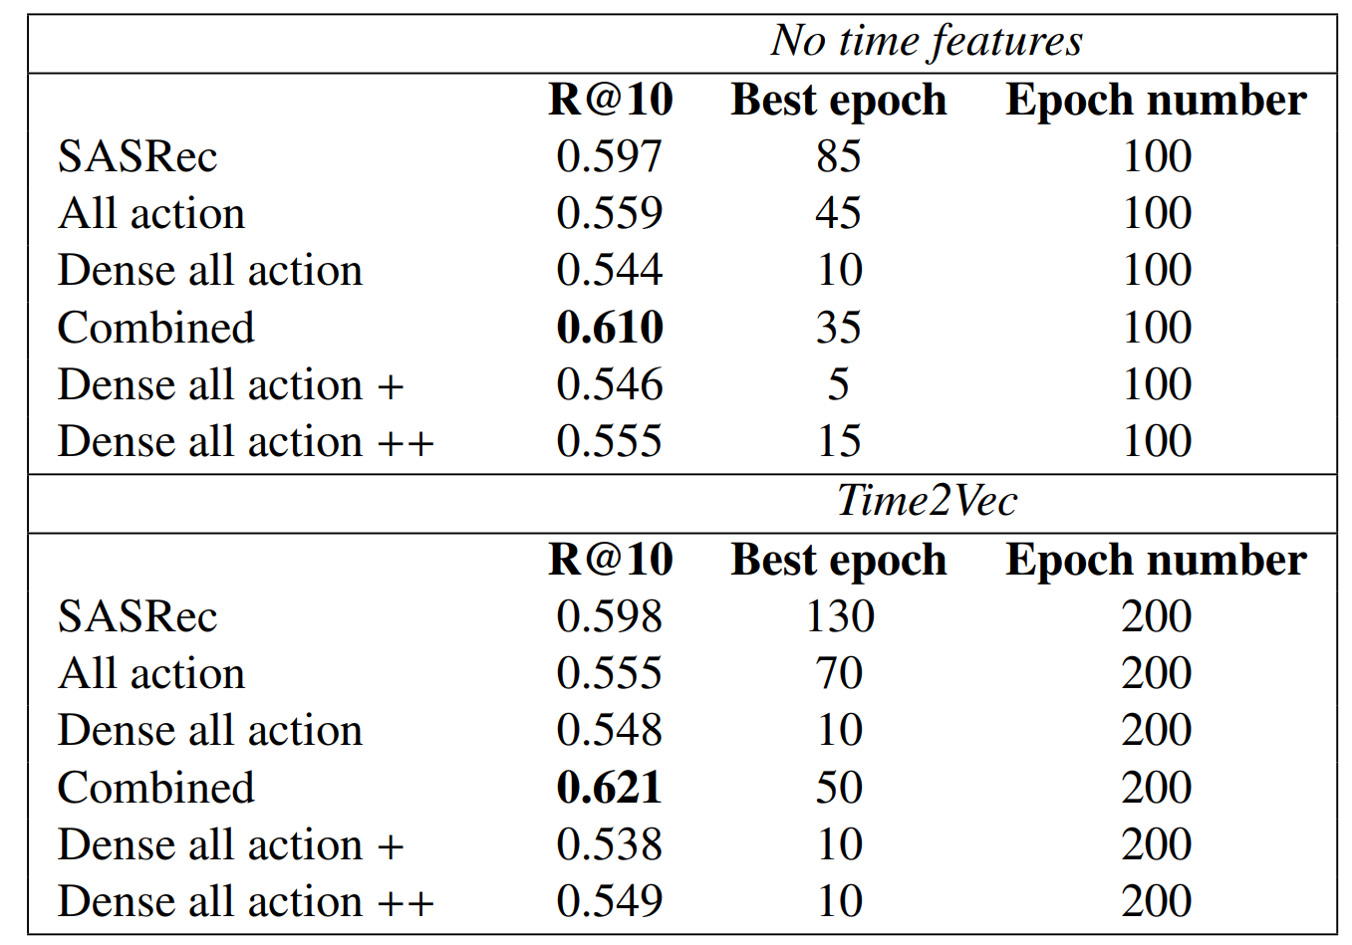
Experiment results (ML-20M split by time)
Train from scratch

Slide 6
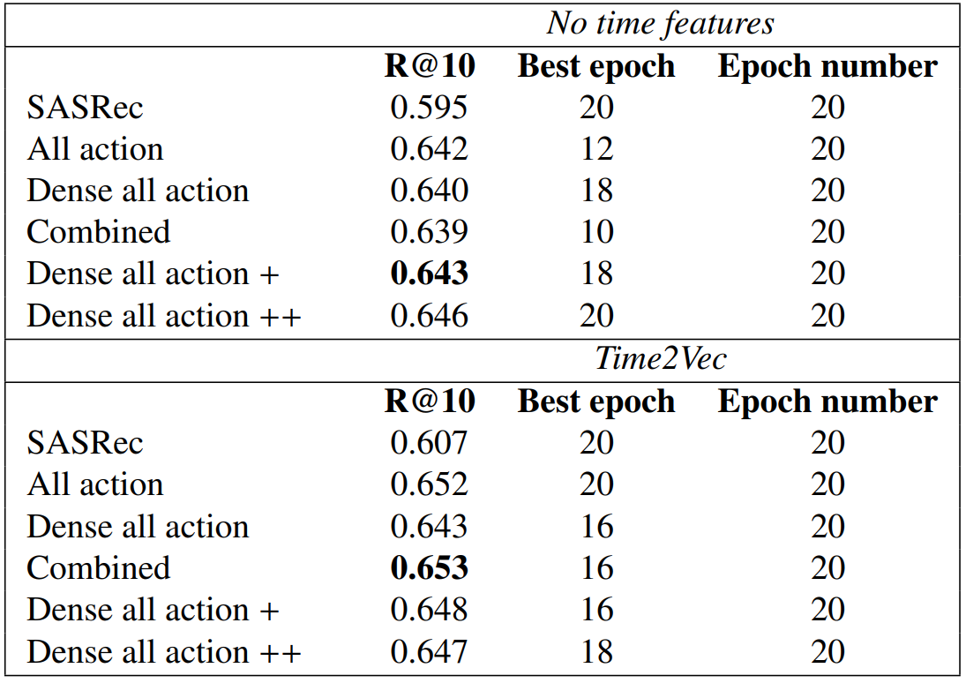
Experiment results (ML-20M split by time)
Transfer Learning
(frozen item embedding)
Learning rate = 0.003
max_len = 200
Loss = sampled softmax loss
Item embedding
is trained from
Normal SASRec
(Time-ignorance).

Slide 7
Results Analysis
Use absolute timestamps (time diff between an action’s timestamp with the lastest timestamp in the current action sequence) will improve the model performance on Recall@10.
Assumption
PinnerFormer suggests to use both relative timestamp (and the time gap between each two actions in the sequence, setting the last one to zero.) and absolute timestamp (already done).
Incorporating these two time features could make the system perform better.

Slide 8
Future Direction
1. Make the relative timestamp work in all models.
2. Complete the evaluation metric for P90 coverage.
3. Writing Dissertation

