Slide 1
Week3.
Current Progress (Experiments results)
Result Analysis

Slide 2
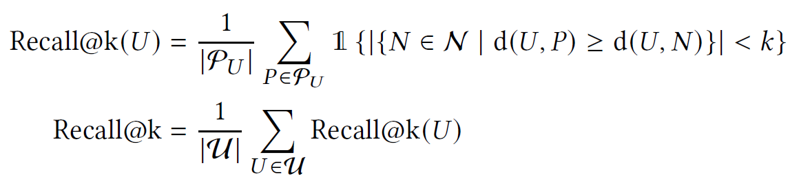
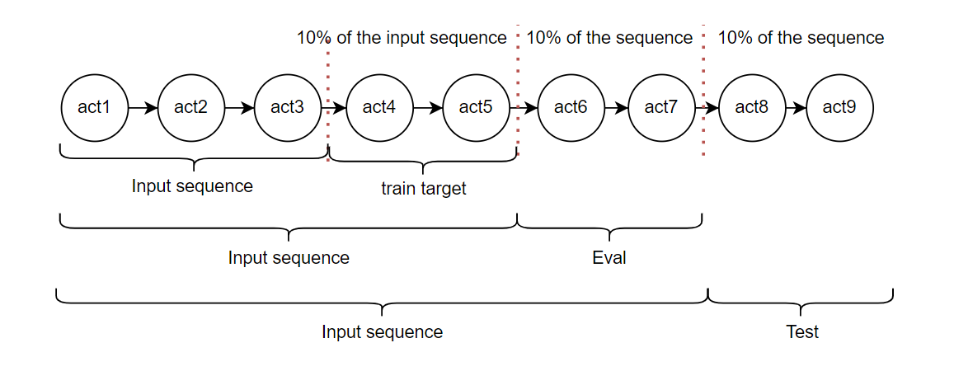
Evaluation metric
Currently focus on recall@10

Slide 3
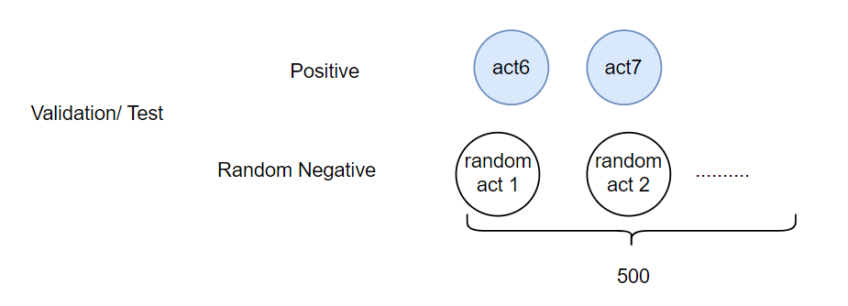
Evaluation method
Evaluation progresss (did not treat each action independently)
Ask the model to rank all positives and random negatives together

Slide 4
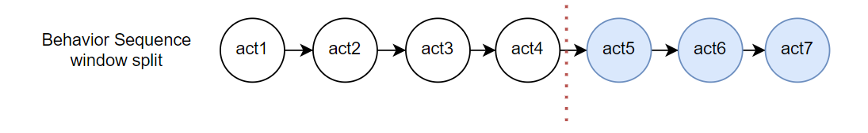
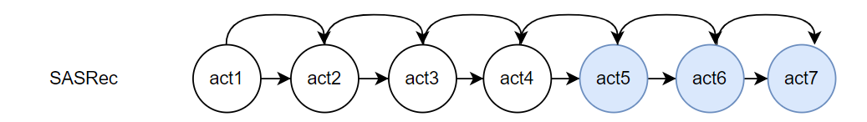
Model 1. Normal SASRec
Train Sequence
Training objective

Slide 5
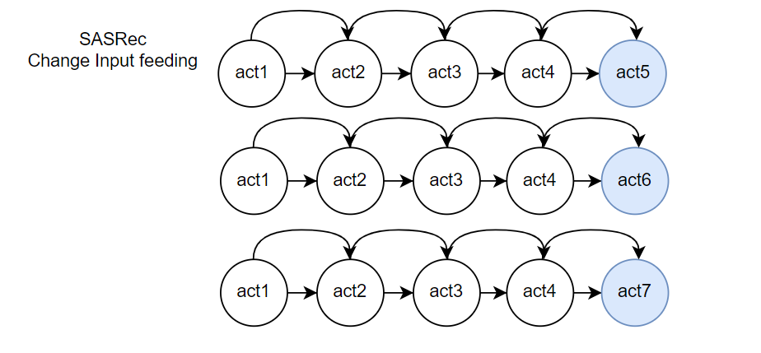
Model 2. SASRec change the sampling
Train Sequence
Training objective

Slide 6
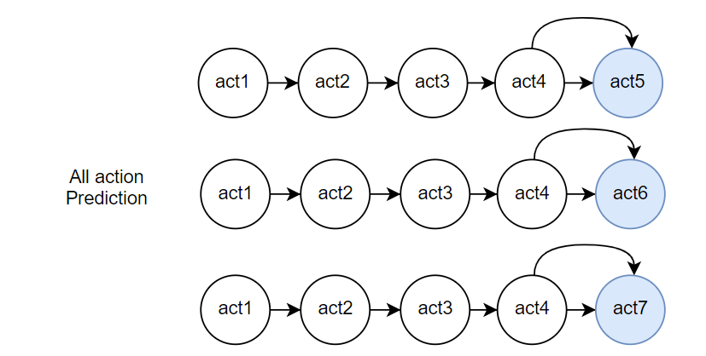
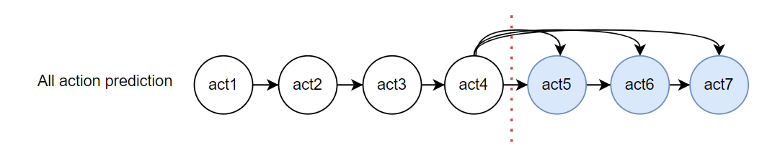
Model 3. All action prediction
Train Sequence
Training objective – 1
Training objective - 2

Slide 7
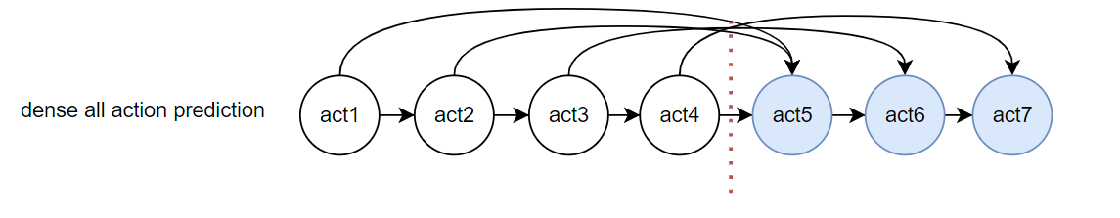
Model 4. Dense all action prediction
Train Sequence
Training objective

Slide 8
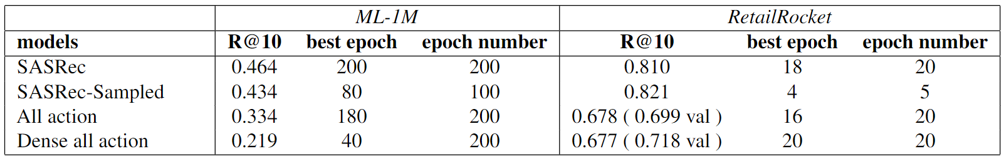
Experiments results

Slide 9
Result Discussion
What could be the reason?
Model architecture (implementation)
Dataset problem
Data split problem (percentage window now rather than temporal window)
What should be the future direction?
Change the loss function
Find more suitable dataset

