Slide 1
Week1.
Current Steps
Future Steps

Slide 2
What has been done
Dataset Decision
Retailrocket
ml-1m
Dataset split strategy
Item split – SASRec (Could not be used in window-based predictor)
Temporal Global split – GRU4Rec (More suitable for window predictor)
Baselines
Popularity-based (PopRec)
SASRec (Implemented)
GRU4Rec (Does not implement)
Loss function (not decided)
We just list some loss functions that can be used.
Top-1 and BPR(GRU4Rec); SASRec (cross entropy); LogQ correction (Pinnerformer)
Evaluation metrics
IPP mentioned four metrics (P@k, R@k, nDCG@k, InterestEntropy@k)
R@k(quality of recommendation), InterestEntropy@k, P90 coverage@k(diversity of interest)
How well each can predict all future purchases over the next k days

Slide 3
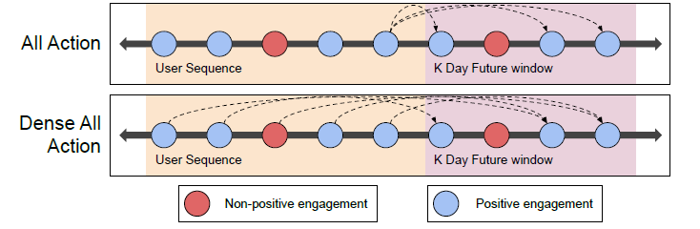
Detailed about Window-based predictor
Training progress
Negative sampling: Uniform sampling (SASRec); Popularity-based sampling (GRU4Rec); Merging these two (PinnerFormer)
Aim: learned user representation based on historical actions
Window based model training objective
Start with all action
Expanded to dense all action (improve the signal)
Resource access
Tested Eddie High performance computing usage with Pytorch (GPU). (Potentially need)

Slide 4
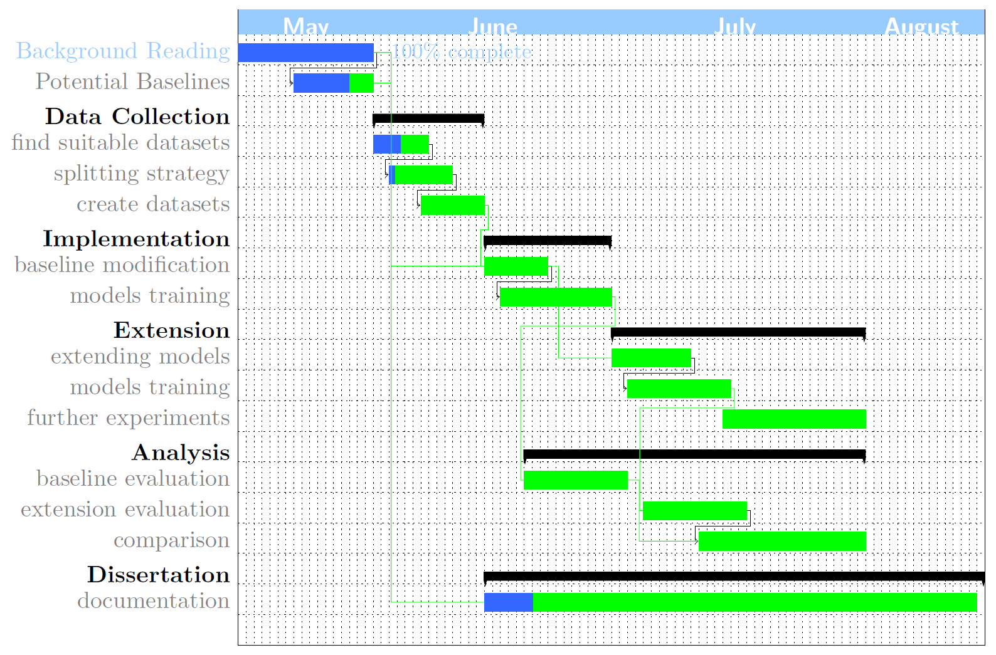

Slide 5
Future steps (This week)
Finding other potential datasets
Dataset split in the current dataset:
14 days/ 28 days
Window size is very different for each kind of dataset. (Hard to create dataset using the same window size)
Find the suitable window size for each dataset.
Find features from each dataset (users, items, actions; sparsity).
Create an easy model, which can process the window data to make sure the processed data can be used (Potentially)

