Slide 1
Week6.
Time Features

Slide 2
Time features
TiSASRec
Including
the scaled (personalised) relative time interval embedding (Time Matrix)
Learnable absolute positional embedding.
Problem:
Memory consuming
Very big relative time interval matrix
I used 128 as batch size 200 as maxlen before, but this will cause memory error using time features. Currently 64 as batch size and 50 maxlen.

Slide 3
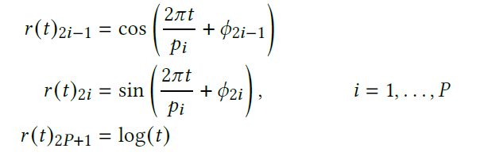
Time features
Time2Vec (Similar as PinnerFormer)
Two Time values for each action:
The time since the lastest action a user has taken.
The time gap between actions.
For each value:
Periodic Activation: cos (P dims)
Periodic Activation: sin (P dims)
Logarithm transformation: log (1 dim)
This generate 2P + 1 features for value.
Fixed P as hyperparameter, only keep one learnable parameter

Slide 4
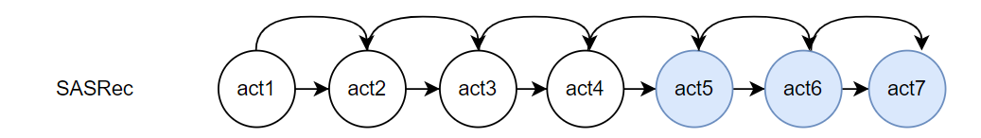
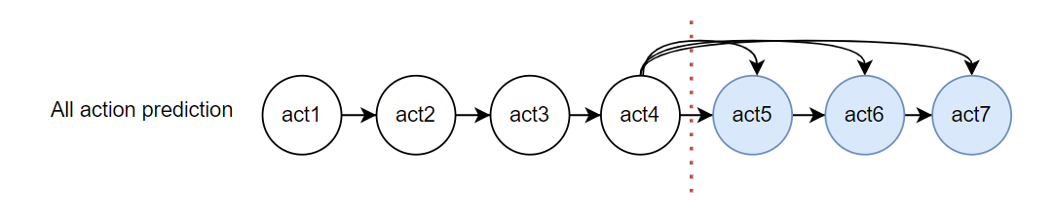
Transfer learning Approaches
1. Fine Tuning (1e-5 lr on item embeddings)
2. Freeze the item embeddings
Item embedding
Trained on the normal sasrec
Other parameters
Train from different training objectives

Slide 5
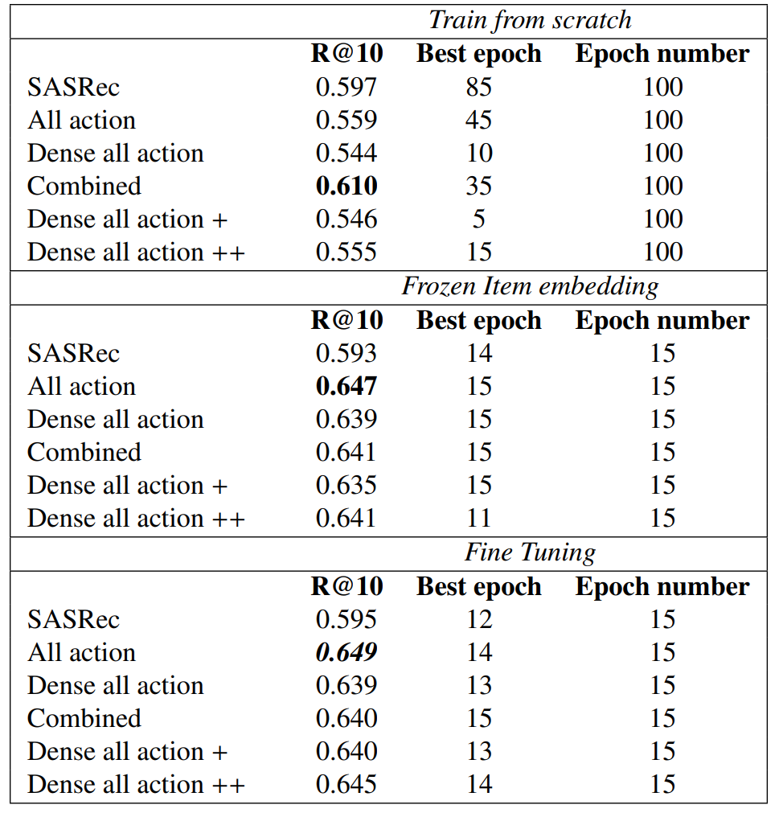
Experiment results (ML-20M split by time)
Item embedding for transfer learning is trained
by normal SASRec in 50 epochs

Slide 6
Results Analysis
Next item prediction outperforms all other models trained from scratch because of the accurate item embeddings as we can see from the experiment results.
Window predictor is much more helpful when learning other predicted used parameters.
We currently used the temporal window to split the dataset, time features could potentially make some help during the prediction.
Assumption

Slide 7
Time Features
Follows the instruction of TiSASRec:
Including
the scaled (personalised) relative time interval embedding (Time Matrix)
Learnable absolute positional embedding.
Problem: More memory cost
I used 128 as batch size 200 as maxlen before, but this will cause memory error using time features. Currently 64 as batch size and 50 maxlen.

Slide 8
Future Direction
1. Make the P90 coverage evaluation metric works as expected.
2. Implement proposed models with the time features.
3. Use other models’ generated item embeddings to convince my analysis.
4. Writing

