Slide 1
Week1.
Current Steps
Future Steps

Slide 2
What has been done
Baselines Decision
Popularity-based (PopRec)
SASRec (Implemented)
Dataset Decision
Retailrocket
ml-1m
Evaluation metrics
Ipp mentioned four metrics (P@k, R@k, nDCG@k, InterestEntropy@k)
R@k(quality of recommendation), InterestEntropy@k (diversity of interest)
Loss function (not decided)
We just list some loss functions that can be used.
Dataset split strategy
Item split – SASRec (Could not be used in window-based predictor)
Temporal split – More suitable (Choosed in window-based predictor)

Slide 3
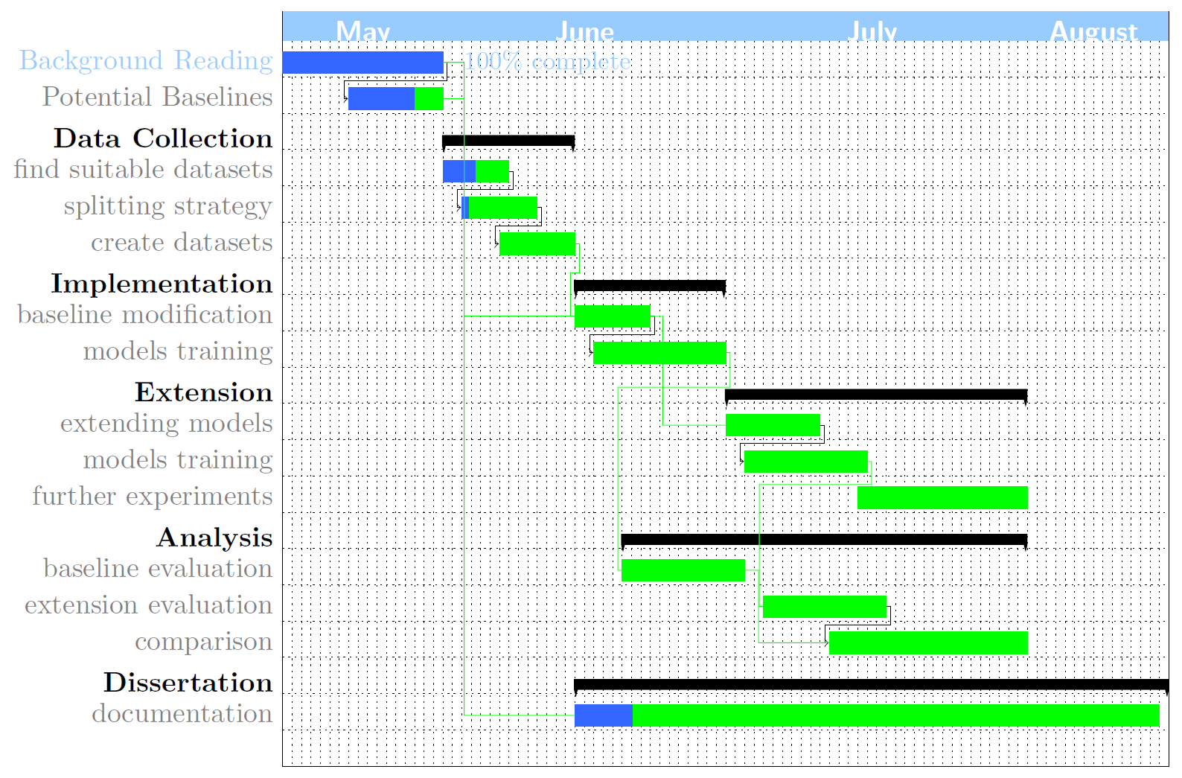

Slide 4
Future steps (This week)
Dataset split in the current dataset:
14 days/ 28 days
Window size is different for each kind of dataset.
(Hard to create dataset using the same window size)
Finding other potential datasets
Create an easy model, which can process the window to make sure the processed data can be used (Potentially)

