Slide 1
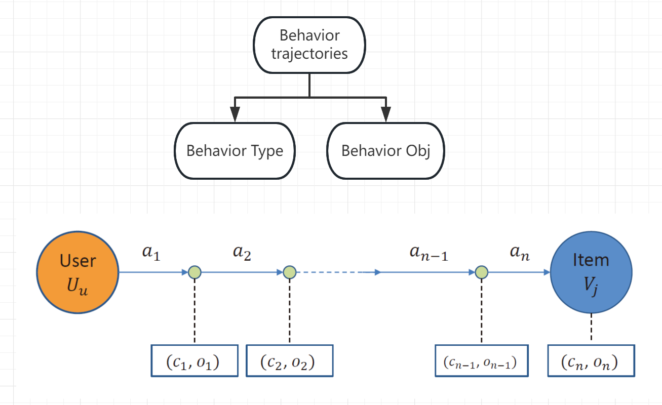
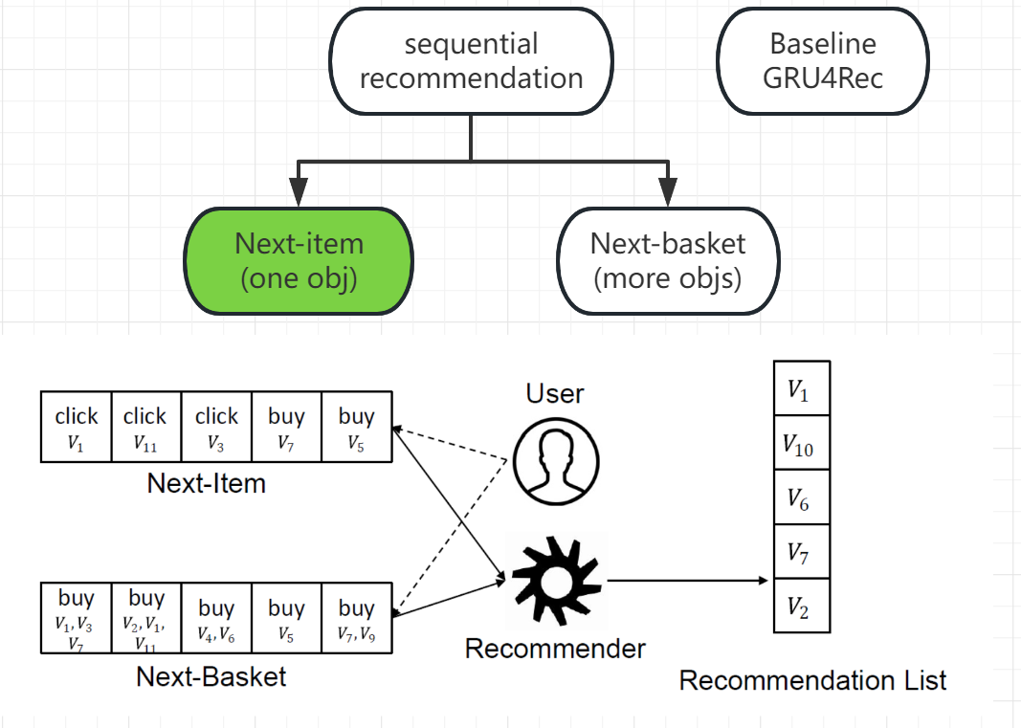

Slide 2
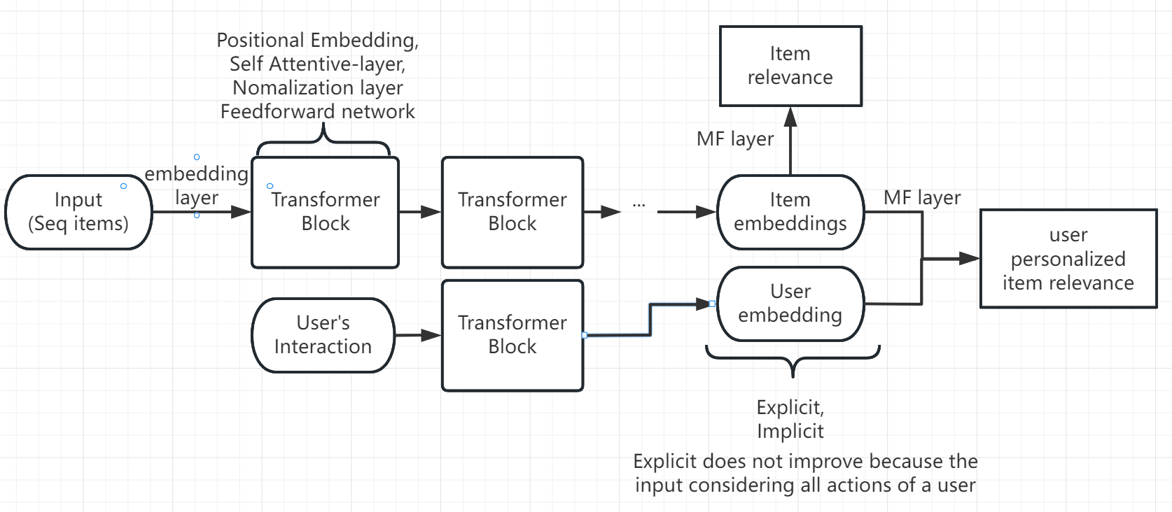
SASRec

Slide 3
Dataset
MovieLens: Movie recommendation
Retailrocket:
Movies, links could be used to do movie embedding
Ratings, tags could be seen as different behavior types
Clear Behavior type (“view”, “addtocart” or “transaction”.)
with behaviour data (events.csv) for behavior type
a file with item properties (item_properties.сsv) for behavior objects

