Slide 1
Sequential Recommendation

Slide 2
Sequential Recommendation - Definitions
(Fang et al., 2020)
Behavior - combination of a type and an object
Behavior Object - The item or service user could interact with
Behavior Type - The way user interact with items or service
Behavior trajectory - a behavior sequence with multiple behaviors
Sequential Recommender system
Input: behavior trajectory
Output: next best behavior object

Slide 3
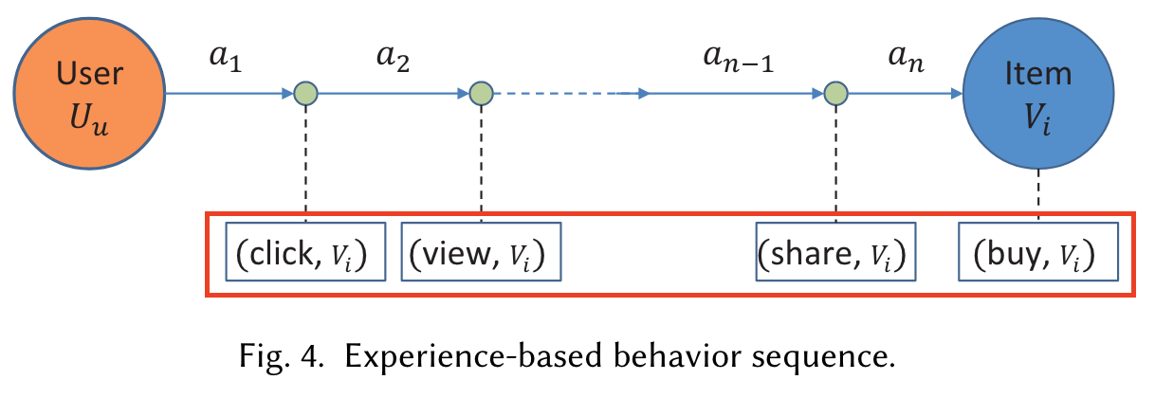
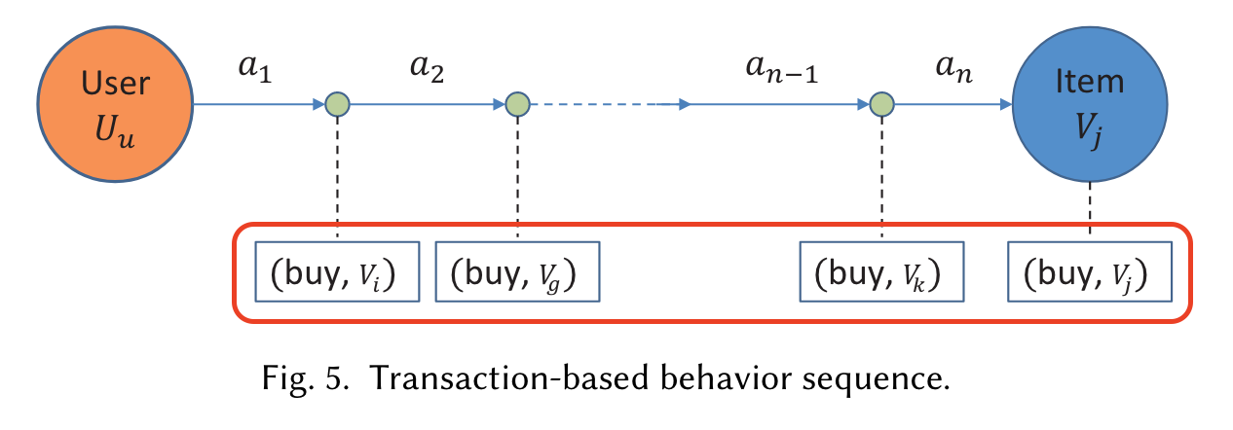
Different types of Sequential Recommender
(Fang et al., 2020)
Experience-based
User interact with a same object multiple times by different behavior types
Transaction-based
User interact with different object using same behavior types
Interaction-based
Mixture of above, User interact with different objects using different behavior types

Slide 4
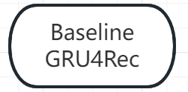
Different types of tasks
(Fang et al., 2020)
Next-item
A behavior containing single object
Next-basket
A behavior containing Multiple objects
Top-K lists

Slide 5
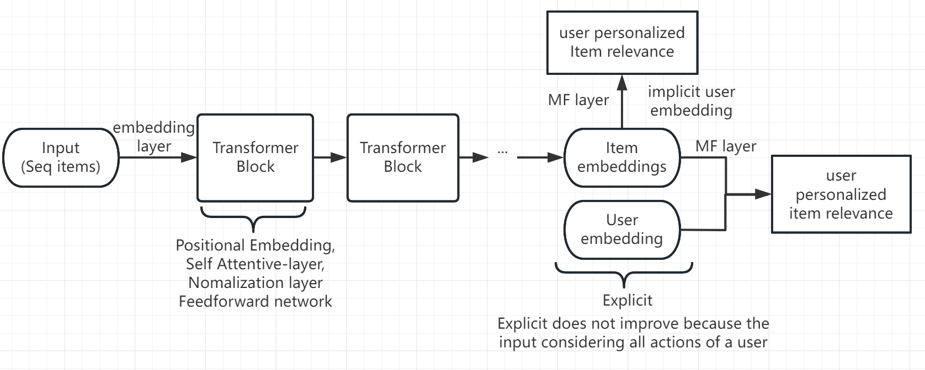
SASRec

Slide 6
Dataset
MovieLens: Movie recommendation
Retailrocket:
A simple approach to handle the data (SASRec)
Movies, links could be used to do movie embedding
Ratings, tags could be used to do user embedding
Clear Behavior type (“view”, “addtocart” or “transaction”.)
with behaviour data (events.csv) for behavior type
a file with item properties (item_properties.сsv) for behavior objects
For each userID:
the most recent action for testing
the second most recent action for validation
all remaining actions for training.

