Slide 1
Week5.
Transfer Learning

Slide 2
Why transfer learning
The Reason: Pinnerformer use static item embedding.
For each Pin in the corpus, we have a PinSage [28] embedding 𝑝𝑖 ∈ R256, which is an aggregation of visual,
text, and engagement information for a Pin 𝑃𝑖 .
As the Experiments results. Training item embedding from scratch will decrease the model performance for window-based model.

Slide 3
Experiments results

Slide 4
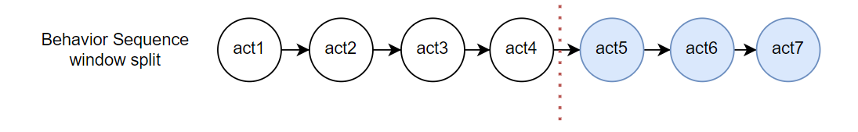
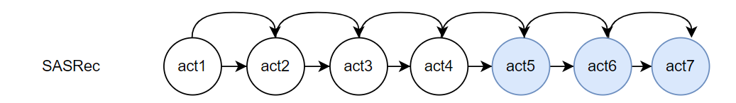
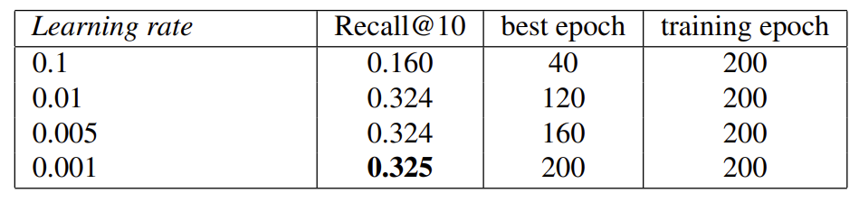
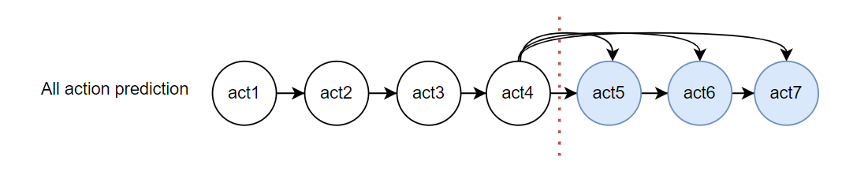
Learning Rate (All action prediction)
Train Sequence
Training objective
Experiment Results (All action)

Slide 5
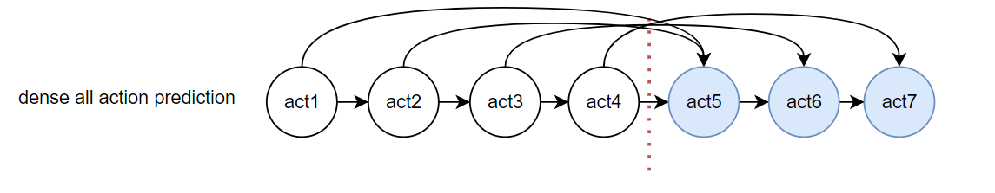
Whether it could be the signal problem (intensity)
Training objective
Num_connects = len(seq)
Has more connections
Training each time step
Num_connects = len(target _seq)
Num_connects = len(input_seq)

Slide 6
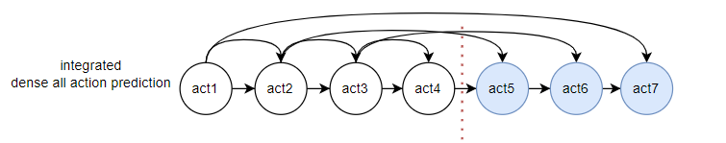
Model 1. Combined model
Train Sequence
Training objective

Slide 7
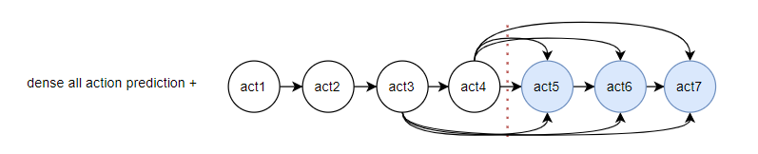
Model 2. Dense all prediction plus
Train Sequence
Training objective

Slide 8
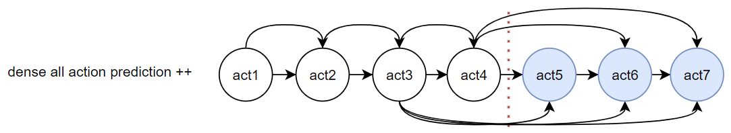
Model 3. Dense all prediction plus plus
Train Sequence
Training objective

Slide 9
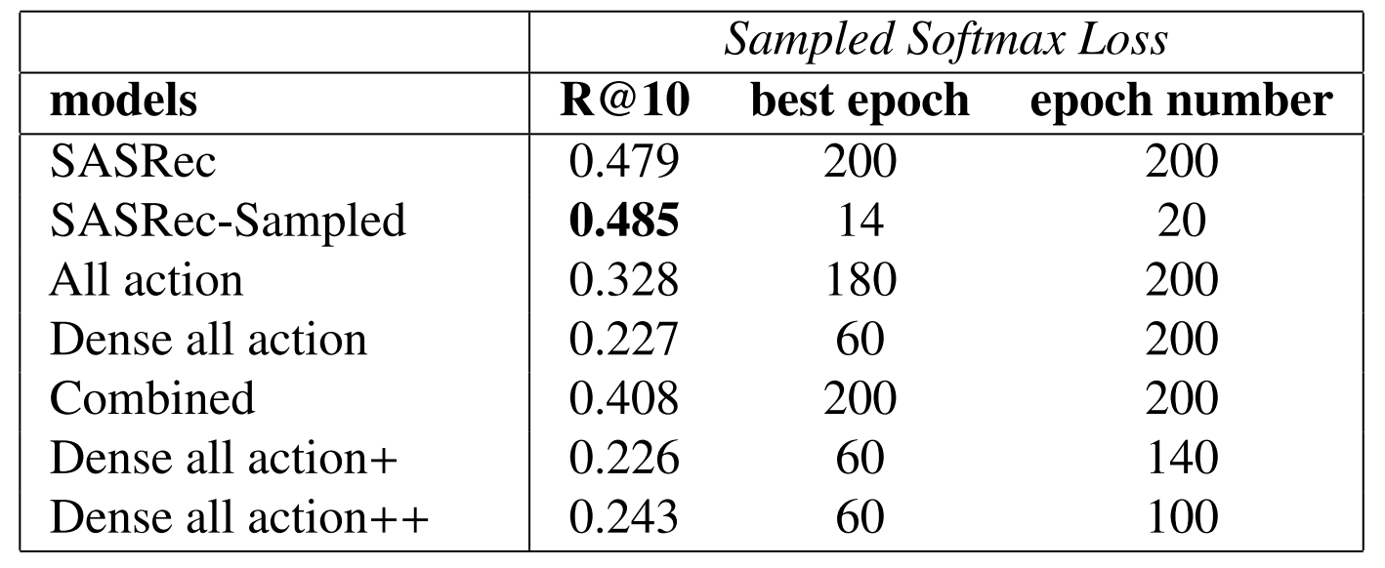
Experiments results – ML-1M

Slide 10
Result Explain
Next item of each time step is very relevant to the current user embedding. This training objective also increase the model performance for the future items prediction.
train the model to predict the item in the target window make the model perform worse: The item in the target window has weaker relationship between the items in the input sequence. (Larger distance) In this case, dense all action prediction method can sometimes make wrong connection making the model perform worse. At least in ML-1M dataset.

