Slide 1
Week2.
Evaluation metrics
Baselines

Slide 2
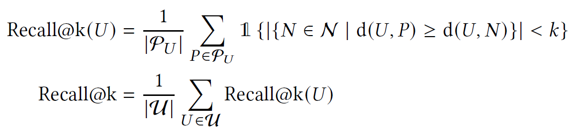
Evaluation changes
Original SASRec:
(hit ratio@k, nDCG@k)
Modified SASRec: (Recall@k, P90coverage@k)
Recall@k for recommendation quality:
P90 coverage@k evaluates the diversity of recommendations.
P90 coverage means the smallest item sets that appear in the top k lists of at least 90% of the users. Focus on the global diversity.

Slide 3
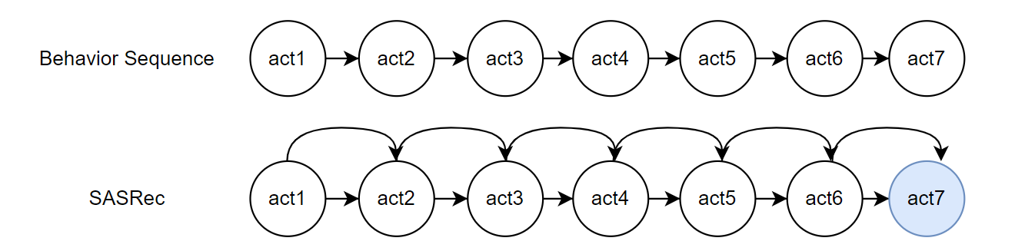
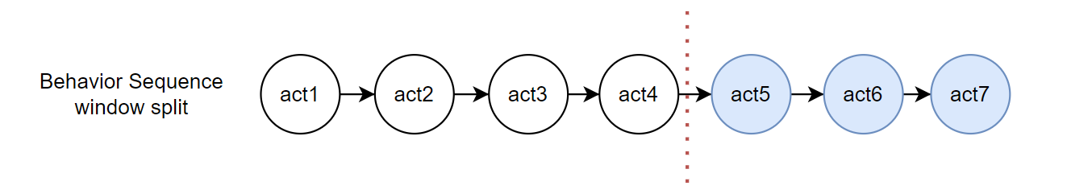
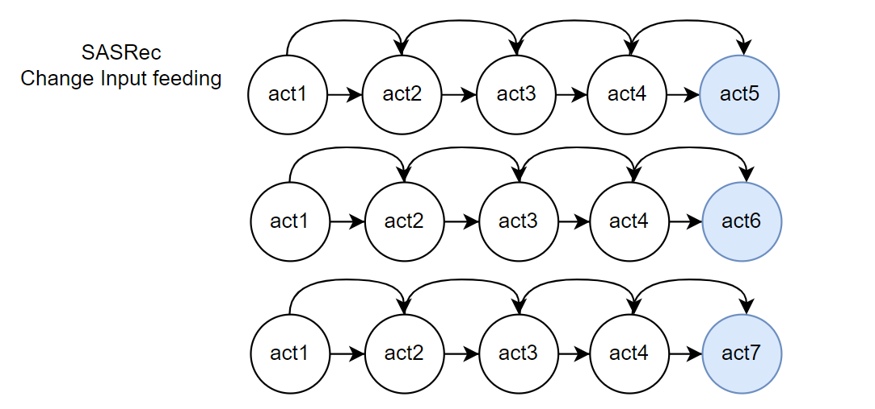
Modify SASRec can process window data
Original:
Avg seq Length: 163.50
Num of training data: 6040
Num of items: 3416
Modified:
Avg seq Length: 185.46
Num of training data: 121919
Num of items: 3416

Slide 4
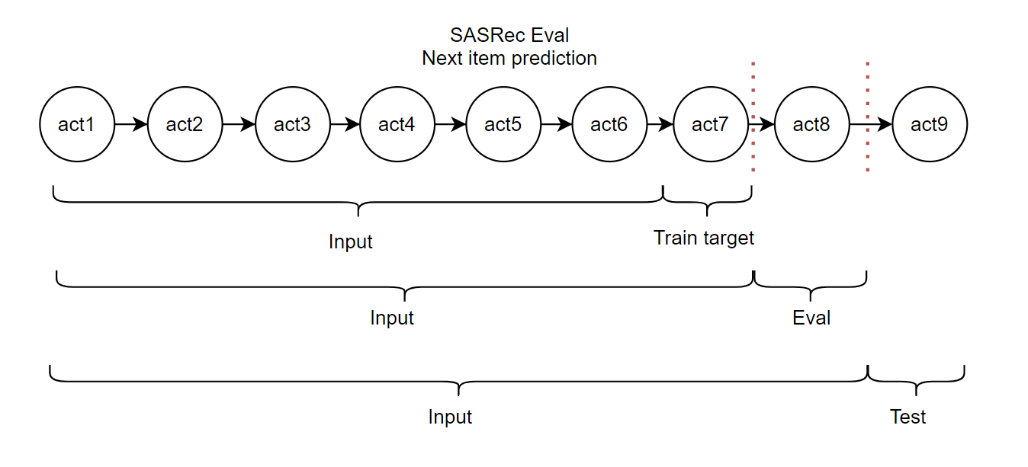
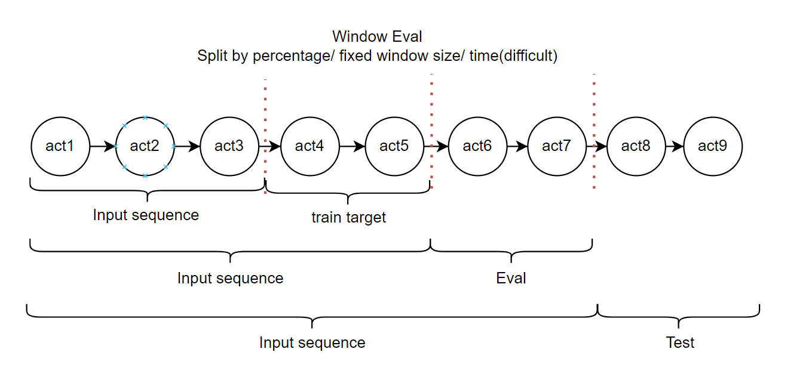
Modify SASRec evaluated on window data

Slide 5
Evaluation Results
All results reported on (R@10, P90Coverage@10)
PopRec:
Train on 1 epoch, just feeding all user-items sequence
Valid: (0.02763014686996881, 0.018)
Test: (0.023668275679878076, 0.018)
SASRec:
Train on 200 epochs, using the original training method in SASRec, and evaluate on our metrics. Evaluates every 20 epochs
Best Valid: 160 epoch, (0.3706746779104318, 0.348)
Best Test: 180 epoch, (0.33170839164631144, 0.364)
SASRec-window:
Train on 5 epochs, change the sampling of the original SASRec.
Best Valid: 1 epoch, (0.22017902563801162, 0.294)
Best Test: 1 epoch, (0.20567050412034238, 0.328)

Slide 6
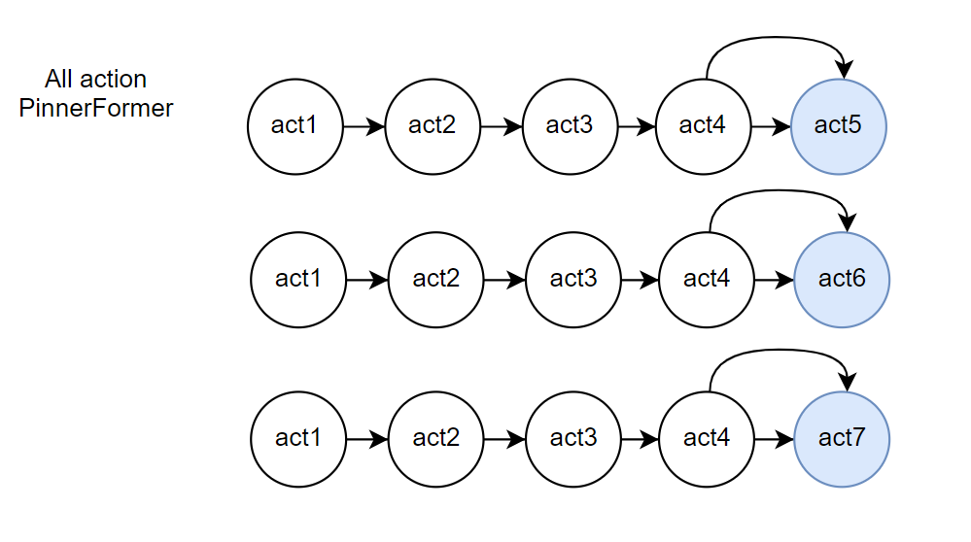
Result Explain

