Slide 1
Week5.
Frozen item embedding
Fine tuning
Time features

Slide 2
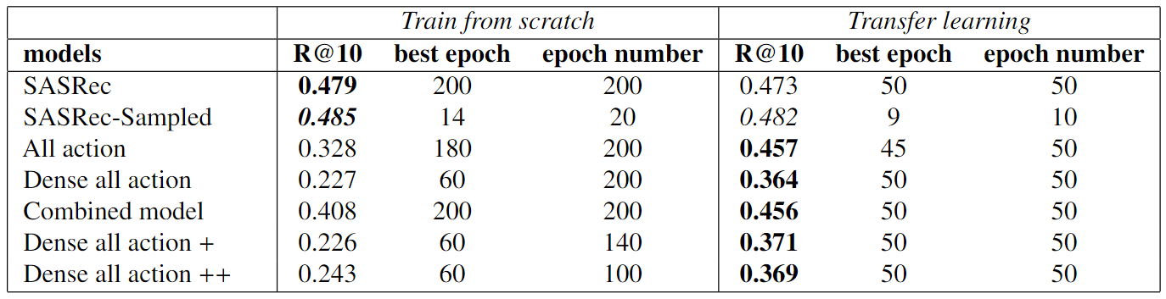
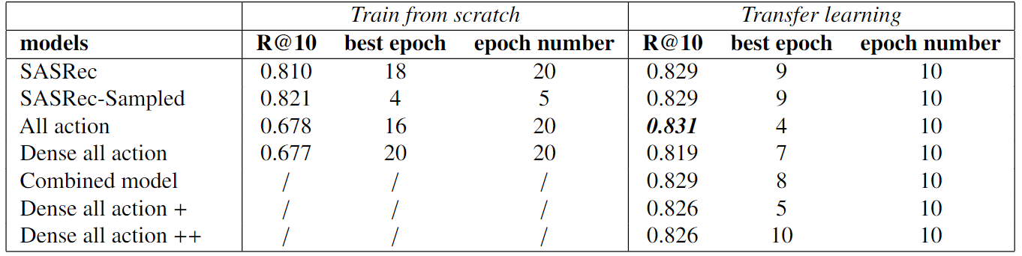
Previous Experiments (Percentage window)
Here transfer learning refers to freeze item embeddings
ML-1M
RetailRocket

Slide 3
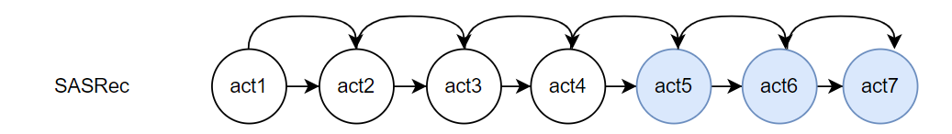
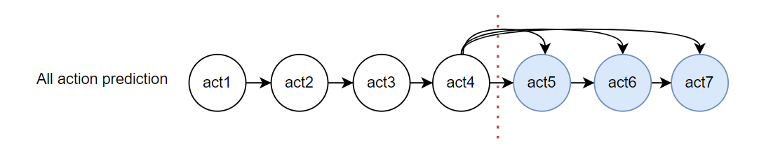
Transfer learning Approaches
1. Fine Tuning (1e-5 lr on item embeddings)
2. Freeze the item embeddings
Item embedding
Trained on the normal sasrec
Other parameters
Train from different training objectives

Slide 4
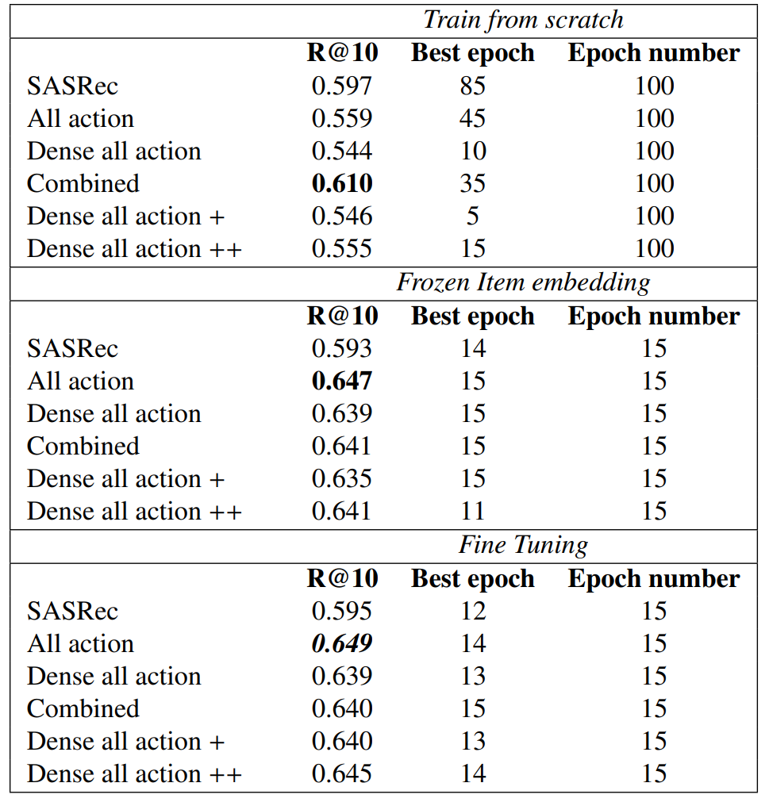
Experiment results (ML-20M)
Item embedding for transfer learning is trained
by normal SASRec in 50 epochs

Slide 5
Results Analysis
Next item prediction outperforms all other models trained from scratch because of the accurate item embeddings as we can see from the experiment results.
Window predictor is much more helpful when learning other predicted used parameters.
We currently used the temporal window to split the dataset, time features could potentially make some help during the prediction.
Assumption

Slide 6
Time Features
Follows the instruction of TiSASRec:
Including
the scaled (personalised) relative time interval embedding (Time Matrix)
Learnable absolute positional embedding.
Problem: More memory cost
I used 128 as batch size before, but this will cause memory error using time features. Currently 64 as batch size.

Slide 7
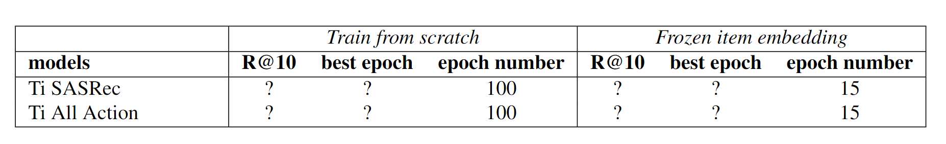
Experiment results
Future Direction
1. Make the P90 coverage evaluation metric works as expected.
2. Implement other models with the time features.
3. Use other models’ generated item embeddings to convince my analysis.

