Slide 1
Week3. Metrics and loss functions
Evaluation metrics
Loss functions
Scheduled Sampling

Slide 2
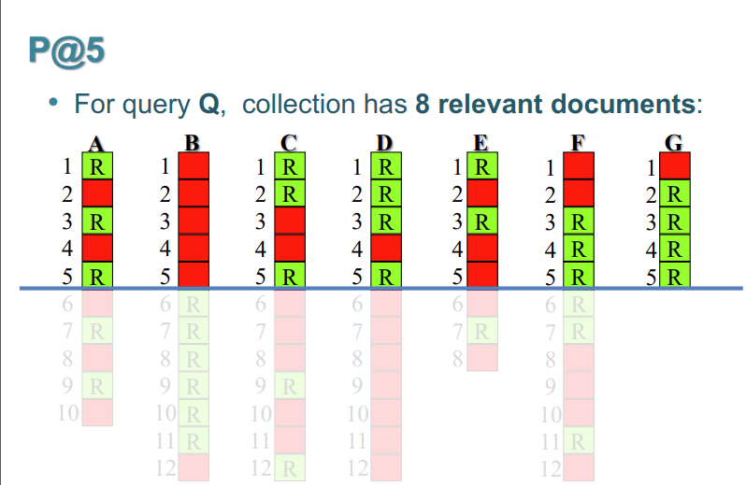
Precision @k, Recall @k,
k (a constant number)
Have a cut-off on the ranked list at rank k, then calculate the precision/recall.
In next item-prediction, only one item is ground-truth, Recall @k represent whether the model identify the ground-truth before position k.

Slide 3
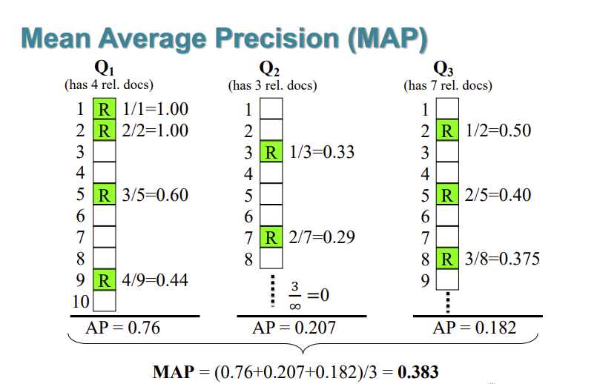
MAP (Mean Average Precision) MRR (Mean reciprocal rank)
AP(average precision): cut-off the ranked list at the when retrieved a relevant items, calculate the average of all precision@k. AP = precision@k in next item prediction, only on ground truth item.
MAP: mean of all AP in the test dataset.
MRR (same as MAP here): cut off the ranked list at the first relevant item (position i), calculate the precision @i, then calculate the average value in all test dataset.

Slide 4
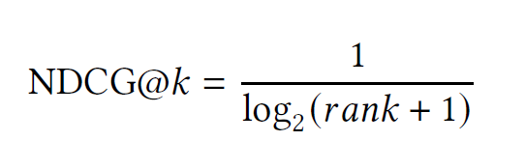
NDCG @k (Normalized Discounted cumulative Gain)
Normalized DCG value with the ideal DCG value at position k.
In next-item prediction only one item is relevant, this metrics can be simplified as: (rank is the position of the ground truth item) indicates how strongly an item is recommended.
The value reduced at lower ranks.

Slide 5
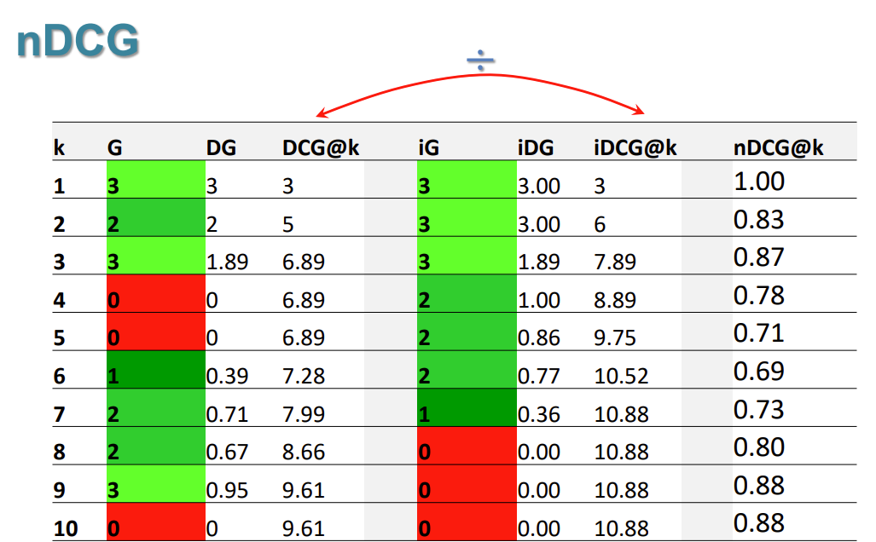
NDCG Progress

Slide 6
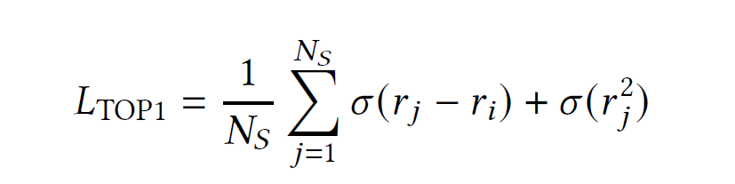


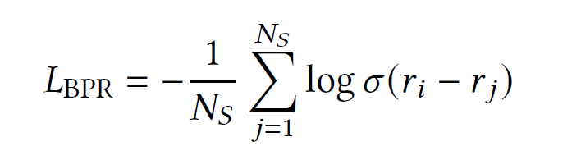
TOP1-Loss, BPR Loss
Top1- Loss: the first part inclines to penalize the incorrect ranking. the second part is used as the regularization.
BPR loss (Bayesian Personalized Ranking): negative logarithm of the probability the positive item is ranked higher than the negative items.
is the ground-truth
is the negative sample

Slide 7

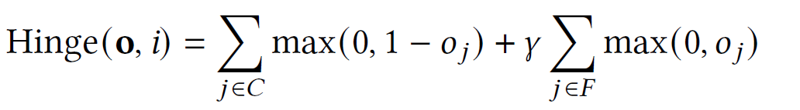
CCE-Loss, Hinge Loss
CCE- Loss (Categorical Cross-Entropy): measuring the difference between the predicted probability distribution and the true distribution of the target labels
Hinge loss : Higher good recommendations, Lower bad recommendations.
𝐶 is the set of recommendations containing ground-truth, while 𝐹 is the set of recommendations not containing ground-truth

Slide 8
Scheduled Sampling
(Bengio et al., 2015)
In training, ground truth is the input for the next time step.
In inference, models predictions is the input for the next time step.
Goal : Mitigate the discrepancy between training and inference.
Q: how to apply it to the next item prediction sequential model

