Slide 1
Extrinsic Gaussian Processes for Regression and Classification on Manifolds
Author: Lizhen Lin, Niu Mu, Pokman Cheung, and David Dunson

Slide 2
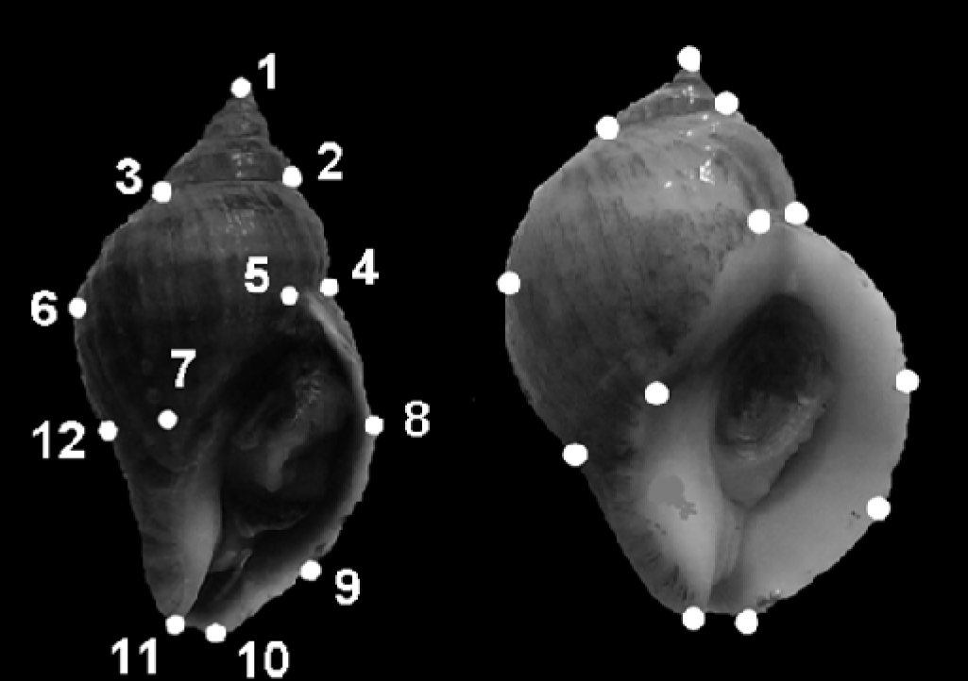
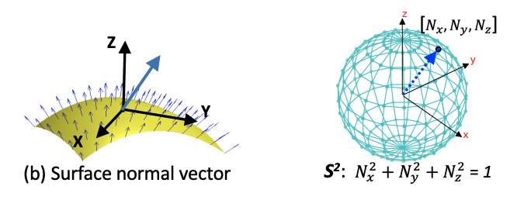
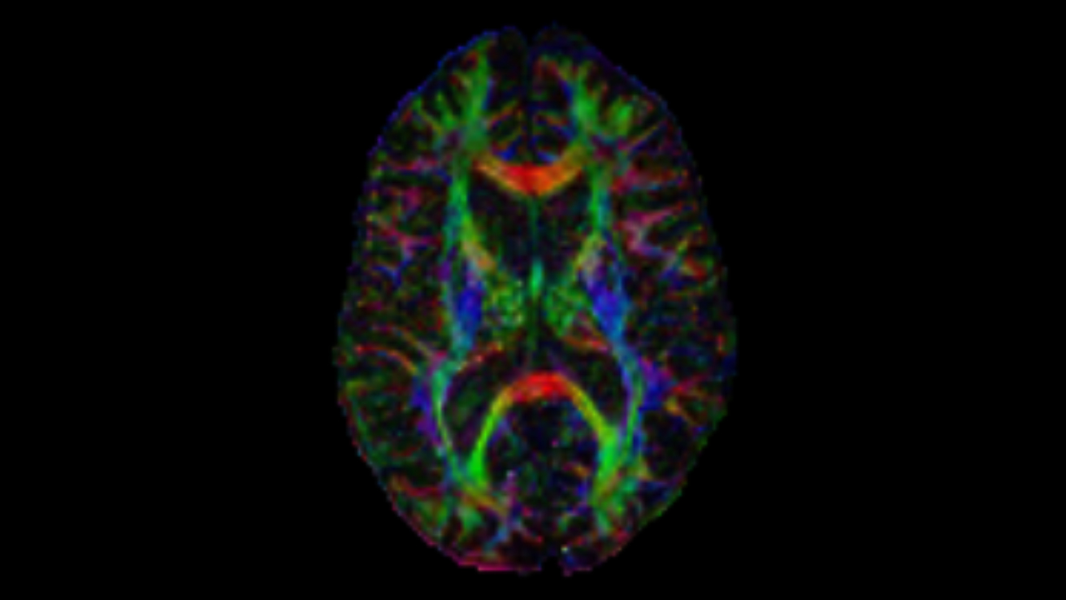
Motivations
DTI
positive definite matrix
Machine vision and medical diagnostics
landmark-based shape space
Surface
Curves
Spheres
Notes:
3 by 3 matrix measuring diffusion of water molecules in the brain related to cognitive traits, magnitude, degree of anisotropy, orientation of directional diffusion.

Slide 3
Motivations
Predictors not in Euclidean space but manifolds

Slide 4



Model
Classification and regression with predictors on known manifolds
Binary/categorical response: classification
Inference on , prior , posterior
GP: simple representation, tractability, flexibility for modeling; theoretical properties.
Euclidean space --> manifolds

Slide 5





GP in manifolds
is a GP with mean function and covariance kernel for
Challenge: valid
Idea (extrinsic GP):
Embed manifolds into Euclidean spaces
Extrinsic kernels on the image manifold :

Slide 6
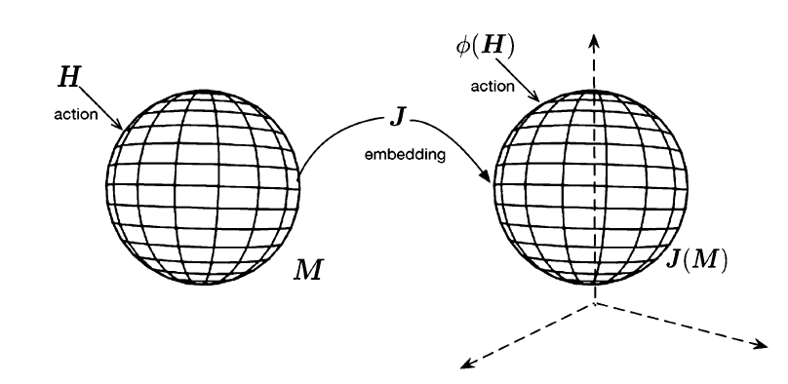


Embedding
Smooth map: differential at each point is an injective map
Injective map: from the tangent space of M at x to the tangent space of at
Homeomorphism between M and
Equivariant embedding: preserves a substantial amount of geometry
Not unique
Notes:
- continuous transformation, is an equivalence relation and one-to-one correspondence between points in two geometric figures or topological spaces that is continuous in both directions.
- If a lage group H acts on the manifolds such as by rotation before embedding, such an action can be preserved via phi on the image \Tilde M
- General linear group

Slide 7
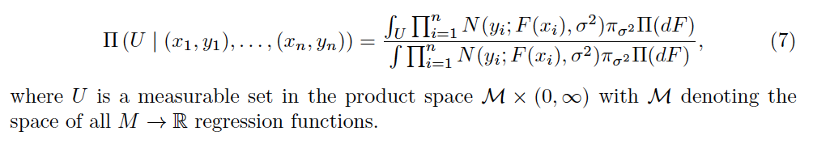


Posterior distribution
For classification, a latent process and link function

Slide 8


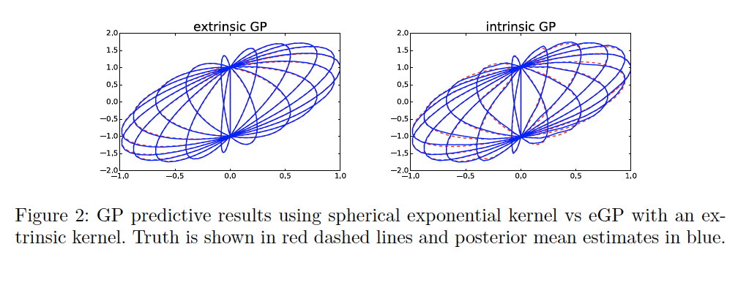
Examples: Spheres
Inclusion map
Equivariant w.r.t (symmetry)
Kernel:
Notes:
Special orthogonal matrices
arcsin(1/2||x-x'||)

Slide 9
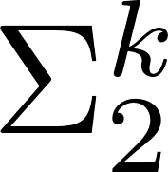




Examples: Landmark-based shape space
Planar shapes
Veronese-Whitney embedding:
Equivariant w.r.t
Kernel:
Notes:
Collections of landmark points’ modulo the Euclidean motions including translation, scaling, rotation
Complex Hermitian matrices

Slide 10

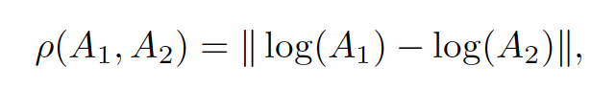
Examples: positive definite matrices
Log-map embedding:
Equivariant w.r.t
kernel
Notes:
Actions of GL
Lie group
General linear group

Slide 11
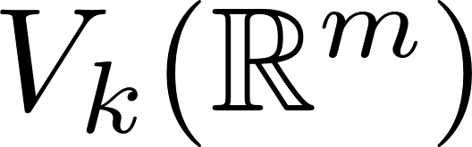
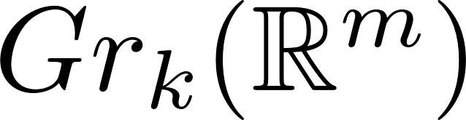
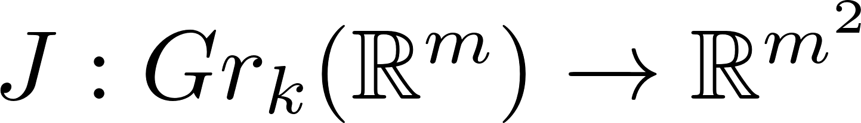


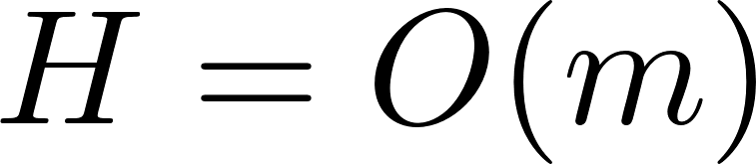
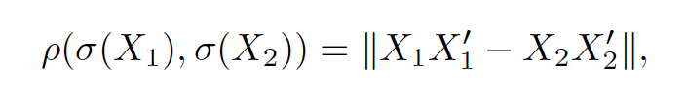
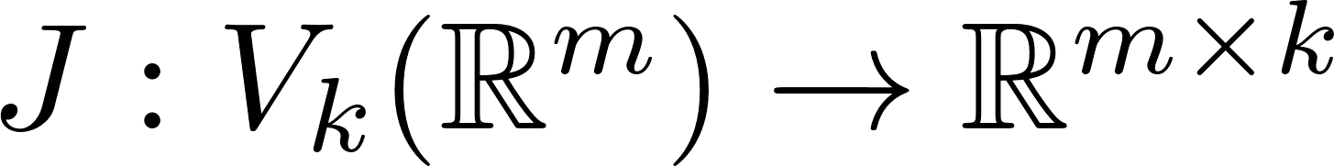
Examples: Stiefel manifolds & Grassmann manifolds
Grassmann manifolds
Embedding:
Equivariant w.r.t.
Kernel:
Stiefel manifolds
Inclusion map:
Equivariant embedding

Slide 12
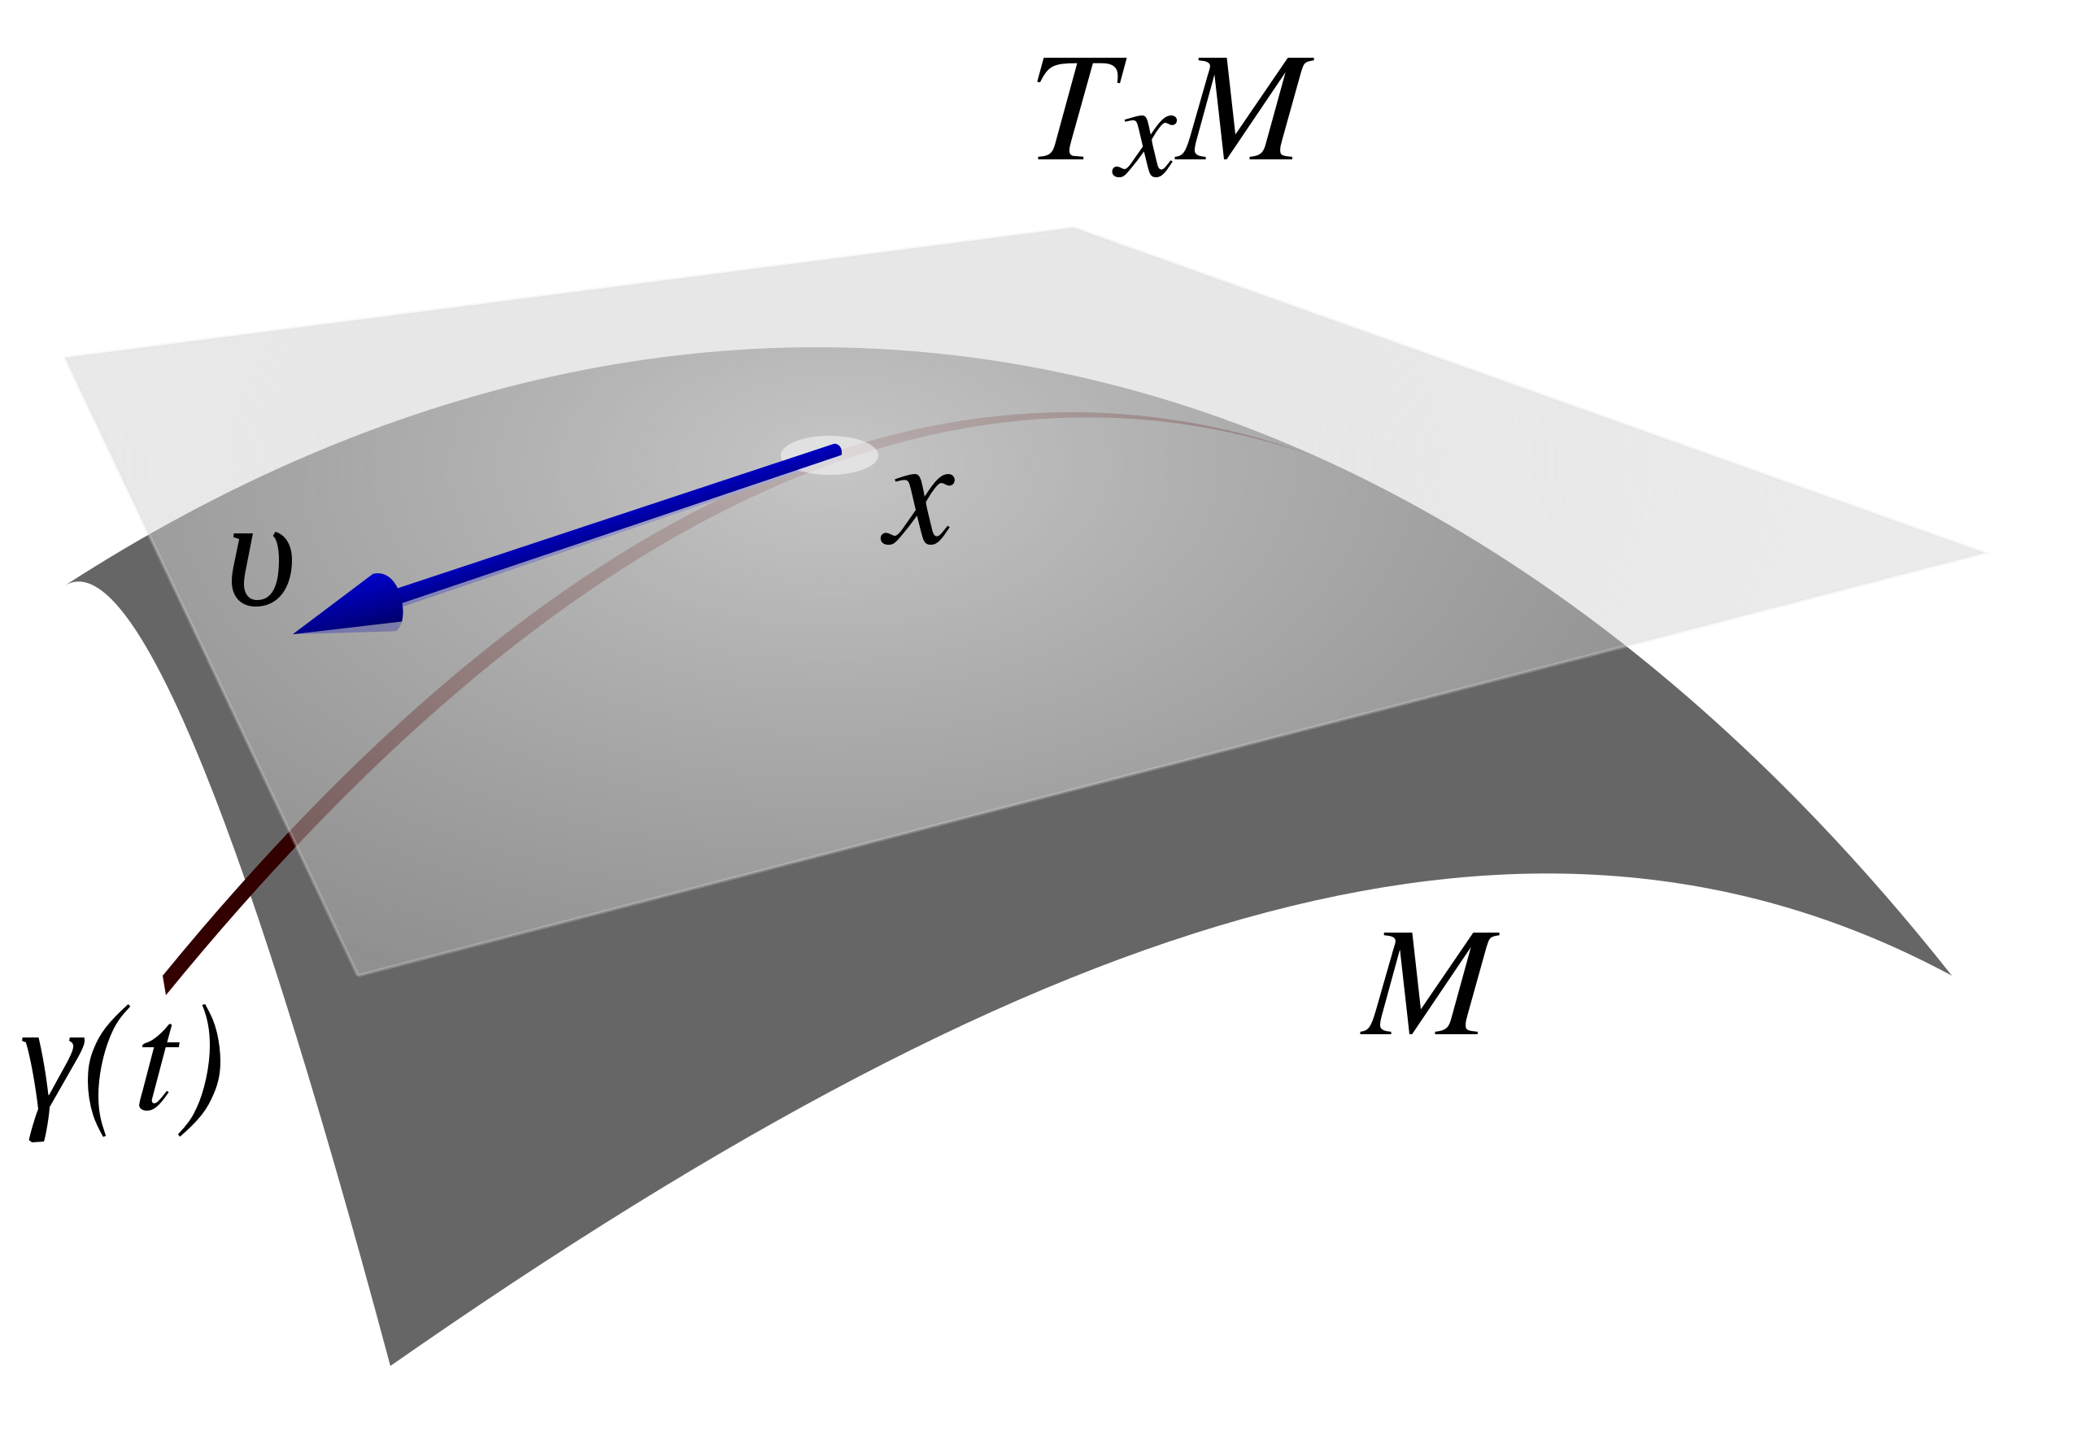
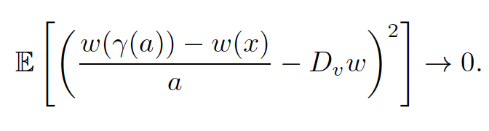








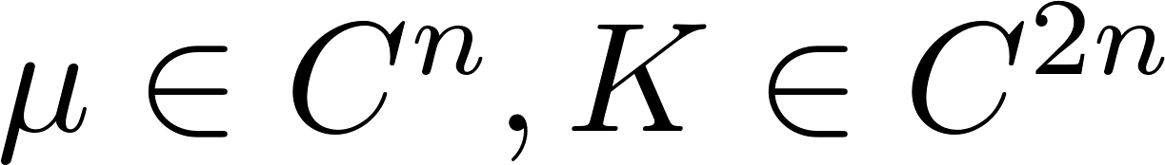




Properties of eGPs
Mean square differentiability of stochastic process
Proposition 2: differentiable , is of a class --> MS differentiable at
Proposition 3: MS derivative has mean func. , Cov func.
Corollary 1: n-times MS differentiable.
Important for interpolation and prediction
E.g. pull back to with
Posterior contraction rates adapt to dim of underlying M
Notes:
V: tangent vector field
Posterior contraction rates: how fast the posterior concentrates in small neighborhoods of the true regression function
d dim of manifold
s: continuous functions that have continuous first s derivatives

Slide 13
Discussions
Other manifolds? Space beyond manifolds?
Unknown manifolds?
Other criterion for embedding?
Comparison between extrinsic and intrinsic?
Manifold-valued response? (Lin et al., 2017)
Notes:
Equivariant class: keep a substantial geometry. Intrinsic Riemannian geometry of manifolds,
Cons of intrinsic: computation, hard to implement
Local regression (kernel regression). Project it back

