Slide 1

NetWalk: A Flexible Deep Embedding Approach for Anomaly Detection in Dynamic Networks
Wenchao Yu, Wei Cheng, Charu C. Aggarwal, Kai Zhang, Haifeng Chen, and Wei Wang
(UCLA, IBM)
KDD 2018
Yunseob Shin
Information & Intelligence System Lab.
Sungkyunkwan University
2018/10/15

Slide 2
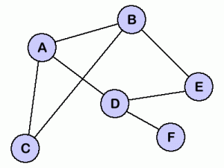
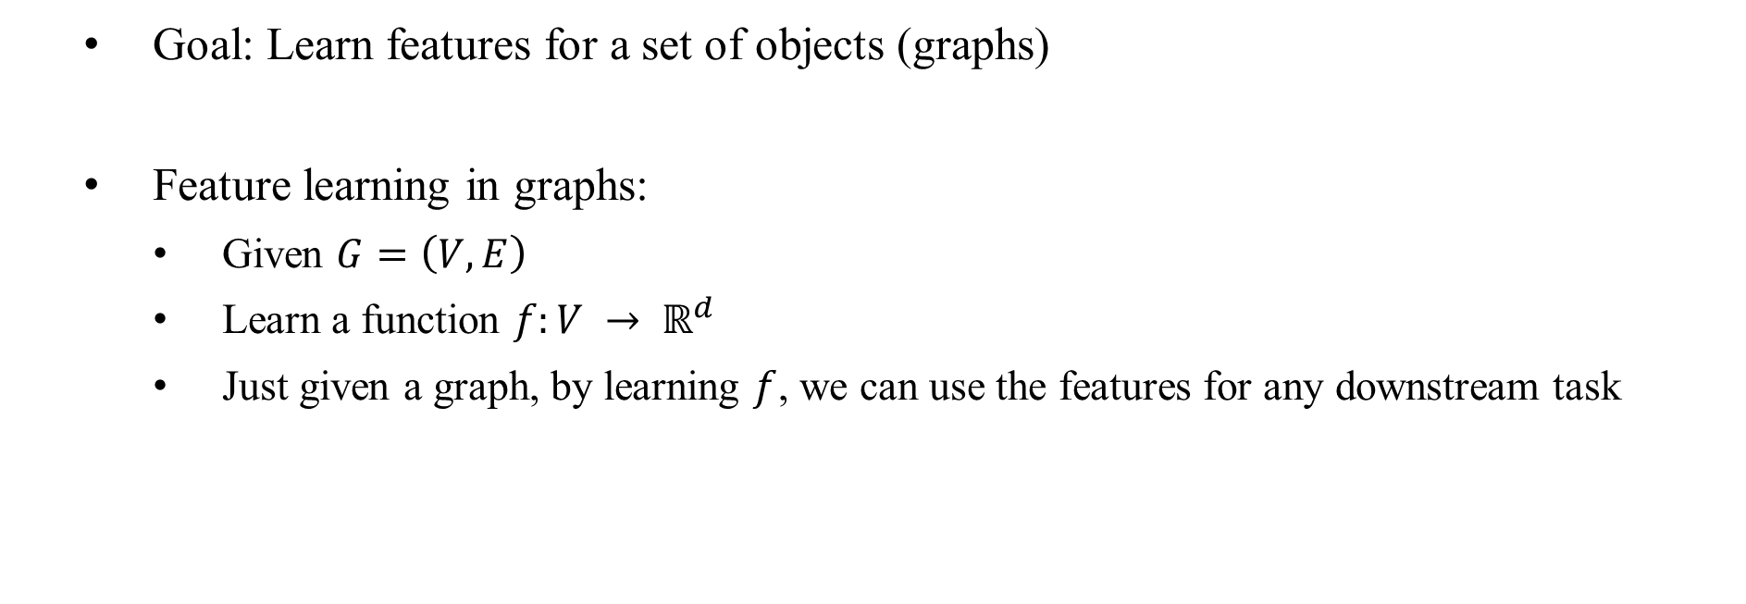
Feature Learning in Graphs
Goal: Learn features for a set of objects (graphs)
Feature learning in graphs:
Given $G=\left(V, E\right)$
Learn a function $f:V → ℝ^{d}$
Just given a graph, by learning $f$, we can use the features for any downstream task
A
B
C
D
E
F
Notes:
downstream task: learning algorithm, model

Slide 3
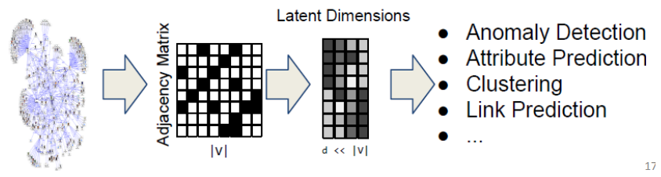
Feature Learning in Graphs
Why network embedding?
Vector spaces are more amenable to data science than graphs
We can only use specific mathematics and toolsets for graph data
Notes:
downstream task: learning algorithm, model

Slide 4
Contribution
Detects anomalies in a network using graph embedding
Applicable for dynamically changing networks
Accurate and efficient algorithms to update representations
Notes:
Static environmen가 아닌 online 환경에서도 적용할 수 있도록 알고리즘을 설계했다.
기존 어노말리 디택션 방법론, 다른 그래프 임베딩보다 더 좋은 결과를 보였다.

Slide 5
Why anomaly detection?
In social media, malicious activities can be detected as anomalies
In advanced persistent threat (APT) detection problem, malicious activities can be quite different from normal system behaviors
In clinics, anomaly detection can provide valuable information on managing diagnosis with electric patient records
Notes:
downstream task: learning algorithm, model

Slide 6
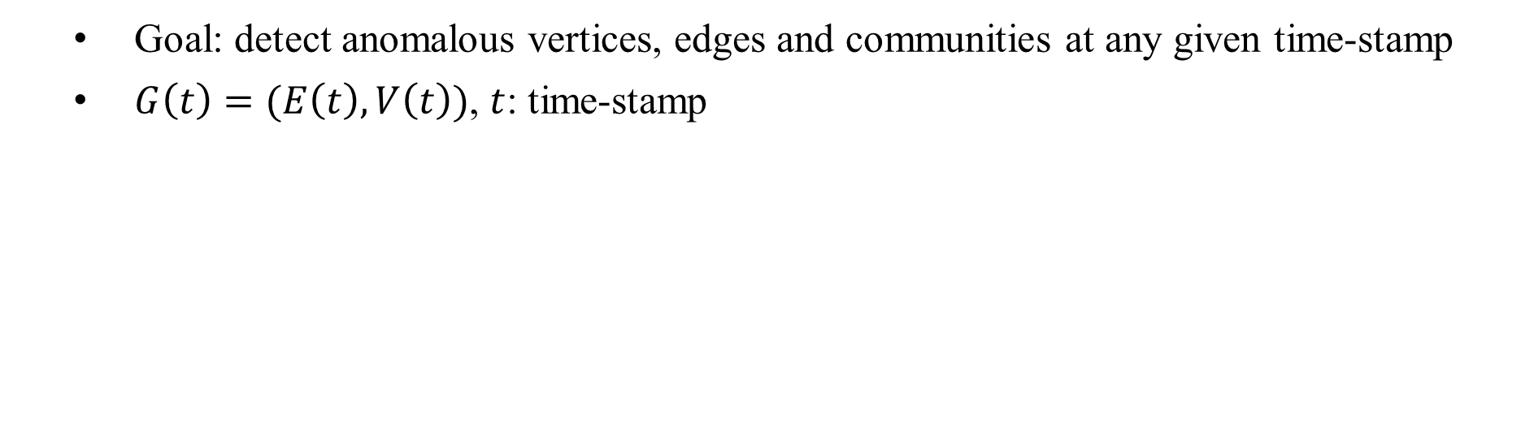
Problem Definition
Goal: detect anomalous vertices, edges and communities at any given time-stamp
$G\left(t\right)=(E\left(t\right), V\left(t\right))$, $t$: time-stamp
Notes:
downstream task: learning algorithm, model

Slide 7
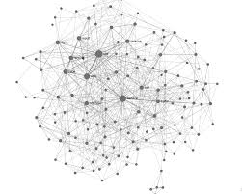
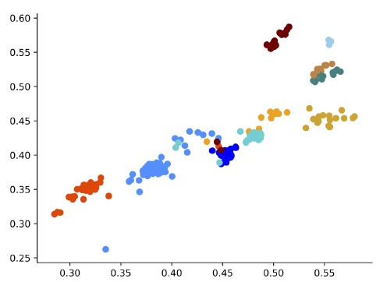
Overall structure of NetWalk
0 | 2 | 3 | 2 | … | 15
0 | 1 | 2 | 5 | … | 56
1 | 41 | 54 | 56 | … | 4
1 | 25 | 12 | 3 | … | 11
2 | 15 | 21 | 0 | … | 48
2 | 56 | 7 | 45 | … | 87
Generate random walks
Learn embeddings with autoencoder
Initial graph
Incremental maintenance with new edges and vertices and deletions
Notes:
downstream task: learning algorithm, model

Slide 8


Random walk generation
$Ω_{v}$: a set of random walk set starting from vertex $v$
$Ω={\left\{Ω_{v}\right\}}_{v∈V}$
$l$: the length of each walk
$ψ$: number of random walks per vertex
0 | 2 | 3 | 2 | … | 15
0 | 1 | 2 | 5 | … | 56
1 | 41 | 54 | 56 | … | 4
1 | 25 | 12 | 3 | … | 11
2 | 15 | 21 | 0 | … | 48
2 | 56 | 7 | 45 | … | 87
$$Ω_{0}$$
Notes:
downstream task: learning algorithm, model

Slide 9
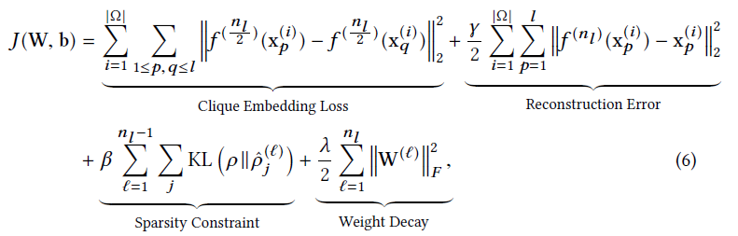
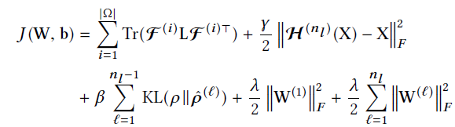
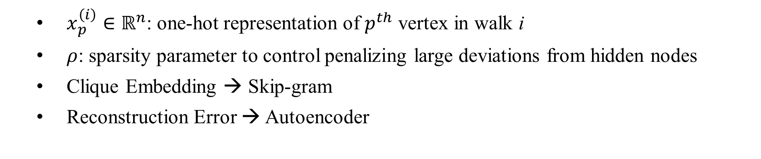
Network embedding
Matrix form
$x_{p}^{\left(i\right)}∈ℝ^{n}$: one-hot representation of $p^{th}$ vertex in walk i
$ρ$: sparsity parameter to control penalizing large deviations from hidden nodes
Clique Embedding → Skip-gram
Reconstruction Error → Autoencoder
Notes:
ρˆ is the average activation of the units in the hidden layer. This sparsity constraint penalizes large deviation of ρˆ from ρ.

Slide 10
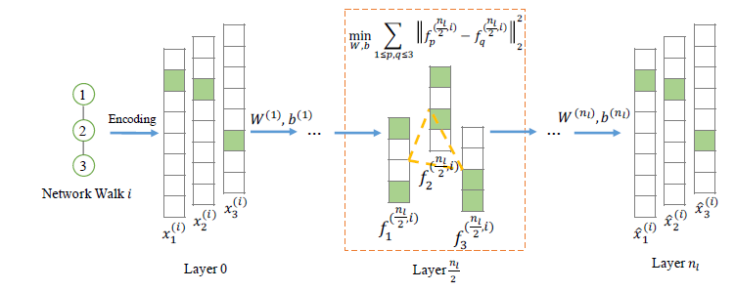
Network embedding
Autoencoder + Skip-gram
Notes:
downstream task: learning algorithm, model

Slide 11
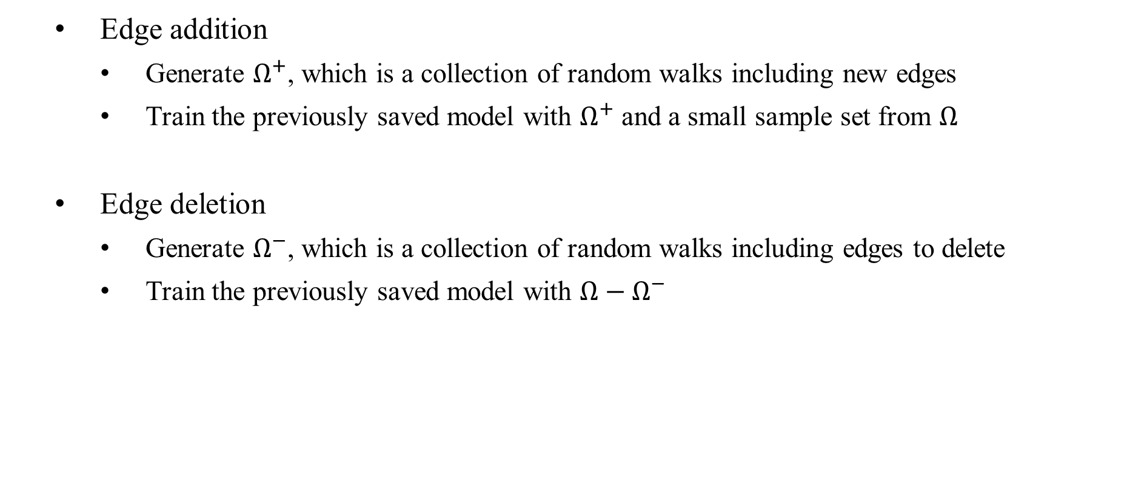
Incremental Maintenance
Edge addition
Generate $Ω^{+}$, which is a collection of random walks including new edges
Train the previously saved model with $Ω^{+}$ and a small sample set from $Ω$
Edge deletion
Generate $Ω^{−}$, which is a collection of random walks including edges to delete
Train the previously saved model with $Ω−Ω^{−}$
Notes:
downstream task: learning algorithm, model

Slide 12

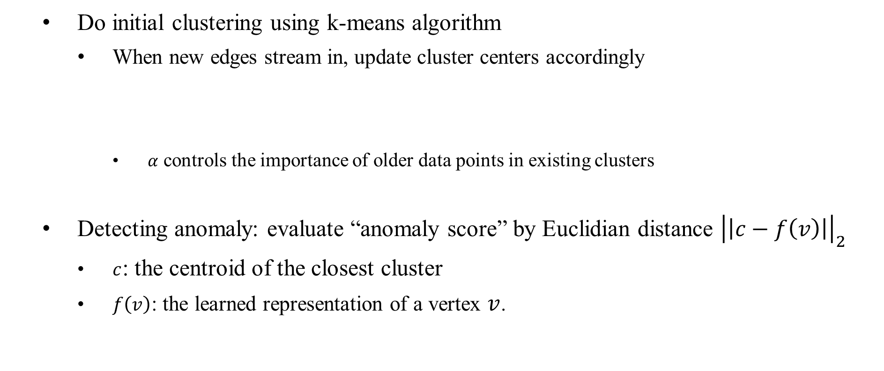
Anomaly detection
Do initial clustering using k-means algorithm
When new edges stream in, update cluster centers accordingly
$α$ controls the importance of older data points in existing clusters
Detecting anomaly: evaluate “anomaly score” by Euclidian distance ${\left|\left|c−f\left(v\right)\right|\right|}_{2}$
$c$: the centroid of the closest cluster
$f\left(v\right)$: the learned representation of a vertex $v$.
Notes:
downstream task: learning algorithm, model

Slide 13
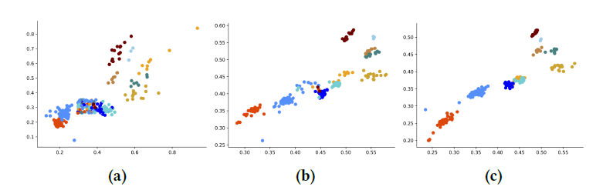
Experiments
(a): initial embedding with 50% edges
(b): online embedding with +25% edges (75%)
(c): online embedding with +25% edges (10%)
Notes:
downstream task: learning algorithm, model

Slide 14
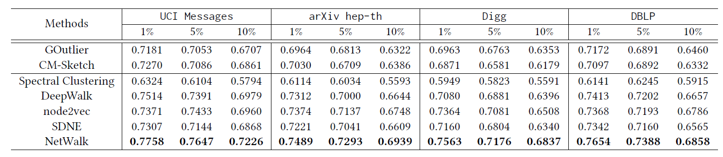
Experiments
AUC score comparison for predicting anomalies in initial embeddings.
Due to no labeled anomalies in ground-truth dataset, they used anomaly injection method
Notes:
downstream task: learning algorithm, model

Slide 15
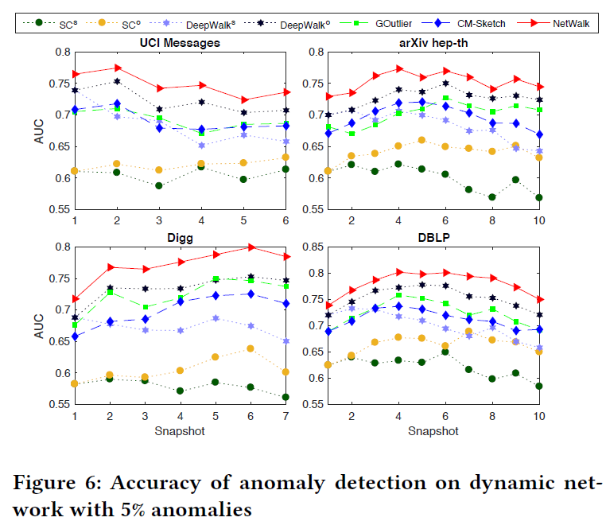
Experiments
Notes:
downstream task: learning algorithm, model

Slide 16
Conclusion
Detects anomalies in a network using graph embedding
Based on the low-dimensional vertex representations, a clustering-based technique incrementally and dynamically detects network anomalies
Better performance than other anomaly detection methods and graph embeddings
Notes:
downstream task: learning algorithm, model

