Slide 1

Learning Graph Representations with Embedding Propagation
Alberto García-Durán and Mathias Niepert (NEC Labs Europe), NIPS, 2017
Yunseob Shin,
Information & Intelligence System Lab., SKKU
2018/05/31

Slide 2
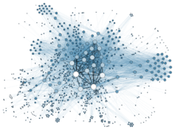
Introduction
Graph-structured data occurs in numerous application domains such as social networks, bioinformatics, and relational knowledge bases.
Problems related with graph-structured data:
Node Classification
Community Detection (Graph Clustering)
Link Prediction
Information Propagation
Novel approaches to unsupervised representation learning for graph-structured data are important and applicable to a wide range of problems.

Slide 3
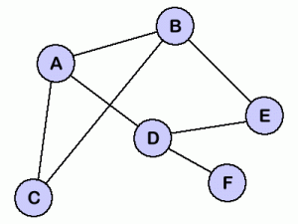
Introduction
Embedding Propagation (EP): an unsupervised learning framework for graph-structured data that supports arbitrary label types.
EP learns vector representations (embeddings) of graph by passing messages between neighboring nodes.
A
B
EP
C
D
E
F
Notes:
Motivation: nodes may have an arbitrary number of label types, and these label types may be heterogenous

Slide 4
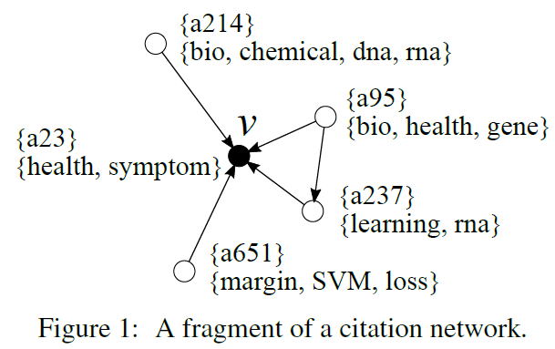
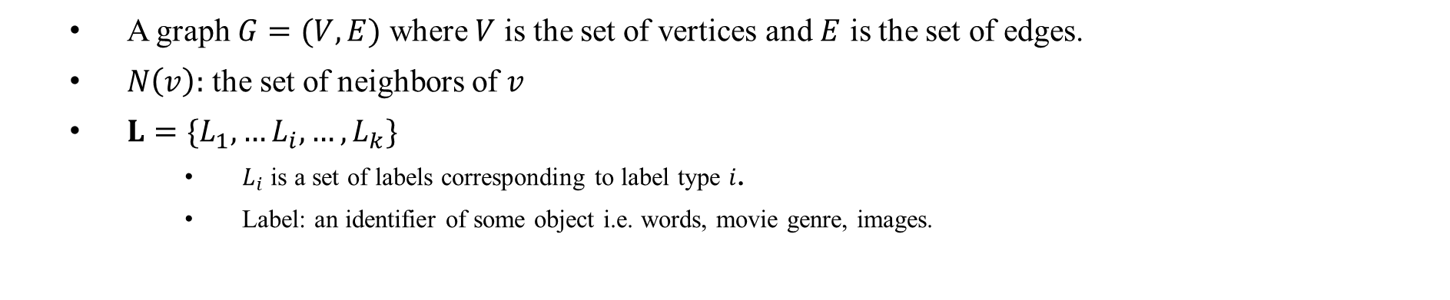
Proposed Framework and Method
A graph $G=(V, E)$ where $V$ is the set of vertices and $E$ is the set of edges.
$N\left(v\right):$ the set of neighbors of $v$
$L=\{L_{1},…L_{i}, …, L_{k}\}$
$L_{i}$ is a set of labels corresponding to label type $i$.
Label: an identifier of some object i.e. words, movie genre, images.

Slide 5
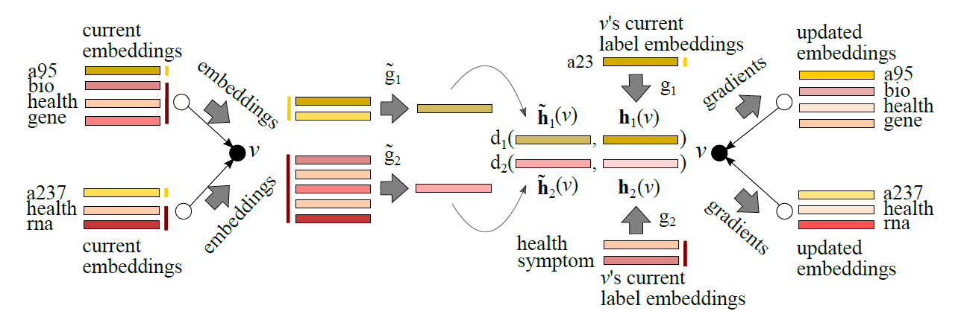
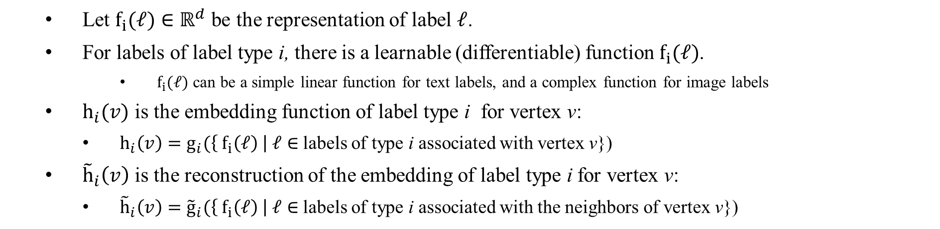
Training Label Embeddings
Let $f_{i}(ℓ)∈ℝ^{d}$ be the representation of label $ℓ$.
For labels of label type i, there is a learnable (differentiable) function $f_{i}(ℓ)$.
$f_{i}(ℓ)$ can be a simple linear function for text labels, and a complex function for image labels
$h_{i}(v)$ is the embedding function of label type i for vertex v:
$h_{i}\left(v\right)=g_{i}(\left\{ f_{i}\left(ℓ\right) \right| ℓ∈$ labels of type i associated with vertex v})
${\tilde{h}}_{i}\left(v\right)$ is the reconstruction of the embedding of label type i for vertex v:
${\tilde{h}}_{i}\left(v\right)={\tilde{g}}_{i}(\left\{{ f}_{i}\left(ℓ\right) \right| ℓ∈$ labels of type i associated with the neighbors of vertex v})
Notes:
각 레이블을 어떻게 뭉치는 지는 (함수 f를 어떻게 설계하는 지는 사용자가 결정)
레이블 별로 f라는 함수를 통해 vector embedding 만들어서, g라는 함수를 통해 하나로 합친 결과가 h
f와 g는 모두 미분가능, 많은 경우에서 g랑 g_hat은 parameter free function; element-wise avg, max

Slide 6

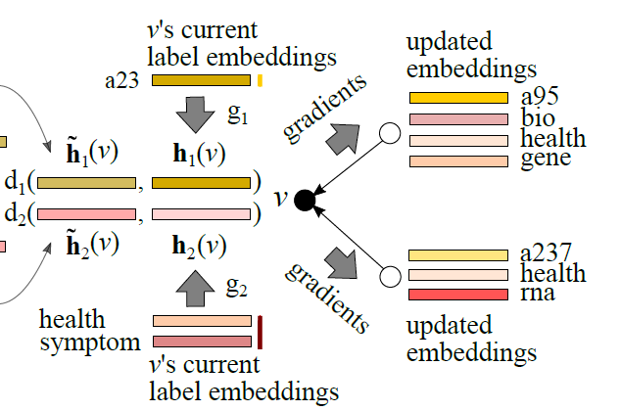
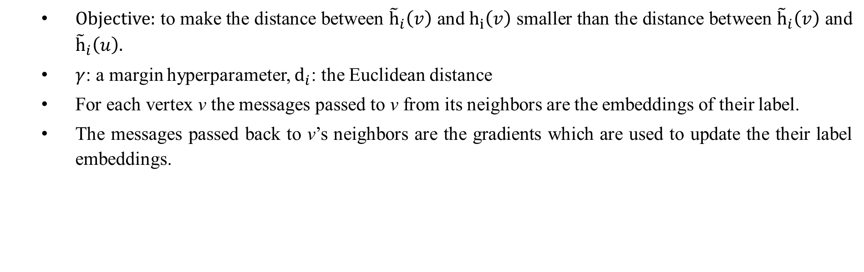
Training Label Embeddings
Objective: to make the distance between ${\tilde{h}}_{i}\left(v\right)$ and $h_{i}\left(v\right)$ smaller than the distance between ${\tilde{h}}_{i}\left(v\right)$ and ${\tilde{h}}_{i}\left(u\right).$
$γ$: a margin hyperparameter, $d_{i}$: the Euclidean distance
For each vertex v the messages passed to v from its neighbors are the embeddings of their label.
The messages passed back to v’s neighbors are the gradients which are used to update the their label embeddings.
Notes:
The objective is to make the distance between ${\tilde{h}}_{i}\left(v\right)$ and $h_{i}\left(v\right)$ smaller than the distance between ${\tilde{h}}_{i}\left(v\right)$ and ${\tilde{h}}_{i}\left(u\right).$
Gradient를 어떻게 전달시켜서 업데이트하는지는 안나와있음

Slide 7
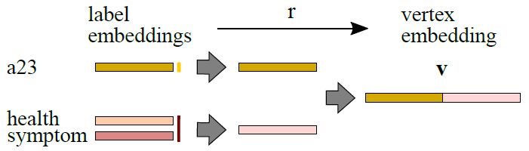
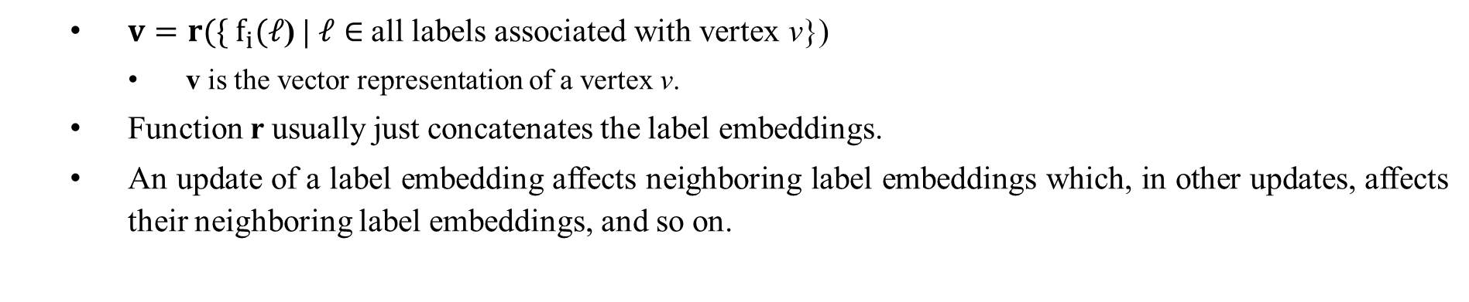
Training Label Embeddings
$v=r(\{ f_{i}(ℓ$) | $ℓ∈$all labels associated with vertex v})
v is the vector representation of a vertex v.
Function r usually just concatenates the label embeddings.
An update of a label embedding affects neighboring label embeddings which, in other updates, affects their neighboring label embeddings, and so on.
Notes:
The objective is to make the distance between ${\tilde{h}}_{i}\left(v\right)$ and $h_{i}\left(v\right)$ smaller than the distance between ${\tilde{h}}_{i}\left(v\right)$ and ${\tilde{h}}_{i}\left(u\right).$

Slide 8

EP-B Method
EP-B: an instance of EP framework found to be effective several of the typical graph-based learning problems.
Hyperparameters of EP framework: $f_{i}$, $g_{i}$, ${ \tilde{g}}_{i}$, r
$f_{i}$ ← linear embeddings equivalent to an embedding lookup table.
$g_{i}$ and ${ \tilde{g}}_{i}$ ← element-wise average
r ← concatenation of the label embeddings
Notes:
Gradient step을 한 번만 해도 어차피 다른 노드에서 할 때 또 바뀜

Slide 9
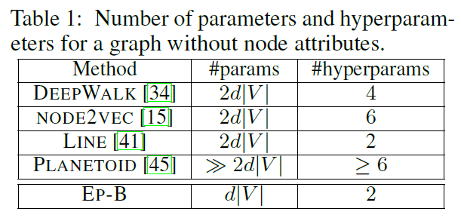
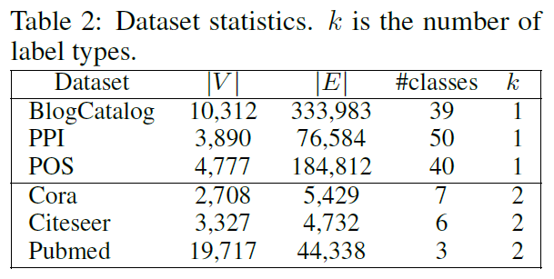
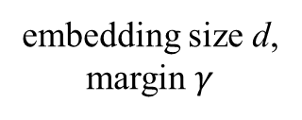

Experiments
Evaluation by node classification problem
d is fixed to 128 for all methods
$γ$ is chosen from [1, 5, 10, 20] via cross validation
2
2
2
1
1
1
embedding size d, margin $γ$
Notes:
BlogCatalog (online social net.), PPI (protein-protein interactions), POS (Wikipedia)
Multi-label classification
Cora, Citeseer, Pubmed
One label per node

Slide 10
Experiments
Evaluation by node classification problem
Input: a graph
A fraction of the nodes is assigned a class label
The output is an assignment of class label to the test node
The paper choose logistic regression trained with node representations v.
Notes:
BlogCatalog (online social net.), PPI (protein-protein interactions), POS (Wikipedia)
Multi-label classification
Cora, Citeseer, Pubmed
One label per node

Slide 11

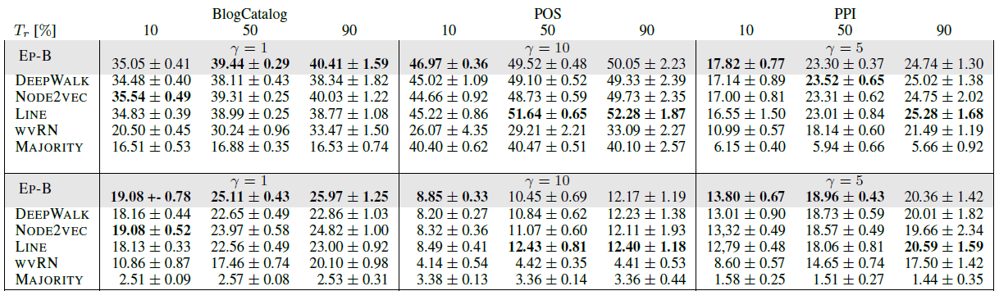

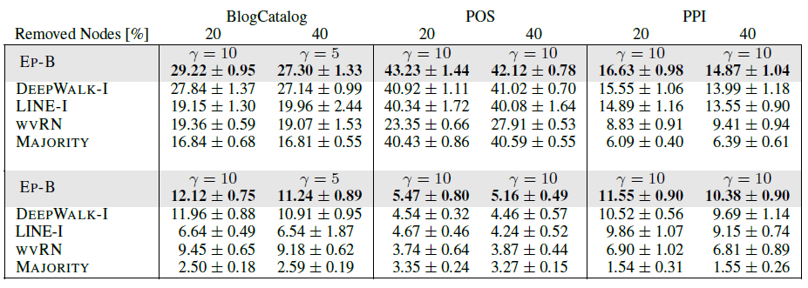
Experiments: multi-label classification
Notes:
Node2vec 논문에서 주장한 바와는 달리 node2vec이랑 deepwalk이랑 큰 차이 없음
Transductive: 모두 사용, inductive: 트레이닝에서 일부 제거

Slide 12
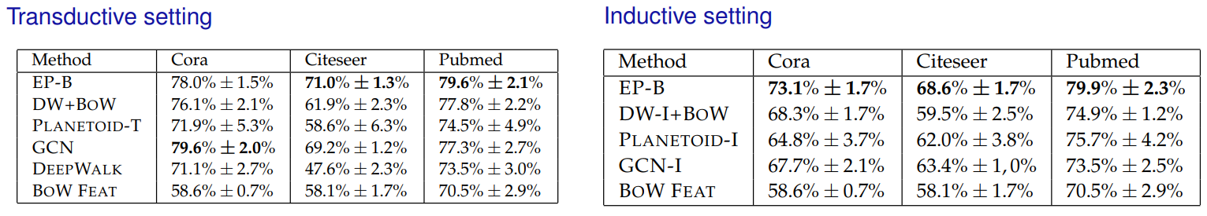
Experiments: single-label classification
Notes:
BlogCatalog (online social net.), PPI (protein-protein interactions), POS (Wikipedia)
Multi-label classification
Cora, Citeseer, Pubmed
One label per node

Slide 13
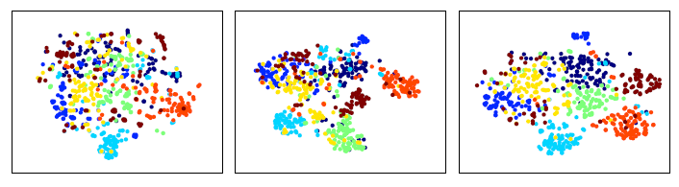
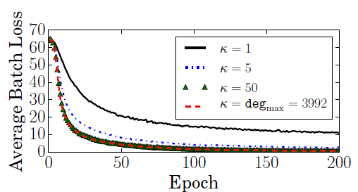
Experiments: visualization and number of neighbors
Identity labels only
Word labels only
Both
Silhouette score s
(-1 < s < 1)
0.008
0.107
0.158
Notes:
s 가 1에 가까울수록 clustering이 잘 됨
딱히 잘된 것 같진 않으나 레이블이 추가되어서 클러스터링이 더 잘 된 것을 볼 수 있음
임베딩 학습 시 이웃 수를 5개 정도로 제한하면 효율적으로 학습 가능

Slide 14
Conclusion and Future Work
Contribution:
Ability to learn arbitrary label type representations and combine them into a joint vertex embedding.
EP-B method is competitive and often outperforms the other state of the art methods with fewer parameters and hyperparameters.
Future work:
Incorporates with image and sequence data
Multi-relational graphs

