Slide 1

Learning to Model the Tail
Yu-Xiong Wang Deva Ramanan Martial Hebert
NIPS 2017
Yunseob Shin
Information & Intelligence System Lab.
Sungkyunkwan University
2019/09/18

Slide 2
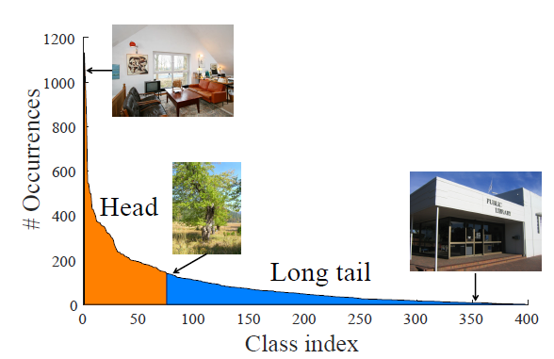
Introduction
Power law distribution among many labels
a few “head” labels with large data
many “tail” labels with few data

Slide 3
Introduction
Head labels
class No.
# of examples
1
5,000
Feature
Map
2
3,000
INPUT
IMAGE
CNN
…
…
j
30
…
…
…
M
17
Tail labels

Slide 4
Introduction
Head labels
class No.
# of examples
1
5,000
Feature
Map
2
3,000
INPUT
IMAGE
CNN
…
…
j
30
…
…
…
M
17
Tail labels

Slide 5
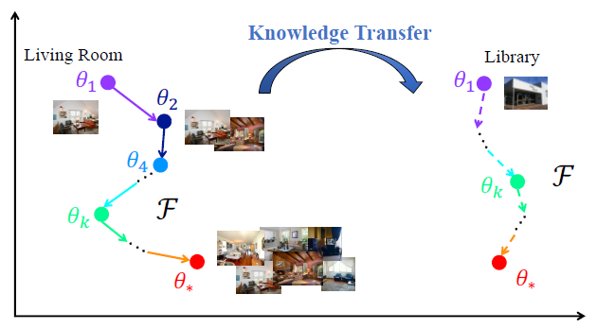
Introduction
Contributions
analyze the dynamic of how model parameters evolve with more training data
propose a single meta-network based on deep residual learning
gradually transfers meta-knowledge learned from head to the tail

Slide 6

Related Work
Meta Learning (Learning to Learn) by regressing network (ECCV 2016)
$g(x;θ)$: a neural net to classify $x$ with parameter set $θ$
$ℱ\left(g,θ;w\right)$: a meta-learner to find optimal $θ$ with parameter set $w$
Objective: training a “meta-learner” $ℱ$ by regressing $θ$to the optimal $θ^{∗}$

Slide 7
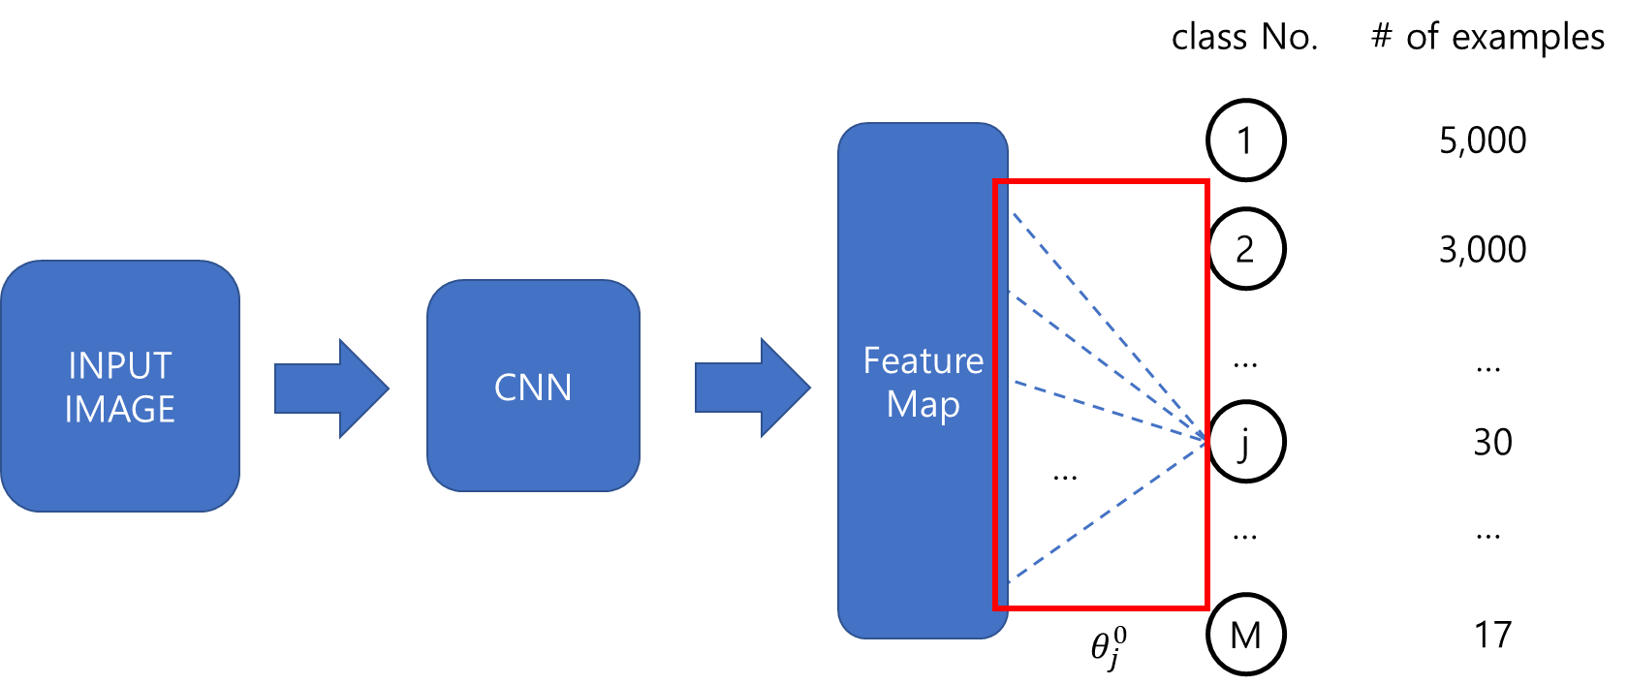
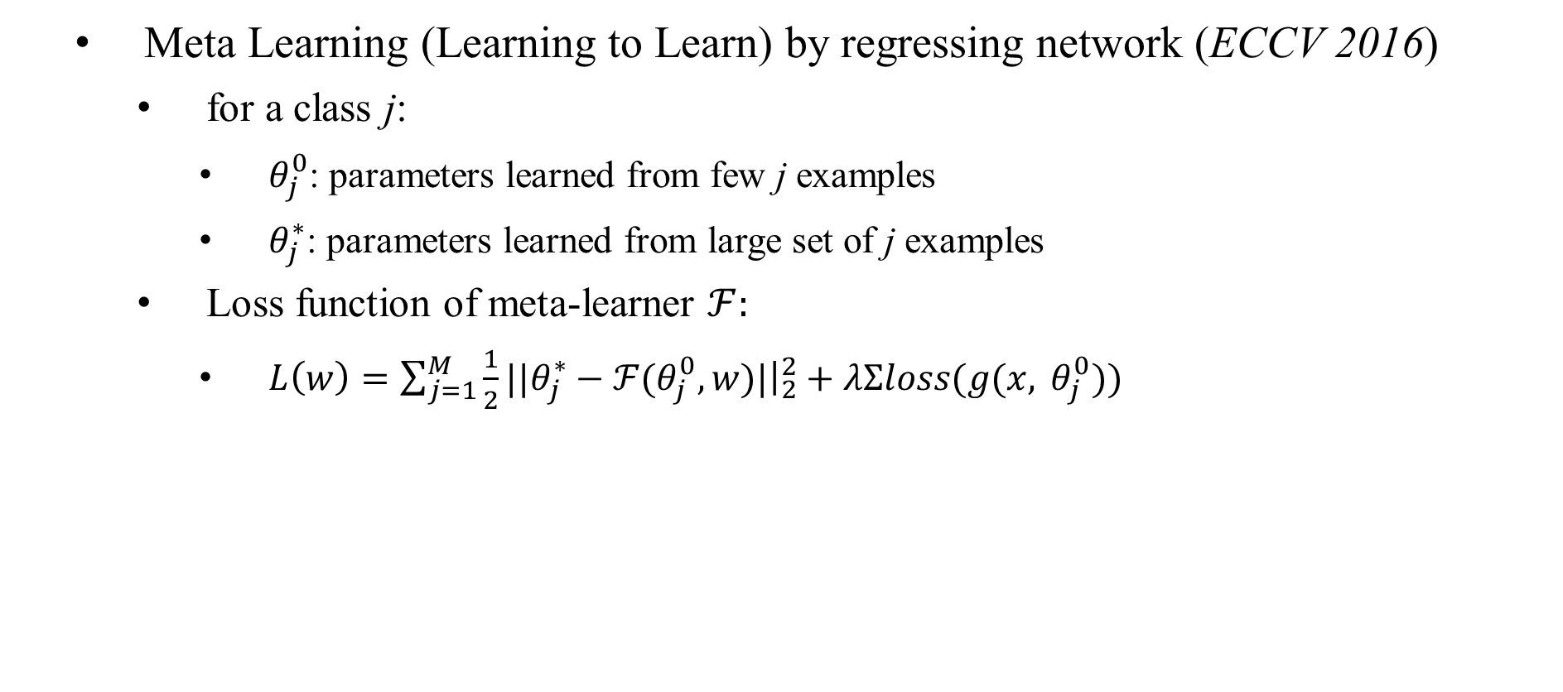
Related Work
Meta Learning (Learning to Learn) by regressing network (ECCV 2016)
for a class j:
$θ_{j}^{0}$: parameters learned from few j examples
$θ_{j}^{∗}$: parameters learned from large set of j examples
Loss function of meta-learner $ℱ$:
$L\left(w\right)=\sum_{j=1}^{M}{\frac{1}{2}||θ_{j}^{∗}−ℱ(θ_{j}^{0},w)|{\left.​\right|}_{2}^{2}+λΣloss(g(x, }θ_{j}^{0}))$

Slide 8

Proposed Method
Overall process of MetaModelNet
get pseudo-optimal parameter $θ^{∗}$
train the residual meta-learner with parameters from head labels
use meta-learner to modify the parameters from tail labels

Slide 9
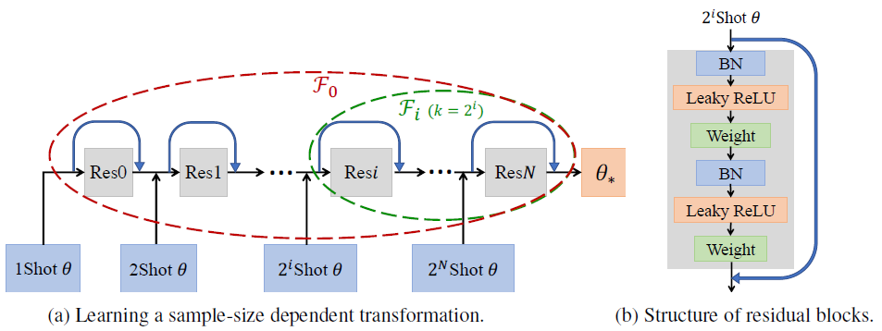

Proposed Method
Set $H_{t}=\left\{\left(x, y\right) | y∈head labels\right\}$ ($t$: head-label threshold)
Get $θ_{1}^{∗},θ_{2}^{∗},…,θ_{C_{t}}^{∗}$ for each head label by tuning g on $H_{t}$ ($C_{t}$: # of heads)
Train $ℱ$ with pairs $\left(θ_{1}^{0}, θ_{1}^{∗}\right), …(θ_{C_{t}}^{0},θ_{C_{t}}^{∗})$

Slide 10
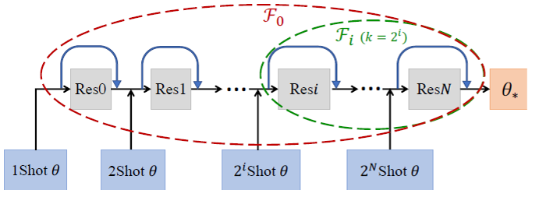

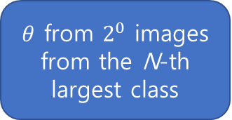
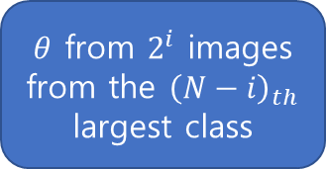
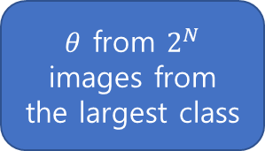
Proposed Method
<Training $ℱ$>
$θ$ from $2^{0}$ images from the N-th largest class
$θ$ from $2^{i}$ images from the ${\left(N−i\right)}_{th}$ largest class
$θ$ from $2^{N}$ images from the largest class
learn back to front

Slide 11



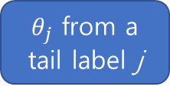
Proposed Method
<Inferencing $ℱ(θ)$>
$$ℱ(θ_{j})$$
$θ_{j}$ from a tail label j
$θ_{j}$ ← $ℱ(θ_{j})$
learn back to front

Slide 12
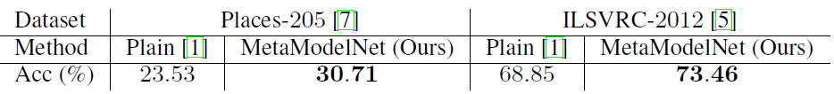

Experiments
Datasets:
SUN-397 (397 classes)
Places-205 (200 clases), ILSVRC-2012 (1000 → 200 classes)
Baseline: ResNet152[4], ImageNet[1]
Setting $ℱ$: 7 residual blocks

Slide 13
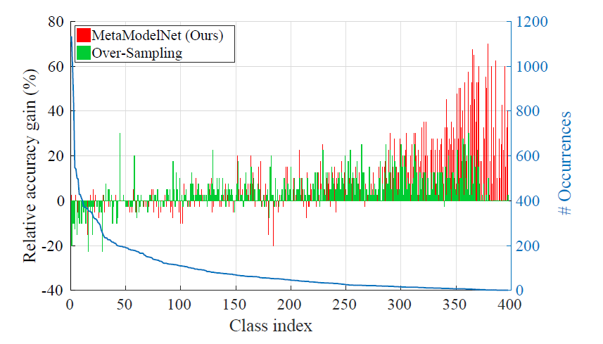
Experiments

Slide 14
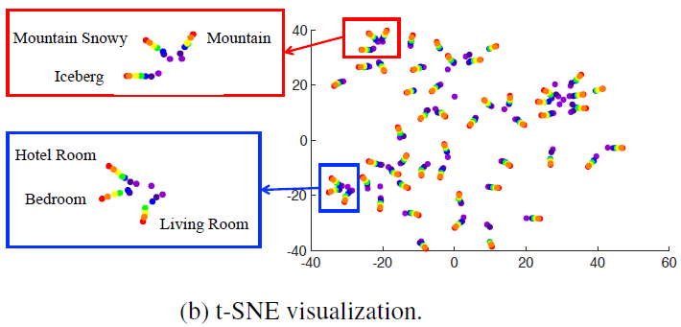
Experiments
Visual analysis
one-shot (purple) → many-shot (red)

