Slide 1

Multi-Label Image Recognition with Graph Convolutional Networks
Zhao-Min Chen, Xiu-Shen Wei, Peng Wang, Yanwen Guo
CVPR 2019
Yunseob Shin
Information & Intelligence System Lab.
Sungkyunkwan University
2019/10/16

Slide 2
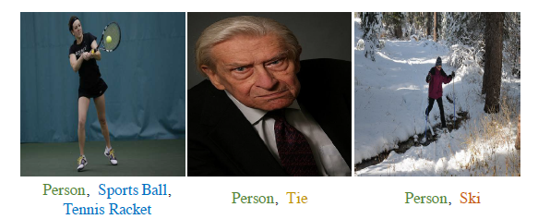
Introduction
Multi-label image recognition
predicting a set of object labels in an image
Notes:
downstream task: learning algorithm, model

Slide 3
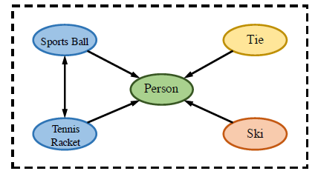
Introduction
Label dependency
Using co-occurrence among object labels to improve performance
Notes:
downstream task: learning algorithm, model

Slide 4
Introduction
Contributions
Performance improvement in image recognition using label dependency
An end-to-end model learning both image feature and label dependency with GCN

Slide 5
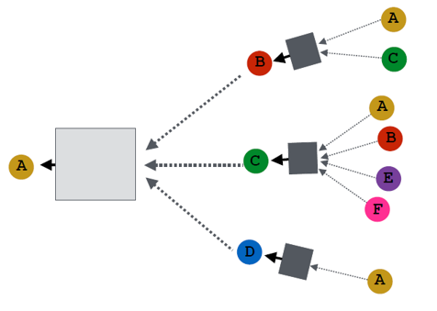
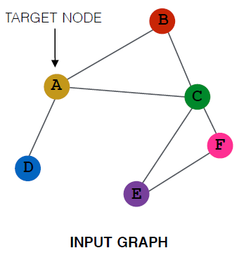
Related work
Graph Convolutional Networks (ICLR 2017)
semi-supervised node classification problem
A
B
C
D
B
A
C
D

Slide 6













Related work
Graph Convolutional Networks (ICLR 2017)
$$H^{l+1}=σ(\hat{A}H^{l}W^{l})$$
$$d$$
$$C$$
$$d$$
$$d$$
$C$: # of nodes
$H$: node feature matrix
$\hat{A}$: normalized adjacency matrix
$$C$$
$$=$$
$$C$$
$$H^{l+1}$$
$$\hat{A}$$
$$H^{l}$$
$$W^{l}$$

Slide 7
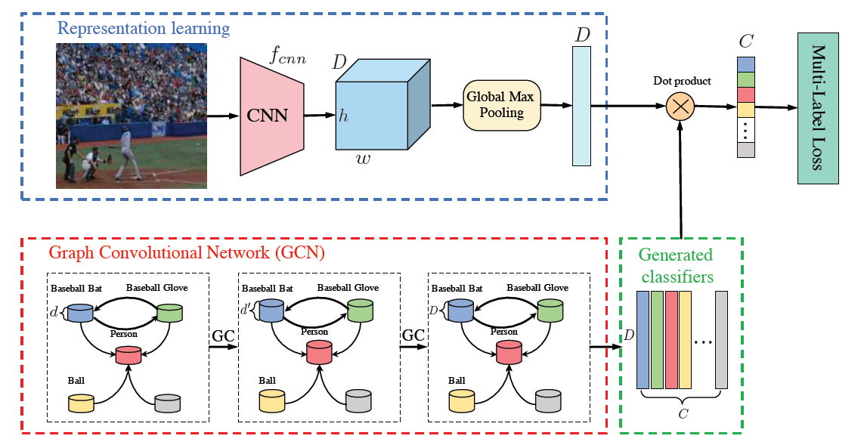
Proposed Method
Overall structure

Slide 8
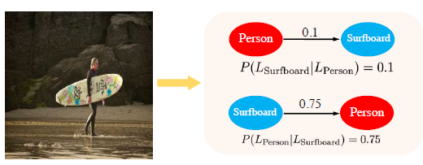
Proposed Method
Constructing label graph
label correlation → conditional co-occurrence probability

Slide 9

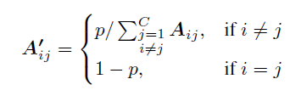
Proposed Method
Constructing label graph
binary vs. re-weighted
over-smoothing problem
Binary
Re-weighted
Notes:
p = 0 → neighboring information will be ignored
p = 1 → feature of a node itself will not be considered

Slide 10
Experiments
Datasets
MS-COCO
82,081 training images, 80 classes, 2.9 labels per image
VOC 2007
9,963 images, 20 classes

Slide 11
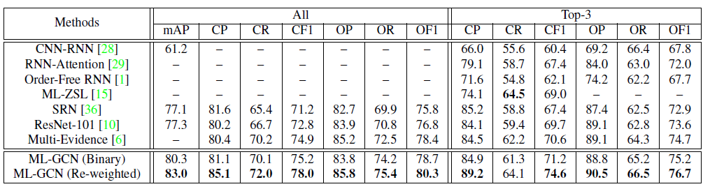
Experiments
Performance results on MS-COCO
CP: average per-class precision
OP: average overall precision

Slide 12
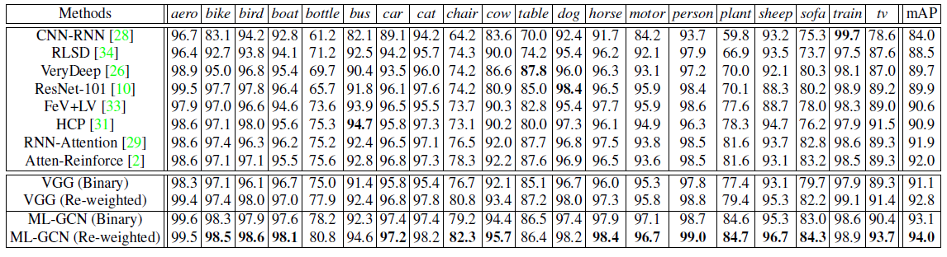
Experiments
Performance results on VOC 2007

Slide 13
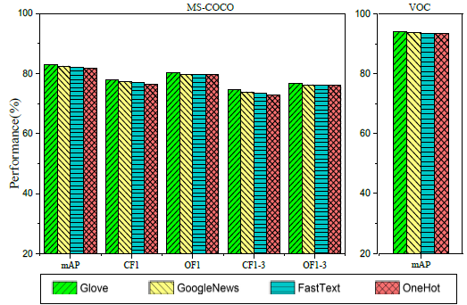
Experiments
Ablation Study
performance difference
by word embedding method

Slide 14
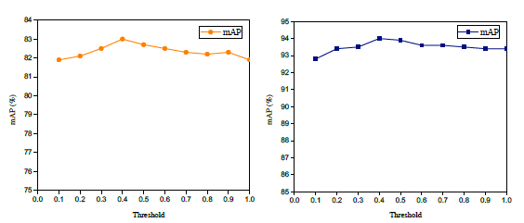
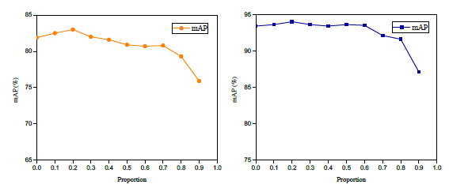
Experiments
Ablation Study

Slide 15
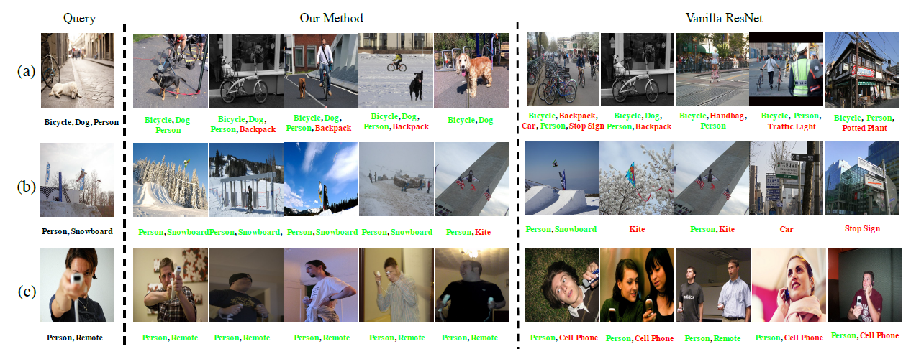
Experiments
Image retrieval examples

Slide 16
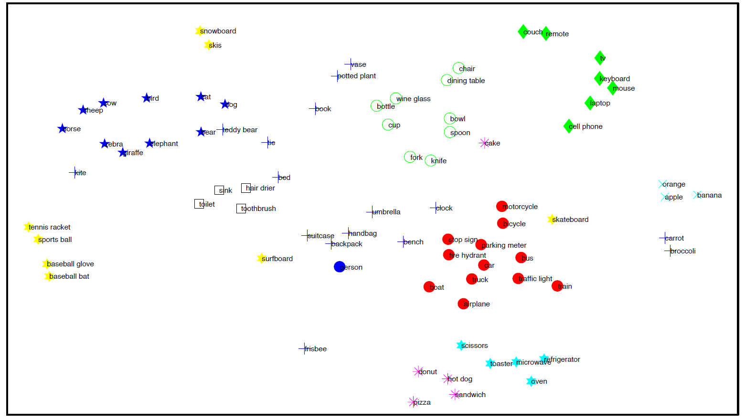
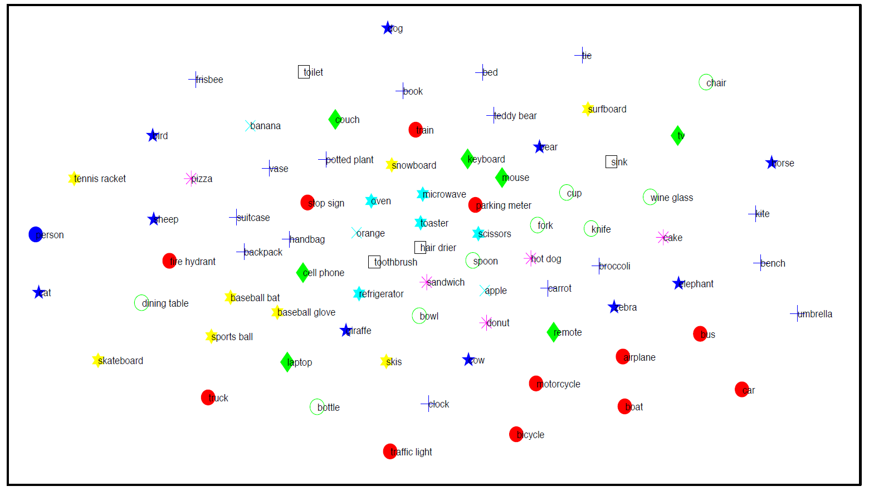
Experiments
t-SNE visualization
parameters of the last fully-connected layer
ML-GCN
ResNet

Slide 17
Conclusion
Performance improvement by capturing label dependencies using GCN
design a novel re-weighted scheme to construct the label graph
effectively alleviate over-fitting and over-smoothing

