Slide 1

node2vec: Scalable Feature Learning for Networks
Adaitya Grover and Jure Leskovec
(Stanford University)
KDD 2016
Yunseob Shin
Information & Intelligence System Lab.
Sungkyunkwan University
2018/11/27

Slide 2
Contents
Introduction
Proposed Method
Experiments
Conclusion
Future Work

Slide 3
Introduction
Three keywords:
Network Embedding
Biased Random Walk
Skip-gram model

Slide 4
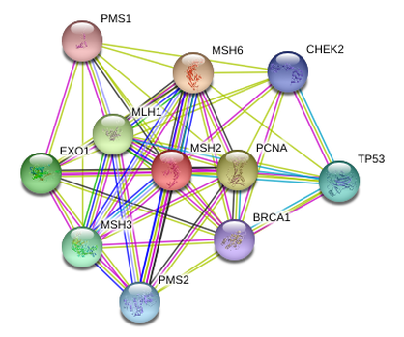
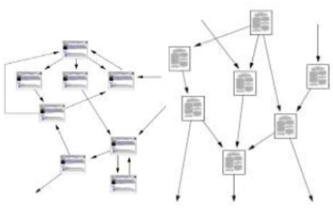
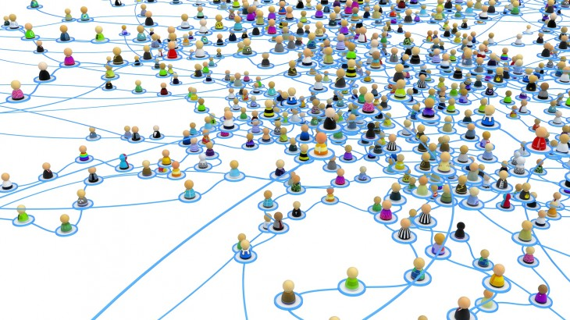
Introduction
Network dataset
Entities with naturally created relations
Ubiquitous data available in various domain
Web/mobile, social media, bio-informatics
Information Network
Social Network
Protein-protein network
Notes:
네트워크 데이터는 어떤 형태를 지닌 엔터티와 그 엔터티 자연스럽게 형성된 관계를 담고 있는 데이터이다
이는 분야를 가릴 것 없이 유비쿼터스한 성질을 가지고 있어 여러 도메인에서 활용될 여지가 많다.
같은 네트워크 분석기법으로 웹, 소셜넷, 단백질 네트워크 등의 다른 종류의 도메인에 접근이 가능하다.

Slide 5
Introduction
A network → a graph-structured data
Each entity: node
Each relationship: edge

Slide 6
Introduction
Machine Learning tasks in networks:
Node classification
Predict a type of a given node
Link prediction
Predict whether two nodes are linked
Community detection
Identify clusters of nodes
Anomaly detection
Detect abnormal entities

Slide 7
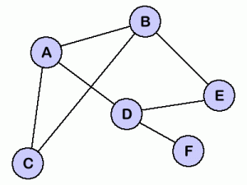
Introduction
Graph is limited to apply general mathematics for ML
We need feature of nodes!
Vector representations of nodes which well preserve the original network
A
B
C
D
E
F
Notes:
이러한 문제들을 풀기 위해선 각 노드의 featur를 알아서 그에 따른 벡터값을 구하면 더 용이하다.

Slide 8
Introduction
Feature engineering
Classical way to get vector representation of nodes
Structural feature, node’s attributes, …
Expensive for hand-crafting feature
Network Data
Node Vectors
Downstream
Tasks
Feature Engineering
A
B
C
D
E
F
Notes:
벡터 스페이스에 임베딩을 해야한다.
여기서 벡터 임베딩, 벡터 리프레젠테이션, 노드 피쳐는 다 똑같은 말이라고 생각하시면 된다.

Slide 9
Introduction
Network embedding
Learning process of node’s feature
Embed a network into a low dimensional space
Network Data
Node Vectors
Downstream
Tasks
Network Embedding
A
B
C
D
E
F
Notes:
벡터 스페이스에 임베딩을 해야한다.

Slide 10
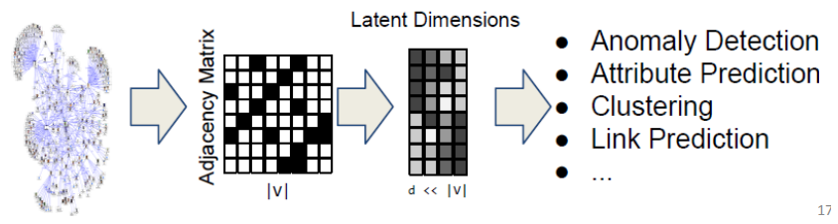

Introduction
Goal: Learn features(=vector embedding) for a set of nodes
Feature learning in graphs:
Given $G=\left(V, E\right)$, Learn a function $f:V → ℝ^{d}$
By learning $f$, we can use the features for any downstream task

Slide 11
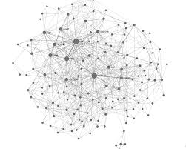

Proposed Method
Overview of node2vec
Make a set of sequences of nodes from the network
Put them into Skip-gram model
The hidden representation of each node will be its feature
How?
Random Walks!
We already know
…
…
…
…
…
Network Data
Sequences
Skip-gram
Features
Notes:
벡터 스페이스에 임베딩을 해야한다.

Slide 12

Proposed Method
Random walk
Generating a sequence of nodes by repeating visit-neighbors
DeepWalk(2014) uses uniform random walk
A
B
E
A
B
D
E
A
C
C
D
$$P\left(c_{i}=x | c_{i−1}=v\right)=\frac{1}{|N\left(v\right)| }$$

Slide 13
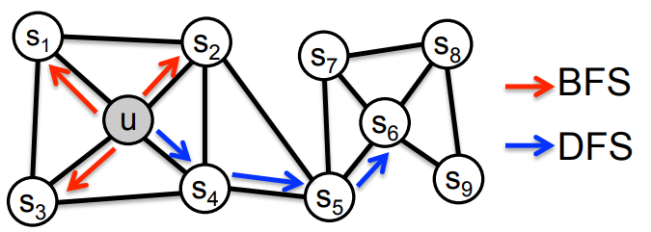

Proposed Method
Biased Random Walk
Interpolating between BFS and DFS with two parameters $p$ and $q$
Flexible design for random walk

Slide 14
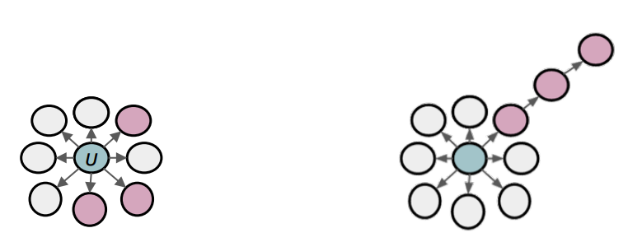
Proposed Method
Biased Random Walk
BFS:
Micro-view of neighborhood
DFS:
Macro-view of neighborhood

Slide 15
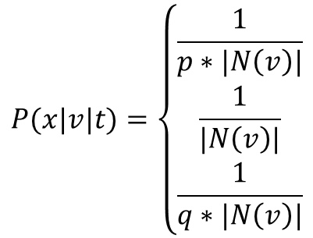

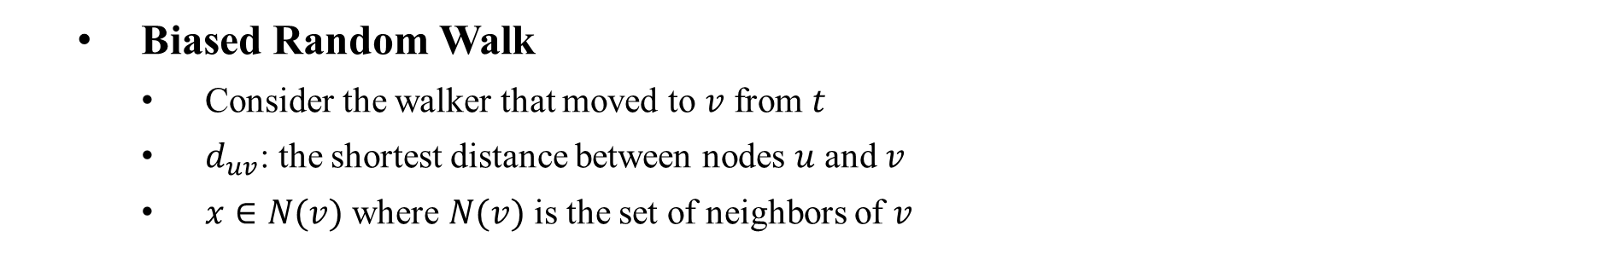












Proposed Method
Biased Random Walk
Consider the walker that moved to $v$ from $t$
$d_{uv}$: the shortest distance between nodes $u$ and $v$
$x∈N(v)$ where $N(v)$ is the set of neighbors of $v$
$$d_{ta}=1$$
$$P(x|v|t)=\left\{\begin{aligned}\frac{1}{p∗|N\left(v\right)|} \\ \frac{1}{|N\left(v\right)|} \\ \frac{1}{q∗|N\left(v\right)|}\end{aligned}\right.$$
Return to $t$
$$a$$
if $d_{tx}=0$
$$d_{tb}=2$$
BFS
$$v$$
$$b$$
if $d_{tx}=$1
Same area with $t$
$$t$$
if $d_{tx}=$2
Further from $t$
DFS
$$d_{tt}=0$$
Notes:
벡터 스페이스에 임베딩을 해야한다.

Slide 16
Proposed Method
Network Embedding → learning feature of nodes
node2vec
Biased Random Walk → generating sequences of nodes
Skip-gram model → learning vector representations using sequence data

Slide 17
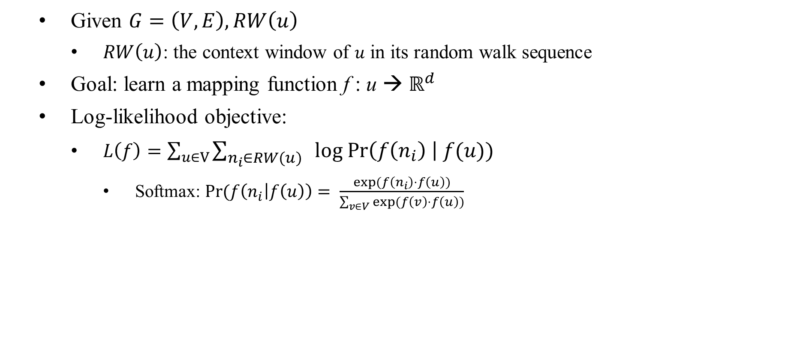
Proposed Method
Given $G=\left(V,E\right), RW\left(u\right)$
$RW\left(u\right)$: the context window of $u$ in its random walk sequence
Goal: learn a mapping function f : u → $ℝ^{d}$
Log-likelihood objective:
$L\left(f\right)=\sum_{u∈V}{\sum_{n_{i}∈RW\left(u\right) }{log Pr\left(f\left(n_{i}\right) \right| f(u))}}$
Softmax: $Pr(f\left(n_{i} | f\left(u\right)\right)= \frac{exp(f\left(n_{i}\right)⋅f\left(u\right))}{\sum_{v∈V}{exp(f\left(v\right)⋅f\left(u\right))}}$

Slide 18
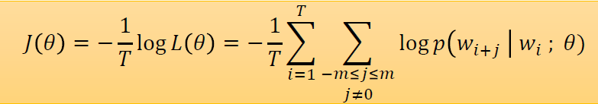
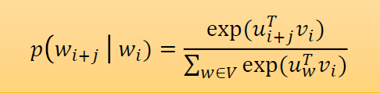


Proposed Method
Objective: $\max_{f}\sum_{u∈V}{\sum_{n∈RW(u)}{log}}\frac{exp(f\left(n_{i}\right)⋅f\left(u\right))}{\sum_{v∈V}{exp(f\left(v\right)⋅f\left(u\right))}}$
word2vec

Slide 19
Experiments
Task 1: Multi-label classification
Task 2: Link prediction
Datasets:
Social networks (BlogCatalog, Facebook)
Protein networks (PPI)
Information networks (Wikipedia, arXiv)

Slide 20
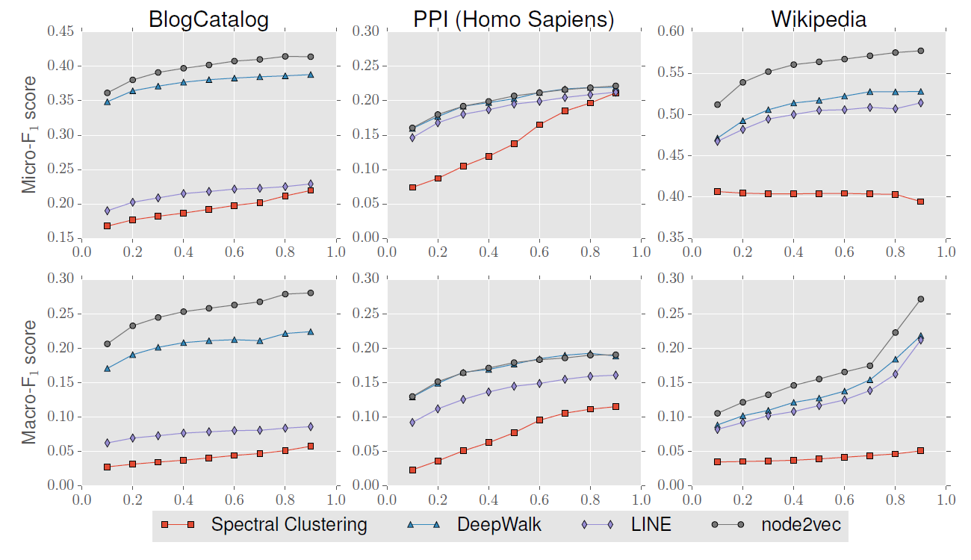
Experiments
Task 1: Multi-label classification
x-axis: fraction of labeled data
One vs. rest logistic regression classifier

Slide 21
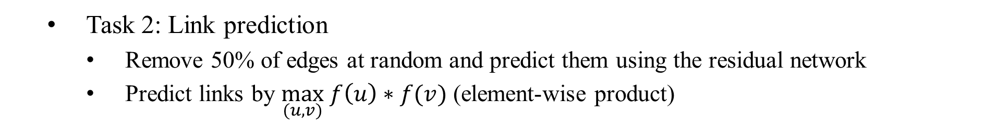
Experiments
Task 2: Link prediction
Remove 50% of edges at random and predict them using the residual network
Predict links by $\max_{(u,v)} f\left(u\right)∗f(v)$ (element-wise product)
AUC scores for link Prediction
Algorithms | Facebook | PPI | arXiv
Common Neighbors | 0.8100 | 0.7142 | 0.8153
Jaccard's Coefficient | 0.8880 | 0.7018 | 0.8067
Adamic Adar | 0.8289 | 0.7126 | 0.8315
Pref. Attachment | 0.7137 | 0.6670 | 0.6996
Spectral Clustering | 0.6192 | 0.4920 | 0.5740
DeepWalk | 0.9680 | 0.7441 | 0.9340
LINE | 0.9490 | 0.7249 | 0.8902
node2vec | 0.9480 | 0.7719 | 0.9366

Slide 22
Conclusion
A locality preserving network embedding method
Biased random walks to capture diversity of network patterns
Scalable and robust
Limits:
Not incremental → new training for new nodes
No parameter sharing

Slide 23
Thank you
Q & A

