Slide 1

Task Embeddings: Learning Query Embeddings using Task Context
Rishabh Mehrotra and Emine Yilmaz
CIKM 2017
Yunseob Shin
Information & Intelligence System Lab.
Sungkyunkwan University
2018/09/12

Slide 2
Contents
Introduction
Proposed Method
Experiments
Conclusion

Slide 3
Introduction
Problem Definition
With rising multi-tasking nature of web search sessions, users often try to accomplish different tasks in a single session.
Consequently, the search context gets polluted with queries from different unrelated tasks which renders “heterogeneous contexts”
Such heterogenous contexts makes it difficult for the retrieval system to use to create localized user interest models e.g. contextual result rankings, query suggestions
Proposal
Novel task context embedding architecture to learn representation of queries.
Notes:
웹 이용자들의 멀티태스킹 경향이 늘어나고 있다.
이러한 멀티태스킹 액티비티는 한 세션에서도 관계 없는 것들끼리 묶이게 되어서 context 기반 검색결과 추출에 악영향을 준다.

Slide 4

Introduction (Cont’d)
An ideal case of searching activity – one task at one session
Task A
Task B
Tack C
Sequence of Queries
“Tensor flow”
“keras”
…
“Twice” “Black Pink”
…
“RTX 2080”
“GPU Benchmark”
…
TIME
Notes:
검색결과를 제안하는 시스템의 입장에서 바라는 유저의 행동

Slide 5
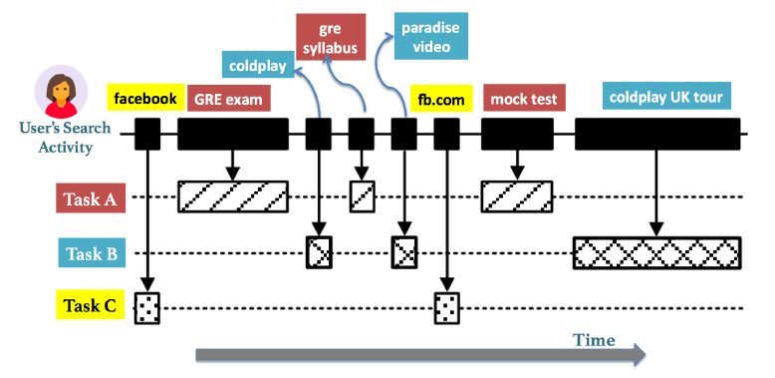
Introduction (Cont’d)
In real situations, users tend to seek to handle multiple tasks within a single search session.
These multitasking and task switching behaviors make the resulting search context heterogenous, composed of interleaved search goals and tasks.
Notes:
하지만 일관되게 한 작업을 수행하지 않고 이것저것 난잡하게 조금씩 하는 유저들도 많음

Slide 6
Proposed Method
Extract queries belonging to the same task using latent structural SVM framework.
For each query collection, learn representations for queries using a neural model.
Notes:
이렇게 시간적으로 분절된 테스크들을 같은 시퀀스 별로 모으는 작업
모여서 형성된 시퀀스를 sentenc로 skip-gram에 캐스팅하여 임베딩을 하는 작업

Slide 7








Proposed Method (Cont’d)
Extract queries belonging to the same task using latent structural SVM framework.
Best-link
The objective of clustering queries: a query belonging to one particular search task does not need to be similar to all the other queries in this task (all-link), but there has to be at least one query, which is strongly associated with this query in that task (best-link).
$$q_{1}$$
$$q_{2}$$
$$q_{3}$$
$$q_{4}$$
$$q_{5}$$
$$q_{6}$$
$$q_{7}$$
$$S_{1}=\left\{q_{1}, q_{3},q_{5},q_{6}\right\} \\ S_{2}=\{q_{2}, q_{4}, q_{7}\}$$

Slide 8
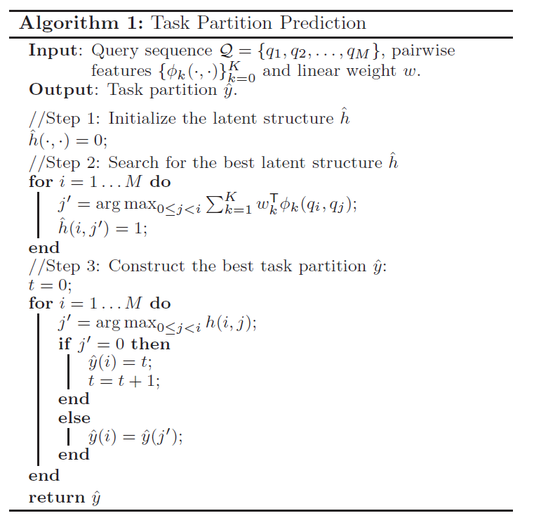
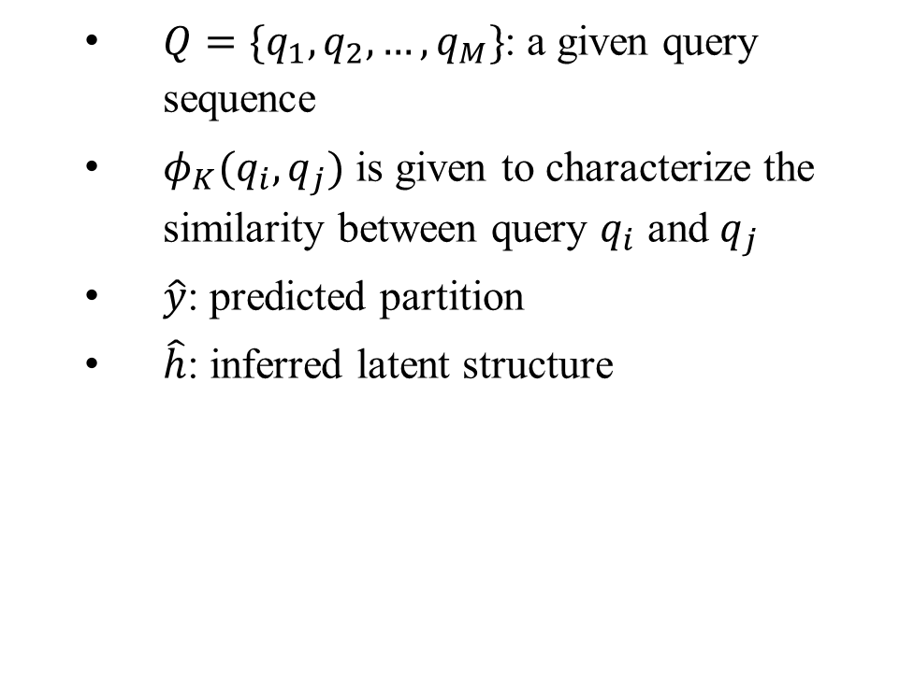
Proposed Method (Cont’d)
$Q=\{q_{1},q_{2},…,q_{M}\}$: a given query sequence
$φ_{K}(q_{i}, q_{j})$ is given to characterize the similarity between query $q_{i}$ and $q_{j}$
$\hat{y}$: predicted partition
$\hat{h}$: inferred latent structure
Notes:
h는 similarity를 기반으로 0또는 1로 결정되는 pairwise feature

Slide 9
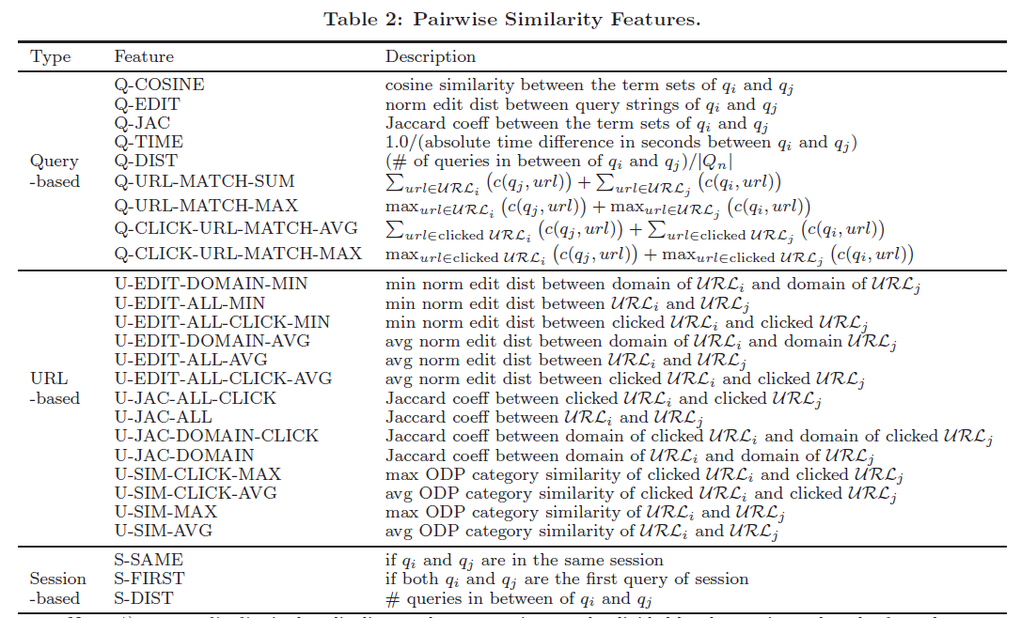
Proposed Method (Cont’d)

Slide 10
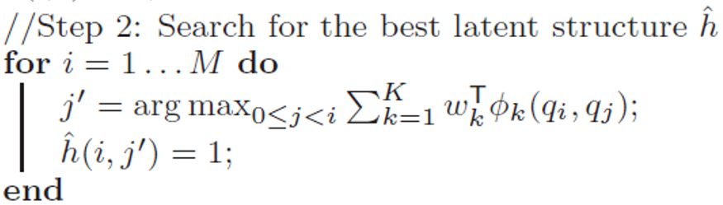
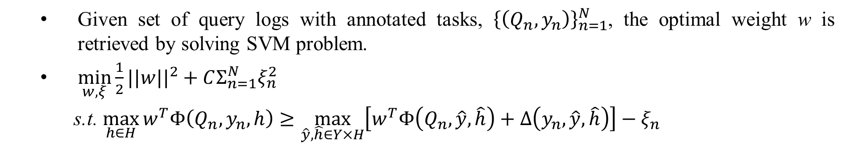
Proposed Method (Cont’d)
Given set of query logs with annotated tasks, ${\left\{\left(Q_{n}, y_{n}\right)\right\}}_{n=1}^{N}$, the optimal weight w is retrieved by solving SVM problem.
$\min_{w, ξ}{\frac{1}{2}||w||^{2}+CΣ_{n=1}^{N}ξ_{n}^{2}}$
s.t. $\max_{h∈H}{w^{T}Φ\left(Q_{n}, y_{n}, h\right)≥\max_{\hat{y},\hat{h}∈Y×H}\left[w^{T}Φ\left(Q_{n},\hat{y},\hat{h}\right)+Δ\left(y_{n},\hat{y},\hat{h}\right)\right]−ξ_{n}}$
Notes:
델타는 y랑 y_hat의 디스턴스

Slide 11





Proposed Method (Cont’d)
For each query collection, learn representations for queries using a neural model.
Cast a query sequence from a given user as a sentence, and feed it into the skip-gram model.
$$q_{m−2}$$
$$q_{m−1}$$
$$q_{m}$$
hidden
$$q_{m+1}$$
$$q_{m+2}$$

Slide 12

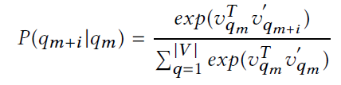
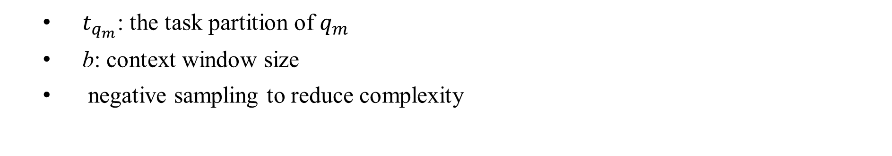
Proposed Method (Cont’d)
$t_{q_{m}}$: the task partition of $q_{m}$
b: context window size
negative sampling to reduce complexity

Slide 13
Experiments
Dataset: random sample of one week search log data
24M search impressions spread over 8M sessions, issued by over 200K users
resulting in a vocabulary size of over 5M words
Baselines
Global Embeddings: word2vec model trained on the document collection retrieved by the queries.
Session Embeddings
Random: randomly shuffled sequence of original queries.

Slide 14
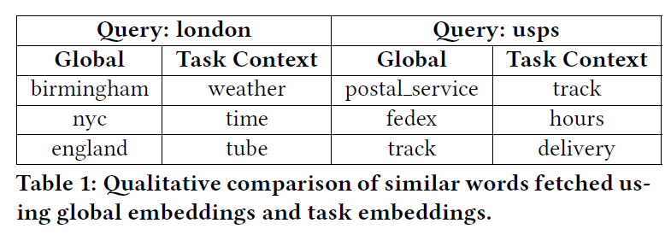
Experiments (Cont’d)
Qualitative analysis
Top 3 query terms most similar to two randomly chosen queries

Slide 15
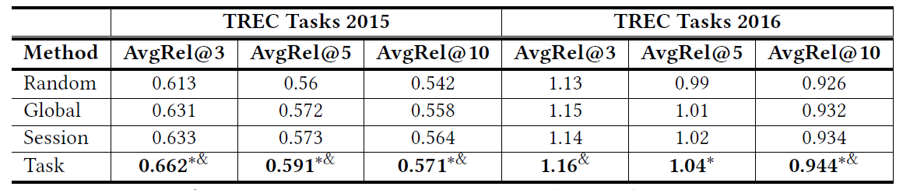
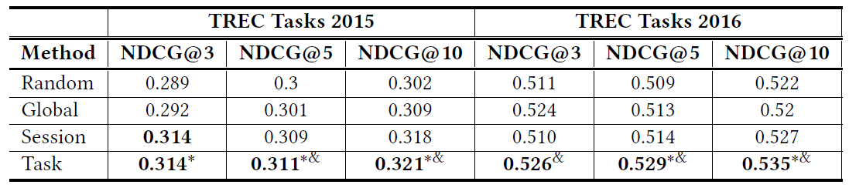
Experiments (Cont’d)
Notes:
*, &: statistical significant

Slide 16
Conclusion
Leveraged task context to learn query representations.
An useful approach for personalized search engine in real situations

