Slide 1

Generating Wikipedia by Summarizing Long Sequences
Peter J. Liu, Mohammad Saleh, Etienne Poty, Ben Goodrich, Ryan Sepassi, Łukasz Kaiser, Noam Shazeer
(Google Brain, Mountain View, CA)
ICLR 2018
Yunseob Shin
Information & Intelligence System Lab.
Sungkyunkwan University
2019/03/28

Slide 2
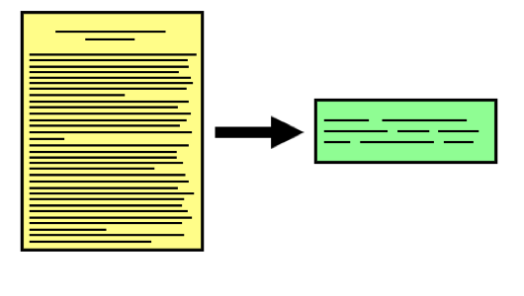
Introduction
Document Summarization:
A task to generate a fluent, condensed summary for a document, and keep important information.
Extractive Methods
Abstractive Methods

Slide 3
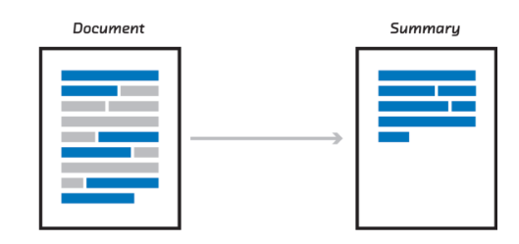
Introduction
Extractive methods
Extract original sentences to form the summary
+ Salient content
+ Fluent sentences
- Incoherent discourse
- Redundant information

Slide 4
Introduction
Abstractive methods
Generate the summary using arbitrary words
+ Concise, coherent, fluent and scalable summary
+ Ultimate goal
- Difficult

Slide 5

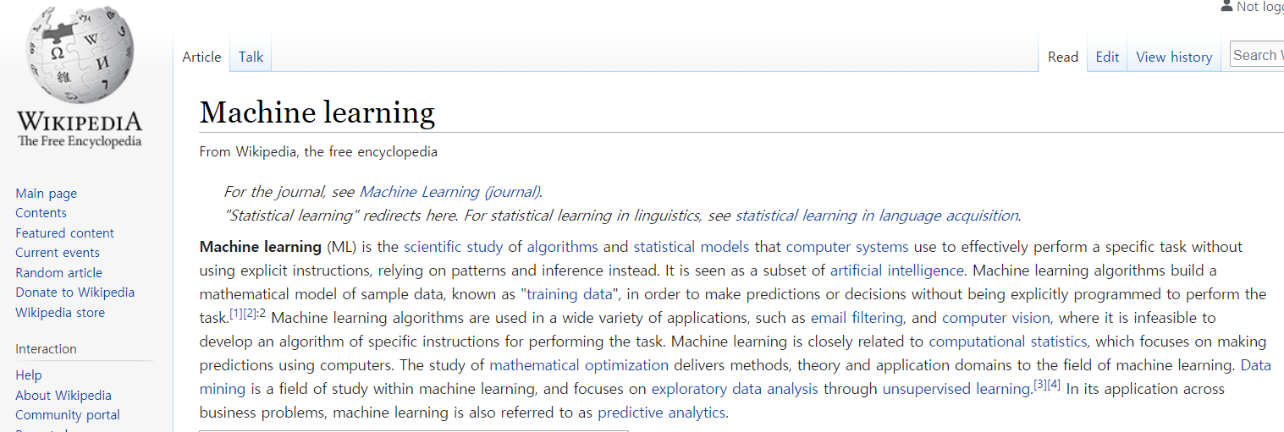








Introduction
Wikipedia Generation $≈$ Multi-document summarization
Extract paragraphs from sources to generate a “lead” section of the target wiki article
…
$$s_{1}^{i}$$
$$s_{2}^{i}$$
$$s_{10}^{i}$$
Top 10 search results by Google
…
$$c_{1}^{i}$$
$$c_{2}^{i}$$
$$c_{𝒩(i)}^{i}$$
Referenced Wikipedia documents
Lead section (introduction)
Sources
Notes:
downstream task: learning algorithm, model

Slide 6
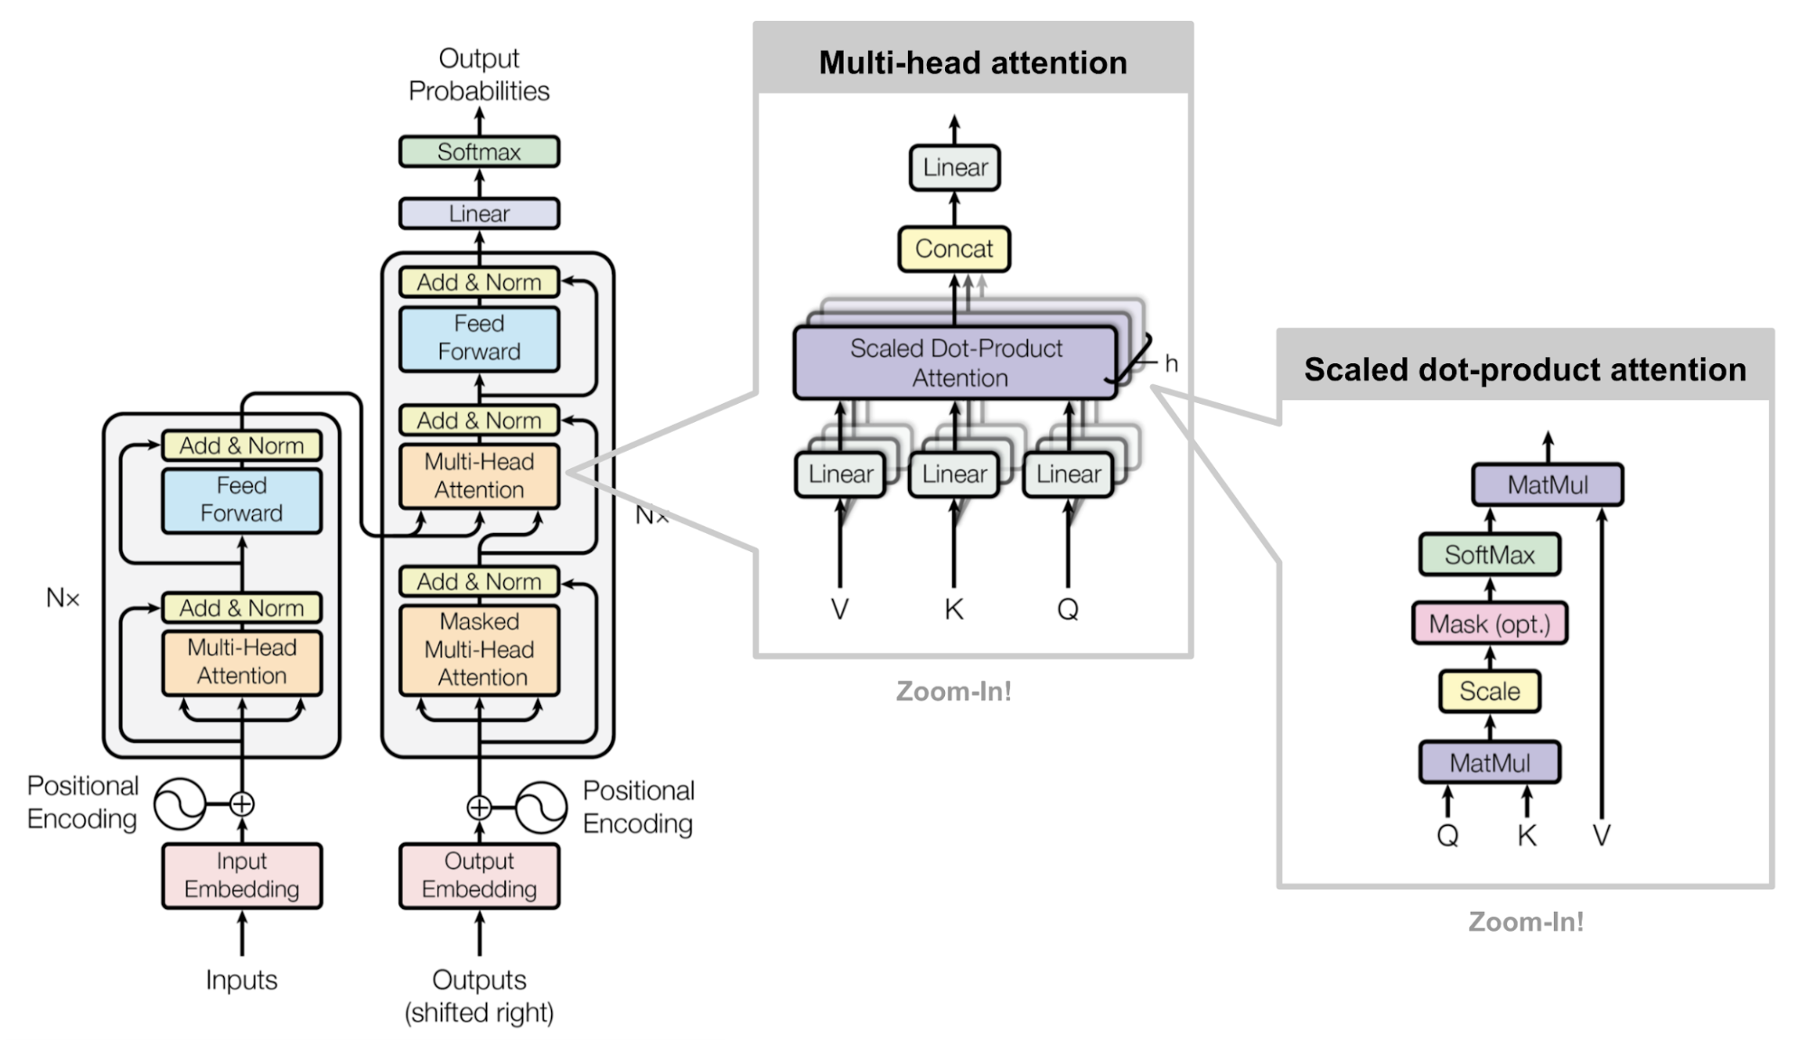

Related work
Transformer model (Attention is all you need, NIPS 2017)

Slide 7
Proposed Method
Preprocessing
Wikipedia and search results
Extractive
Multi-documents
Summarization
Abstractive Summarization

Slide 8

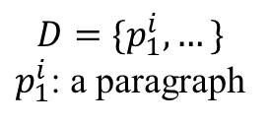






Proposed Method
Step 1. Gathering paragraphs from input sources for an article $i$
…
$$s_{1}^{i}$$
$$s_{2}^{i}$$
$$s_{10}^{i}$$
Top 10 search results by Google
…
$$c_{1}^{i}$$
$$c_{2}^{i}$$
$$c_{𝒩(i)}^{i}$$
$$D=\{p_{1}^{i}, …\}$$
$p_{1}^{i}$: a paragraph
Referenced Wikipedia documents

Slide 9


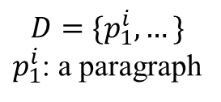
Proposed Method
Step 2. Extractive stage: rank and select top K paragraphs by TF-IDF
TF-IDF
with title(i)
Sub-word
tokenize
$$(p_{1}^{i}, …, p_{K}^{i})$$
$$m^{i}=(x_{1}^{i}, …x_{L}^{i})$$
Input for the
abstractive model
$$D=\{p_{1}^{i}, …\}$$
$p_{1}^{i}$: a paragraph

Slide 10
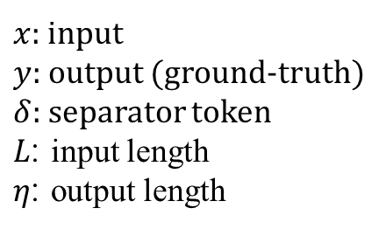

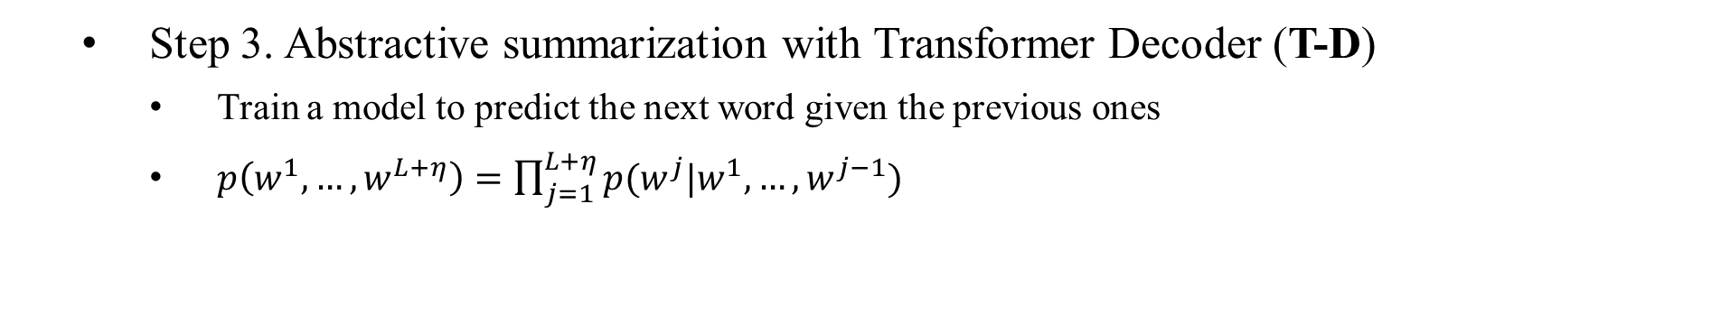
Proposed Method
Step 3. Abstractive summarization with Transformer Decoder (T-D)
Train a model to predict the next word given the previous ones
$p\left(w^{1},…, w^{L+η}\right)=\prod_{j=1}^{L+η}{p(w^{j}|w^{1}, …, w^{j−1})}$
ENCODER
DECODER
ENCODER
DECODER
$x$: input
$y$: output (ground-truth)
$δ$: separator token
$L$: input length
$η$: output length
Input Sentence
$w=(x_{1}^{i}, …, x_{L}^{i}, δ, y_{1}^{i}, …, y_{η}^{i})$

Slide 11
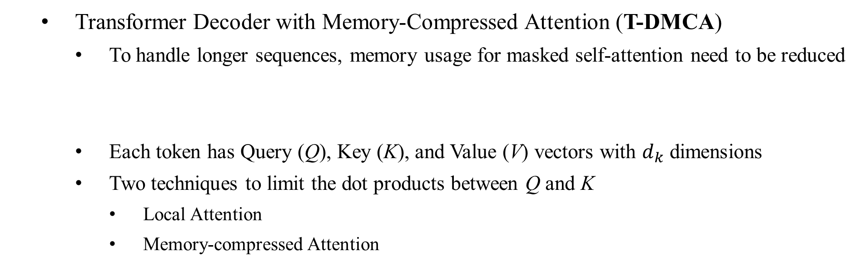
Proposed Method
Transformer Decoder with Memory-Compressed Attention (T-DMCA)
To handle longer sequences, memory usage for masked self-attention need to be reduced
Each token has Query (Q), Key (K), and Value (V) vectors with $d_{k}$ dimensions
Two techniques to limit the dot products between Q and K
Local Attention
Memory-compressed Attention
Model | Max L
T-ED | 2,000
T-D | 4,000
T-DMCA | 11,000

Slide 12
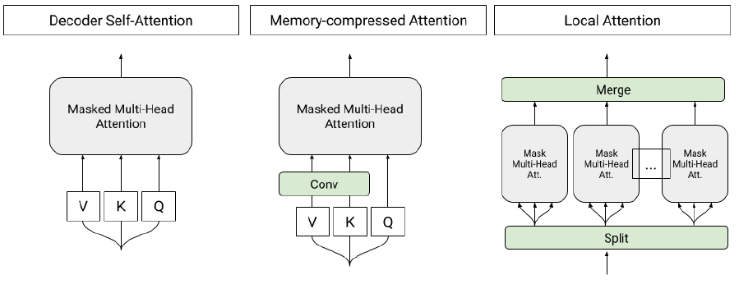
Proposed Method
Transformer Decoder with Memory-Compressed Attention (T-DMCA)
Memory compression for larger input size L
Proposed model consists of 5 layers (LMLML)

Slide 13
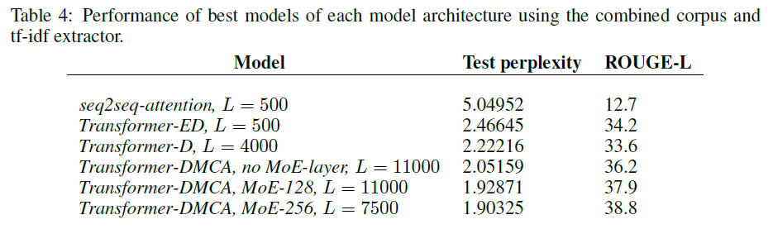
Experiments
Training data: 1,865,750 articles
Test data: 233,252 articles
Validation data: 232,998 articles
MoE: added with Mixture-of-Experts layer (Shazeer, ICLR 2017)

Slide 14
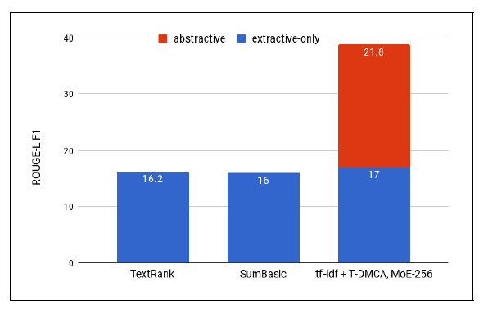
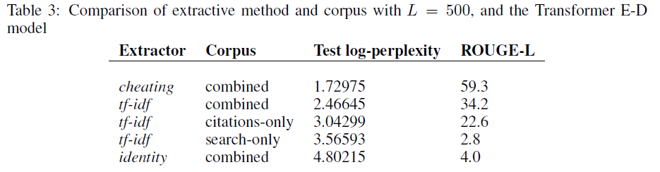
Experiments
Extractive-only is not enough
Both input corpus are significant and complementary
Cheating: extract paragraphs based on ground-truth

Slide 15
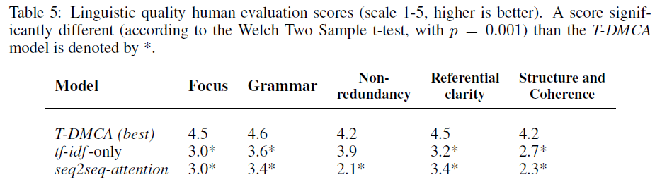
Experiments
Human evaluation

Slide 16
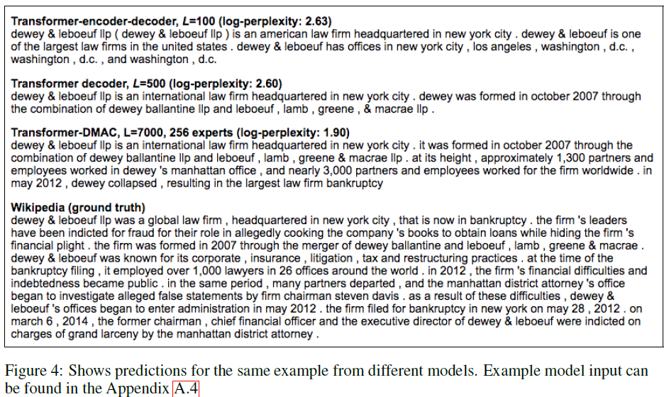
Experiments

Slide 17
Conclusion
Contribution
Generating Wikipedia can be approached as a multi-document summarization
The coarse extraction stage has a significant effect on final performance
Decoder-only model capable of handling very long input-output examples
Outperforms traditional encoder-decoder architectures on long sequence
Limitation
In practice, the user has to define reference articles to actually generate new one

